Slide 1
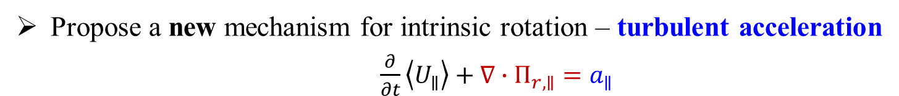


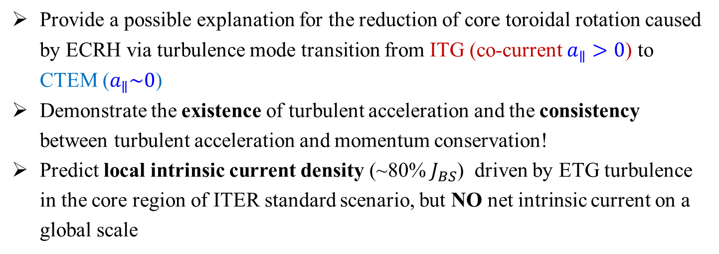
Theory of turbulence driven intrinsic rotation and current
Propose a new mechanism for intrinsic rotation – turbulent acceleration
$\frac{∂}{∂t}\left\langle U_{∥}\right\rangle +∇∙Π_{r,∥}=a_{∥}$
Residual stress: $∇∙Π_{r,∥}^{res}$, surface force,
Qualitatively different
Turbulent acceleration: $a_{∥}$, volume force
Quantitatively comparable: ${|a}_{∥}|\sim |∇∙Π_{r,∥}^{res}|$ for electrostatic ITG turbulence
Provide a possible explanation for the reduction of core toroidal rotation caused by ECRH via turbulence mode transition from ITG (co-current $a_{∥}>0$) to CTEM ($a_{∥}\sim 0$)
Demonstrate the existence of turbulent acceleration and the consistency between turbulent acceleration and momentum conservation!
Predict local intrinsic current density (~80% $J_{BS}$) driven by ETG turbulence in the core region of ITER standard scenario, but NO net intrinsic current on a global scale

