Slide 1
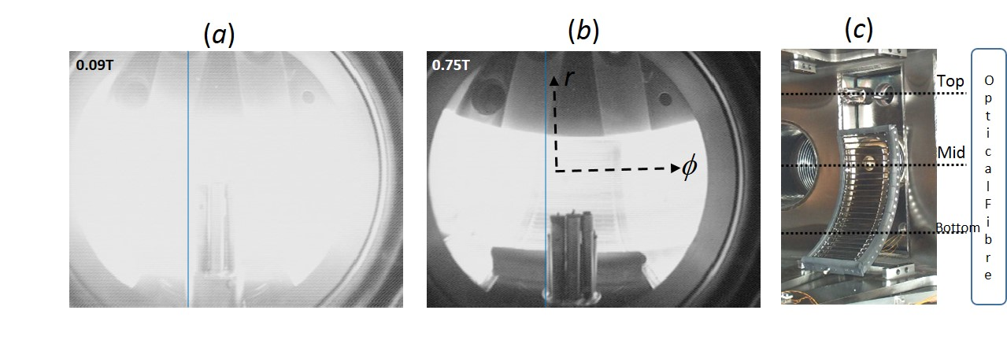
EX/P4-28
Fast Wave induced ICRF plasma Expansion in ADITYA Torus
By Kishore Mishra et al.
Plasma homogeneity is desirable for effective wall conditioning and uniform coating on fast wall of ITER and Fusion Machines
Usual ICRF Plasma is localized near resonance or antenna
An effect of Fast Wave suddenly propagating at a critical Bt ➔ leads to plasma fills up the torous.
This may be useful for uniform wall coating in permanent field machines.
Experimental Observation
(a)
(b)
critical Bt
critical Bt
Expanded at critical Bt
Confined near outer wall
Plasma starts a sudden expansion at a critical Bt = 0.1 T
(a)
(b)
critical Bt
critical Bt
Top CCD camera shows plasma fills up the whole torus at critical Bt, when FW starts propagating. At high Bt = 0.75 T, plasma is only confined near the outboard wall at antenna location.
Fast Wave is propagating only below the critical Bt from dispersion relation. Experimental observation agrees well
Theoretical Calculation

