Slide 1
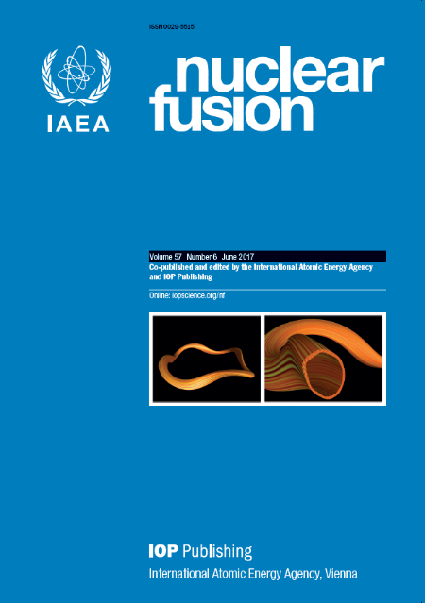
Nuclear Fusion Prize 2017 and 2018
Richard Hawryluk
on behalf of the
Board of Editors

Slide 2
Nuclear Fusion Prize
Annual award, established in 2006.
Celebrates high impact articles from the journal volume published three years prior to the award year.
The selection process involves consideration of citations and recommendations by the journal’s Board of Editors.
The shortlist of nominees and the eventual winner are decided by confidential votes.

Slide 3
2017 Nominees
C. Angioni
M.N.A. Beurskens
D. Carralero
I.T. Chapman
S.N. Gerasimov
E. Joffrin
A. Loarte
C.F. Maggi
S. Potzel
F. Ryter

Slide 4
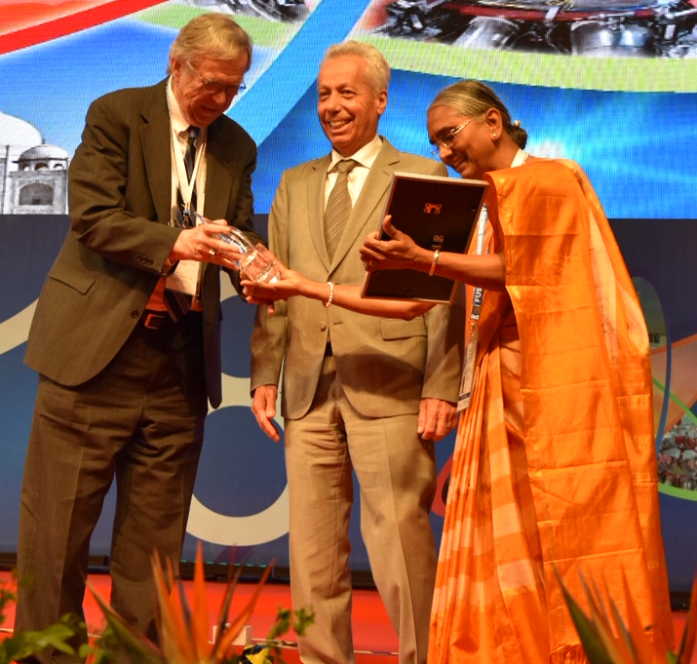
2017 Prize Winner
F. Ryter et al.
Experimental evidence for the key role of the ion heat channel in the physics of the L-H transition

Slide 5
2018 Nominees
J. Eriksson
K. Ida
A. Kallenbach
A. Kirk
C.F. Maggi
T.H. Osborne
T.J. Petty
C. Reux
A. Simonin
M.R. Wade

Slide 6
2018 Prize Winner
A. Kallenbach et al.
Partial detachment of high power discharges in ASDEX Upgrade

