Slide 1
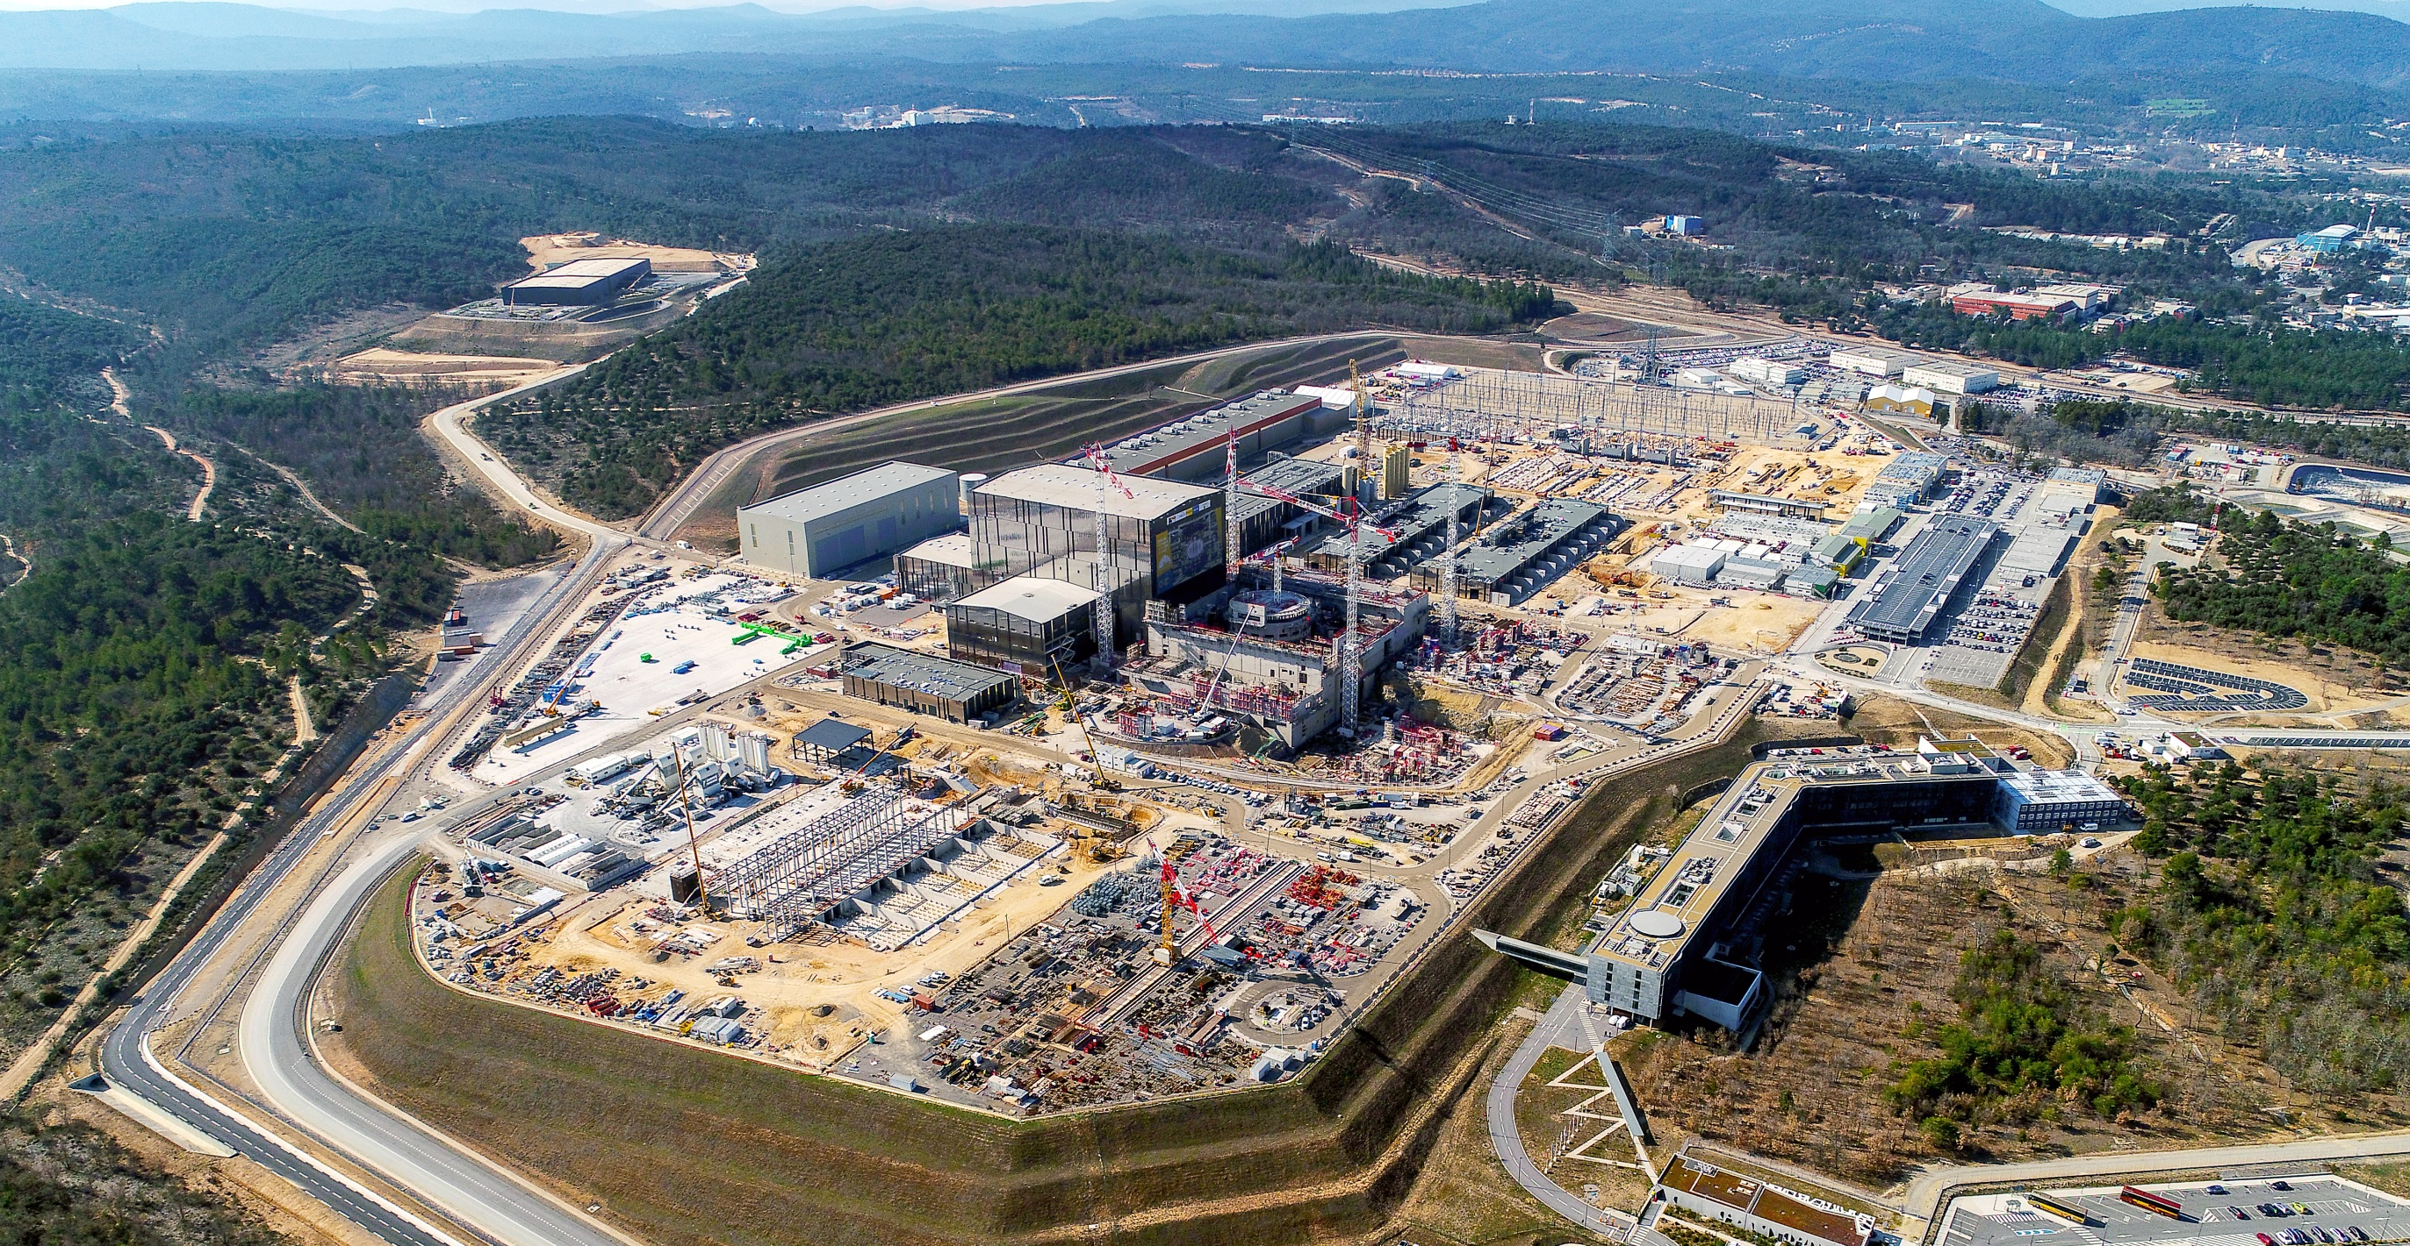
The ITER Project
Construction and Manufacturing Progress Toward First Plasma
Bernard BIGOT, Director-General, ITER Organization

Slide 2
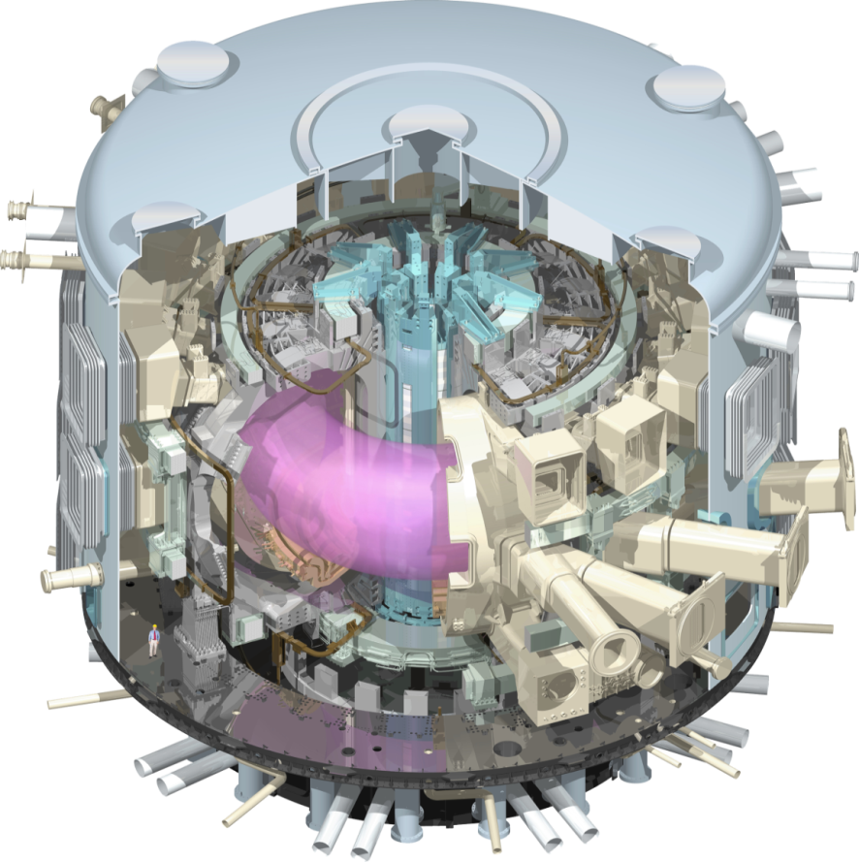
ITER mission
To demonstrate the scientific and technological feasibility of fusion power for peaceful purposes
ITER is the only magnetic fusion device under construction aimed to produce a burning plasma.
Input (heating power): 50 MW
Output (fusion power): 500 MW

Slide 3
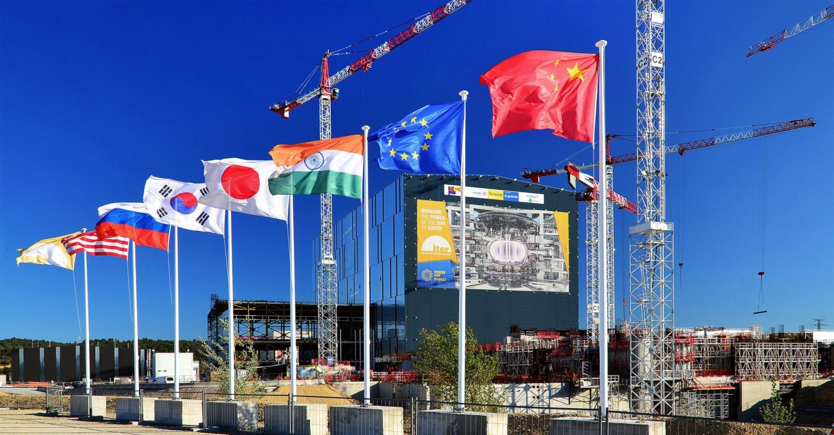
ITER
A multinational scientific collaboration without equivalent in history
A large-scale experiment to demonstrate the feasibility
of fusion energy

Slide 4
An integrated project:
Central Team & Seven Domestic Agencies
IO
The 7 ITER Members make cash and in-kind contributions (90%) to the ITER Project. They have established Domestic Agencies to handle the contracts to industry.
The ITER Organization Central Team manages the ITER Project in close collaboration with the 7 Domestic Agencies.
The ITER Members share all intellectual Property generated by the Project.
CN
US
ITER Project
RF
EU
KO
IN
JA

Slide 5
A unique formula
ITER is being built through the in-kind contributions
of the seven Members of the ITER Organization.
400
China, India, Japan, Korea, Russia and the United States each have responsibility for ~ 9% of procurement packages.
Europe’s share, as Host Member, is ~ 45% (construction and manufacturing).
300
200
100
Machine Core
0
Internal Auxiliary
External Auxiliary
EU
CN
Heating, Diagnostics, Control
CN
IN
IN
JA
KO
RF
Buildings
US
IO

Slide 6
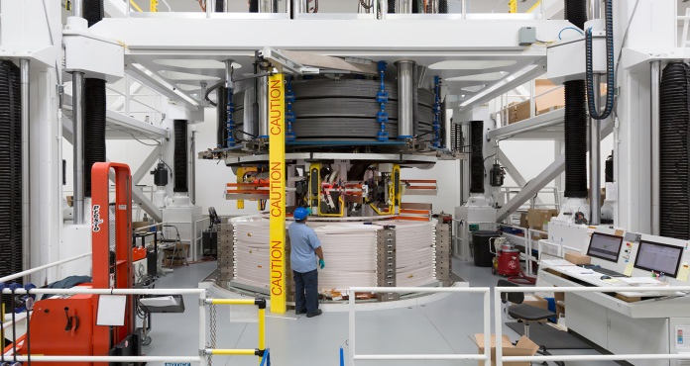
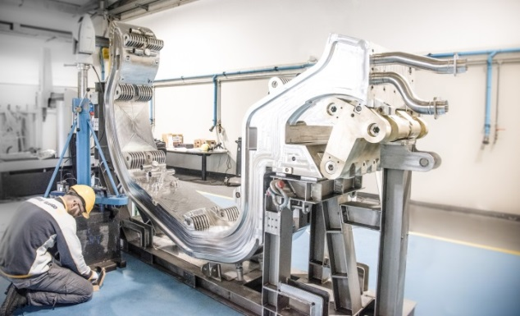
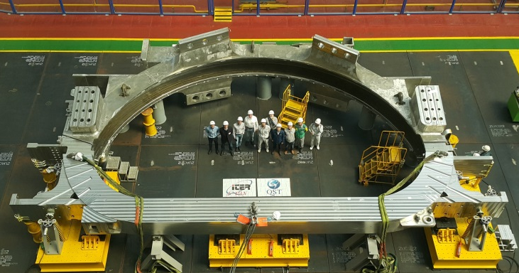
ITER Council Milestones
2016-2017: 29 technological and organizational milestones set
Monitoring mechanism to show that the project remains on track
Additional milestones added through First Plasma
36 milestones met so far: many challenges and potential delays mitigated
Demonstrates enhanced risk anticipation and management
Two milestones postponed, with mitigation in place
Critical path remains on schedule for First Plasma in 2025

Slide 7
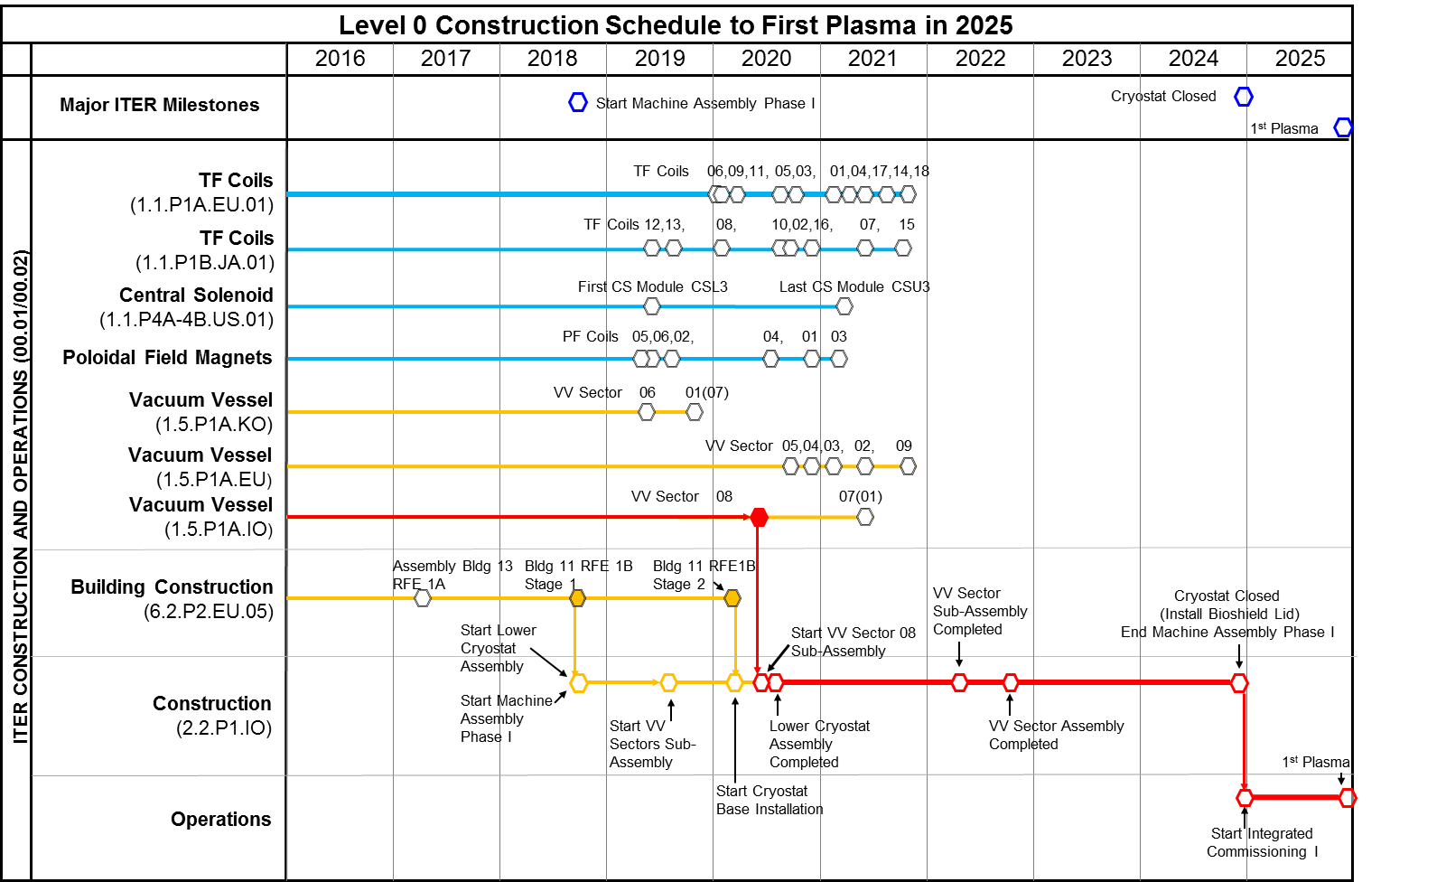
Major assembly milestones

Slide 8
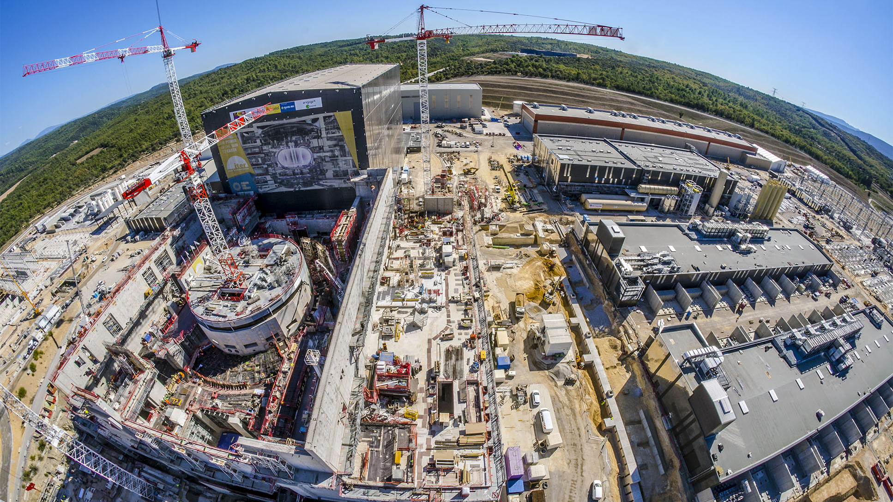
Worksite progress
Assembly Hall
Cryostat Workshop
PF Coil Winding Facility
Radiofrequency Heating
Cryoplant
Service Bldg.
Cooling System
400 kV Switchyard
~ Machine axis
Tritium Bdg.
Diagnostics Bdg.
Bioshield
Magnet Power Conversions Bdgs.
Tokamak Bdg.
4 October 2018

Slide 9
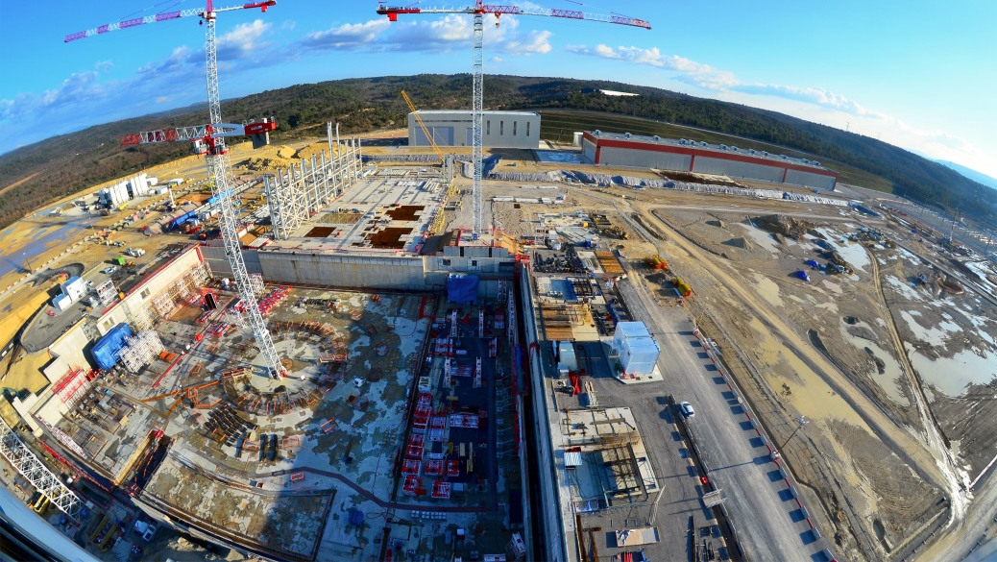
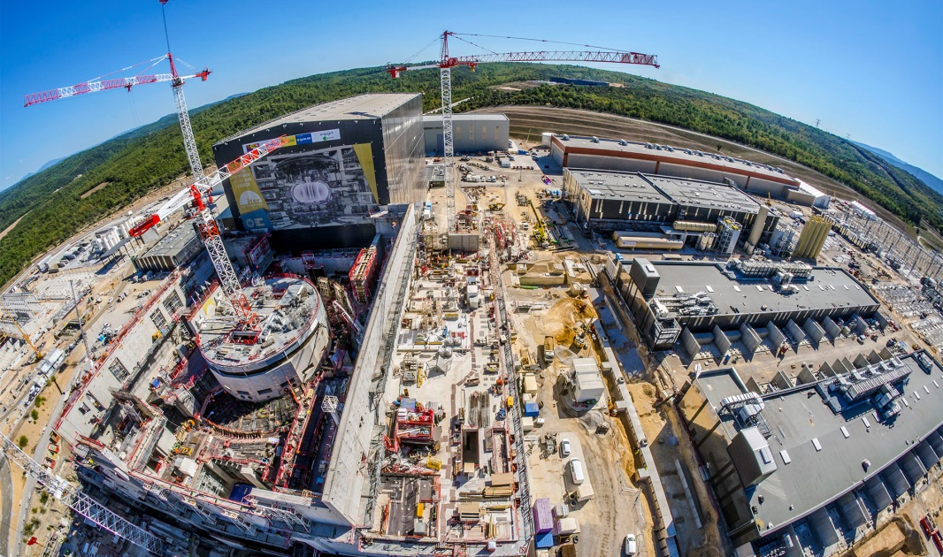
Worksite Progress: Feb. 2015 – Oct. 2018
More Than Halfway to First Plasma:
According to the stringent metrics that measure ITER project performance, in November 2017 the project reached 50%of the “total construction work scope through First Plasma.” [August 2018: ~57.4%]

Slide 10
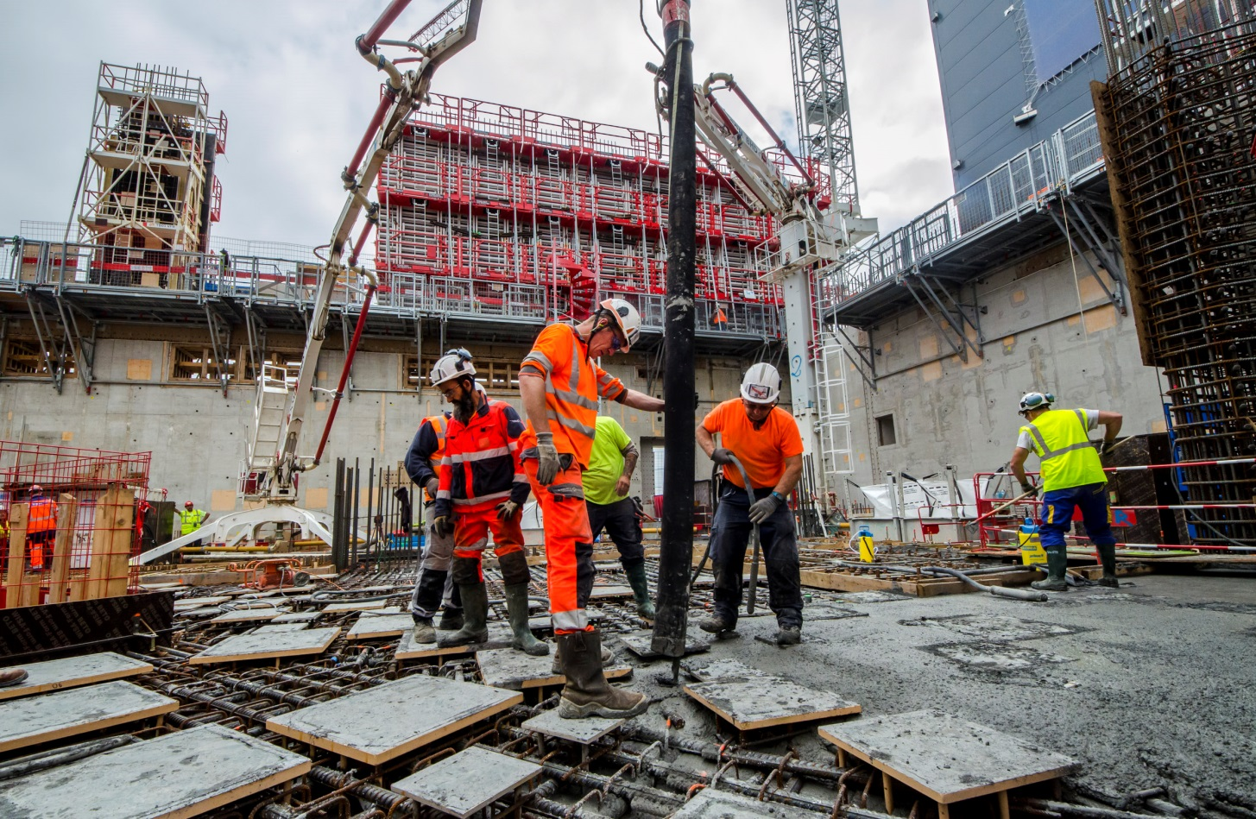
The ITER worksite
2,300 workers, technicians and engineers today, up to 3,000 in the coming years;
ITER construction represents 18 million working hours (2010-2020).

Slide 11
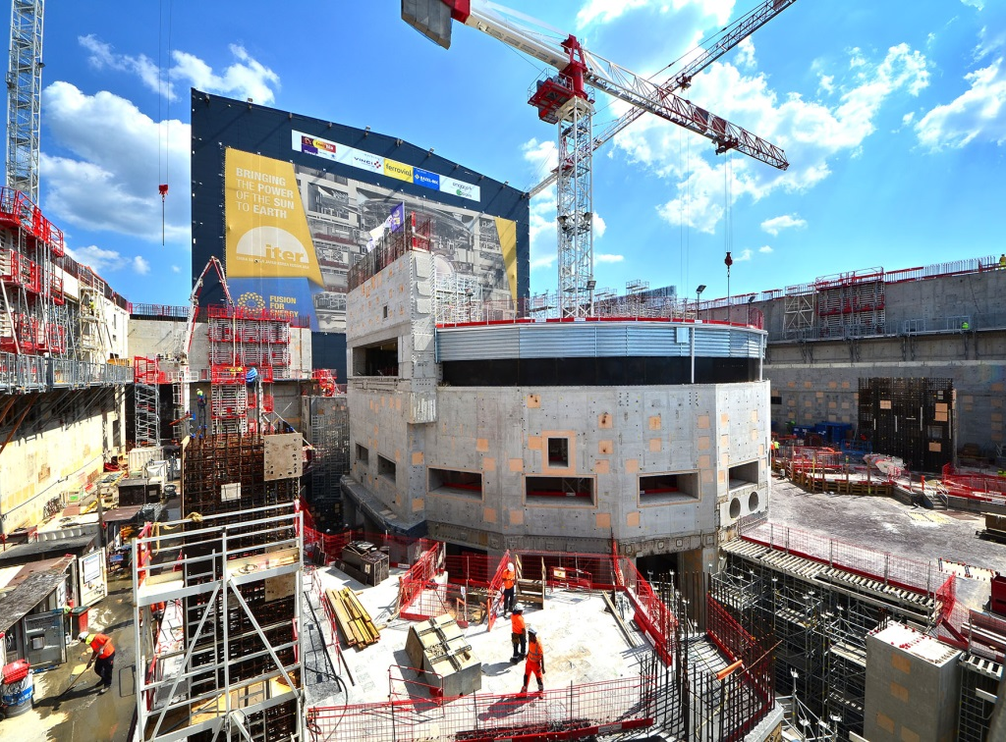
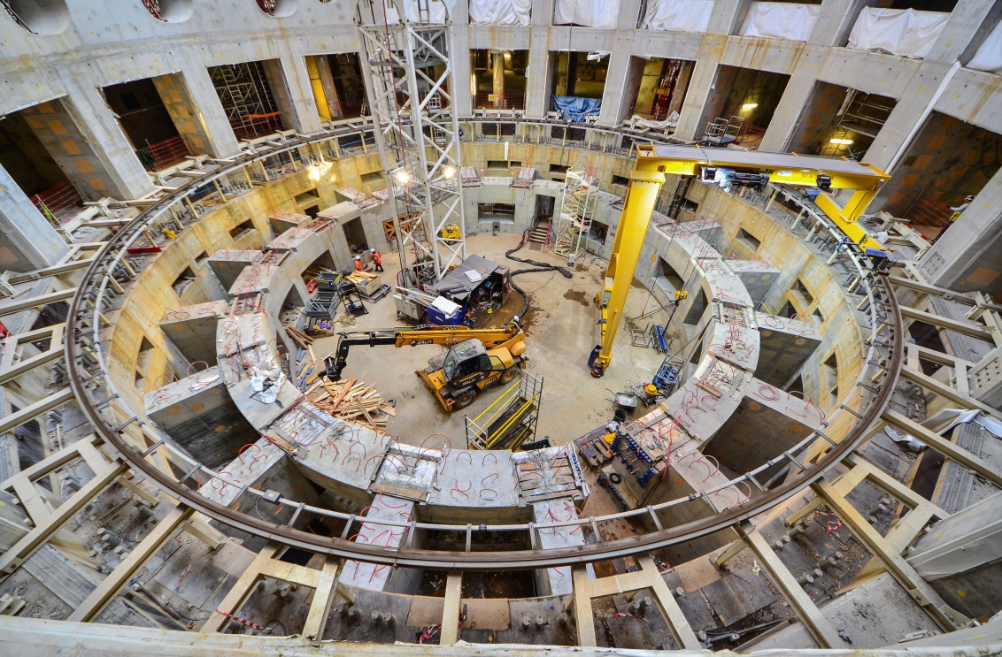
Tokamak Complex
The bioshield is now finalized. Openings in the wall are for the cryostat bellows connecting the machine to the port cells designed to give access to systems such as remote handling, heating and diagnostics. The high-resistance concrete-and-steel structure (the “Crown”) that will support the combined mass of tokamak + cryostat (23 000 tonnes) is in the last stages of completion.

Slide 12
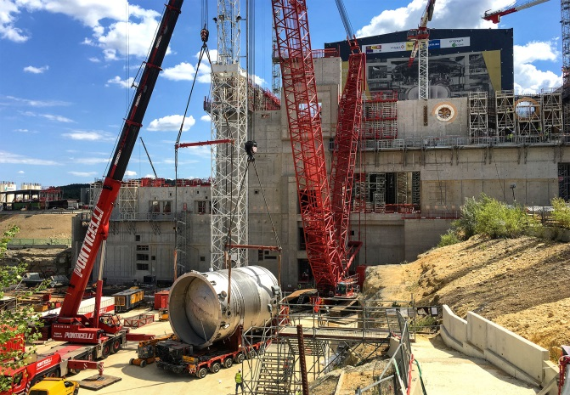
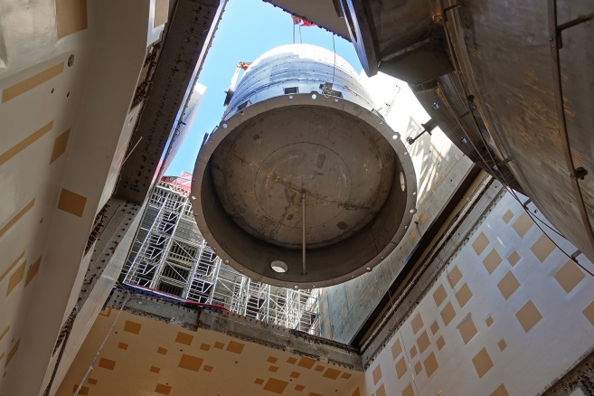
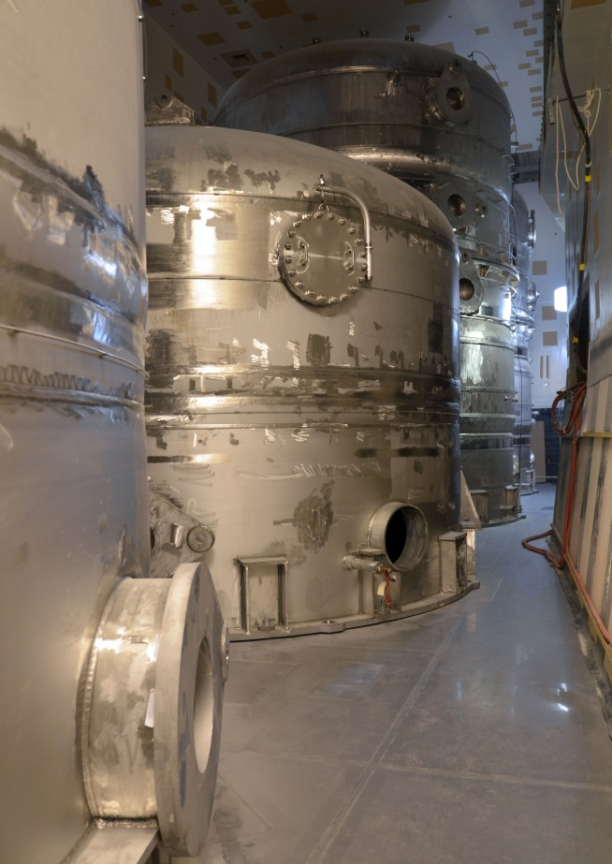
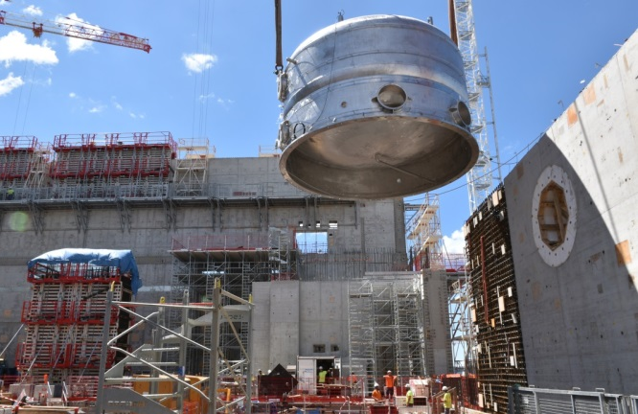
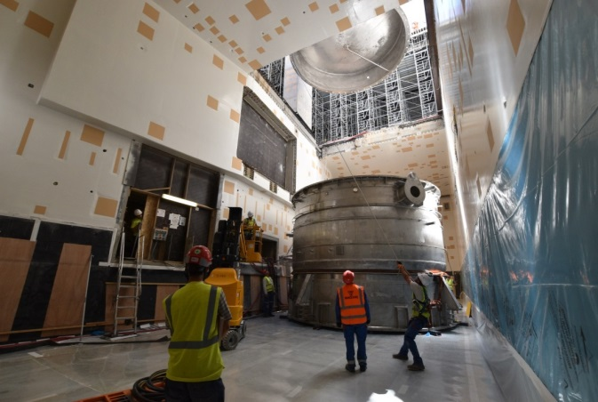
Tokamak Complex
Seven water storage tanks (four of them from China) for the machine's cooling water and vacuum vessel pressure suppression systems were installed in less than one week in mid-August 2018,

Slide 13
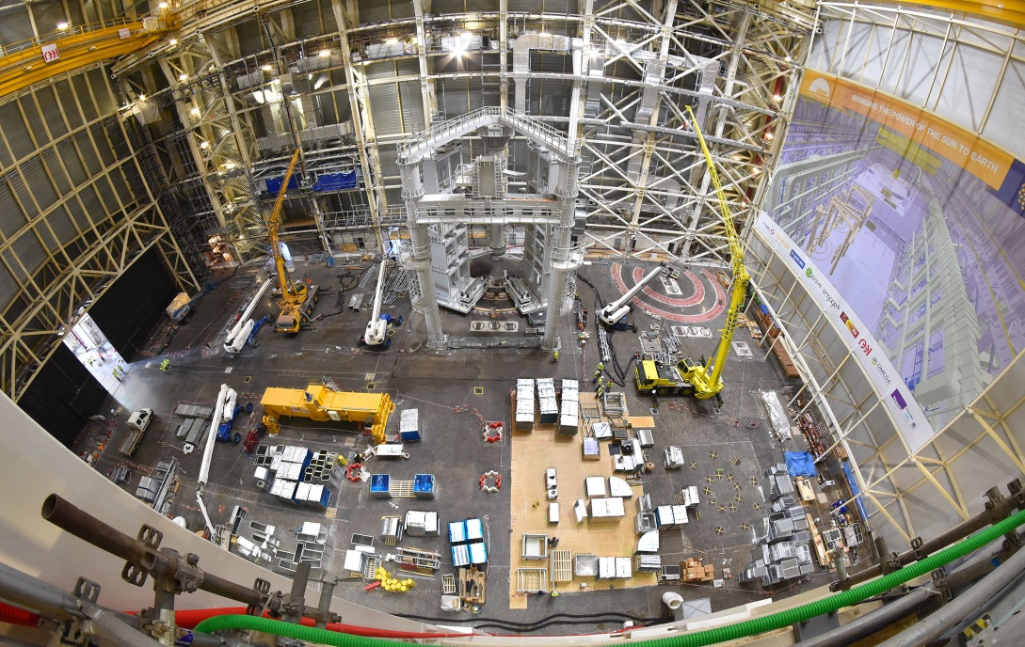
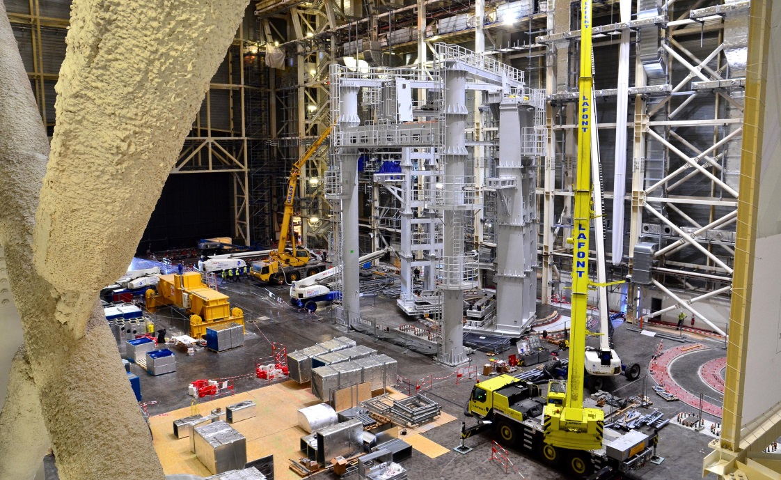
Assembly Hall
Before being integrated in the machine, the components will be prepared and pre-assembled in this 6,000 m2, 60-metre high building. The Assembly Hall is equipped with a double overhead travelling crane with a total lifting capacity of 1,500 tons.
To the right, the installation of the sub-assembly tool (SSAT-1) is almost finalized.

Slide 14
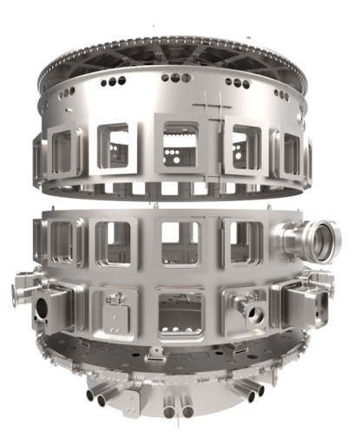
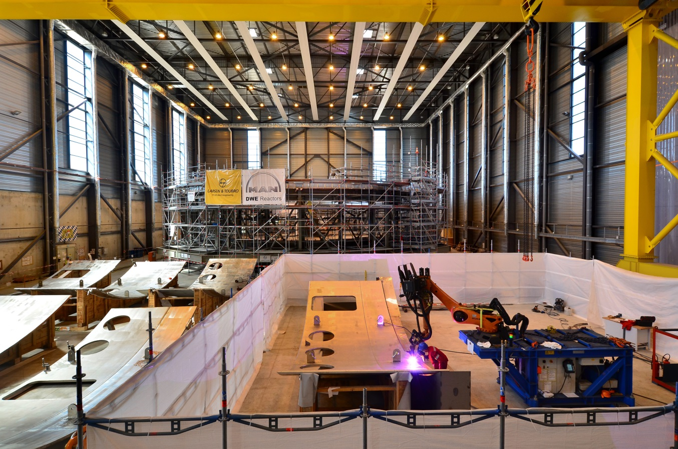
Cryostat workshop
Lid
Upper cylinder
Lower cylinder
Base section
Manufactured in India, the 30 m x 30 m cryostat (the insulating vacuum vessel that encloses the machine) is being assembled and welded on site.

Slide 15
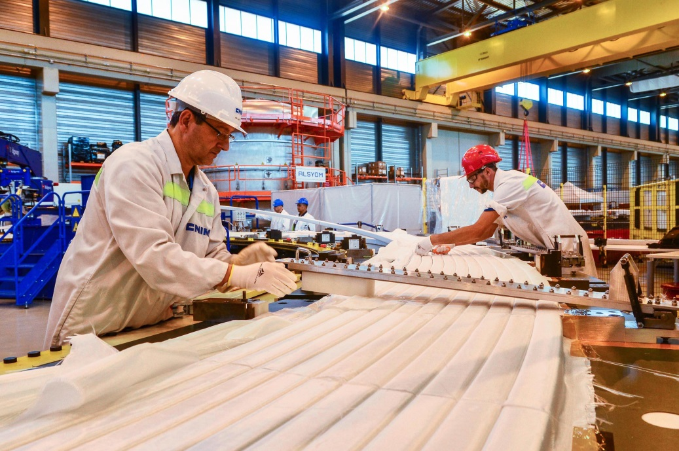
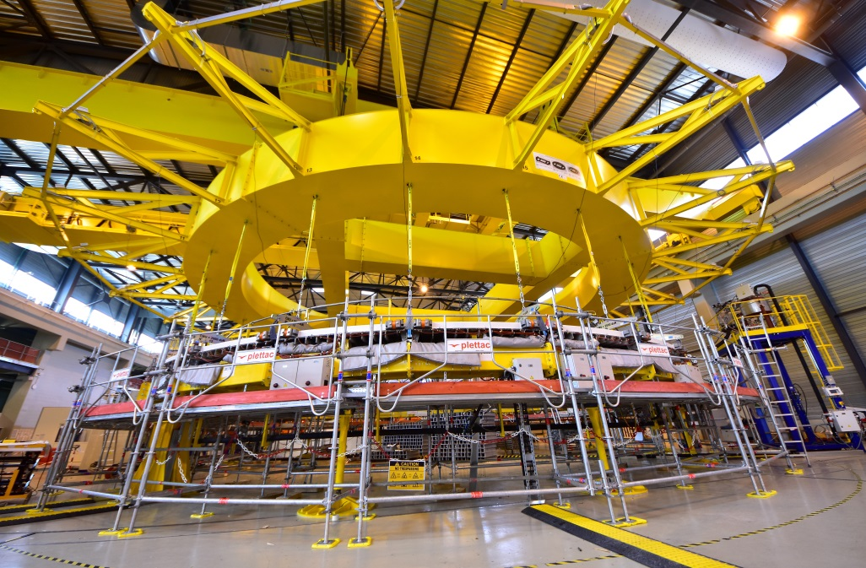
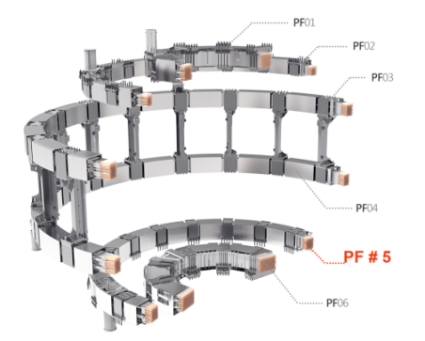
PF Coil winding facility
Too large to be transported by road, four of ITER’s six ring-shaped magnets (the poloidal field coils, 17 to 24 m, in diametre) will be assembled on site by Europe in this 12,000 m² facility. Resin impregnation operations have begun for PF Coil # 5 (17 m. diametre, ~ 350 tonnes).

Slide 16
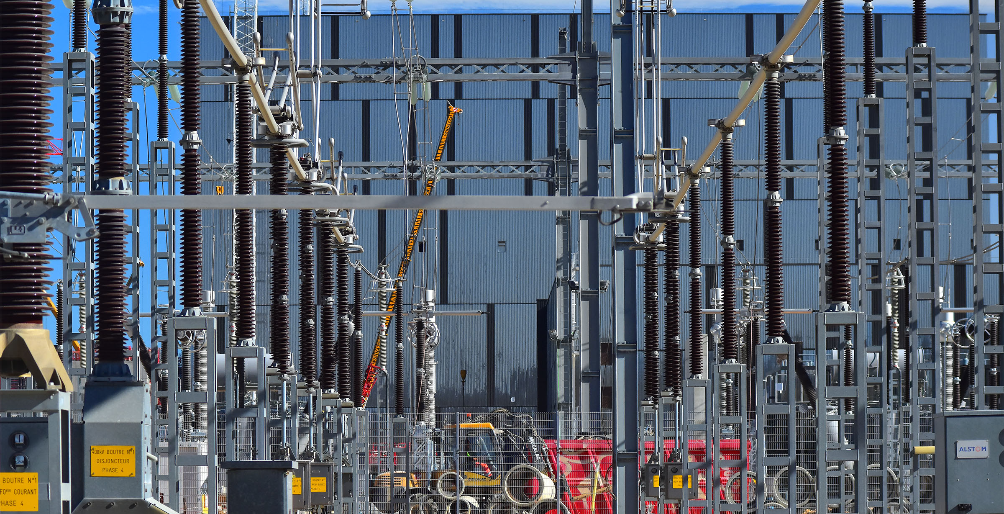
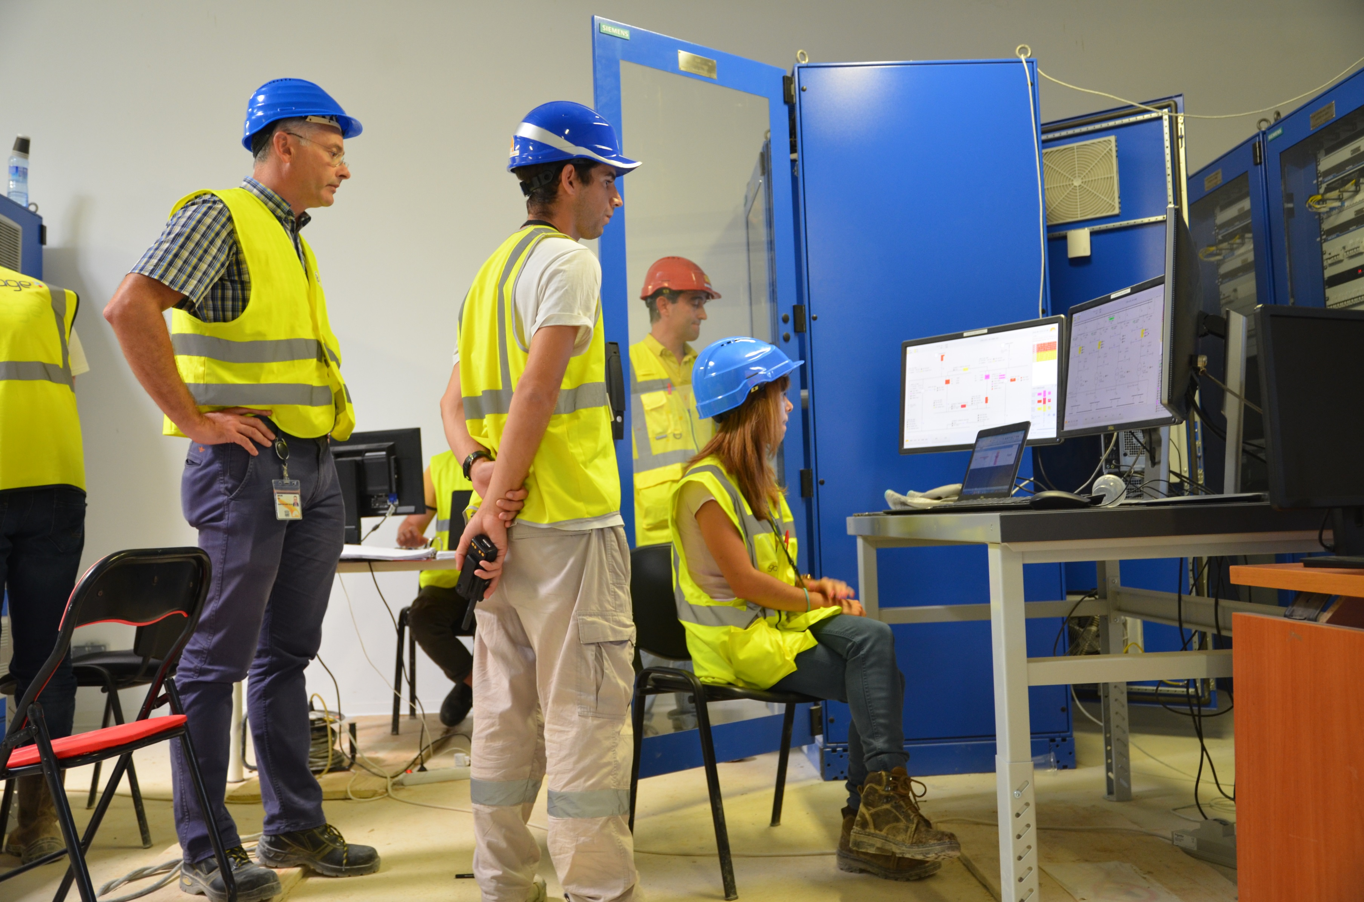
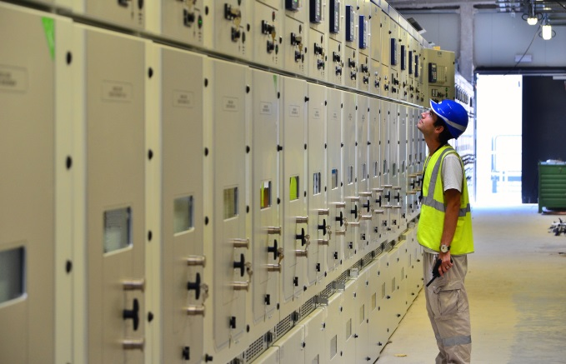
Electrical network
The connection of the 400 kV switchyard to the French grid was successfully established on 17-18 Sept. 2018

Slide 17
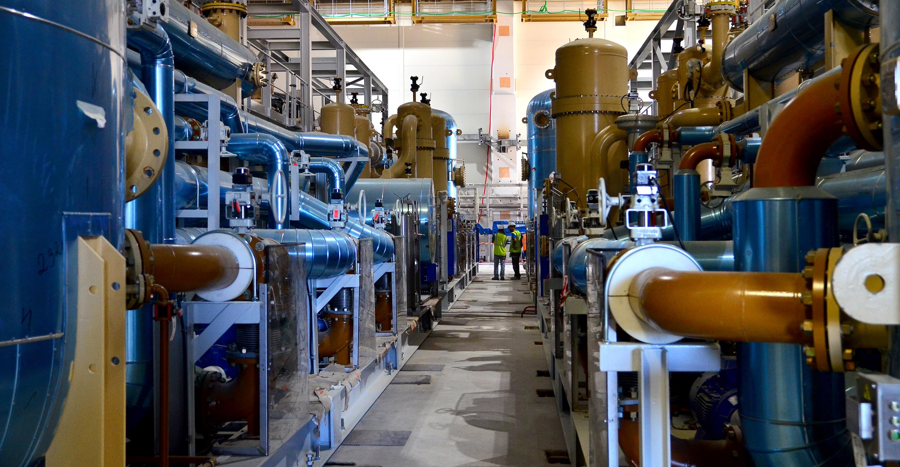
Cryoplant
Equipment installation for what will be the largest cryogenic unit in the world is now approximately half complete.

Slide 18
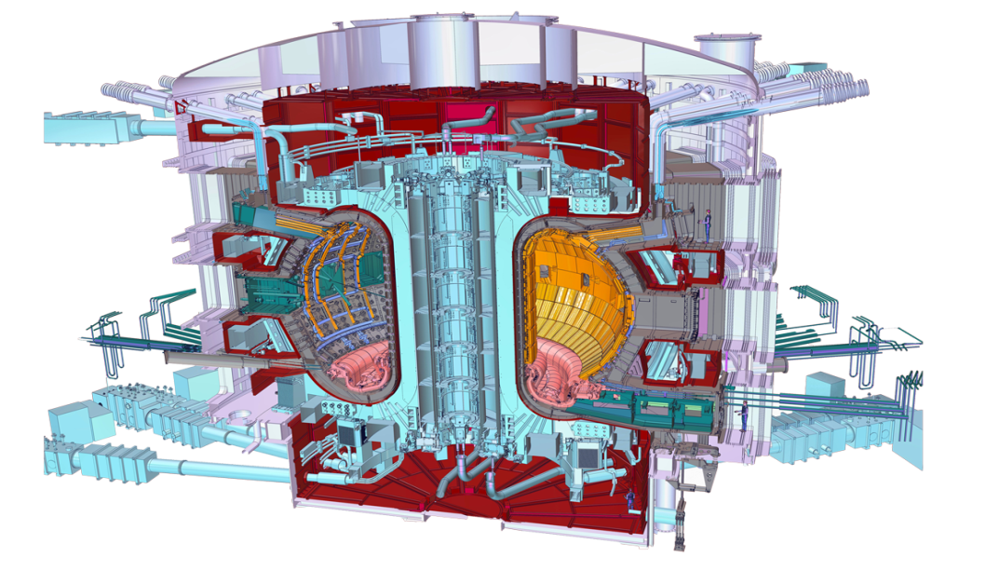
Who manufactures what? The ITER Members share all intellectual property
Cryostat
Feeders (31)
Thermal shield
Toroidal Field coils (18)
Vacuum vessel
Poloidal field coils (6)
Blanket modules
Correction coils (18)
Central solenoid (6)
Divertor

Slide 19
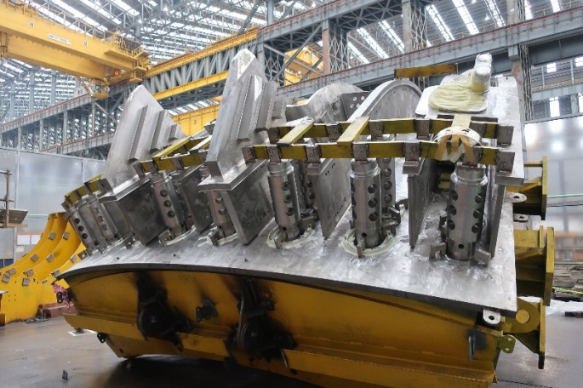
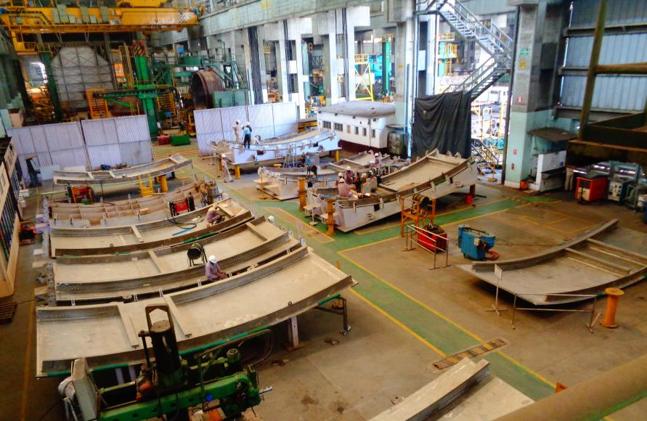
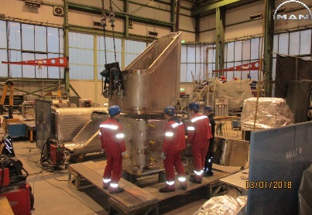
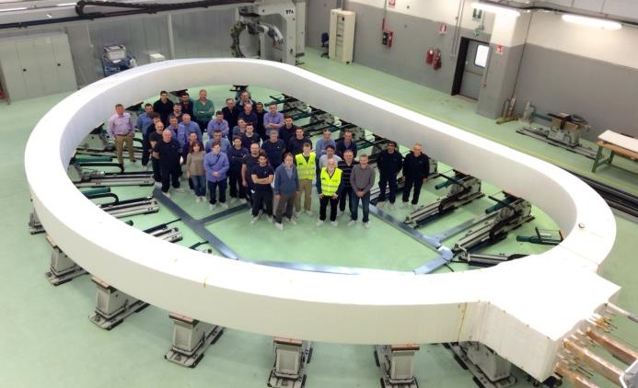
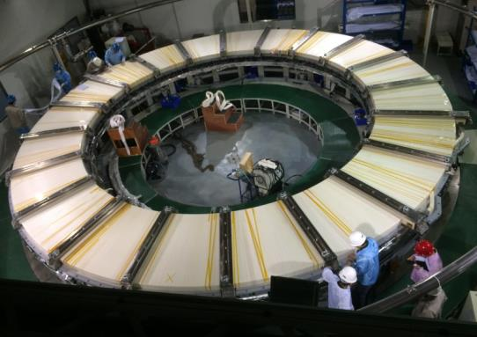
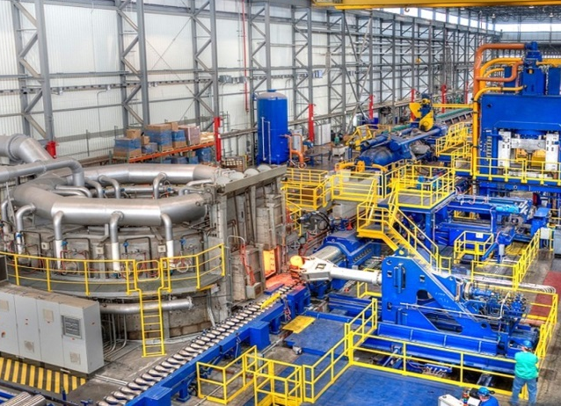
Manufacturing Progress
Vacuum Vessel, Magnets, Cryostat, Thermal Shields, Cryopumps, etc.

Slide 20
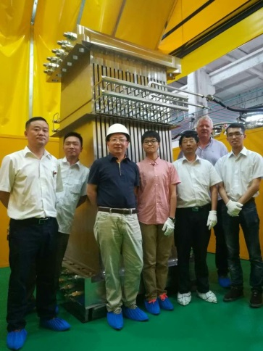
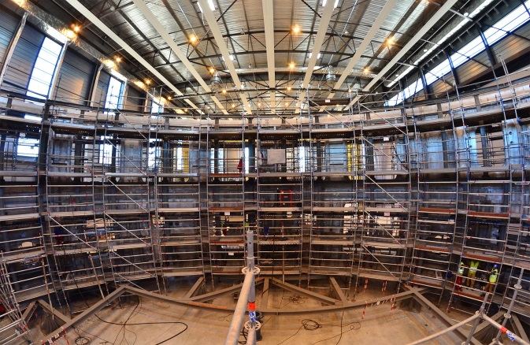
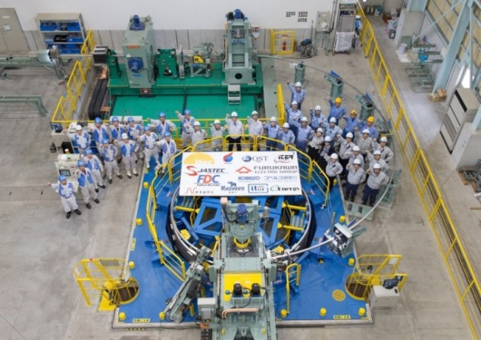
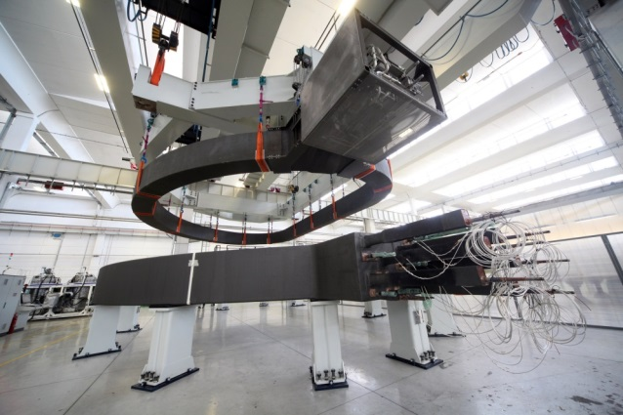
Manufacturing progress
The first production unit gravity support has been realized in China. Its design is based on years of prototyping, load analyses and testing
Welding operations for the cryostat’s lower cylinder are
finalized. Weld verification is ongoing.
Two out of ten toroidal field coils to be procured by Europe are finalized.
Fabrication of Japan’s share of superconducting cables (43 km, 745 t.) is finalized.

Slide 21
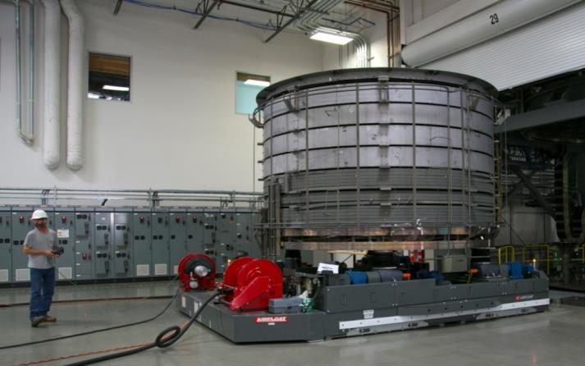
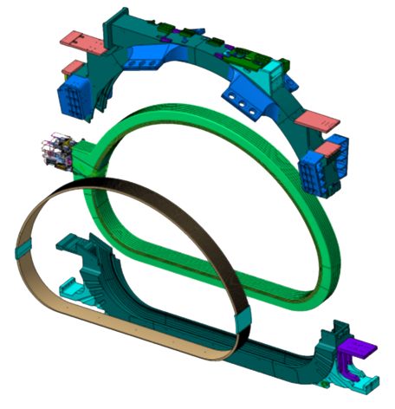
Manufacturing progress
4 out of 9 segments for the vacuum vessel are being manufactured at Hyundai Heavy Industries shipyard in Ulsan.
In San Diego, General Atomics is completing the high-temperature treatment for the Central Solenoid modules.
The fitting test for the first Toroidal Field Coil Structure, manufactured partly in Korea, partly in Japan, was completed at Hyundai Heavy Industry in Ulsan. Tolerance requirements of 0.5mm +- 0.25mm were successfully met!

Slide 22
A staged approach to DT plasma
Extensive interactions among IO and DAs to finalize revised baseline schedule proposal
Schedule and resource estimates through First Plasma (2025) consistent with Members’ budget constraints
Proposed use of 4-stage approach through Deuterium-Tritium (2035) consistent with Members’ financial and technical constraints

Slide 23
Progress on ITER Fusion Science since IAEA-FEC 2016
Elaboration of ITER Research Plan within Staged Approach
Revised strategy for development of Disruption Mitigation System
Progress on R&D to support planning of ITER operations
5 MA / 1.8 T H-mode plasma operation in PFPO-1
Development of Integrated Modelling & Analysis Suite (IMAS) and creation of Scenario Database
Optimization of ELM control in ITER scenarios
Revision of Divertor heat flux limits
Development of First Wall heat flux control schemes

Slide 24
ITER Research Plan (IRP) within Staged Approach
IRP developed from First Plasma through to achievement of Project’s goals: Q = 10 (300-500 s), Q = 5 (1000 s) & Q = 5 steady-state
R&D supported by available systems in each phase of Staged Approach
Full fusion power

Slide 25
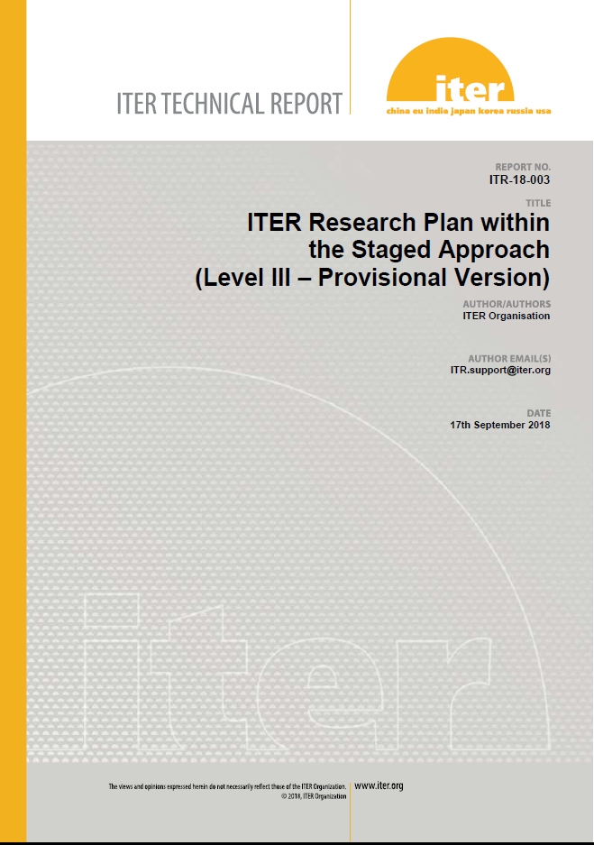
Release of ITER Research Plan as ITER Technical Report
Elaboration of ITER Research Plan (IRP) → supported by experts from ITER Members’ fusion R&D institutions and DAs → recommendation by IC- STAC
IRP made publicly available as ITER Technical Report ITR-18-003 for first time since ITER Organization established
IRP informs fusion community on details of experimental plans to achieve project’s goals → definition of required supporting R&D programmes

Slide 26
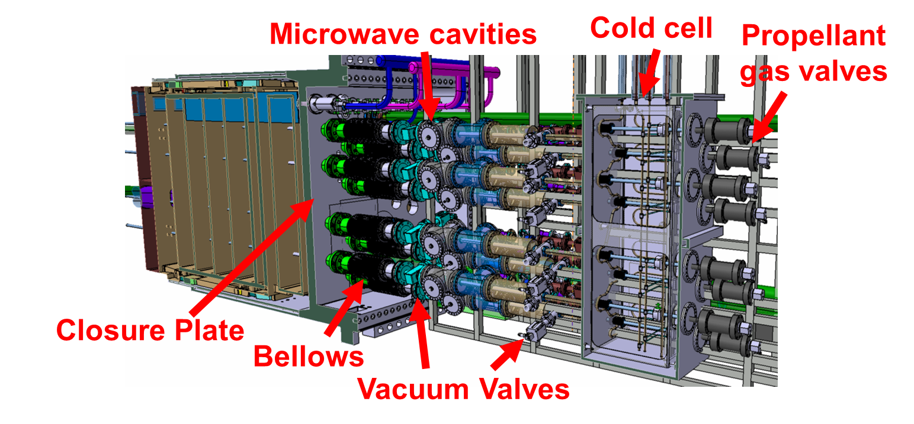
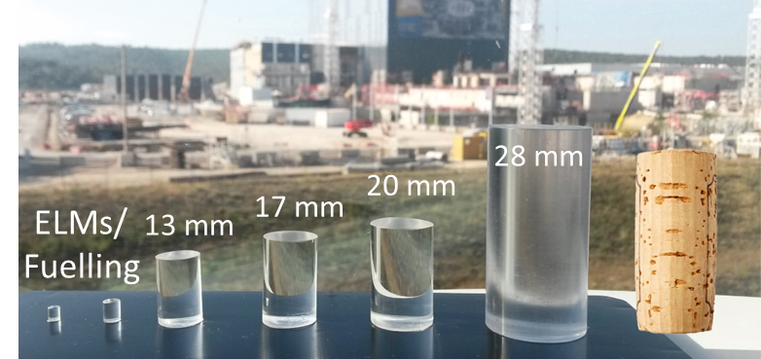
Disruption Mitigation System (DMS)
The DMS is a key plant system for ITER to achieve its goals
Increase of injection capabilities in preparation:
≤ 32 x 28 mm pellets in 3 equatorial ports
3 x 13-20 mm pellets in 3 upper ports
Ne, Ar, D₂
Lehnen
EX/P7-12
ITER DMS Task Force – Implementation of design validation and engineering studies
Scientific validation (experiment and theory) of DMS requirements → in progress
Technology development to ensure required DMS reliability → in progress
Studies to address future upgrades or alternative approaches
Notes:
The Disruption Mitigation System of ITER must be highly reliable and effective and is required from early operation on. ITER has decided to increase the injection capabilities to meet requirements based on present day knowledge. Up to 32 pellets of 28 mm diameter can be injected through EPs and 3 of medium size through UPs. The right hand side shows a preliminary design of the integration of 8 injectors in one third of an equatorial port plug. Significant gaps exist still in the physics basis for disruption mitigation and the injection technology has to be developed for the ITER requirements. The ITER DMS task force has been established to implement the plan for design validation and engineering studies. This plan includes a) scientific validation of the concept including tokamak experiments and theory & modelling tasks; b) technology developments to adapt the SPI technology to the ITER needs; c) studies to assess the possible need for later DMS upgrades. To ensure timely integration of such upgrades should they be required in a later phase of the project, it will be essential that alternative technology or alternative concepts are developed by the ITER community.

Slide 27
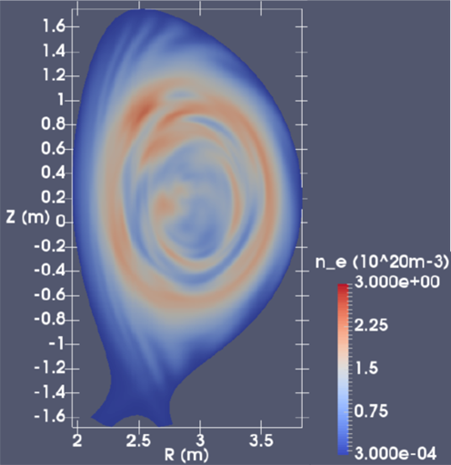
Scientific validation of DMS requirements
Baseline concept:
dissipating thermal and magnetic energy → radiation
preventing runaway electron formation → increasing plasma density
Baseline technique:
injection of Ne, Ar and D₂ through Shattered Pellet Injection
Most urgent issues to be addressed:
Confirm concept of multiple injections by experiment (needed to inject material in ITER)
Identify most effective pellet fragment sizes
Assess concept of runaway electron avoidance and runaway energy dissipation
3D MHD JOREK SPI simulation of JET :
Density distribution at thermal quench is critical for runaway electron avoidance
Hu, Nucl. Fusion 2018 (accepted)
Notes:
The baseline concept to mitigate disruptions in ITER is based on the dissipation of the energy through radiation to avoid local overheating of components like the first wall panels or the divertor and to control the current decay for electro-magnetic load mitigation. At the same time, the plasma density must be raised to avoid the formation of high energy runaway electrons. The technique to inject the radiating material is shattered pellet injection due to its better delivery properties compared to more conventional massive gas injection. The most urgent issues to be addressed through the DMS task force for closing gaps in the DMS design basis are: a) confirmation of the effectiveness of pellet injection through multiple injectors at various injection locations as required to achieve the injection quantities presently envisaged; b) identification of the most effective sizes of the pellet fragments for ITER; c) to assess and conclude on the validity of the concepts to avoid runaway electron impact on the ITER in-vessel components. The figure shows 3D MHD simulations of SPI in preparation of JET experiments in support for ITER. The density distribution shown can be critical for the suppression of runaway electron formation during the mitigation process.

Slide 28
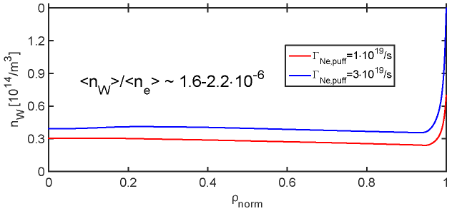
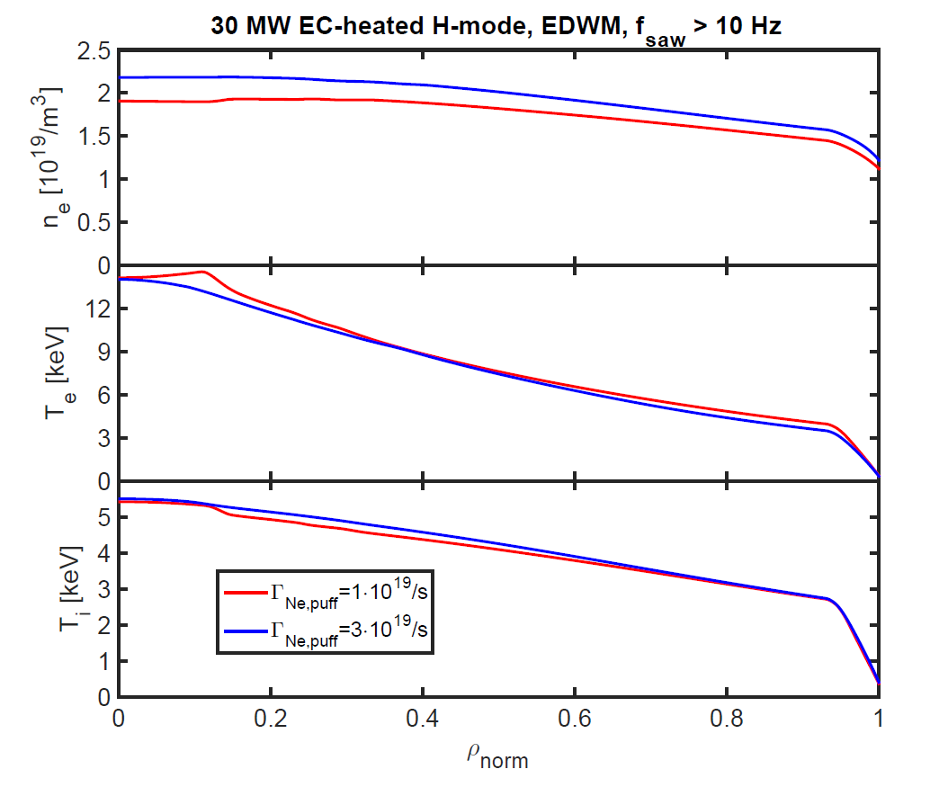
Assessment of 5 MA / 1.8 T H-mode plasma operation in PFPO-1
5 MA / 1.8 T allows H-mode access in PFPO-1 → risk reduction for later operation
No outstanding physics/operational issues for 5 MA/1.8T plasmas:
ECH heating with good absorption (3rd harmonic)
Electron temperatures > 10 keV with low plasma tungsten content
Divertor heat fluxes ≤ 5 MWm⁻²
Low core W density
Schneider
TH/6-1
T_{e} > 10 keV
Militello-Asp
APS 2018
Moderate Divertor
heat fluxes

Slide 29
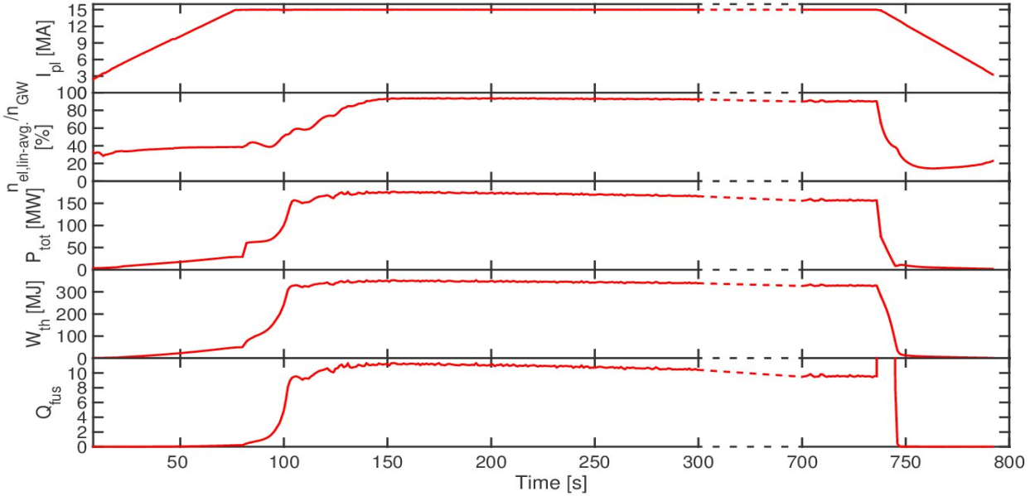
Development of Integrated Modelling & Analysis Suite (IMAS) and Scenario Database
First high fidelity IMAS simulations of 15 MA / 5.3 T Q = 10 DT baseline scenarios including core – edge - divertor evolution respecting principal engineering limitations
Optimization of scenario and control schemes for plasma shape control, current induction, heating, fuelling and seeding actuators
IMAS Scenario Database set up and populated with simulations representing all stages of the ITER Research Plan (currently over 110 entries)
Support to joint activities such as diagnostic design, performance assessments, etc.
End-to-end IMAS simulation of 15 MA Q = 10 DT baseline scenario with DINA-JINTRAC
Köchl EX/P7-25
Pinches TH/P6-7

Slide 30
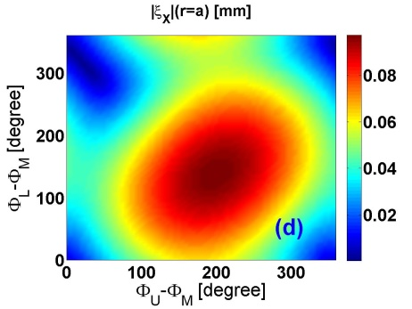
Optimization of ELM control in ITER
MagnetoHydroDynamic simulations → optimization of current waveforms in ELM control coils performed under ITER Scientist Fellow Network (ISFN) work programme
Optimization → maximum ELM control potential (X-point deformation, ξ) with minimum detrimental effects (slowing down of plasma rotation)
Li & Liu TH/P1-7
ITER ELM control coils
I_{coil}^{max} = 90 kAt
ξ ~ mm/kAt
Good for ELM control
n = 3

Slide 31
Revised divertor steady state heat flux limit
G. De Temmerman et al., PPCF 60 (2018) 044018 R.A. Pitts et al., PSI 2018
Loading
Macro-crack initiates if material recrystallized too deeply
W divertor monoblock
Cooling
~ 2000 - 3000 hours FPO-1 to FPO-3
New “Operational Budget” for peak divertor heat flux → time for hardness to drop (due to recrystallization) by 50% at given depth below W surface
Gives q_{peak,target} ≲ 15 MWm⁻² for first ITER divertor up to end of FPO-3
Increased margin wrt. the previous limit of 10 MWm⁻²
Time to reduce hardenss by 50% (hours)
Divertor peak heat flux (MWm⁻²)
Notes:
The previous limit of 10 MWm⁻² as an approximate maximum stationary divertor peak heat flux limit fpor the ITER divertor is purely historical. It was based on CFC monoblock technology and was always the value that people thought that technology could handle for the given type of CFC and material thickness which was chosen on the basis of erosion lifetime. The CFC was thicker than the W monoblocks because it erodes (by chemical sputtering) even if physical sputtering is kept low by keeping the divetor plasma temperature low (detached divertor). However, when you switch to W material, as the IO chose to do in 2013 for the first divertor, the thickness of the material can be kept much lower since steady state erosion is no longer the determining factor (no chemistry, much higher sputtering threshold for W). But the switch from CFC to W also means that the criterion for setting the limit on peak heat flux changes. This is now set by maximum surface temperature, since if the temperature exceeds a certain limit (the recrystallization temperature for the W material), then the hardness reduces and the material can crack more easily under the thermal cycles that ITER operation will impose on the divertor monoblocks (thermal fatigue). If the material cracks, there is a greater risk of eventual operational issues. Because the ITER monoblocks have specific geometry (square block with circular cooling channel), the centre of the block is more strongly cooled than the extremities and this sets up thermal gradients which mean that cracking first occurs in the centre of the block. We thus impose a new criterion on the surface temperature in the block centre to stay below the recrystallization temperature at that point. Since surface temperature is directly proportional to heat flux density, this is the same as imposing a limit on peak heat flux, which is the quantity we try to predict with plasma boundary modelling. Our criterion is actually fixed with regard to recrystallization at a given depth below the material surface since recent finite element calculations of material response have shown that the macro-cracks are more likely to develop if recrystalllization reaches deeper into the material. 2 mm seems currently like a reasonable depth to assume as the point at which cracking is more likely if the material recrstallizes to this depth. More R&D needed on this however, in particular on the specific W grade ITER will be using. SCOD/SCD is looking at this through contract work and ITPA activities. Since recrystallization is a function of both temperature AND time, we estimate the maximum time expected for fusion power operation (when divertor heat fluxes are highest) in FPO from the new ITER Research Plan. This is ~2200 hours. As metric for recrystallization we take the Vickers Hardness and use standard recrystallization theory to compute the surface temperature versus time curves for the hardness to drop by 50% at a given depth. This surface temperature is then related directly to the power flux density on the monoblocks. The intersection of the time = 2200 hours on the 2 mm Vickers hardness curve with the x-axis on the plot gives the approximate maximum stationary peak heat flux you are allowed to operate at continuously. Note that this metric allows for the near surface to be recrystallized to a certain degree. If we insisted that only the very top surface is allowed to be recrystallized, then the allowed stationary peak heat flux would be closer to the 10 MW/m2 criterion originally fixed for CFC monoblocks (but purely by coincidence). R&D in the coming years (e.g. on tokamaks like WEST and on linear devices) should allow us to more clearly quantify the validity of this criterion.

Slide 32
ITER First Wall heat flux control development
Heat flux on first wall panels needs to be controlled from early IRP phases
New algorithm combines off-line 3D field line tracing and 2D real-time heat flux estimation for control system
SMITER incorporated in IMAS
ITER Start-up
Heat fluxes
Cross-calibration
using SMITER
Work performed under Monaco postdoctoral programme
Anand EX/P7-24

Slide 33
Challenges ahead for ITER
until construction completion
ITER Organization, Domestic Agencies and suppliers working as “One-ITER Team” with a strong project culture
Strict respect by suppliers for quality and safety requirements
Strict respect by all stakeholders for the schedule requirements, in particular for the required delivery dates for materials and equipment on the ITER site
Reliable and fully integrated assembly/construction sequences on ITER site
Contracting with high performing and experienced companies for the assembly activities in the Tokamak Complex
Setting in place a well-suited organization in charge of commissioning
Setting in place a well-suited organization to conceive and execute the progressive take-over of the machine, ultimately for its operation and maintenance
Timely, reliable availability of the planned and committed resources from the seven ITER Members

Slide 34
ITER is moving forward!
http://www.iter.org

