Slide 1
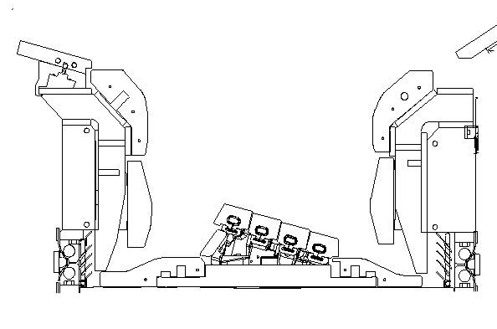
Erosion/Deposition in the JET Divertor During the ITER-like Wall Campaigns
JET ILW divertor
Deposition in the JET ILW divertor
0
0
1
8
Campaign | D (g) | Be (g) | C (g)
ILW-1 | 0.9 | 53 | 13
ILW-2 | 0.7 | 60 | 7
ILW-3 | 0.9 | 46 | 6
5
3
A
B
7
C
D
4
6
Erosion/Deposition in the JET divertor studied using marker tiles
Decrease of material deposition rate by factor 4-9 compared to JET-C
Decrease of D retention by factor 10-20 compared to JET-C
Confirmed in all three ILW campaigns

