Slide 1
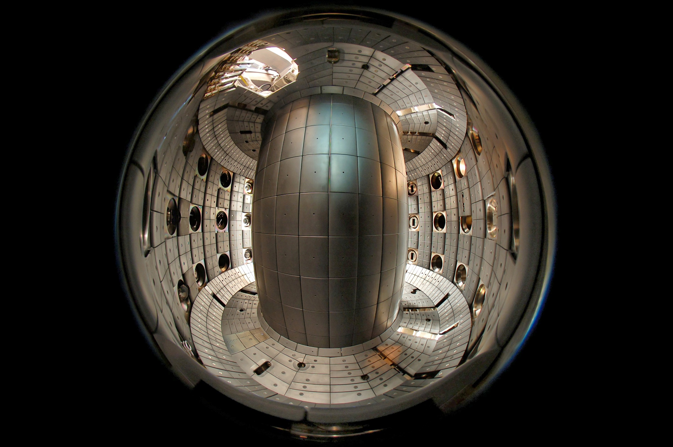
Physics research on the TCV tokamak:
from conventional to alternative scenarios and beyond
S. Coda for the TCV team
and the EUROfusion MST1 team

Slide 2
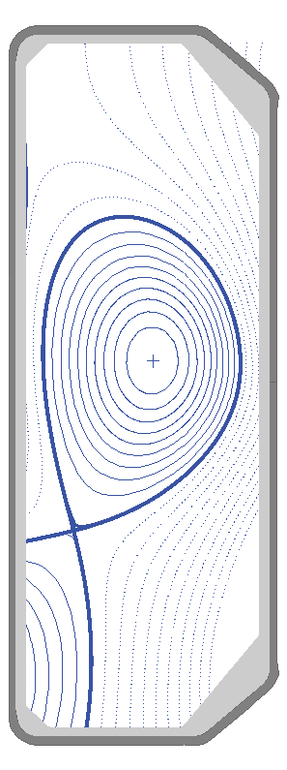
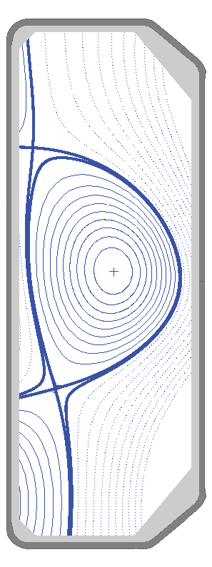

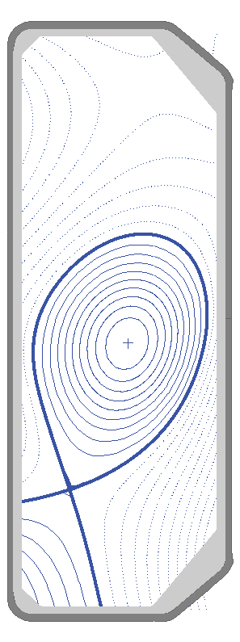
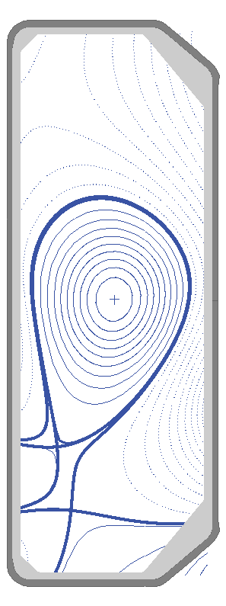
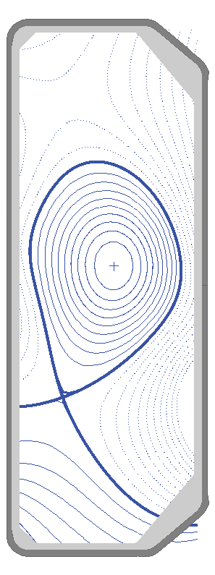
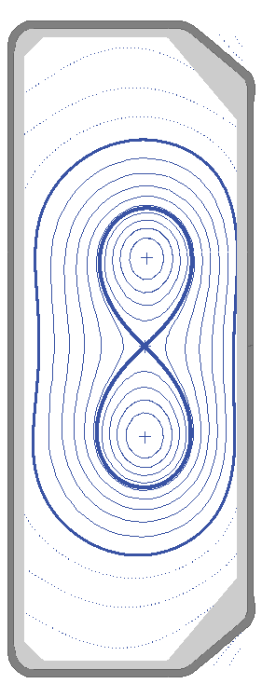
These are a few of our favorite shapes

Slide 3
Medium-size tokamak with ECRH and NBI heating
I_{p} < 1 MA
B_{T} < 1.54 T
κ < 2.8
-0.6 < δ < 0.9
a=0.25 m
R=0.88 m
carbon wall

Slide 4
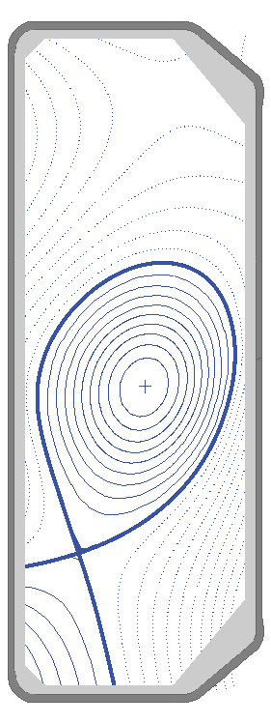
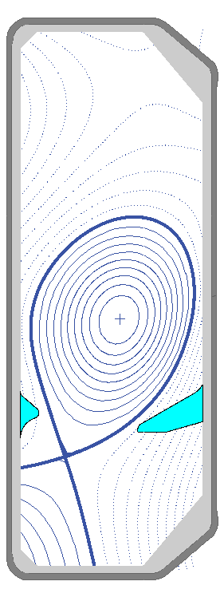
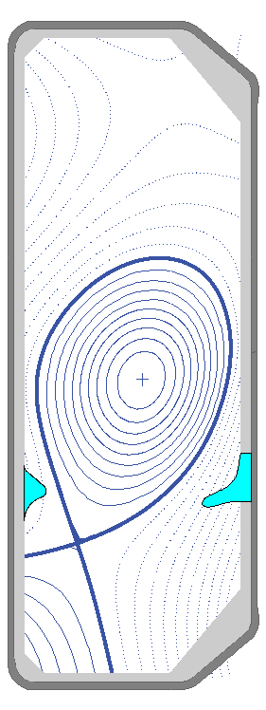
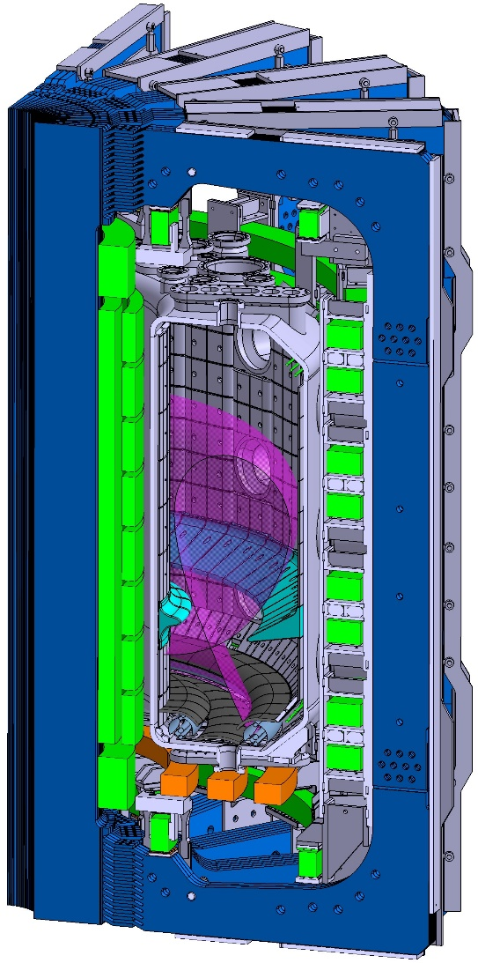
Starting in 2019, TCV will experiment with interchangeable divertor baffles
A. Fasoli, FIP/P8-6 (Friday afternoon)

Slide 5
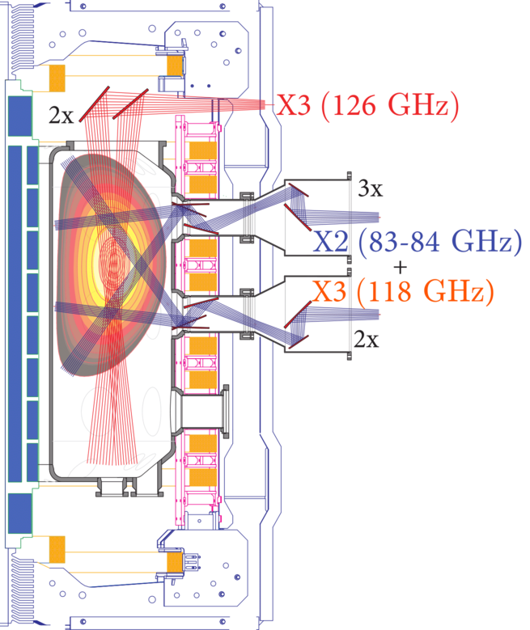
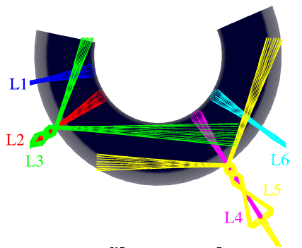
ECRH heating on the rise again
4.5 MW (2003)
 1.8 MW (2018)
 4.8 MW (2019)

Slide 6
NBI heating to be doubled
1 MW (2015)
 2 MW (2020)
15-25 keV
50-60 keV
(future)

Slide 7
TCV science: outline
Scientific mission
Scientific results
  Disruptions and runaway electrons
  Heat exhaust and edge physics
  Integrated reactor scenarios
  Pedestal and core physics
  The uses of triangularity
  A highly alternative configuration
Summary and outlook

Slide 8
TCV mission
Investigating fusion science and control techniques for reactor
and power plant
Furthering high-temperature plasma science
  agile program to respond to new ideas and theoretical challenges
Run since 2015 partly as a European facility
within Medium-Size Tokamak (MST) Task Force
in EUROfusion program

Slide 9
TCV science: outline
Scientific mission
Scientific results
  Disruptions and runaway electrons
  Heat exhaust and edge physics
  Integrated reactor scenarios
  Pedestal and core physics
  The uses of triangularity
  A highly alternative configuration
Summary and outlook

Slide 10
Taming disruptions:
keep peak performance, else avoid, else mitigate
Disruptive 2/1 NTMs induced by massive gas injection (MGI)
Documented
  preventive ECCD (triggered by radiation)
  stabilizing ECCD (triggered by locked-mode detection)
  safe termination with rampdown

Slide 11
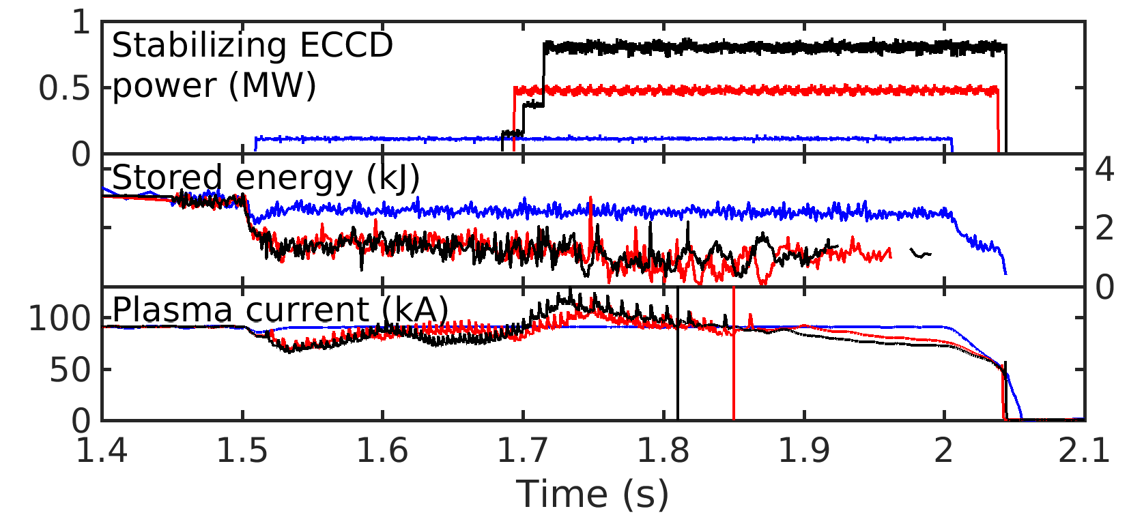
Taming disruptions
Prevention is more efficient than stabilization
prevention
mode unlocking
U. Sheikh et al, NF 2018
r/t q=2 tracking added for more robust control
M. Kong, EX/P1-25 (Tuesday morning)

Slide 12
Successful r/t control of disruptive runaway-electron beam
Current quench detection from I_{p} and HXR
Dedicated controller
  ramps down current with Ohmic transformer
  controls position with PF coils
  limits energy with MGI
D. Carnevale et al, submitted to PPCF

Slide 13
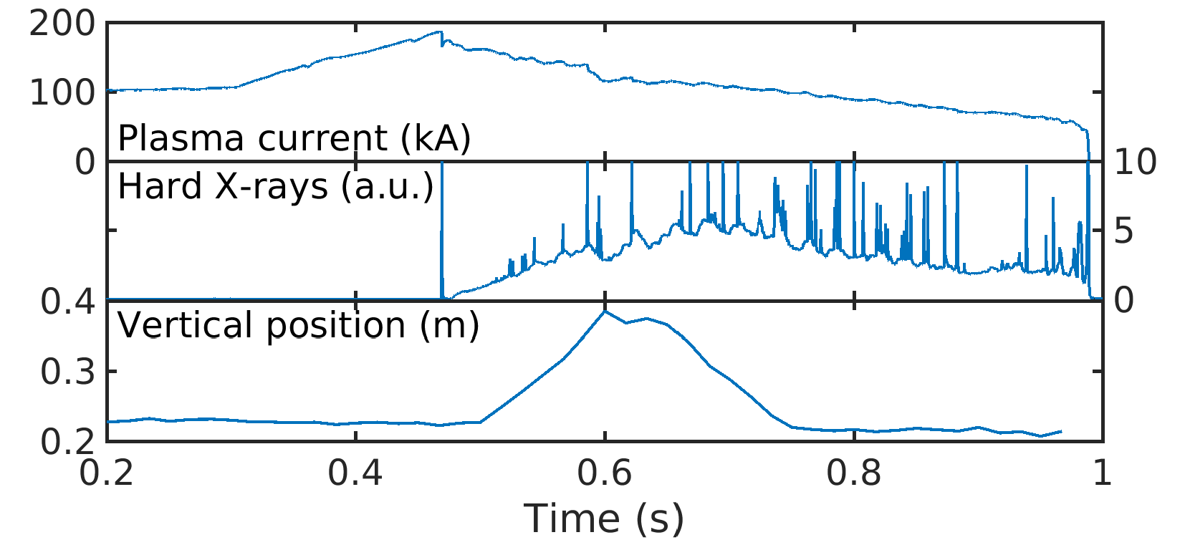
Successful r/t control of disruptive runaway-electron beam
Demonstration of controlled 11-cm vertical excursion
New: RE beam also for κ=1.5
New: RE beam also for q_{edge}< 3

Slide 14
TCV science: outline
Scientific mission
Scientific results
  Disruptions and runaway electrons
  Heat exhaust and edge physics
  Integrated reactor scenarios
  Pedestal and core physics
  The uses of triangularity
  A highly alternative configuration
Summary and outlook

Slide 15
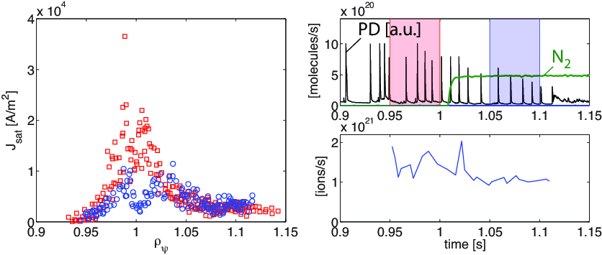
Detachment work has moved to H-mode
Partial detachment seen with N₂ seeding in inter-ELM + ELM-free phases
Heat flux down by a factor 2
Particle flux reduced by 30% only in ELMy case

Slide 16
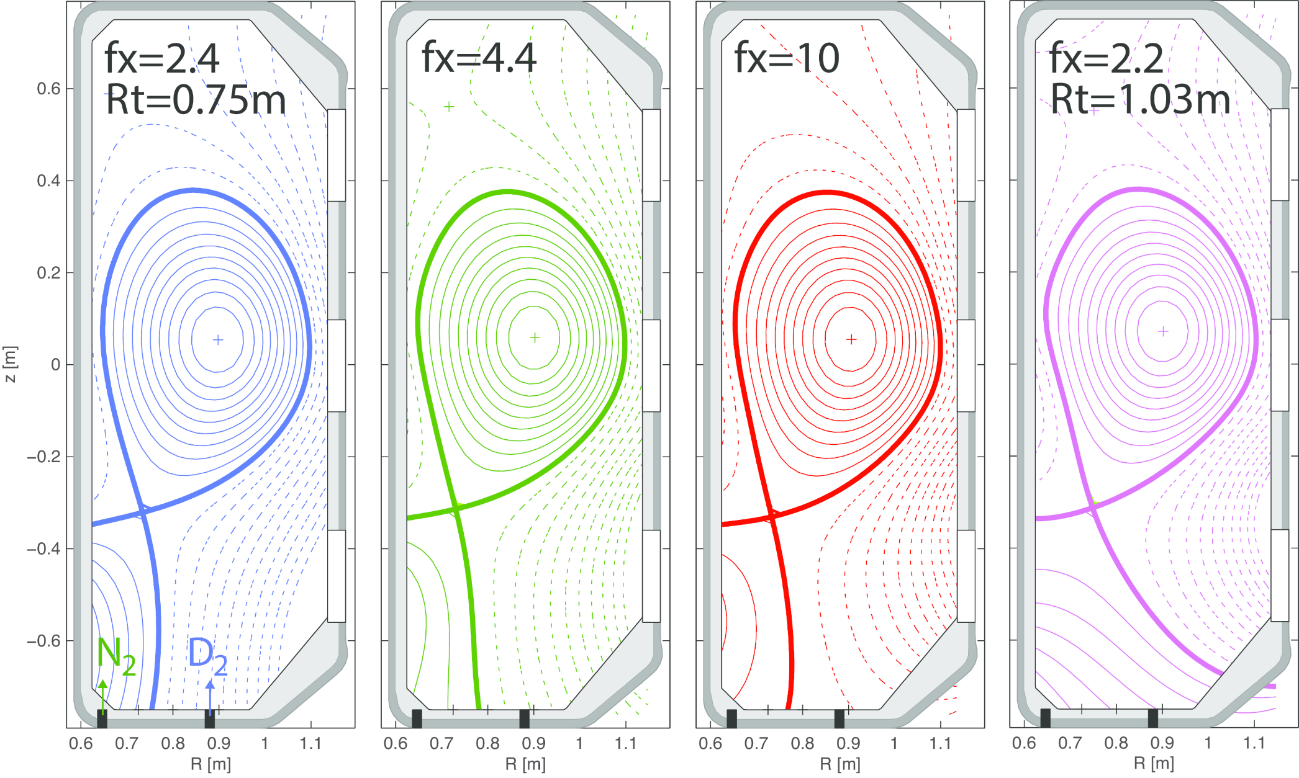
Explored poloidal and total flux expansion

Slide 17
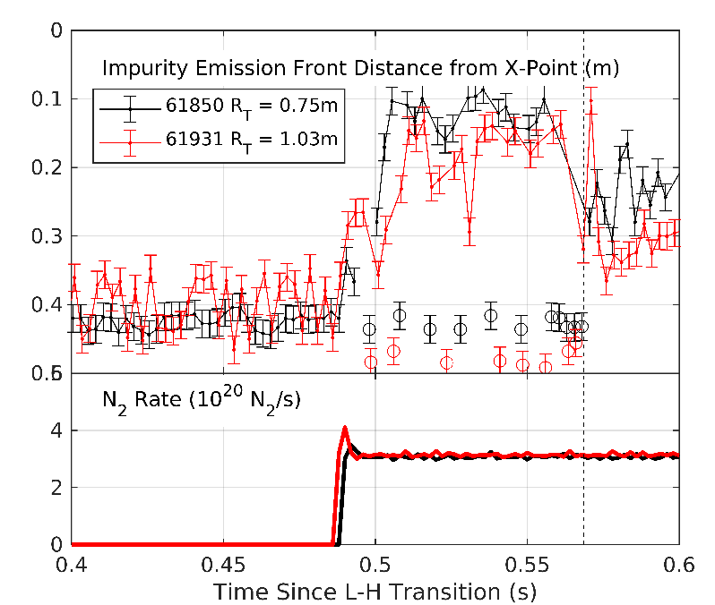
Effects of total flux expansion on detachment
appear weak so far
Reproduced by solps (flux expansion counteracted by power losses)
C. Theiler, EX/P1-19 (Tuesday morning)

Slide 18
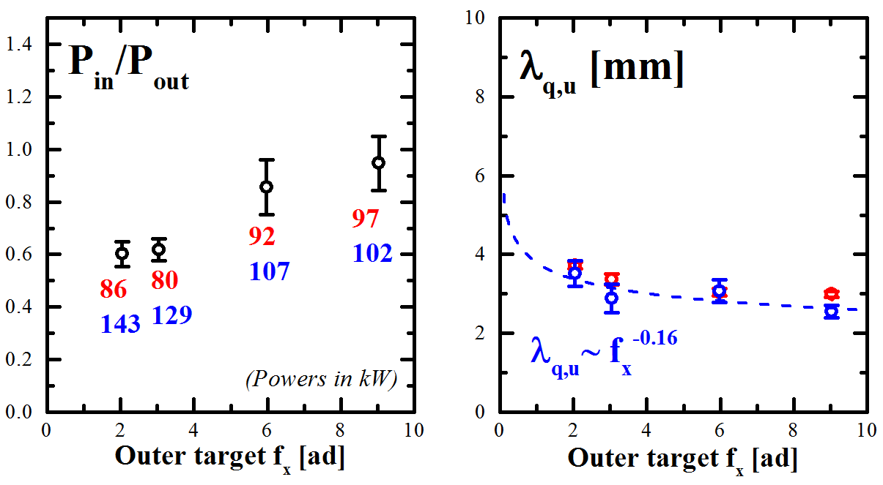
Poloidal flux expansion deepens
outer-target detachment
This is partly through flux redistribution to inner target
(attributed to decrease in outer conductance)
Flux expansion also has little effect on power decay length λ_{q}
L-mode data
R. Maurizio et al, NF 2018

Slide 19
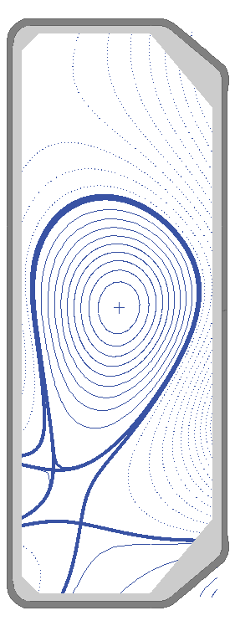
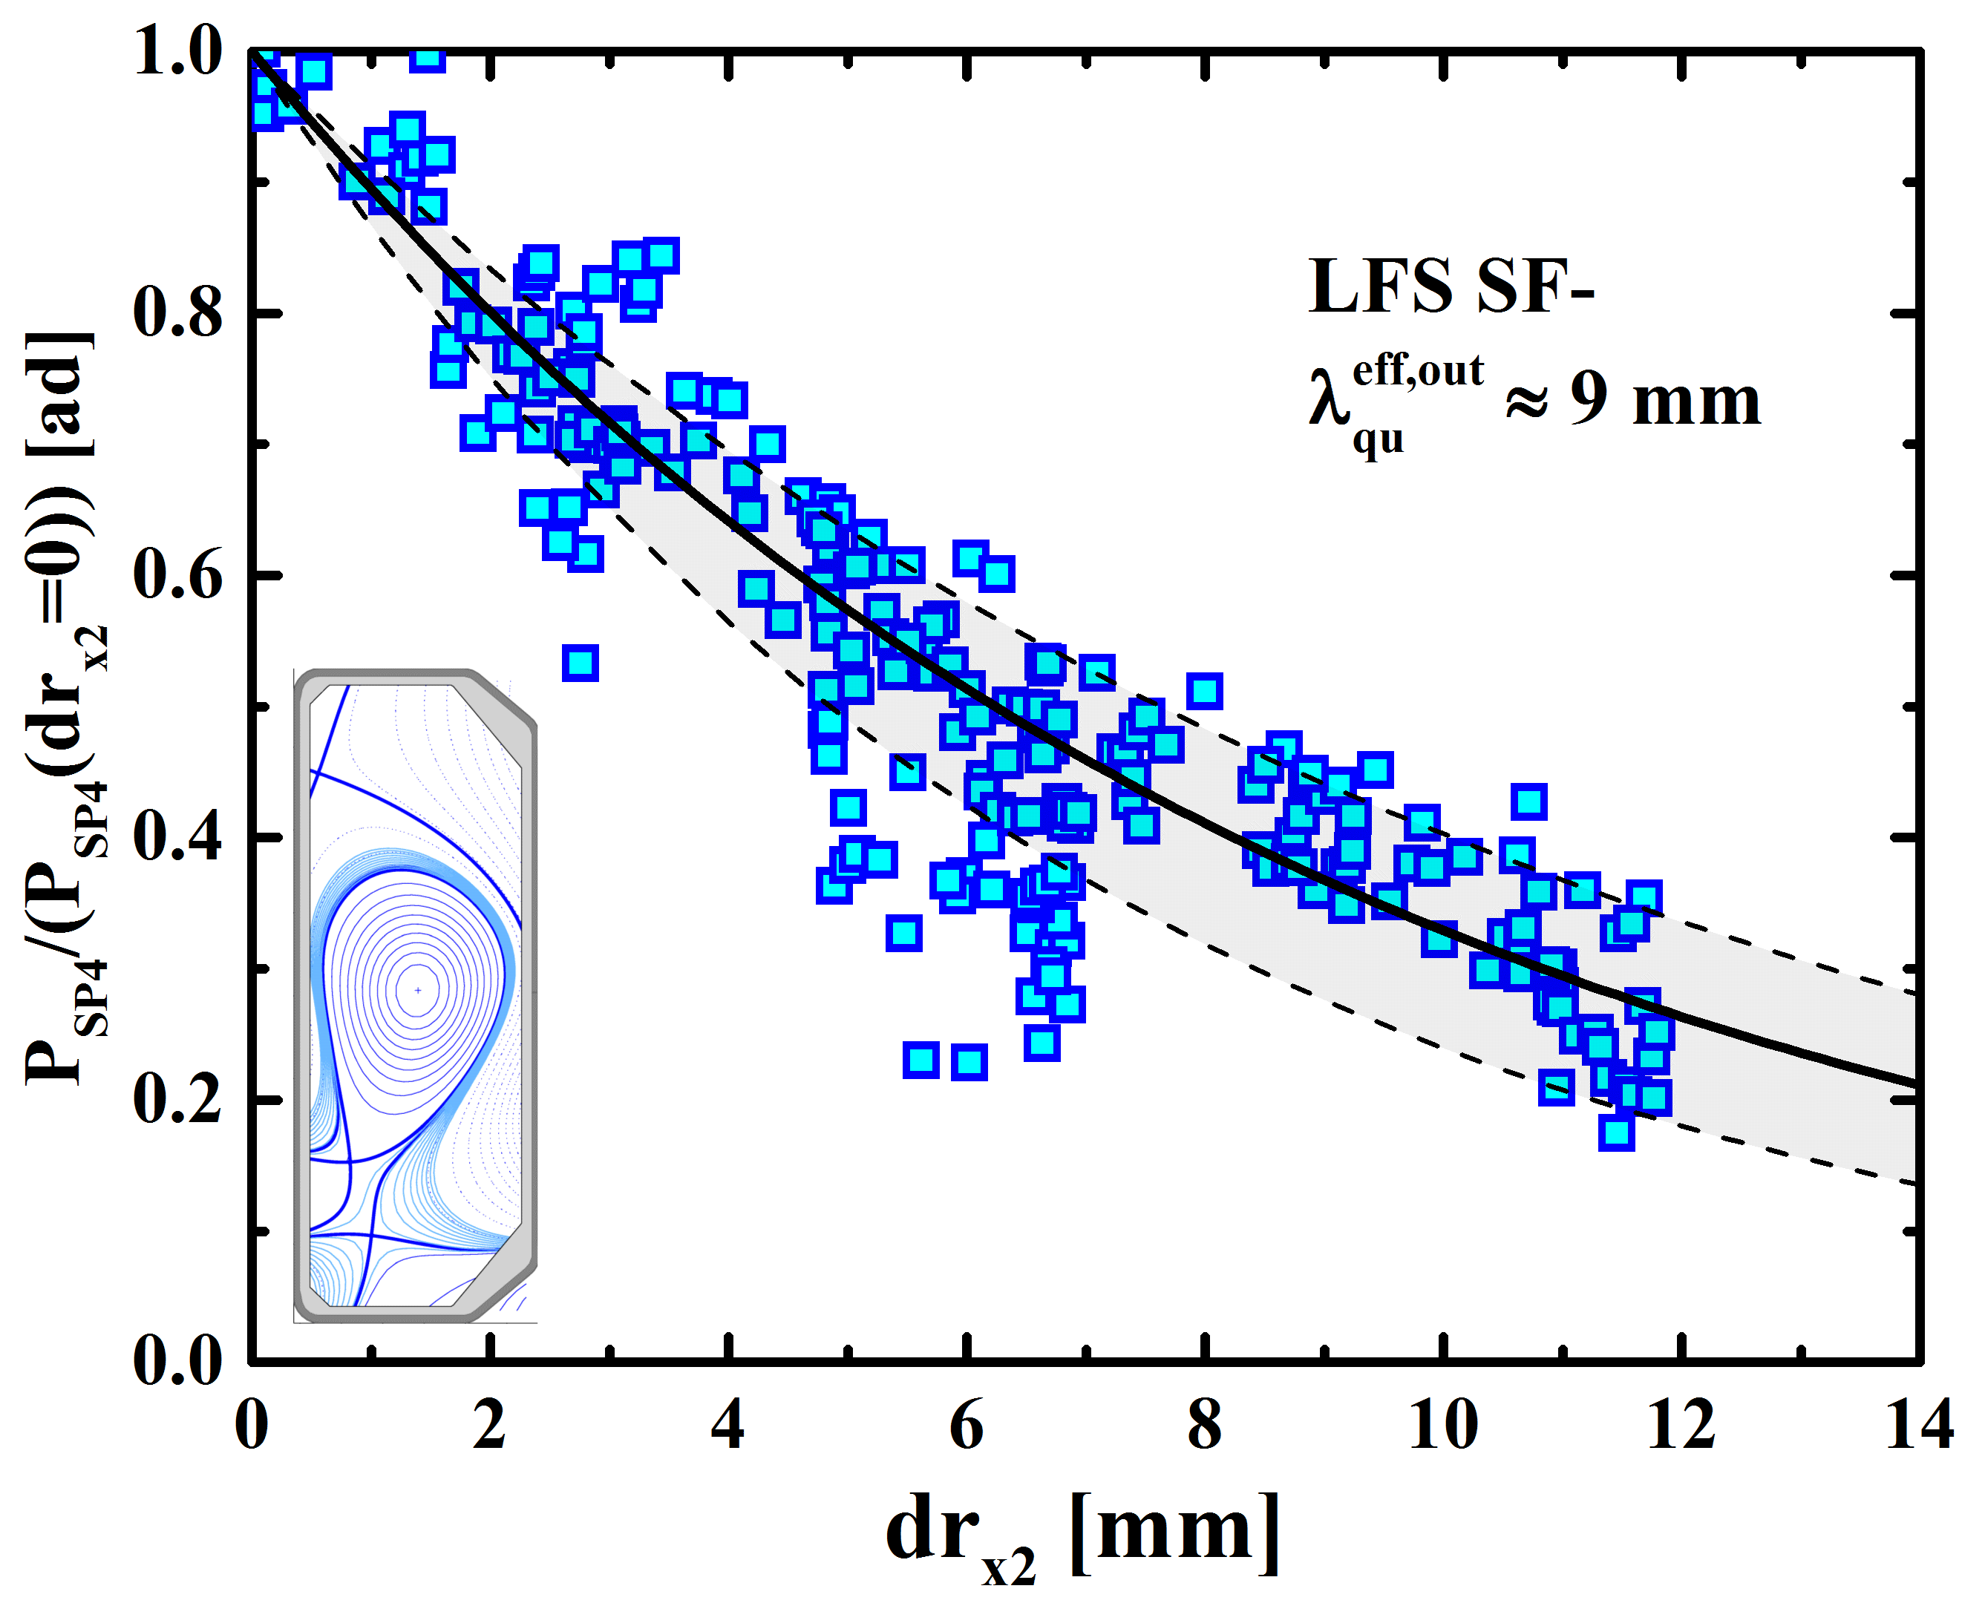
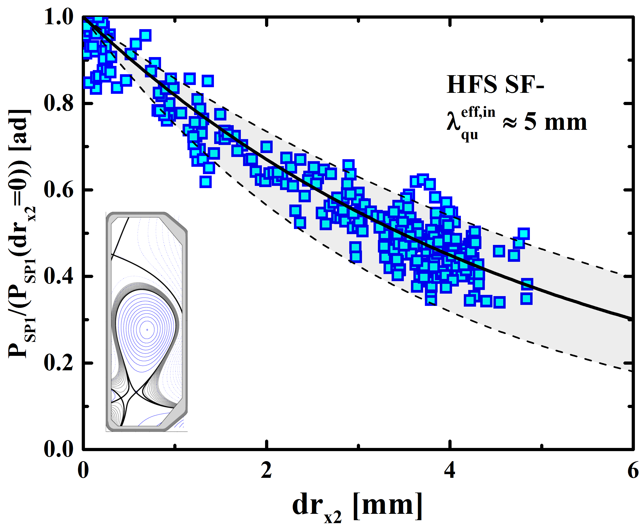
Enhanced X-point diffusivity in LFS snowflake-minus
whereas HFS SF- is similar to standard single-null
Enhanced diffusivity incompatible with convection,
consistent with interchange ballooning turbulence
R. Maurizio et al, submitted to NF

Slide 20
SOL density “shoulder”
defies simple explanation on TCV
but no clear correlation between Θ and collisionality (Λ_{div}), or between collisionality and shoulder (λ_{n}), or between connection length and shoulder
Shoulder appears after detachment (unlike closed-divertor devices)
Filament size Θ increases with density
N. Vianello, EX/P8-13 (Friday afternoon)

Slide 21
TCV science: outline
Scientific mission
Scientific results
  Disruptions and runaway electrons
  Heat exhaust and edge physics
  Integrated reactor scenarios
  Pedestal and core physics
  The uses of triangularity
  A highly alternative configuration
Summary and outlook

Slide 22
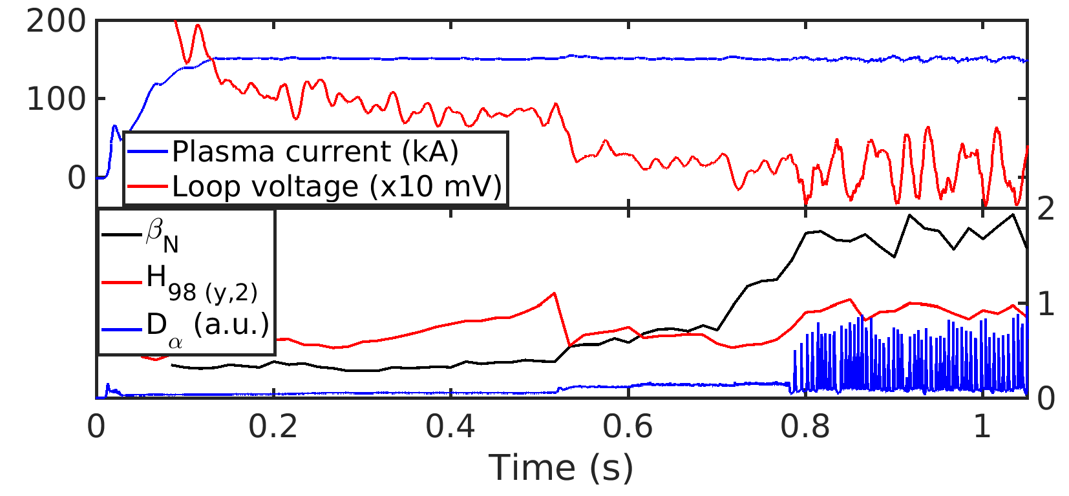
Progress in baseline and AT scenarios
ITER-like scenarios explored (q₉₅=3.6)
Advanced Tokamak: nearly non-inductive H-mode scenario achieved with NBI + X2: β_{N}=1.7, higher power could help
C. Piron, EX/P1-30 (Tuesday morning)

Slide 23
TCV science: outline
Scientific mission
Scientific results
  Disruptions and runaway electrons
  Heat exhaust and edge physics
  Integrated reactor scenarios
  Pedestal and core physics
  The uses of triangularity
  A highly alternative configuration
Summary and outlook

Slide 24
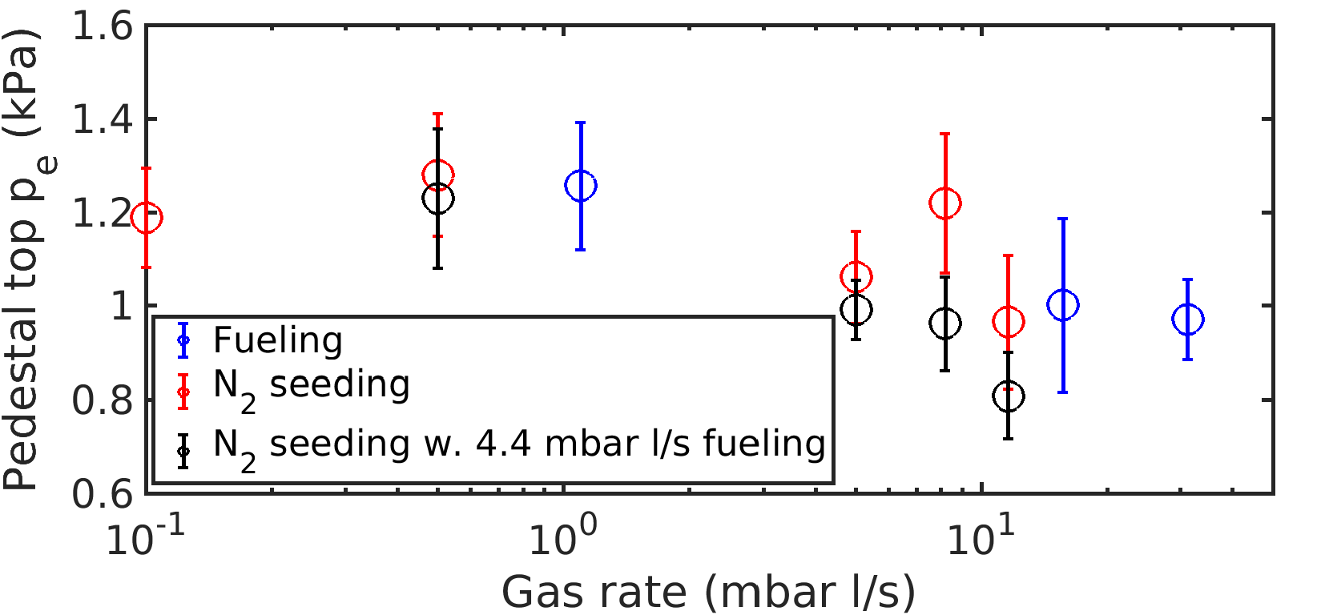
Fueling and seeding affect pedestal height and radius, but not τ_{E}
Core profiles not stiff with respect to fueling and seeding
Pedestal is peeling-ballooning limited, agreement with eped1/iped
L. Frassinetti, EX/P8-22 (Friday afternoon)
U. Sheikh et al, to be published in PPCF

Slide 25
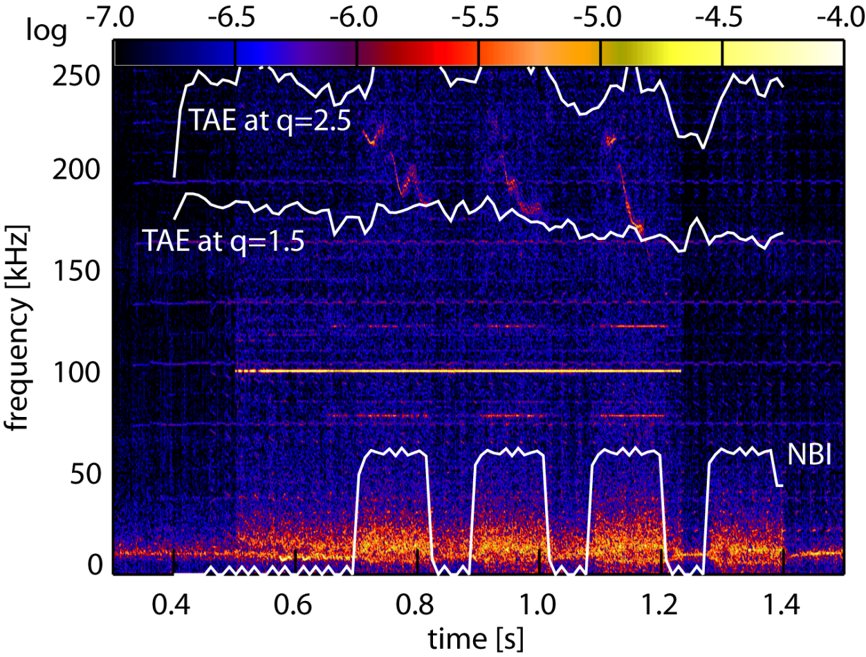
Fast-ion physics: first TAE observation
only with NBI and X2 ECRH
ECRH on
B. Geiger, EX/P8-24 (Friday afternoon)

Slide 26
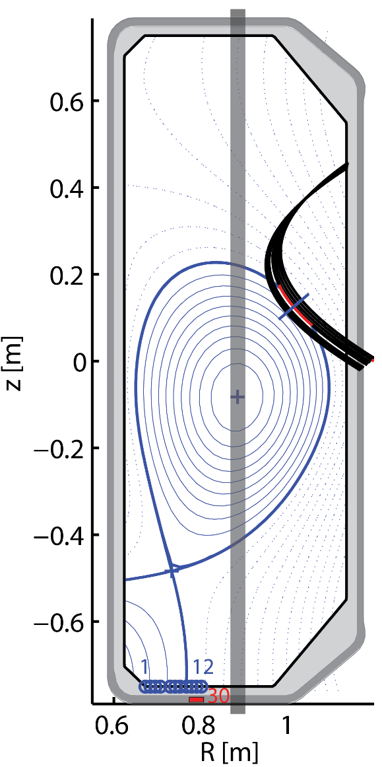
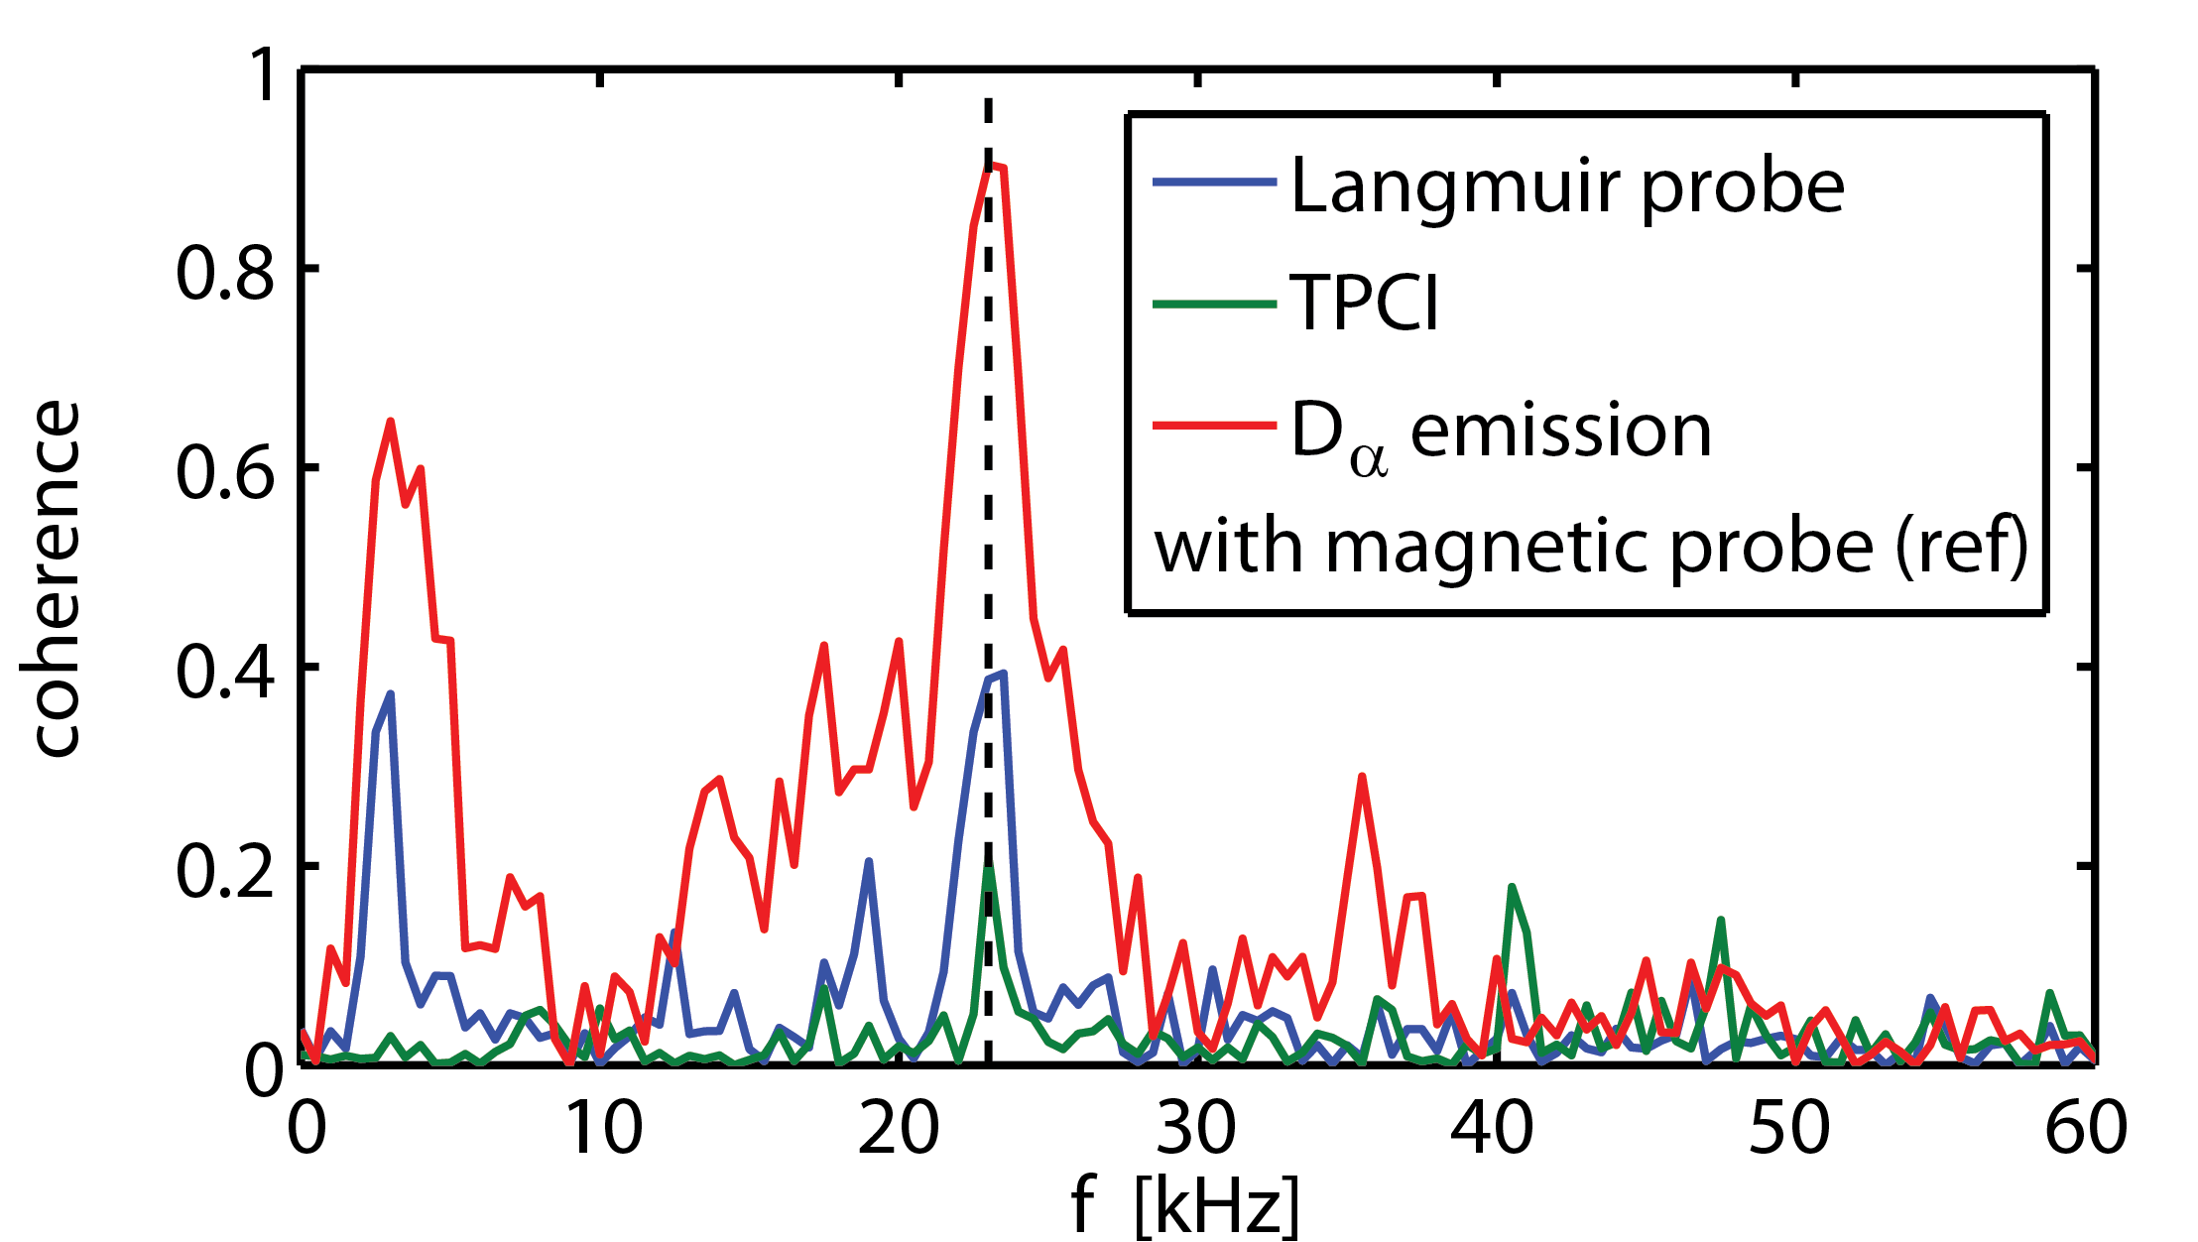
First evidence of GAM (possibly coupled with avalanche) driving flux to the wall
Z. Huang, PPCF 2018

Slide 27
TCV science: outline
Scientific mission
Scientific results
  Disruptions and runaway electrons
  Heat exhaust and edge physics
  Integrated reactor scenarios
  Pedestal and core physics
  The uses of triangularity
  A highly alternative configuration
Summary and outlook

Slide 28
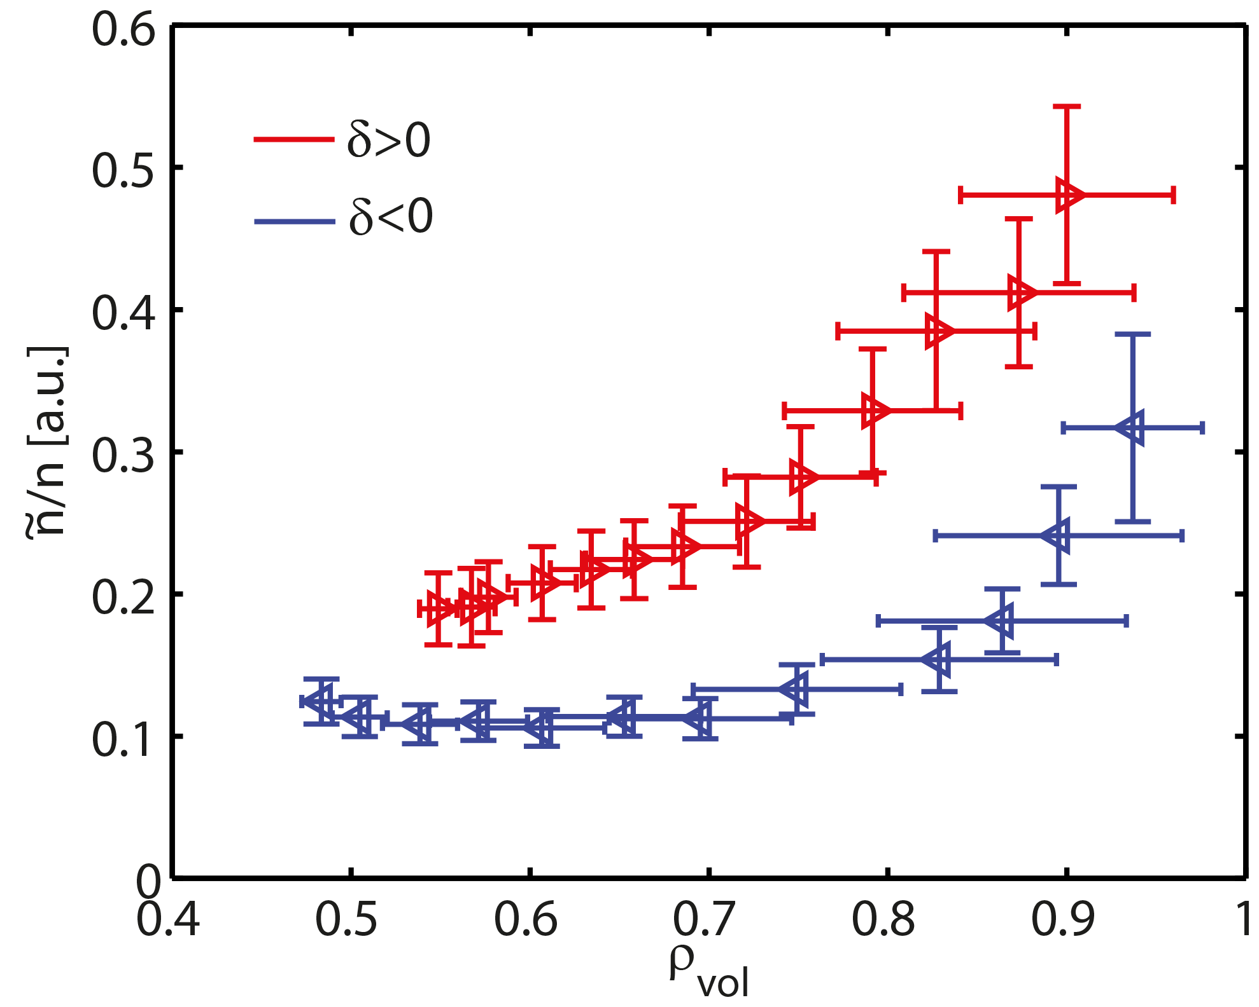
Higher τ_{E} with δ<0 in L-mode  reduced turbulence
Z. Huang et al, PPCF 2018

Slide 29
ELM mitigation with δ<0
Increased ELM frequency, lower ELM heat load
Understood through removal of ballooning second-stability region, limiting pedestal growth
EPED predictions
vs data
A. Merle et al, PPCF 2017

Slide 30
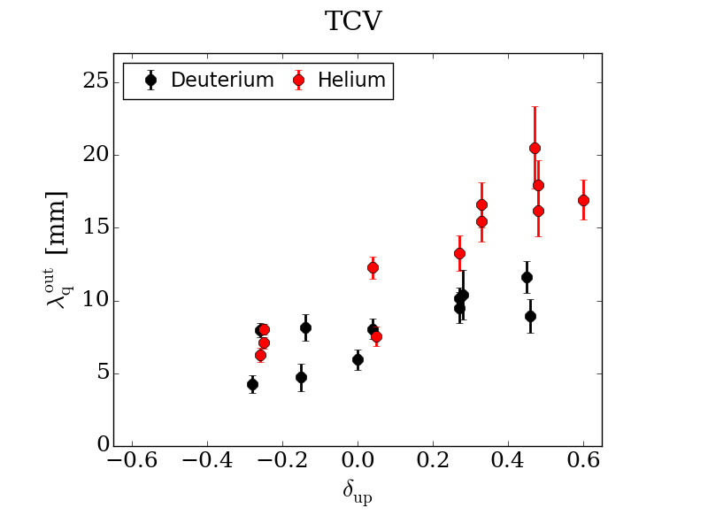
λ_{q} decreases with δ<0
M. Faitsch et al, PPCF 2018

Slide 31
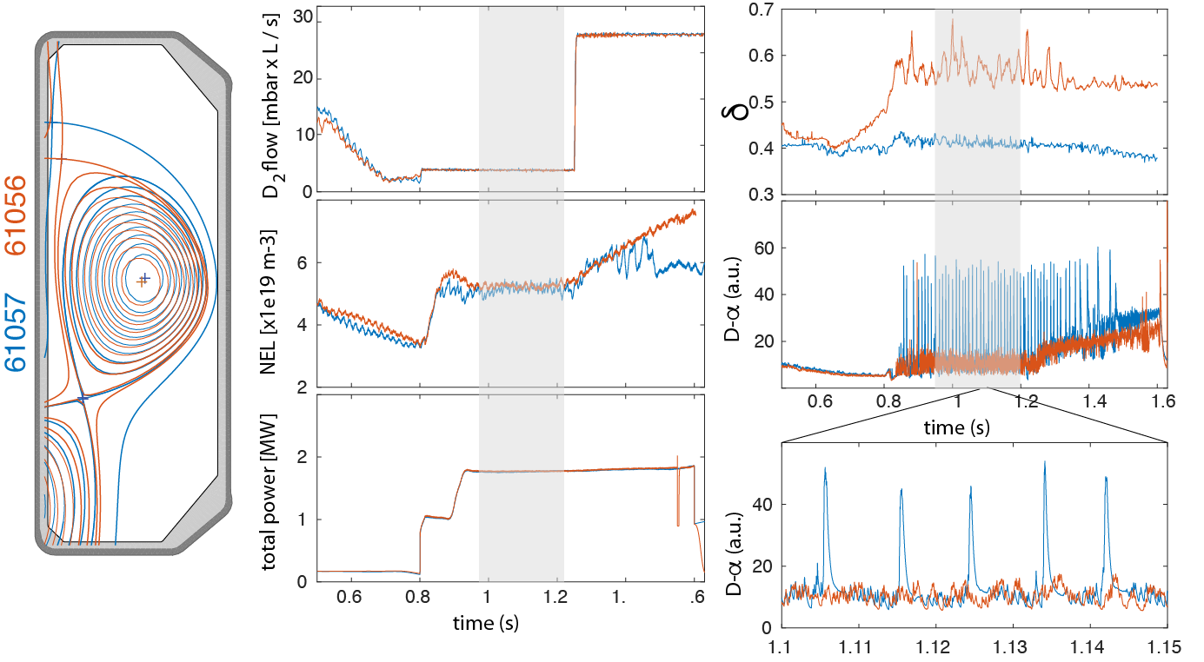
Grassy ELMs with high δ (+ high fueling)
B. Labit, EX/2-5 (Wednesday morning)

Slide 32
TCV science: outline
Scientific mission
Scientific results
  Disruptions and runaway electrons
  Heat exhaust and edge physics
  Integrated reactor scenarios
  Pedestal and core physics
  The uses of triangularity
  A highly alternative configuration
Summary and outlook

Slide 33
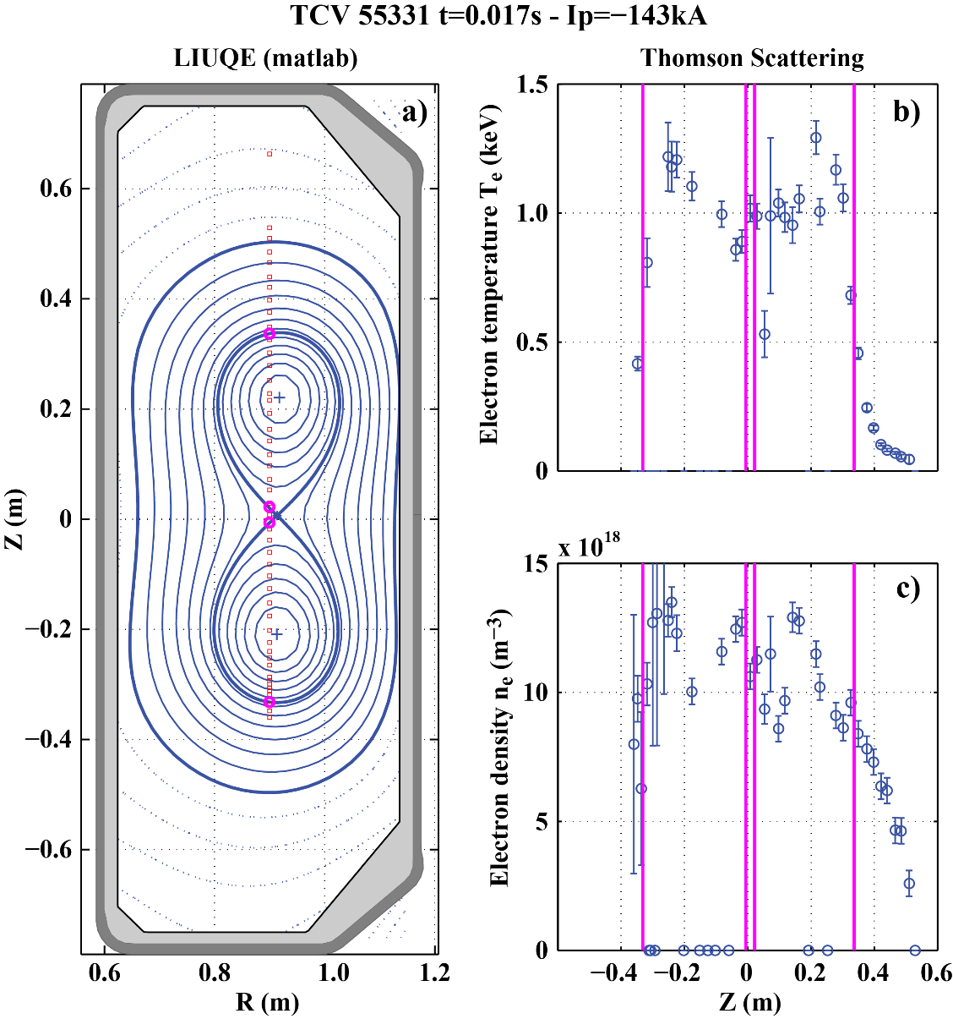
Doublet: an old idea for a possible future
The expected benefit:
higher vertically-stable elongation;
extensive surface wetted by mantle
The difficulty: coalescing instabilities
Achieved transiently with ECRH,
up to 270 kA
Transport barrier in mantle
 similar stored energy in two lobes
B. Duval, EX/P1-6 (Tuesday morning)

Slide 34
Summary of highlights
Demonstration of disruption avoidance and mitigation
and of runaway-electron control
Detachment studies have begun in H-mode in conventional and alternative configurations
Nearly non-inductive steady-state H-mode
Documented and successfully modeled pedestal response
to fueling and seeding
Characterized and modeled negative-triangularity performance:
higher confinement, lower turbulence, mitigated ELMs, but smaller λ_{q}
Grassy ELM regime at high triangularity
Achieved doublet configuration

Slide 35
TCV contributions
  EX/P1-6: B.P. Duval, “Singlet Breakdown Optimization to a Doublet Plasma Configuration on the TCV Tokamak”, Tue am
  EX/P1-19: C. Theiler, “SOL Transport and Detachment in Alternative Divertor Configurations in TCV L- and H-Mode Plasmas”, Tue am
  EX/P1-25: M. Kong, “Control of NTMs and Integrated Multiactuator Control on TCV”, Tue am
  EX/P1-30: C. Piron, “Extension of the Operating Space of High-β Fully Noninductive Scenarios on TCV Using Neutral Beam Injection”, Tue am
  EX/2-5: B. Labit, “Plasma Shape and Fuelling Dependence on the Small ELM Regime in TCV and AUG”, Wed am
  EX/P8-13: N. Vianello, “SOL Transport and Filamentary Dynamics in High Density Tokamak Regimes”, Fri pm
  EX/P8-22: L. Frassinetti, “Role of the Pressure Position on the Pedestal Stability in AUG, JET-ILW and TCV in Deuterium and Hydrogen Plasmas and Implications for ITER”, Fri pm
  EX/P8-24: B. Geiger, “Fast-Ion Confinement in Low Collisionality Discharges at ASDEX-Upgrade and TCV”, Fri pm
  FIP/P8-7: A. Fasoli, “TCV Heating and Divertor Upgrades”, Fri pm

