Slide 1
High-temperature creep properties of NIFS-HEAT-2 high-purity low-activation vanadium alloy
T. Nagasaka^{a, b}, T. Muroga^{a, b}, T. Tanaka^{a, b}, A. Sagara^{a, b}, K. Fukumoto^{c}, P. F. Zheng^{d}, and R. J. Kurtz^{e}
ªNational Institute for Fusion Science
^{b}The Graduate University for Advanced Studies
^{c}Research Institute of Nuclear Engineering, University of Fukui
^{d}Southwestern Institute of Physics
^{e}Pacific Northwest National Laboratory

Slide 2
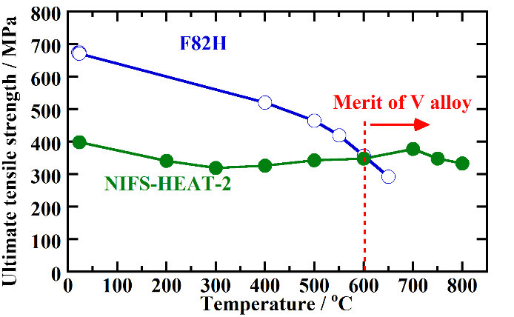
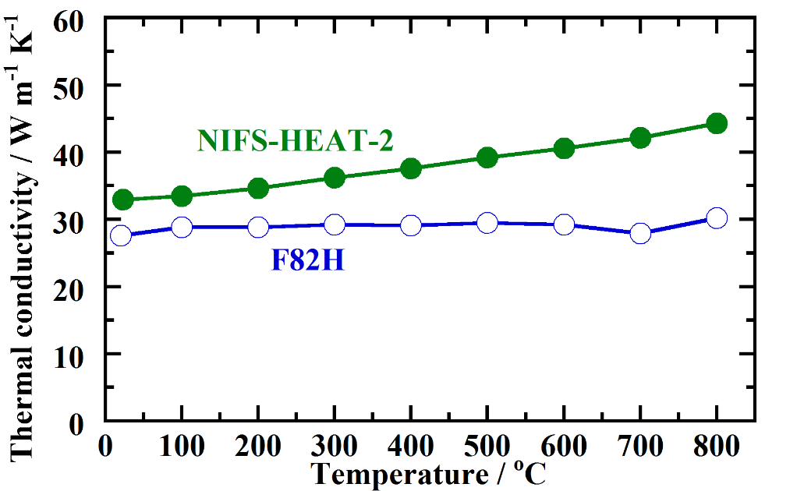
Vanadium alloy is one of options Back-up and alternative to ferritic steels
Back-up if the ferromagnetism causes big problems
No magnetization
 | SS316 | V alloy (NIFS-HEAT-2)
Magnetic permeability (RT) | 1.004 @H=200 Oe | 1.0005 @H=1300 Oe
Alternative for higher thermal efficiency blanket
Stronger above 600ºC
Higher thermal conductivity
ferritic steel
Fig. Tensile strength
Fig. Thermal conductivity

Slide 3
Scale-up of alloy production is ongoing in the world
Scale-up for V alloy was pursued in the US for the first time. Fabrication technology for 1.2 ton-scale melting and breakdown process have been developed.
Development of advanced technology for purification, joining and coating are ongoing in the world
1995
2000
2005
2010
Project
500, 1200 kg
US832665, 832864, V-4Cr-4Ti, US-DOE
US-DOE Fusion
30, 160 kg
NIFS-HEAT-1 & 2, V-4Cr-4Ti, NIFS, Japan
NIFS Fusion Eng.
42, 110 kg
RF-VVC2 & 3, V-(4-8)Cr-(4-5)Ti, A. A. Bochvar Inst., RF
Fusion & FBR
30 kg
SWIP-30, V-4Cr-4Ti, SWIP, China
Fusion HL-2A
30 kg
CEA-J57, V-4Cr-4Ti, CEA Saclay, France
SFR & GFR
Fig. Activities with the fabrication scale of 30 kg or more

Slide 4
The highest-purity vanadium alloy in the world: NIFS-HEAT-2
ID | Country | Fabrication size / kg | Alloying elements / mass% |  |  | Interstitial impurities / mass ppm
 |  |  | V | Cr | Ti | C | N | O | C+N+O
NIFS-HEAT-2[1] | Japan | 166 | Bal. | 4.02 | 3.98 | 69 | 122 | 148 | 339
US832665[2] | USA | 500 | Bal. | 3.25 | 4.05 | 170 | 100 | 330 | 600
RF-VVC3[3] | Russia | 110 | Bal. | 3.76 | 4.64 | 290 | 100 | 200 | 590
SWIP-30[4] | China | 30 | Bal. | 3.81 | 3.92 | 130 | 20 | 270 | 420
CEA-J57[5] | France | 30 | Bal. | 3.76 | 3.93 | 70 | 110 | 290 | 470
ID | Harmful radioactive impurities / mass ppm
 | Al | Co | Nb | Ni | Mo | Al+Co+Nb+Ni+Mo
NIFS-HEAT-2 | 59 | 0.7 | 0.8 | 7 | 24 | 92
US832665 | 355 | 0.295 | 60 | 9.6 | 315 | 740
RF-VVC3 | 240 |  | < 10 | < 5 | 68 | 308
SWIP-30 | 100 |  |  | 82 | 35 | 217
CEA-J57 | 190 | 0.4 | < 10 | 17 | 75 | 282
V
a
O
Nb
Both interstitial impurities and radioactive impurities are successfully reduced using industrial-scale technologies
Substitutional
solute
Interstitial solute:
Much hardening
[1] T. Nagasaka et al., J. Plasma and Fusion Res. SERIES, 5 (2002) 545., [2] M. L. Grossbeck et al., J. Nucl. Mater., 258-263 (1998) 1778., [3] M. M. Potapenko et al., ICFRM-14, Sep. 6-11, 2009, Sapporo, Japan., [4] H. Y. Fu et al., J. Nucl. Mater. 442 (2013) S336., [5] V. Duquesnes et al., J. Nucl. Mater. 426 (2012) 96.
Fig. Lattice of V alloy

Slide 5
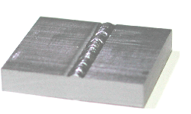
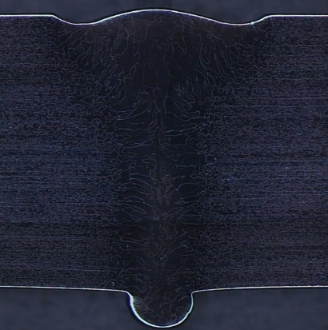
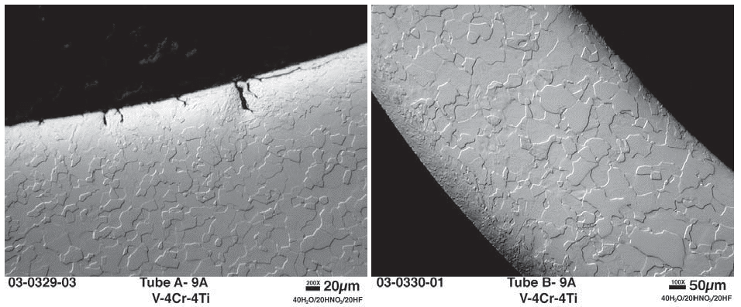
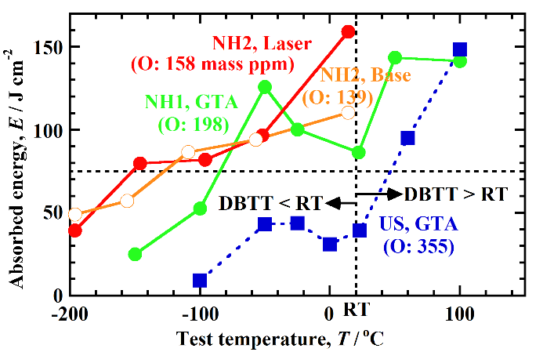
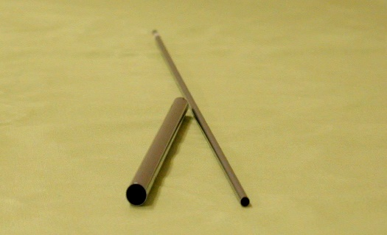
Many properties have been improved by the purification - Interstitial impurity effect -
Weldability
IAEA FEC 2000 & 2004
Workability
Defects on tube wall
5 mm
US
C+N+O: ~1380
mass ppm
NH2
C+N+O: 1174
Fig. Laser weld and its cross section
9 rolling +
10 annealing
1 mm
Fig. Cross section after tubing at RT[1]
C+N+O: 313-570
Plates: 0.25-25.4 mm t
Wires: φ2, 8 mm
Tubes: φ4.57 x 0.25t,
φ10 x 0.5t mm
Fig. Various products of NH2
[1] Rowcliffe et al., Fusion Mater. Semi-annual Progress Rep., US-DOE/ER-0313/34 (2003) 6.
Fig. Impact absorbed energy of weld joint
The reduction of interstitial impurities enabled welding and room-temperature heavy working

Slide 6
Low-activation characteristics have been improved by the purification - Metallic impurity effect -
Low-activation characteristics
The reduction of the harmful high activation impurities resulted in one-order smaller contact dose rate compared with US alloy after 100 y cooling
NH2 satisfies the quasi-hands-on limit, 10⁻⁴ Sv h⁻¹, where material recycling is possible with simple radiation shields, such as 4 cm-thick lead blocks
One order reduction at 100 y
Remote recycling
Quasi-hands-on recycling
US
RF&CEA
NH2
Hands-on recycling
No impurity
Fig. Decay of contact dose rate after the irradiation with neutron wall loading of 1.5 MW/m² for 7.5 y (110 dpa)

Slide 7
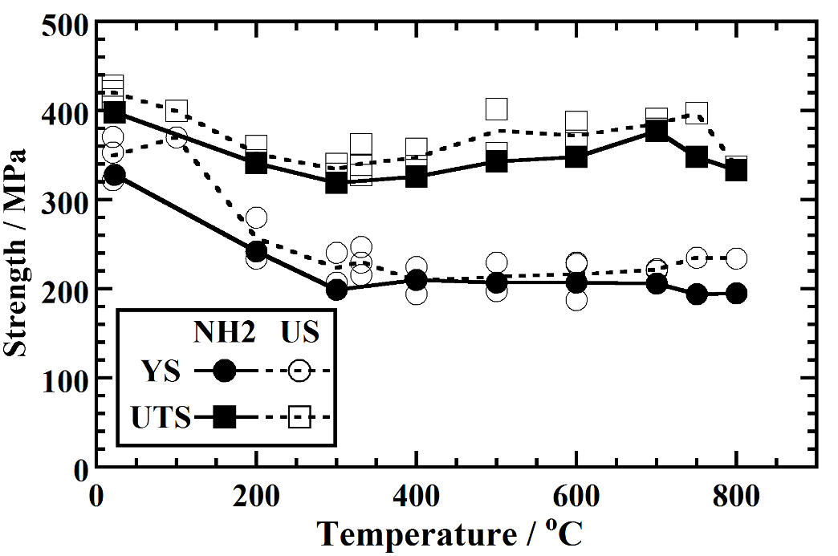
A big concern: possible degradation of high-temperature strength due to purification softening
Fig. Comparison of yield strength (YS) and ultimate tensile strength (UTS) of NIFS-HEAT-2 (NH2) and US832665 (US) in tensile tests
Degradation of yield strength was observed at 750 and 800ºC in tensile tests
The degradation is attributed to reduction in interstitial impurity (C, N and O) level

Slide 8
Creep: Deformation under small constant load – Determine the upper limit of operation temperature –
Tensile test:
1 min~1 hr, ~500 MPa
Creep test:
1 day~3 year, ~100 MPa
Creep tests apply small and constant stress, several 10 MPa, which is typical and normal in fusion blanket condition
For blanket design, creep lifetime determines the upper limit for operation temperature
$$Load, P$$
$$Displacement, x$$
$$x$$
$$\frac{dx}{dt}=const.$$
$$Load, P$$
$$P=const.$$
$$P=f\left(x\right)$$
$$x=f\left(t\right)$$
Fixed: Deformation speed
Measured: Load & displacement
Load
Displacement & time
Fig. Principles for tensile tests and creep tests

Slide 9
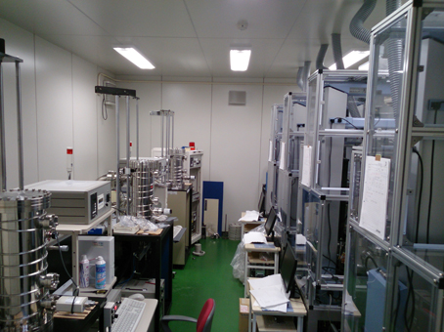
Creep test facility in NIFS: Eight creep testing machines
# | Base mechanics | Temp. | Load | Vacuum
1 | INTESCO MC-100 Dead weight | RT 300-800ºC | 10-500 N | <10⁻⁴ Pa Zr getter
2 | INTESCO MT-100 Crosshead
3 | INTESCO MT-100 Crosshead
4 | SHIMADZU AG-1kNXplus Crosshead | RT 300-900ºC Constant temp. air booth | 50-1,000 N
5
6
7
8 | SHIMADZU AG-20kNXplus Crosshead |  | 200-20,000 N
6
7
5
1
4
2
3
Fig. Creep testing machines
Design features
Miniature specimen: 5 mm in gauge length
High temperature: Max. 900ºC
High vacuum: <10⁻⁴ Pa with Zirconium getter
Materials in ongoing collaborations: V alloys, RAF steels, ODS steels, W alloys, Zr alloys, Nb alloys
International activity: Standardization of small specimen test technique (IAEA-CRP-F1.30.17)

Slide 10
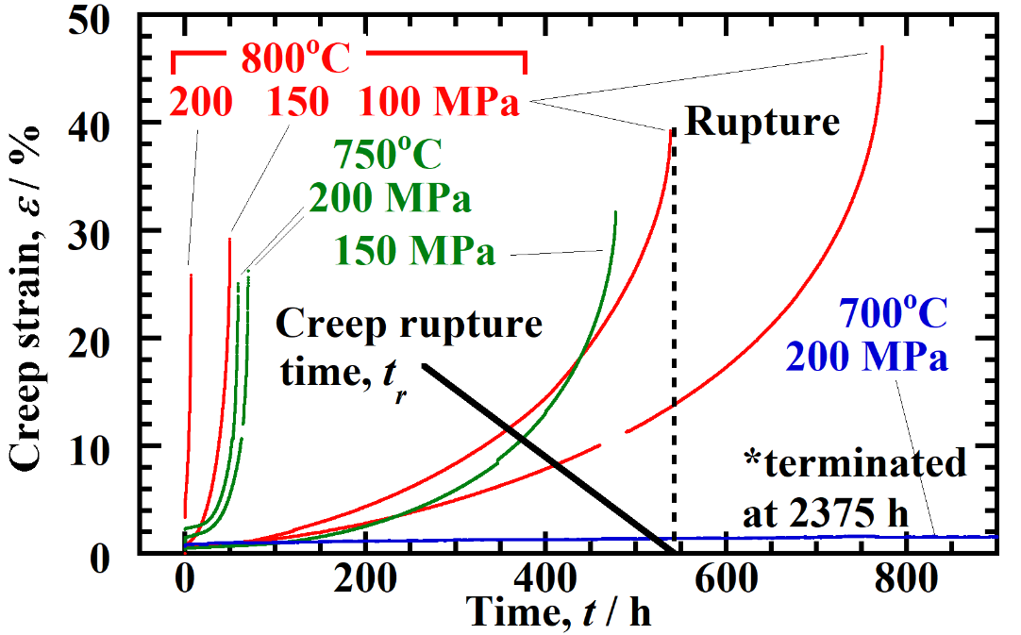
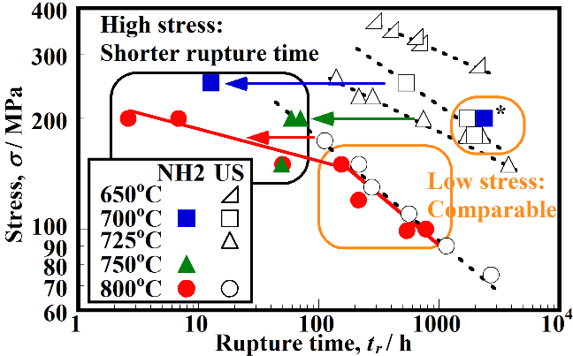
Results of creep tests Purification softening limited at high stress region
Fig. Typical time-strain creep curves
Fig. Creep rupture stress vs. rupture time
In the higher stress region, rupture time of NH2 were shorter than the dashed trend line for US data
→ Purification softening at higher stress region than 150 MPa
Creep rupture time of NH2 in the lower applied stress region was comparable to those of US alloy
→ The purification did not degrade creep strength around 100 MPa
Detailed analysis on mechanisms: the degradation of yield stress might lead to deformation by dislocation glide, in addition to deformation by dislocation climbing, the predominant creep process in this stress and temperature regime

Slide 11
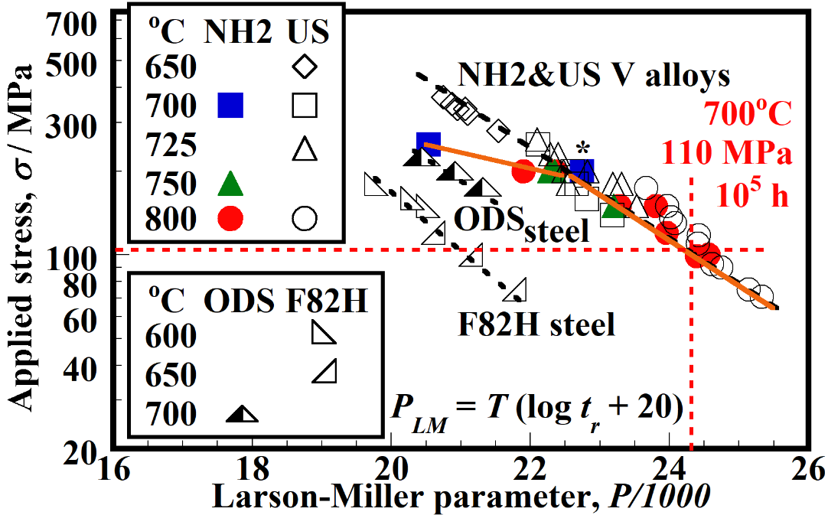
Scaling with Larson-Miller parameter Expected rupture time: 10⁵ h at 700ºC, 110 MPa
$$P_{LM}:Larson−Miller parameter$$
$$T:Test temperature$$
High creep strength
$$t_{r}:rupture time$$
High temperature and long rupture time
Fig. Larson-Miller plot of creep data
Larson-Miller Parameter for time-temperature equivalence analyses
Creep strength of NH2 is degraded at 200 MPa and above, while is still superior to other fusion structural materials, such as RAF & ODS steels, and comparable to US under 100 MPa and below.
100,000 h is expected for creep rupture time at 700ºC under 110 MPa
$$P_{LM}=T\log\left(t_{r}+20\right)$$

Slide 12
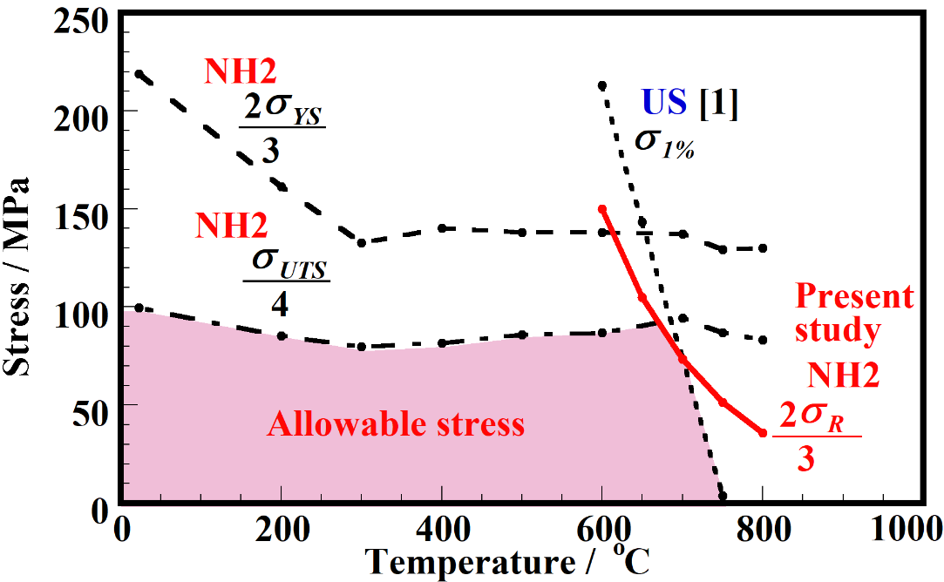
Operation window for vanadium alloys
$$σ_{D}=σ_{1\%}=\frac{2σ_{R}}{3}=73 MPa at 700℃$$
An example: ASME code
$$σ_{D}=min\left\{\frac{2σ_{YS}}{3}, \frac{σ_{UTS}}{4}, σ_{1\%}, \frac{2σ_{R}}{3}\right\}$$
$$σ_{D}:Allowable design stress$$
$$σ_{YS}:Yield stress in tensile tests$$
$$σ_{UTS}:Ultimate tensile stress in tensile tests$$
$$σ_{1\%}:Stress to reach 1 \% strain at 100,000 h$$
$$in creep tests$$
$$σ_{R}:Stress to rupture at 100,000 h in creep tests$$
Fig. Allowable stress window
[1] R. J. Kurtz et al., J. Nucl. Mater. 329-333 (2004) 47.
σ_{1%} has not been obtained for NH2 because of large error for primary creep measurement
σ_{1%} for the US heat was used for preliminary analysis, assuming creep properties of NH2 is similar to the US heat at 100 MPa or less
A design allowable stress, 73 MPa, is possible up to 700ºC

Slide 13
Allowable heat flux to V alloy blanket
One-side heating with edge constraint
$$σ_{th}=\frac{αEΔT}{2\left(1−ν\right)}=\frac{αEq_{S}t_{w}}{2λ\left(1−ν\right)}≤σ_{D}=\text{73 }\text{MPa}$$
First wall
Plasma
& vacuum
Plasma
& vacuum
$$σ_{th}:Thermal stress$$
Coolant
Coolant
$$α:thermal expansion cofficient$$
$$T_{S}$$
$$σ_{th}$$
$$q_{S}$$
$$∆T$$
$$q_{S}$$
$$T_{i}:Temperature$$
$$y$$
$$ν:Poisson^{′}s ratio$$
First wall of blanket
$$x$$
$$T_{C}$$
$$q_{S}:Heat flux,$$
$$z$$
$$z$$
$$t_{w}:Wall thickness of the first wall$$
$$λ:Thermal conductibity$$
$$tw$$
First wall thickness, t_{w} | Allowable heat flux, q_{S}
3 mm | 1 MW m⁻²
5 mm | 0.6 MW m⁻²
700ºC operation of vanadium alloy blanket is feasible
Based on the preliminary analyses for the thermal stress, 700ºC is possible for operation temperature of vanadium alloy blanket, if the heat flux is set as 1 MW m⁻² or less

Slide 14
Conclusions and future plan
The purification for NIFS-HEAT-2 improved many properties, however the concern was degradation of creep strength
No negative effect of purification is observed in creep, if applied stress is around 100 MPa, which is enough for blanket design
According to the creep properties, 700ºC is possible for operation temperature of vanadium alloy blanket
Longer creep tests than 10,000 h are planned in future, to validate the allowable stress in long-term operation
Progress by the present study
Table The longest creep data for vanadium alloys at 700ºC
Condition | NIFS-HEAT-2 |  |  | US832665
 | Uniaxial | Biaxial (Pressurized tube) |  | Uniaxial | Biaxial（Pressurized tube)
Time / h | 2375 | 240 [1] | 2000 [2] | 4000 [3] | 9663 [4] | 2000 [2]
Stress / MPa | 200 | 150 | 110 | 160 | 120 | 120
Atmosphere | Vacuum | Vacuum | Liq. Li | Vacuum | Vacuum | Liq. Li
[1] K. Fukumoto et al., ICFRM-12, De. 5-9, 2005, Santa Barbara, USA., [2] M. M. Li et al., Journal of Nuclear Materials 367-370 (2007) 788., [3] K. Natesan et al., US-DOE/ER 3013/29 (2000) 37., [4] R. Kurtz et al. US-DOE/ER 3013/31 (2001) 7.

