Slide 1
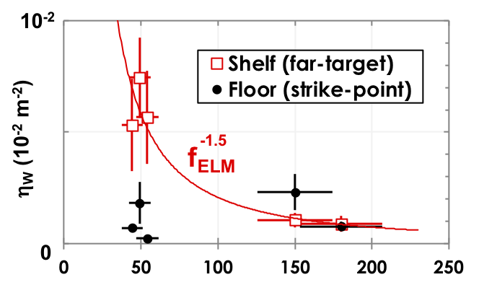
Unique W Target Tile Setup & Impurity Diagnostic in Main SOL Provide New Insight into Divertor Leakage & SOL Transport
Experimental setup & measurements allow divertor leakage discrimination between SP target versus far-target locations
OSP W divertor leakage,$∝η_{W}$, shows inverse trend w/ n_{e,ped} & linear trend w/ P_{SEP}
Far-target W divertor leakage scales inverse to f_{ELM} & has strong correlation with ELM induced arcing at divertor source
Future work: Extend high-Z divertor target compatibility studies using divertor closure (SAS) & >2 W-sources
W leakage vs. ELM frequency
DIII-D
Setup
W-182
Natural
W
ELM frequency (Hz)

