Slide 1
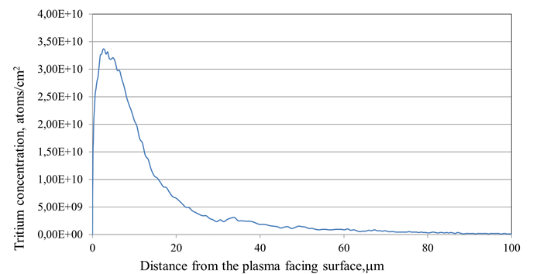
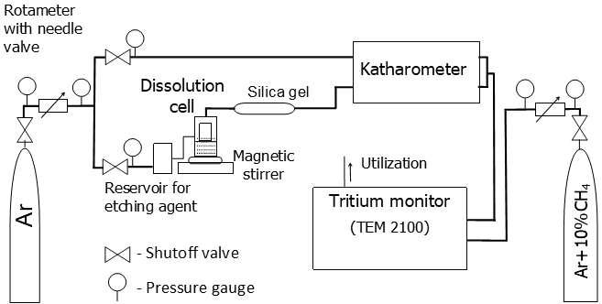
NOVEL METHOD FOR DETERMINATION OF TRITIUM DEPTH PROFILES IN METALLIC SAMPLES
Paper Number | FIP/P3-36
Elina Pajuste^{a,b*}, Gunta Kizaneª, Ieva Igauneª
ª Institute of Chemical Physics, University of Latvia, ^{b}Faculty of Chemistry, University of Latvia,
Novel method for determining the depth profile of tritium in metallic samples has been demonstrated.
Results on tritium profile in neutron irradiated, plasma exposed and tritium gas loaded beryllium have been reported and possible applications of the method for other metallic samples have been tested within this research
Method is based on the simultaneous etching of the metal surface and released tritium measurements.
Successful application of the proposed method has been already demonstrated for various beryllium materials and currently technique for other metallic samples are being developed. For tungsten materials etching is performed electrochemically and removed layer calculated similarly to the beryllium by the amount of evolved hydrogen.
Tritium depth profile in beryllium sample from plasma facing wall of the vacuum vessel of Joint European Torus retrieved after ITER-Like-Wall project 1st campaign in 2012
Experimental set –up
During sample etching evolved hydrogen and released tritium is being carried by Ar flux to measuring detectors
*Corresponding author: elina.pajuste@lu.lv

