Slide 1



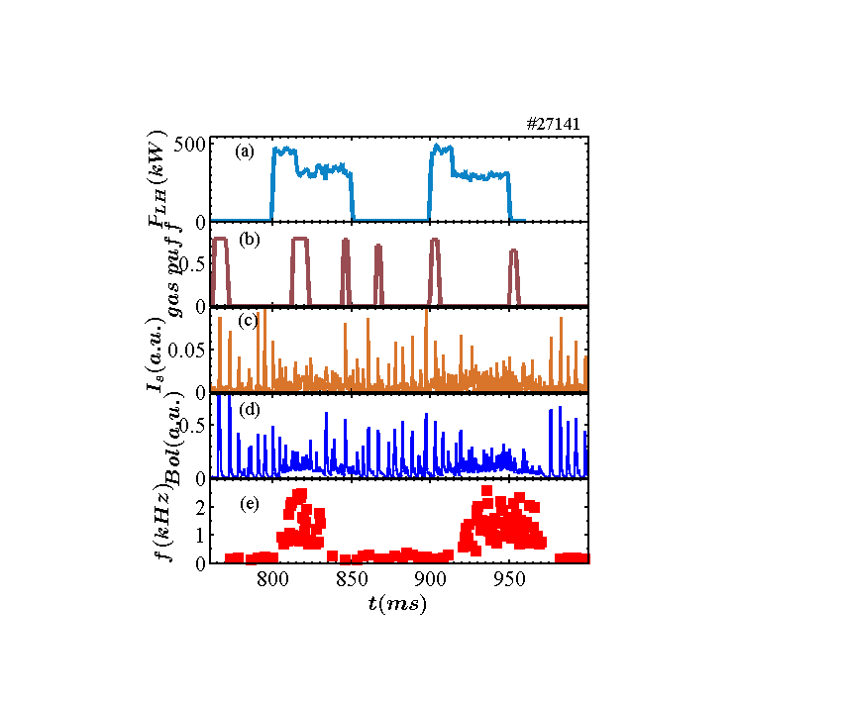


Progress towards development of long pulse ITER operation trough RF heated H-mode experiments in EAST and HL-2A (A. Ekedahl et al., EX/P2-16)
  Fruitful collaboration between EU and China over the last couple of years:
  3.7 GHz LHCD system works successfully in HL-2A: Coupling in H-mode & control of ELMs demonstrated.
  Joint LHCD experiments carried out in EAST and HL-2A: 100 s long H-mode achieved in EAST, sustained primarily by LHCD.
  Modelling of EAST and HL-2A results with EU codes: Experimental trends can be well reproduced.
  Future joint programme can integrate the preparation of HL-2M operation, in order to support ITER and CFETR.
Good wall conditions improves
LH current drive efficiency in EAST
LHCD modifies ELMs in HL-2A

