Slide 1
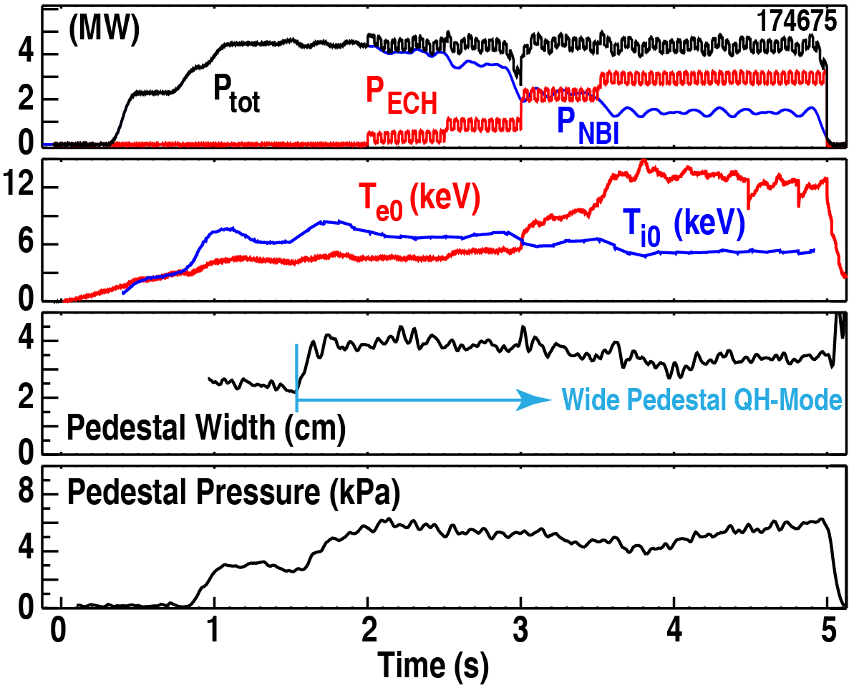
Wide-Pedestal QH-mode Initiated and Sustained with Zero Injected NBI torque throughout, and Sustained with Dominant Electron Heating (77% ECH power)
Achieved zero injected NBI torque throughout
Confinement improves with electron heating
T_{e} internal transport barrier forms due to electron heat pinch
Pinch measured by Fourier analysis: increases R/L_{Te} by 2.4x
Dominantly electron-heated Wide Pedestal QH-mode is an attractive scenario for ITER
Transition from QH-Mode to
65% wider and 60% higher pedestal
H_{98y2} increases 45%
Pedestal regulated by turbulence
No ELMs or low mode number MHD
ITER collisionality
Ernst, Burrell, Petty, Barada, Chrystal et al, EX/2-2
(No ELMs)
D. R. Ernst et al., Viability of Wide Pedestal QH-Mode for Burning Plasma Operation, EX/2-2

