Slide 1
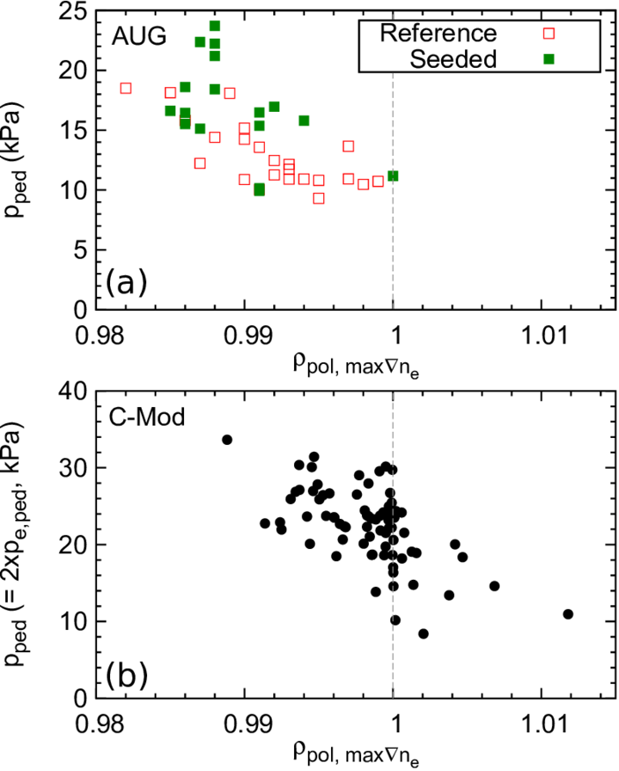
Density position impacts p_{ped} in AUG and C-Mod
Degradation of pedestal top in AUG and C-Mod correlated with outward shift of density profile
Can have different causes:
AUG: linked with high density structure in high-field side SOL (the HFSHD) – proposed to cause diffusive fuelling near separatrix and shift density profile outwards
HFSHD removed by nitrogen seeding -> confinement “improvement”
C-Mod: linked with outer divertor detachment (no observed effect of a similar high density SOL structure on confinement)
Multiple possible origins of the shift point to the requirement of detailed understanding of plasma fuelling

