Slide 1
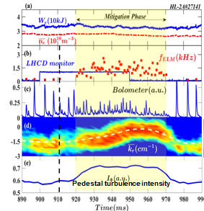
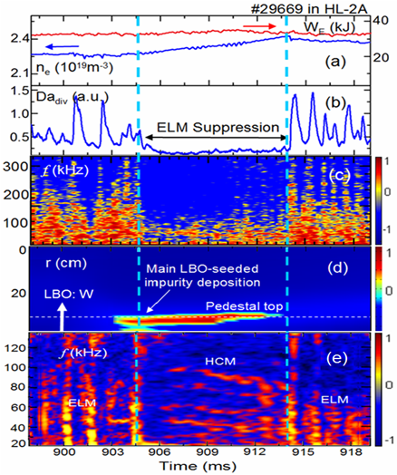
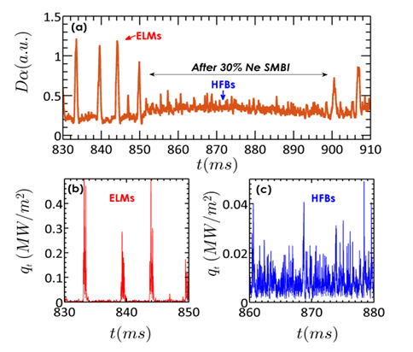
Summary of research highlights on the HL-2A, OV/5-1
ELM control techniques were developed: LHCD, LBO, mixture SMBI
In ELM phase: streamer induces a transport channel from core to edge within a few microsecond
Control of resistive fishbone by ECRH realized on the HL-2A. Wave-particle resonance converts unstable TM to fishbone-like mode.
Found island-width threshold for turbulence modulation. Modulation of ${\tilde{T}}_{e}$ by island only appears in inner half island.
By LHCD,
By LBO W-impurity
By D₂ +Ne(30% ) SMBI
Heat flux
Heat flux

