Slide 1
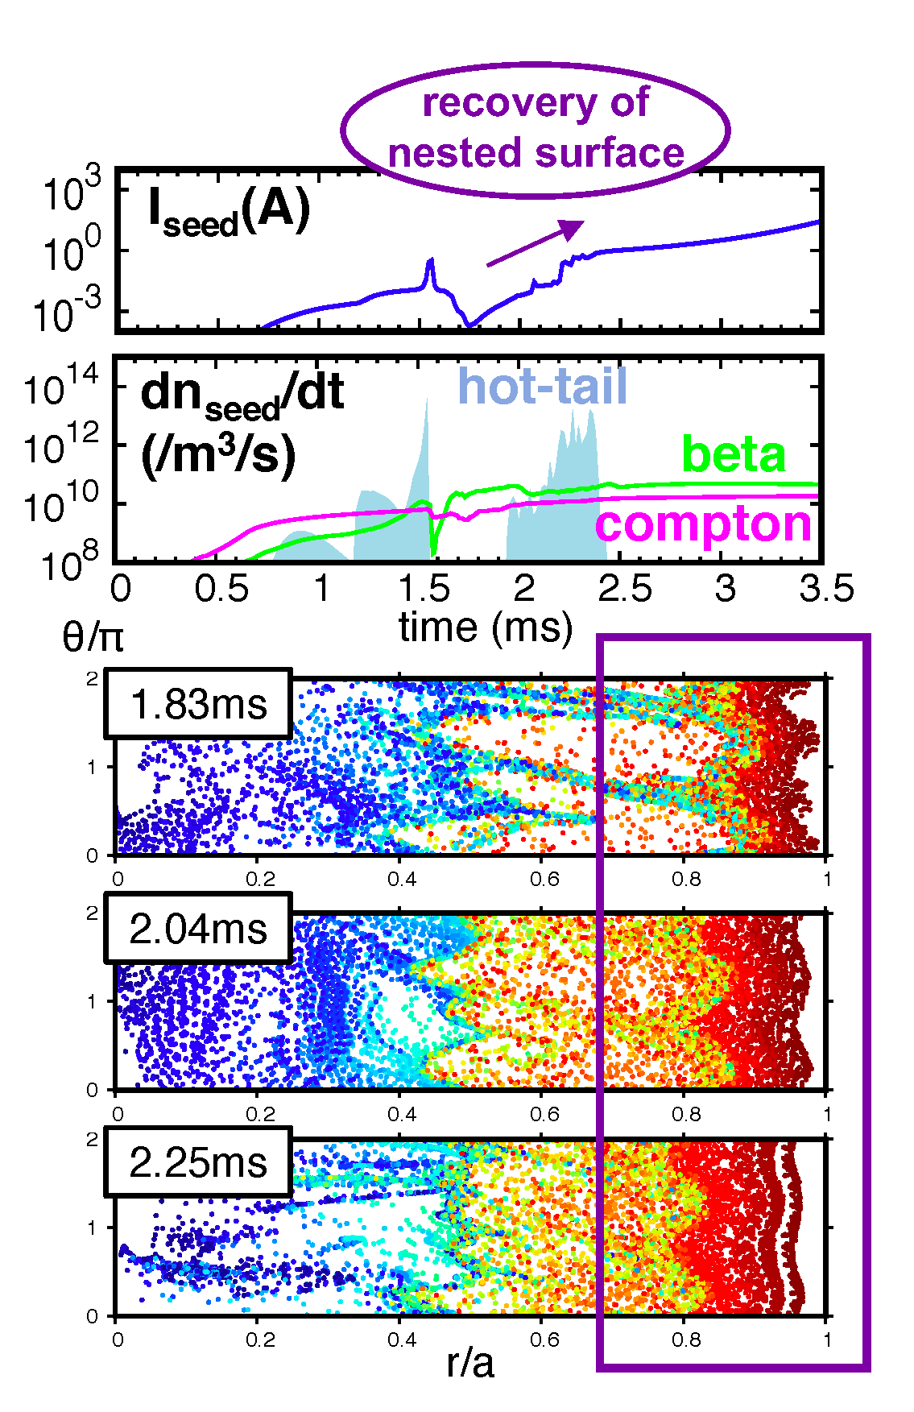
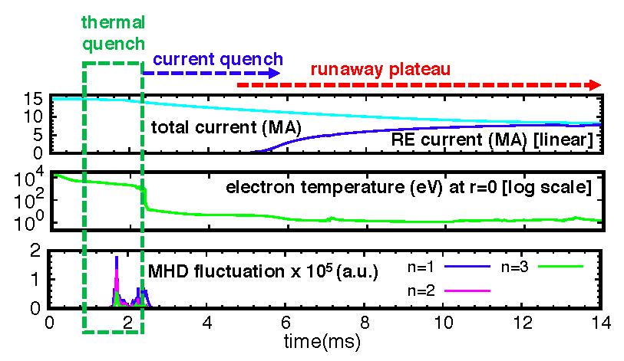
TH/4-2: Self-consistent runaway beam formation in 3D magnetic fields during radiation driven disruptions
A. Matsuyama, N. Aiba, A. Isayama and M. Yagi (QST, Japan)
Runaway avoidance remains as most crucial subject for developing reliable disruption mitigation in ITER
Motivation: Although predominant role of low-n MHD modes for thermal quench has widely been accepted, they have not been taken into account by the prediction of runaway avalanche in ITER.
Highlight: Simulation based on beam fluid model to allow self-consistent simulation of thermal quench MHD, current quench, and runaway generation with ITER-relevant generation mechanisms [Left Fig.].
This new study contributes to improve physics understanding & capability of ITER prediction through self-consistent simulation of:
Hot-tail generation during magnetic surface break-up and recovery [Right Fig.]
Compton scattering and tritium decay
inductance drop due to internal reconnection
reduced ohmic heating, ionization and recombination

