Slide 1
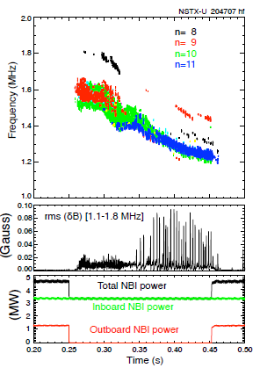
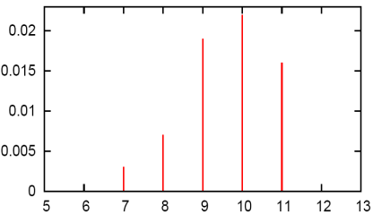
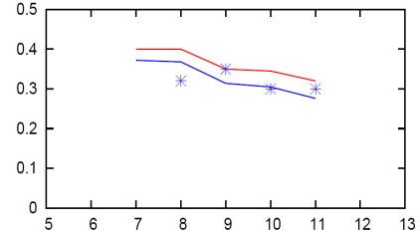
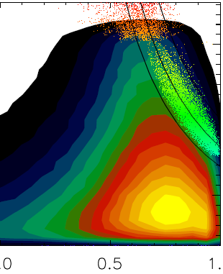
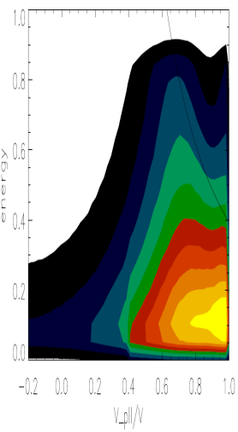
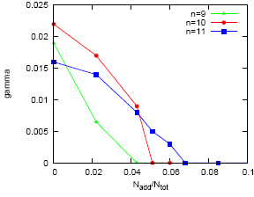
Numerical simulations of GAE stabilization in NSTX-U
E.V. BELOVA, E.D. FREDRICKSON (PPPL), N.A. CROCKER (UCLA), NSTX-U TEAM
HYM #204707 t=0.44
Simulations confirm robust stabilizing mechanism for beam-driven global Alfvén eigenmodes (GAEs) discovered experimentally in NSTX-U, where new beam sources injecting nearly parallel to magnetic field reliably and strongly suppressed unstable GAEs [E. Fredrickson, PRL 2017].
GAEs have been linked to flattening of electron temperature profiles and anomalously low central temperature at high beam power in the NSTX.
Good agreement of simulations with experimental observations from NSTX-U:
- range of toroidal mode numbers, frequencies, and saturation amplitudes of unstable GAEs match the experimentally observed.
A very effective mechanism for stabilizing GAEs - threshold for stabilization of all modes for extra beam is less than 7% of total beam power – demonstrated both experimentally and numerically.
Relevant to ITER, and other fusion devices where super-Alfvénic fast ions might be present.
γ/ω_{ci}
ω/ω_{ci}
t=0.47
- n
t=0.44
(a) Spectrogram on magnetic fluctuations (|n|=8-11 counter-GAEs); (b) Injected beam power; (c) Growth rates and frequencies of unstable counter-GAEs from HYM simulations. Blue line is Doppler-shift corrected frequencies, points – experimental values.
γ/ω_{ci}
N_{add}/N_{tot}
0 0.5 1
0 0.5 1
V|| / V
V|| / V
Fast ion distribution function (a) before and (b) after addition of 5%off-axis injected neutral beam ions; Growth rate of the n=-11(blue), -10(red), -9(green) GAEs vs fraction of outboard beam ion population.

