Slide 1
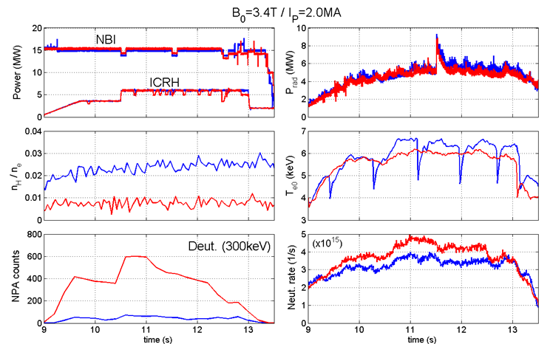
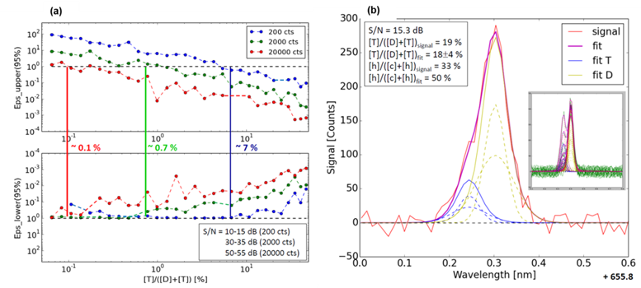
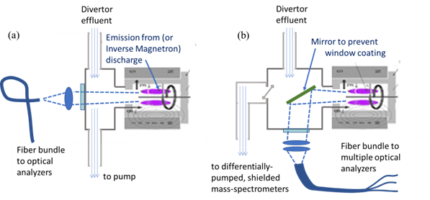
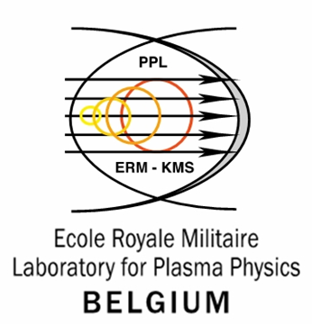
SUBDIVERTOR FUEL ISOTOPIC CONTENT DETECTION LIMIT FOR JET AND IMPACT ON THE CONTROL OF ICRH FOR JET-ILW AND JET-DT OPERATION
The ability to detect and control fuel isotopic content down to a 1% concentration level is important for JET DTE2. A reduction of H minority concentration from ~2% to <~1% greatly impacts the effectiveness of ICRF core heating, while the ability to maintain T or D at or below 1% is critical to limiting DT neutron generation in the DD and TT phases, correspondingly. The subdivertor measurement of (global) isotopic concentration, based on Penning-activated optical spectroscopy, already shown to work in DT environments during DTE1, is now optimized to deliver minimally 1% isotope detection capability and efforts to go below this are under way.
Presently progress as been in the following areas:
Establishing the physics basis of the need to resolve isotopic content down to the 1%-concentration level, including
Impact on the ICRH heating properties in the high-power H-mode plasmas needed for DTE2
Neutron budget control in DD, TT phases (see E. Joffrin et al., this Conference).
Divertor gas analysis system optimization based on DTE1 experience and new methods established since DTE1 - including some for ITER
Re-examination of DTE1 data showed uncertainty in isotopic measurement were as large as the measured values at low (~1%) concentration levels.
New simulation program developed at the CEA: allows to isolated causes of error and can guide design of measurement system upgrade.
Simulation clearly showed that light collection from Penning source to detection is the most significant factor affecting random error.
→ Need to optimize collection and to mitigate losses, some caused the Penning plasma emission source itself (see below)
Divertor Gas Analysis System Upgrade (JET “KT5-Upgrade” Project)
Unlike DTE1, subdivertor gas analysis will have not only the Penning spectroscopy, but also shielded/diff-pumped Mass Spectrometers
Improvements in the Penning source include the use of a mirror to mitigate Penning-coating of the optical window
KT5-Upgrade is prototypical to the so-called ITER DRGA system

