Slide 1
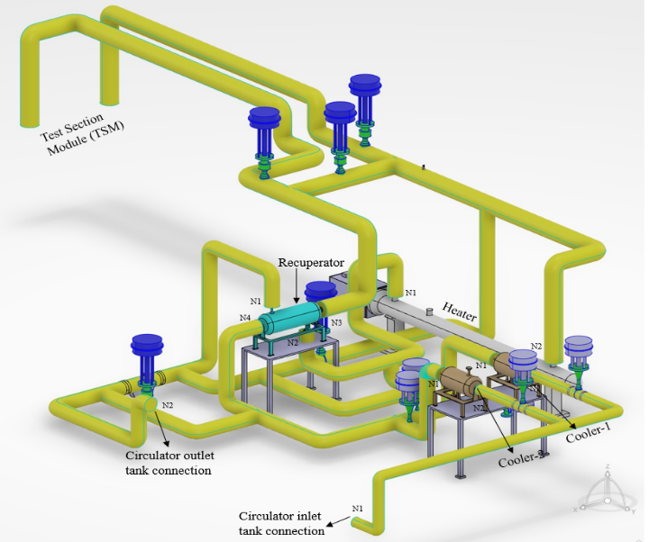
Preliminary Pipe Stress Analysis of High Pressure, High Temperature Experimental Helium Cooling System (EHCL)
Corresponding Author: Aditya Kumar verma
Introduction: Experimental Helium Cooling Loop (EHCL) is a high-pressure high-temperature closed loop helium gas system. This helium loop is similar to the FWHCS and designed mainly for testing various component mock-ups, which are cooled by high temperature and high pressure helium. The Test Section Module (TSM) mock-ups will undergo a series of mock-ups qualification tests for design and performance validations.
Codes and Standards: Process piping code ASMAB 31.3
(Paragraphs 302.3.5 for sustained loads, 302.3.6 for occasional loads and 319.4.4 for thermal expansion loads).
Simplified EHCL model for piping analysis
Software: CATIA V5 (Modelling of EHCL layout preparation)
CAESAR II 5.30 (Pipe stress analysis)
Table: Summary Results of EHCL pipe stress analysis
Load Cases | Available Stress margin % | Code Stress% | Displacements |  |  | Reaction Forces
 |  |  | D_{x}, mm | D_{y}, mm | D_{z}, mm | F_{x}, N | F_{y}, N | F_{z}, N
Sustained Load (W+P) | 68.5 | 31.5 | -1.28 | -0.89 | -9.34 | 598 | -318 | -792
Thermal Load (T) | 43.1 | 56.9 | -8.43 | 15.20 | 17.26 | -1437 | -1931 | -6237
Occasional Load (W+P+ SL) | 29.4 | 70.6 | 9.80 | 19.72 | 21.76 | 1638 | 1044 | 1024
The pipe stress analysis is performed for sustained and occasional (earthquake) load combinations of various operating cases envisaged for TSM mock ups.
The calculated stresses are in acceptable limit. The least available value of stress margin (about 0.29 times the allowable stress) and the corresponding displacement of 9.8 mm (x direction), 19.72 mm (y direction) and 21.76 mm (z direction) is observed in heater to TSM line.
The obtained reaction and moment force results are needed as an input for the selection of pipe supports and location of supports.
This pipe stress analysis results are used in the optimization of EHCL layout and further these inputs would be utilized in final design phase.

