Slide 1











Tritiated dust in tokamak
C Grisolia¹, S. Peillon², E. Bernard¹, A. Autricque¹, C. Arnas³, T. Ascente⁴, L. Couedel³, G. Dinescu⁴, Ph. Delaporte⁵, S. Feuillastre⁶, P. Fournier⁷, N. Herlin⁸, V. Malard⁹, T. Orsiere¹⁰, G. Pieters⁶, J. Rose¹¹, B. Rousseau⁶, D. Vrel¹², K. Liger¹³, C Decanis¹⁴, D Lambertin¹⁵, F. Gensdarmes²
¹ CEA, IRFM, F-13108 Saint Paul lez Durance, France
²IRSN, PSN-RES/SCA, BP68, 91192 Gif-sur-Yvette, France
³ PIIM, Faculté de Saint Jerôme, F-13397 Marseille cedex, France
⁴ NILPRP, 409 Atomistilor Street, 77125 Magurele, Bucharest, Romania
⁵ Aix-Marseille Université/CNRS, Laboratoire LP3 (UMR 7341), F-13288 Marseille, France
⁶CEA Saclay, JOLIOT, Building 547, 91191 Gif-sur-Yvette, France
⁷ LAMES, MMSH, 5 Rue du Chateau de l’horloge, BP647, 13094, Aix En Provence, France
⁸ CEA, IRAMIS, CEA-Saclay, 91191 Gif/Yvette, France
⁹ CEA, BIAM, F-13108 Saint Paul lez Durance, France
¹⁰ IMBE, Faculté de Saint Jerôme, F-13397 Marseille cedex, France
¹¹ CEREGE, Technopôle de l’Arbois, F-13545 Aix en Provence, France
¹² LSPM, UPR 3407 CNRS, 93430 Villetaneuse, France
¹³CEA, DEN, DTN/SMTA/LIPC Cadarache, F-13108 Saint Paul-lez-Durance, France
¹⁴CEA, DEN/DDCC/UADC/BD Cadarache, F-13108 Saint Paul-lez-Durance, France
¹⁵CEA, DEN/DE2D/SEAD/LCBC Marcoule, F-30207 30207 Bagnols-sur-Cèze, France

Slide 2


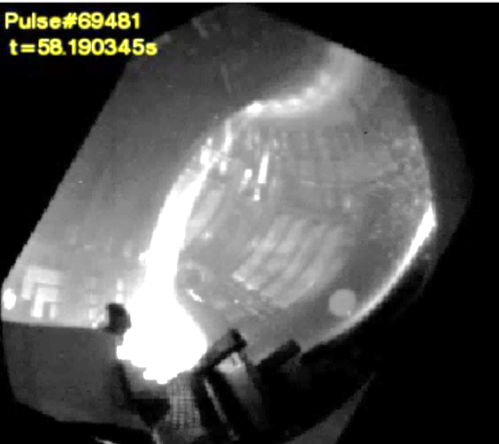
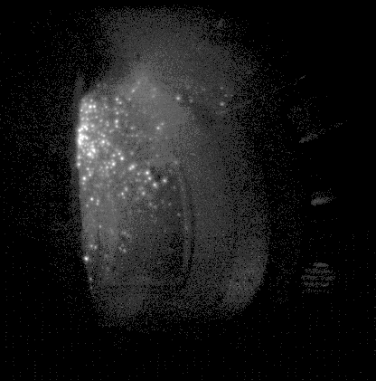
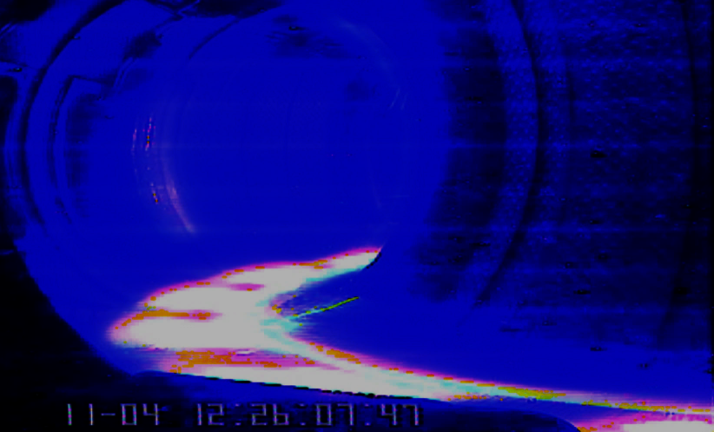
Evidence of dust creation processes
JET
WEST
Tore Supra
ELM impact
Runaway electrons impact
Broken of fragile layer
Dust creation processes in operating tokamaks (examples)

Slide 3
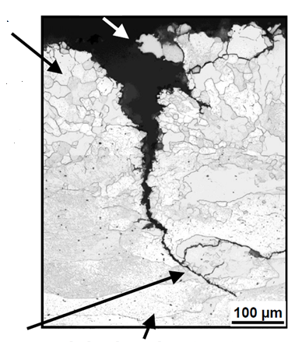
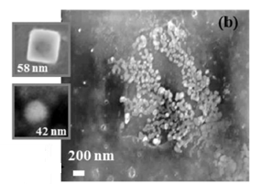
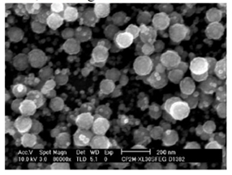
Evidence of dust creation processes
JET
WEST
Tore Supra
ELM impact
Runaway electrons impact
Broken of fragile layer
Dust creation processes in operating tokamaks (examples)
Dust creation processes observed in dusty plasma lab. (ITER relevant conditions?)
W Accretion in plasma edge
Destruction of Recrystallized W
Explosion of blisters

Slide 4
Evidence of dust creation processes
JET
Tore Supra
  By ELM interaction:
  Mainly droplets of large size:
  low Specific Surface Area (SSA) ⇔ low reactivity
ELM impact
Dust creation processes in operating tokamaks (examples)
Dust creation processes observed in dusty plasma lab. (ITER relevant conditions?)

Slide 5
Evidence of dust creation processes
JET
Tore Supra
  By ELM interaction:
  Mainly droplets of large size:
  low Specific Surface Area (SSA) ⇔ low reactivity
ELM impact
Dust creation processes in operating tokamaks (examples)
Dust creation processes observed in dusty plasma lab. (ITER relevant conditions?)
  By accretion of matter in plasma edge:
  Due to High density, low temperature, long shot operation
  small particles (less than 1 µm) with fractal surface structure: high SSA ⇔ high reactivity
W Accretion in plasma edge

Slide 6
Consequences of the numerous dust creation processes
Large set of dust creation processes ➔ large set of dust properties
  Particles from nm to cm size
  Different compositions
  Different chemical reactivity

Slide 7
Consequences of the numerous dust creation processes
Large set of dust creation processes ➔ large set of dust properties
  Particles from nm to cm size
  Different compositions
  Different chemical reactivity
Some dust production processes could be unexpected in ITER
  As accretion in the plasma edge or explosion of blisters
  Collection of Dust in current tokamaks necessary
  But not at all sufficient!
      (produced not in the ITER conditions, untritiated)
  ➔ Needs of ITER dust collection

Slide 8
Consequences of the numerous dust creation processes
Large set of dust creation processes ➔ large set of dust properties
  Particles from nm to cm size
  Different compositions
  Different chemical reactivity
Some dust production processes could be unexpected in ITER
  As accretion in the plasma edge or explosion of blisters
  Collection of Dust in current tokamaks necessary
  But not at all sufficient!
      (produced not in the ITER conditions, untritiated)
  ➔ Needs of ITER dust collection
Main dust properties for safety studies
  Chemical reactivity (linked to SSA)
  Chemical Composition (metallic dust)
  Tritium inventory

Slide 9
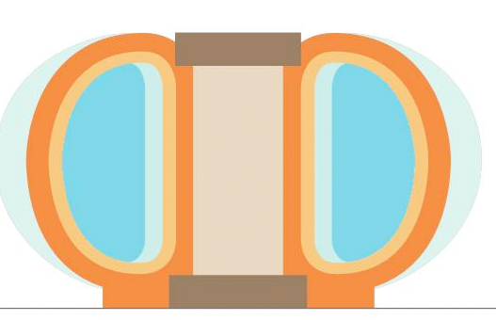
Dust in tokamak:
Scope of this work/outline
T
T
1- Dust tritium
inventory

Slide 10
Dust in tokamak:
Scope of this work/outline
2- Dust adhesion/
Aerosol creation
(T source term)
LOVA
T
T
T
1- Dust tritium
inventory
(LOVA: Loss Of Vacuum Accident)

Slide 11

Dust in tokamak:
Scope of this work/outline
2- Dust adhesion/
Aerosol creation
(T source term)
LOVA
T
T
3-T measurement
In aerosol
T
T
1- Dust tritium
inventory

Slide 12

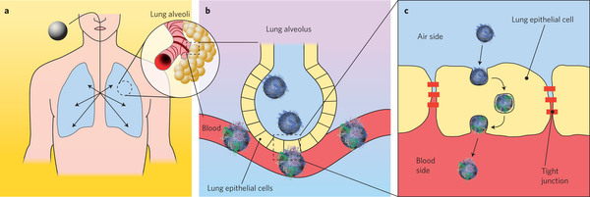
Dust in tokamak:
Scope of this work/outline
2- Dust adhesion/
Aerosol creation
(T source term)
LOVA
T
T
inhalation
3-T measurement
In aerosol
T
T
1- Dust tritium
inventory
4-toxicity
studies

Slide 13
Dust in tokamak:
Scope of this work/outline
2- Dust adhesion/
Aerosol creation
(T source term)
LOVA
T
T
inhalation
3-T measurement
In aerosol
T
T
1- Dust tritium
inventory
Dust collection
(maintenance)
4-toxicity
studies
5-Waste management

Slide 14
Dust in tokamak:
Scope of this work/outline
2- Dust adhesion/
Aerosol creation
(T source term)
LOVA
T
T
inhalation
3-T measurement
In aerosol
T
T
1- Dust tritium
inventory
Dust collection
(maintenance)
4-toxicity
studies
5-Waste management

Slide 15

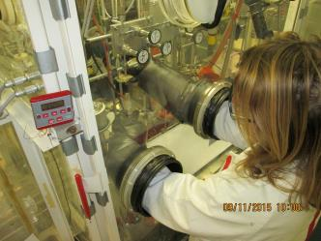
1- Dust Tritium Inventory:
a- W results
Tritium inventory in W powder from experiment:
  From 1 GBq/g to 20 GBq/g (depending on SSA)
  2-3 times greater than massive samples
  Trigger by surface effects
  However, 1000 kg of W dust ➔ 55 g of T
  (1000 kg = safety limit of dust in Vacuum vessel)

Slide 16
1- Dust Tritium Inventory:
a- W results b- Be extrapolation
Tritium inventory in W powder from experiment:
  From 1 GBq/g to 20 GBq/g (depending on SSA)
  2-3 times greater than massive samples
  Trigger by surface effects
  However, 1000 kg of W dust ➔ 55 g of T
Tritium inventory in Be:
  By extrapolation from existing results on massive materials:
    J Likonen PSI 2016: 0.006 to 0.5 D/Be (JET results)
    R Doerner, Nuc. Fus, 2009: 0.1 to 0.3 D/Be (Lab. results)
    Be dust quantity corresponding to Tritium in vessel safety limit
VV tritium quantity (g) | Atomic Ratio (T+D)/Be | VV Be dust quantity (kg)
700 | 0.01 | 420
700 | 0.1 | 42
700 | 0.3 | 14 (40 TBq/g)
R&D on Be dust needed
Notes:
Interesting to see the dust quantity correponding to tritium safety limit
Small quantity of Be dust that can lead to dust a dust measurment open issues

Slide 17
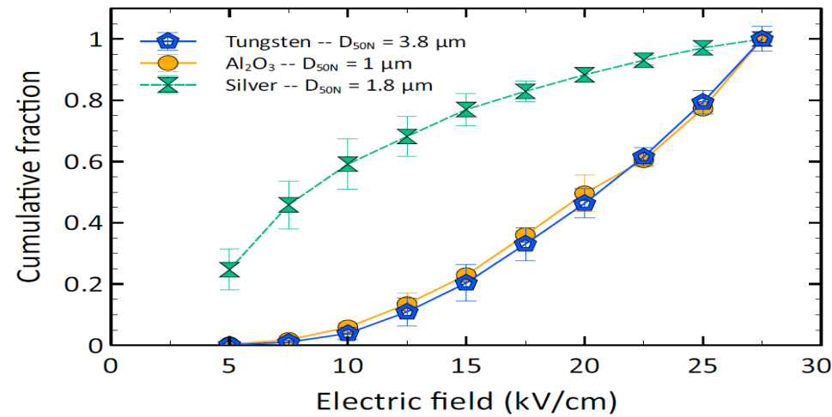
2- Dust adhesion/aerosol creation:
a-Metallic dust electrically insulated
Metallic dust (W/Be) covered by an oxide layer
Mobilization experiment by electric forces
      ➔W dust behave like dielectric dust (aluminum oxide)
      ➔ Strong consequences on dust behavior in tokamak (Be, W)
Cumulative fraction of dust detached by applied electric field
Ag
W
Cumulative Fraction
Al₂O₃
Electric Field (kV/cm)

Slide 18
2- Dust adhesion/aerosol creation:
b- Tritiated metallic dust positively charged
Dust covered by an oxide layer ➔ dust electrically insulated
Tritium decay:
Tritium ➔ ³He⁺ + β + ν_{e} + 325 mW/g
  half life: 12.3 y, <E_{mean}> = 5.7 KeV
      ➔ dust positively charged
Notes:
Rappel de l’expérience fondatrice!

Slide 19
2- Dust adhesion/aerosol creation:
c-Not all β emission contributes to dust charging
Dust covered by an oxide layer ➔ dust electrically insulated
Tritium decay:
Tritium ➔ ³He⁺ + β + ν_{e} + 325 mW/g
  half life: 12.3 y, <E_{mean}> = 5.7 KeV
      ➔ dust positively charged
What is the maximum path (Lmax) of the β emission in W and in Be?
Electron Energy (KeV) | Lmax for W (nm) | Lmax for Be (nm)
5.7 | 43 | 450
➔ not all the electrons escaping tritiated dust
in W, only an external layer of ~50 nm contributes to the dust charging

Slide 20
2- Dust adhesion/aerosol creation:
d-Electrical self charging rate of tritiated W dust
Calculation of the dust charge
(Monte Carlo calculation including tritium β energy spectrum)
55 000 positive charges per day (5 µm)

Slide 21
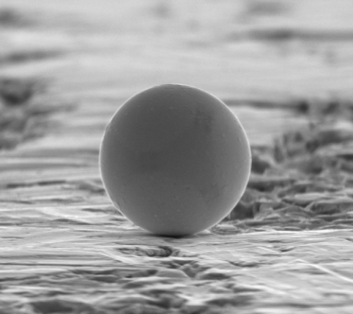
2- Dust adhesion/aerosol creation:
Adhesion of uncharged insulated particle
Balance of forces on a W particle
F_{vdW} = van Der Walls force = A D_{p}/12 z²
A = Hamaker constant
= depends on material
= 1.3 - 4.4 x 10⁻¹⁹ J for W
z = separating distance
= 0,4 nm (ideal surface)
F_{g} = gravity = mg (negligible)
D_{p} = particle diameter, Q_{p} = 0
5 µm
β emission
WO₃ layer
F_{VdW}

Slide 22
2- Dust adhesion/aerosol creation:
Adhesion of uncharged insulated particle
Balance of forces on a W particle
F_{vdW} = van Der Walls force = A D_{p}/12 z²
A = Hamaker constant
= depends on material
= 1.3 - 4.4 x 10⁻¹⁹ J for W
z = separating distance
= 0,4 nm (ideal surface)
F_{g} = gravity = mg (negligible)
D_{p} = particle diameter, Q_{p} = 0
5 µm
β emission
WO₃ layer
F_{vdW}
F_{vdW} difficult to model (A, z, material properties):
Direct measurement (using AFM technique)
(AFM: Atomic Force Microscope)

Slide 23
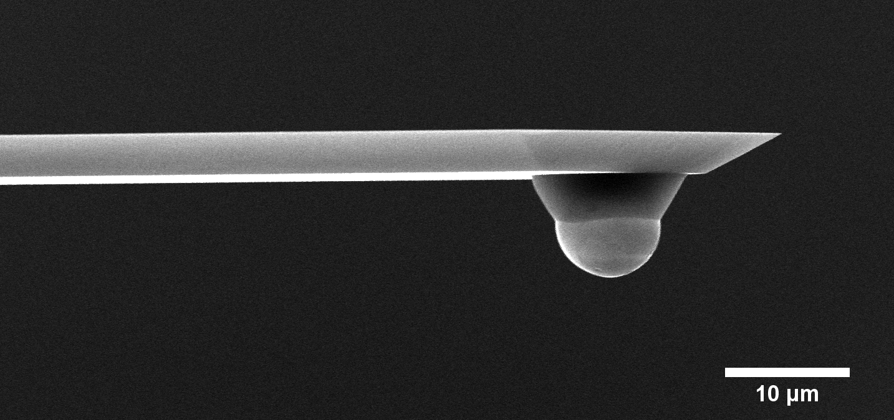
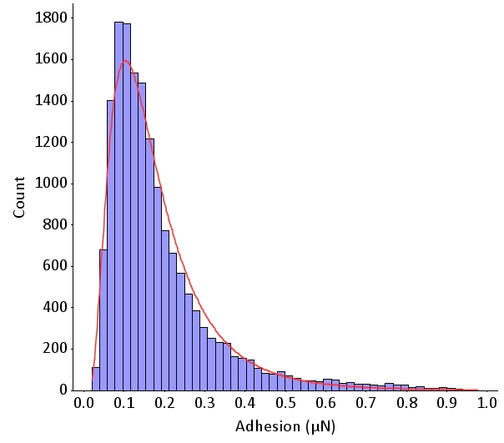
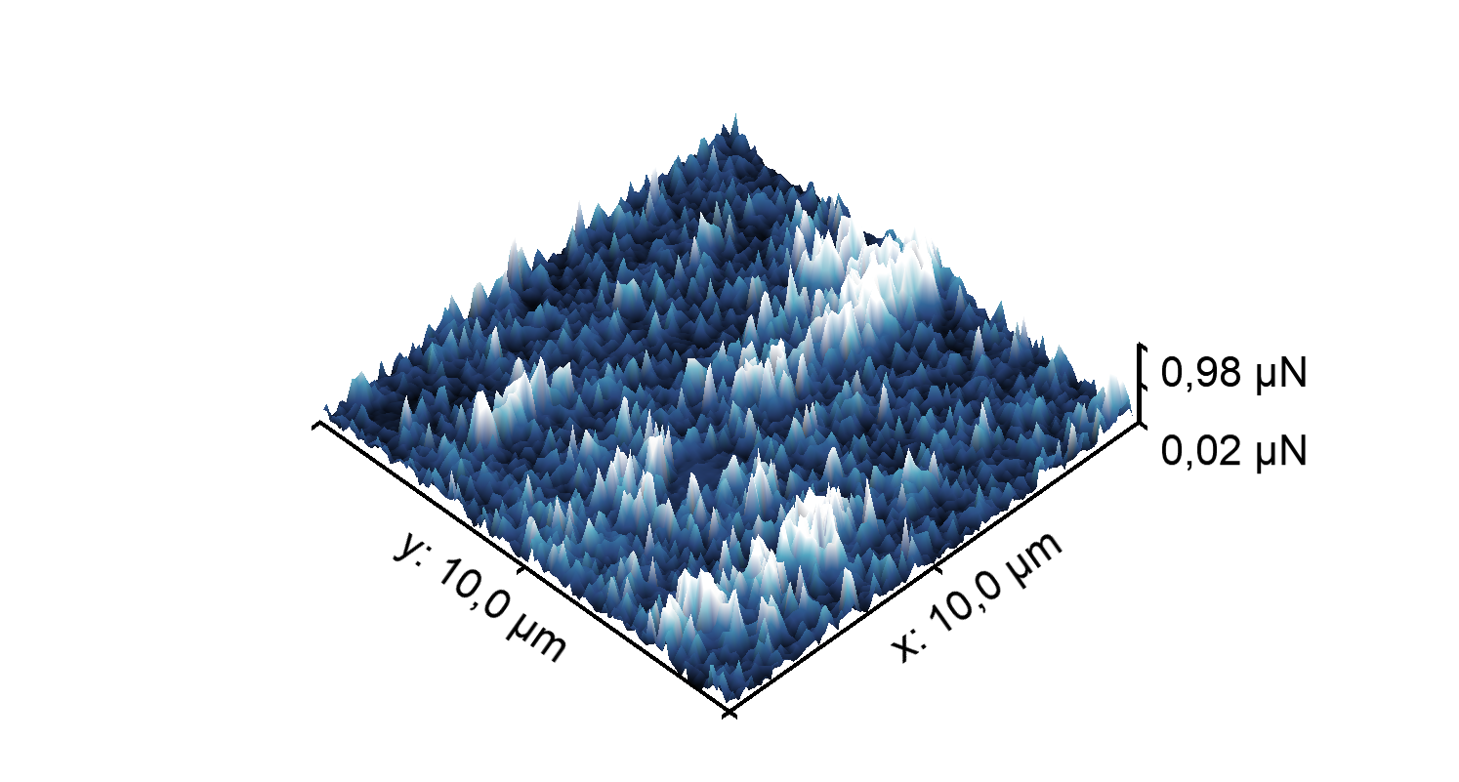
2- Dust adhesion/aerosol creation:
vdW measurement ➔ distribution of forces
Uncharged particles
AFM cantilever
10 µm
W particle
Map of adhesion forces (100 µm²)
Distribution of adhesion forces

Slide 24
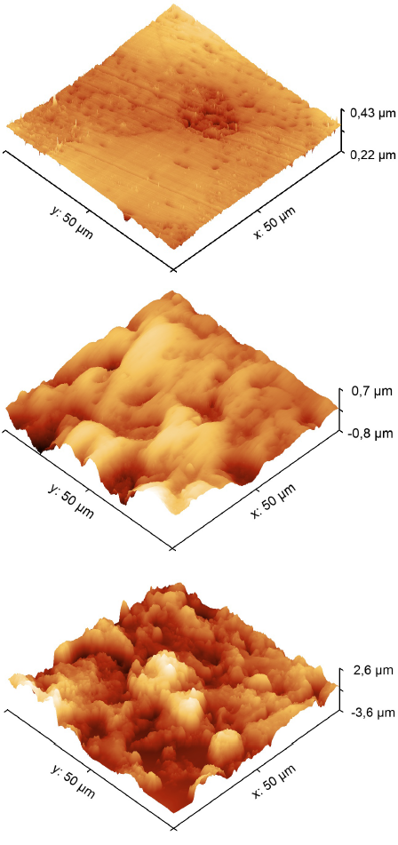
2- Dust adhesion/aerosol creation:
Direct measurements of vdW force
Uncharged particles
1.
3 tungsten substrates with  roughness
Mirror polished W (rms ≈ 15 nm)
Medium polished W (rms ≈ 240 nm)
W exposed to He plasma (rms ≈ 750 nm)
2.
3.
rms = root mean square roughness

Slide 25
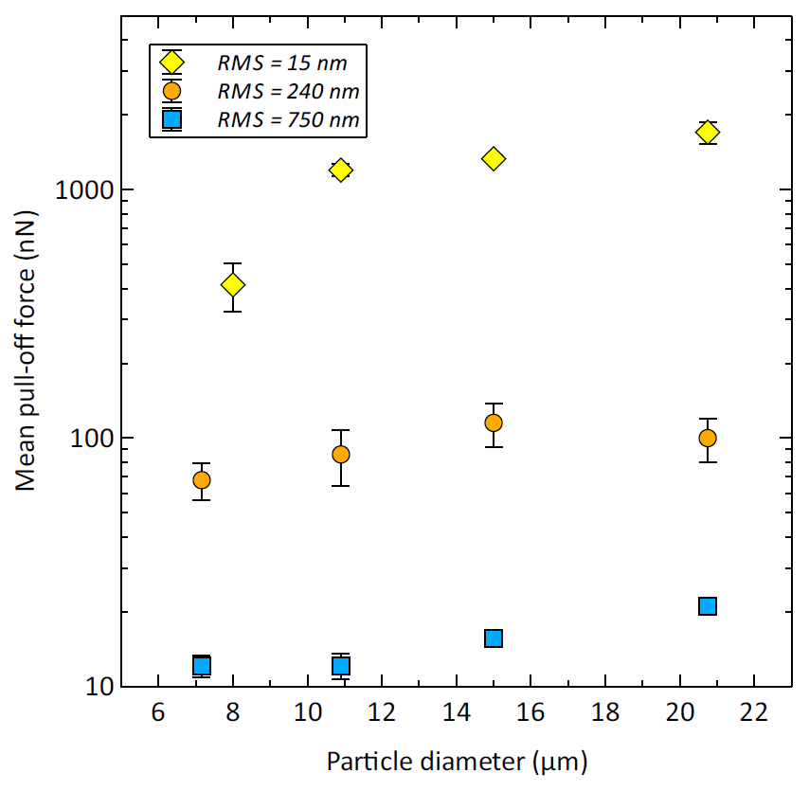
2- Dust adhesion/aerosol creation:
Direct measurements of vdW force
Uncharged particles
RMS=15nm
Adhesion 
When
Roughness 
F_{vdW} = 10 nN
(relevant roughness)
Adhesion force (nN)
RMS=240nm
RMS=750nm
Particle diameter (µm)

Slide 26
2- Dust adhesion/aerosol creation:
Isolated insulated tritiated dust: adhesion 
Balance of forces of a tritiated W particle
F_{VdW} = van Der Walls force = A D_{p}/12 z²
A = Hamaker constant
= depends on material
= 1.3 - 4.4 x 10⁻¹⁹ J for W
z = separating distance
= 0,4 nm (ideal smooth surface)
F_{g} = gravity = mg (negligible)
For insulated charged dust:
F_{im} = image force = (1/4πε₀) Q_{p}²/D_{P}²
D_{p} = particle diameter Q_{p} = charged particle
5 µm
β emission
WO₃ layer
+
F_{im}
F_{VdW}

Slide 27
2- Dust adhesion/aerosol creation:
Isolated insulated tritiated dust: adhesion 
Balance of forces of a tritiated W particle
F_{VdW} = van Der Walls force = A D_{p}/12 z²
A = Hamaker constant
= depends on material
= 1.3 - 4.4 x 10⁻¹⁹ J for W
z = separating distance
= 0,4 nm (ideal smooth surface)
F_{g} = gravity = mg (negligible)
For insulated charged dust:
F_{im} = image force = (1/4πε₀) Q_{p}²/D_{P}²
D_{p} = particle diameter Q_{p} = charged particle
5 µm
β emission
WO₃ layer
+
F_{im}
F_{VdW}
F_{vdW} = 10 nN
F_{im} (charged insulated particles)  adhesion
(F_{im} = F_{vdW} in 14 hours for 5 µm diameter particle with 10 GBq/g of T inventory)

Slide 28
2- Dust adhesion/aerosol creation:
Adhesion in case of aggregated
+
The adhesion of the top particle strongly affected by natural charging of the aggregate!
+
+
+
+
+
+
+
+
+
+
+

Slide 29
2- Dust adhesion/aerosol creation:
conclusions
+
The adhesion of the top particle strongly affected by natural charging of the aggregate!
+
+
+
+
+
+
+
+
+
+
+
Conclusions:
Isolated particles: self charging  dust adhesion
          ⇒ prediction of aerosol creation (LOVA)?
Ongoing activity to check/confirm how particle tritiation influences particle adhesion

Slide 30
2- Dust adhesion/aerosol creation:
conclusions
+
The adhesion of the top particle strongly affected by natural charging of the aggregate!
+
+
+
+
+
+
+
+
+
+
+
Conclusions:
Isolated particles: self charging  dust adhesion
          ⇒ prediction of aerosol creation (LOVA)?
Aggregated particles : self charging strongly affects adhesion (tbc)
          ⇒ easiest particle/aggregate suspension in case of LOVA?
          ⇒ prediction of creation of aerosol?
(Needs of experiments especially with Be dust (tritiated and non tritiated))
Ongoing activity to check/confirm how particle tritiation influences particle adhesion

Slide 31
3- Measurement of tritium in aerosol
Tritiated dust: β emission from the “surface” of particle

Slide 32
3- Measurement of tritium in aerosol
Tritiated dust: β emission from the “surface” of particle
Usually (lab scale), total tritium inventory in dust measured by:
  Full dissolution of particles
  Followed by Tritium measurements by liquid scintillation counting
  ➔not a real time diagnostic

Slide 33
3- Measurement of tritium in aerosol
Tritiated dust: β emission from the “surface” of particle
Usually (lab scale), total tritium inventory in dust measured by:
  Full dissolution of particles
  Followed by Tritium measurements by liquid scintillation counting
  ➔not a real time diagnostic
Tritium gas measured in real time by ionization chamber.
  (recommendation of Standard International Electrotechnical Commission, N°60761-5)
  That is not working for dust due to β attenuation
  ⬇
  Open issue:
  Develop a real time diagnostic to measure T inventory in aerosol
  (for atmospheric survey in workplace and/or exhaust of facility)

Slide 34
What to take away ...
Large set of dust properties including particles of high chemical reactivity
  Dust collection needed during the ITER life

Slide 35
What to take away ...
Large set of dust properties including particles of high chemical reactivity
  Dust collection needed during the ITER life
Dust Tritium inventory:
  ~10 GBq/g for W, unknown for Be
Notes:
!

Slide 36
What to take away ...
Large set of dust properties including particles of high chemical reactivity
  Dust collection needed during the ITER life
Dust Tritium inventory:
  ~10 GBq/g for W, unknown for Be
Dust adhesion/aerosol creation:
  Metallic dust are covered by an electrical insulating layer
  Tritiated metallic dust are positively charged
  Adhesion:
    In case of isolated particles, tritiated dust adhesion 
    In case of aggregate, tritiated dust adhesion remains unknown

Slide 37
What to take away ...
Large set of dust properties including particles of high chemical reactivity
  Dust collection needed during the ITER life
Dust Tritium inventory:
  ~10 GBq/g for W, unknown for Be
Dust adhesion/aerosol creation:
  Metallic dust are covered by an electrical insulating layer
  Tritiated metallic dust are positively charged
  Adhesion:
    In case of isolated particles, tritiated dust adhesion 
    In case of aggregate, tritiated dust adhesion remains unknown
Tritium measurement in aerosol:
  Open issue due to limited β path in material
  Needs: development of real-time diagnostic (atmospheric survey of workplace area )
Notes:
Rappel de l’expérience fondatrice!

Slide 38
What to take away ...
Large set of dust properties including particles of high chemical reactivity
  Dust collection needed during the ITER life
Dust Tritium inventory:
  ~10 GBq/g for W, unknown for Be
Dust adhesion/aerosol creation:
  Metallic dust are covered by an electrical insulating layer
  Tritiated metallic dust are positively charged
  Adhesion:
    In case of isolated particles, tritiated dust adhesion 
    In case of aggregate, tritiated dust adhesion remains unknown
Tritium measurement in aerosol:
  Open issue due to limited β path in material
  Needs: development of real-time diagnostic (atmospheric survey of workplace area )
Toxicity Studies of W Tritiated/untritiated dust :
  Rapid dissolution in biologic media
  no Cytotoxicity observed (no lung cell toxicity)
  Genotoxicity induced
Waste management:
  Needs: development of an immobilization dust technique after collection
Complementary studies needed
(inhalation on rodent, tritiated Be)

Slide 39
Complementary slides

Slide 40
5-Dust and waste management
How to deal with powdery aerosol?
Tritiated dust collected by vacuuming in the ITER vessel (storage in canister)
From a safety point of view, dust open issues concern dust spreading behavior
Needs: Define the best route for ITER Be Dust to mitigate the risk as close as possible to the source
    From canister: no dust handling (avoid dust spreading)
The CEA recommendation (after deep analysis):
  Immobilization in a hydraulic binder:
    suppression of risk of spreading before grouting + prevent from any reconditioning
  Dissolution followed by immobilization in a hydraulic binder:
    suppression of risk of spreading before grouting + prevent from any reconditioning
    but addition of a chemical risk to be managed
Needs of R&D development due to high reactivity of powder in concrete

Slide 41
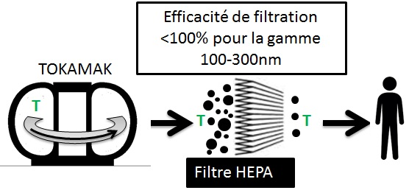
4- toxicity studies
Filtration efficiency
<100% (100-300 nm)
HEPA filter
Small particles reach the inner lung
In case of accidental inhalation:
What is the behavior of these particles / tritium?
What are the consequences of exposure in terms of human toxicity?

Slide 42
4- toxicity studies:
Behavior of W dust in biologic media
Dissolution kinetic of W particles in biologic media
(W particles, 200 nm, 10 mg/l)
Saline Solution
Lung Solution
TRIS (Stock solution)
W dissolution (% in mass)
Time (hour)
  ➔ Full dissolution of W dust in all media (Be?)
  (2 to 60 days depending on the type of W dust)

Slide 43
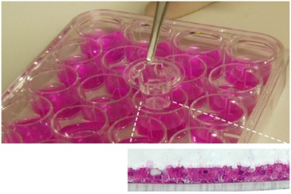
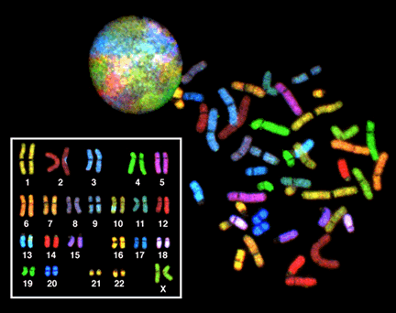
4- toxicity studies:
In vitro cyto and geno toxicity studies
Study of cytotoxicity and DNA damage after exposure to hydrogenated and tritiated particles
Cytotoxicity, Lung model : 3D in vitro cell model of the human airway epithelium (biopsies)
Genotoxicity, Lung model : human derived bronchial epithelial cell line
Same type of particles
In vitro culture :
Transwell insert (0,4µm)
Air-Liquid Interface
Differentiated epithelium
100 nm
No cell toxicity observed after 24h exposure for tritiated W particles.
Tritiated and untritiated W particles induce genotoxic effects during in vitro studies
(DNA and/or chromosome damaging)
Useful information to define guidelines for occupational safety in case of LOVA
(needs of complementary studies as inhalation of rodent)
Notes:
3/ Tritium from tritiated particles is partially absorbed by the epithelial tissue within 24 hours (<20 %),
(tritium from tritiated water is rapidly absorbed (100 %))

