Slide 1
Impact of High Field & High Confinement on L-mode-Edge Negative Triangularity Tokamak (NTT) Reactor
IAEA-CN/258/FIP/3-4 , 27th IAEA Fusion Energy Conference, Ahmedabad, India
M. Kikuchi, T. Takizuka, S. Medvedev, T. Ando, D. Chen, J.X. Li, M. Austin, O. Sauter, L. Villard, A. Merle, Y. Kishimoto, K. Imadera

Slide 2
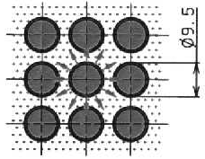
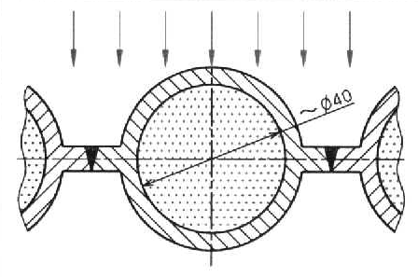
IAEA-CN/258/FIP/3-4 , 27th IAEA Fusion Energy Conference, Ahmedabad, India
1. Motivation: Fusion Power Handling is quite challenging!
10MW/m² : short time fusion / 0.3-1MW/m² : Reliable power system
Disruption
Runaway electron
1000
ELM
Fission
~1MW/m²
100
w/o Radiative cooling
Radiation heat flux on the Sun
10
Heat Flux (MW/m²)
Fusion Divertor
(with Radiative cooling)
Fossil
~0.3MW/m²
1.0
Fusion 1st wall
0.1
10⁻³s
Duration
1 year

Slide 3
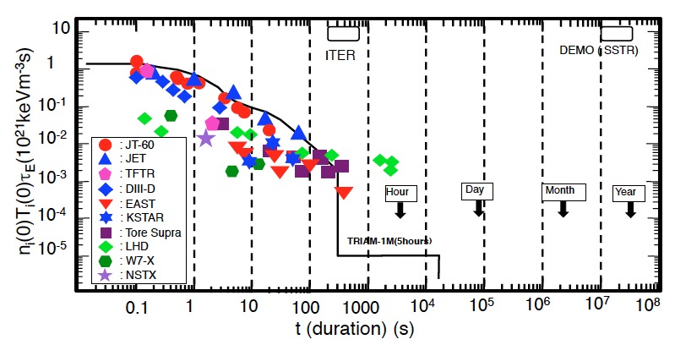
2. Fusion Target to Months of operation
IAEA-CN/258/FIP/3-4 , 27th IAEA Fusion Energy Conference, Ahmedabad, India
There is 7 order of gap between present-day high performance plasma to DEMO in the power load duration.
Most critical is long pulse power handling
7 order difference

Slide 4
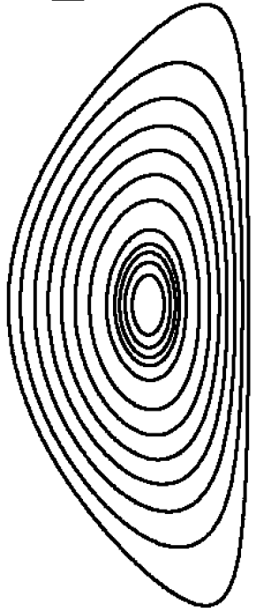
IAEA-CN/258/FIP/3-4 , 27th IAEA Fusion Energy Conference, Ahmedabad, India
3. L-mode Edge Negative Triangularity Tokamak (NTT)
Geometrical Factor ~2.8 @ Grazing angle ~1º
H-mode edge << L-mode edge (suitable for reactor)
a) D-shaped+ H-mode
b) Negative δ+ L-mode Edge
Better stability for TEM
Grad B drift
L-mode profile
I_{p}, B_{t}
1.0
n_{e}
Γ_{p}
R_{div}=5m
H-mode profile
SOL flow
R_{div}=14.5m
R
R
0.0
0.0
r/a
1.0
Γ_{p}^{H} ~NC level
Difficult to pump
Γ_{p}^{L} >>NC level
Easier to pump

Slide 5
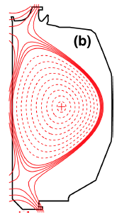
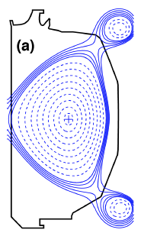
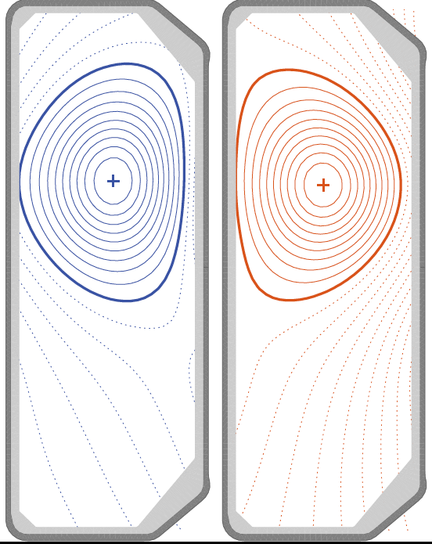
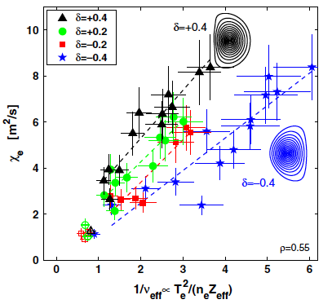
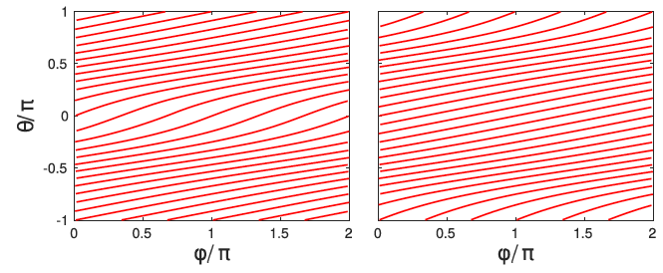
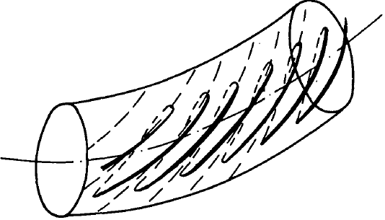
IAEA-CN/258/FIP/3-4 , 27th IAEA Fusion Energy Conference, Ahmedabad, India
4. There are increasing Evidence of L-mode Edge High Confinement
M. Austin, EX/P6-6
High confinement inNegative triangularity discharges in DIII-D
Y. Camenen, NF2007
H
L
τ_{Ee} (NTT)~ 2 times
(L-mode Edge)
CamenenNF 2007
n_{e}(0)=6x10¹⁹m⁻³
T_{e}(0)=4keV
P_{heat}=10.5MW
TCV (a_{p}=25cm,B_{t}=1.44T)
DIII-D (a_{p}=59cm,B_{t}=2T)
More stable
More unstable
Riva PPCF2017：
Larger magnetic pitch stabilize resistive ballooning
SauterPoP2014: De-stiffening
MelroPPCF2015: Higher T_{crit}
Fontana2018: smaller turbulence
CodaFEC2018: smaller λ_{q}??
Kadomtsev NF1971
Precession drift reversal
for TEM stability
Higher B_{p}
δ=−0.3
δ=+0.3

Slide 6
IAEA-CN/258/FIP/3-4 , 27th IAEA Fusion Energy Conference, Ahmedabad, India
5. Optimized Pressure Profile in NTT
NTT is magnetic Hill configuration.
- Central Region limited by Mercier stability.
- Outer half limited by Ballooning stability.
a) Optimized pressure profile
b) Optimized pressure gradient profile in KINX
0.04
0.02
0
1.0
0.5
0.0
Mercier limiting edge
p
p’
Mercier limiting region
Ballooning limiting region
w/o pedestal
0.5 1.0 1.5
0 0.5 1.0
ψ^{0.5}
R/R_{p}
β_{N} (stability limit) ~3.3
Within this limit, reactor design is possible β_{N}=2.3.

Slide 7
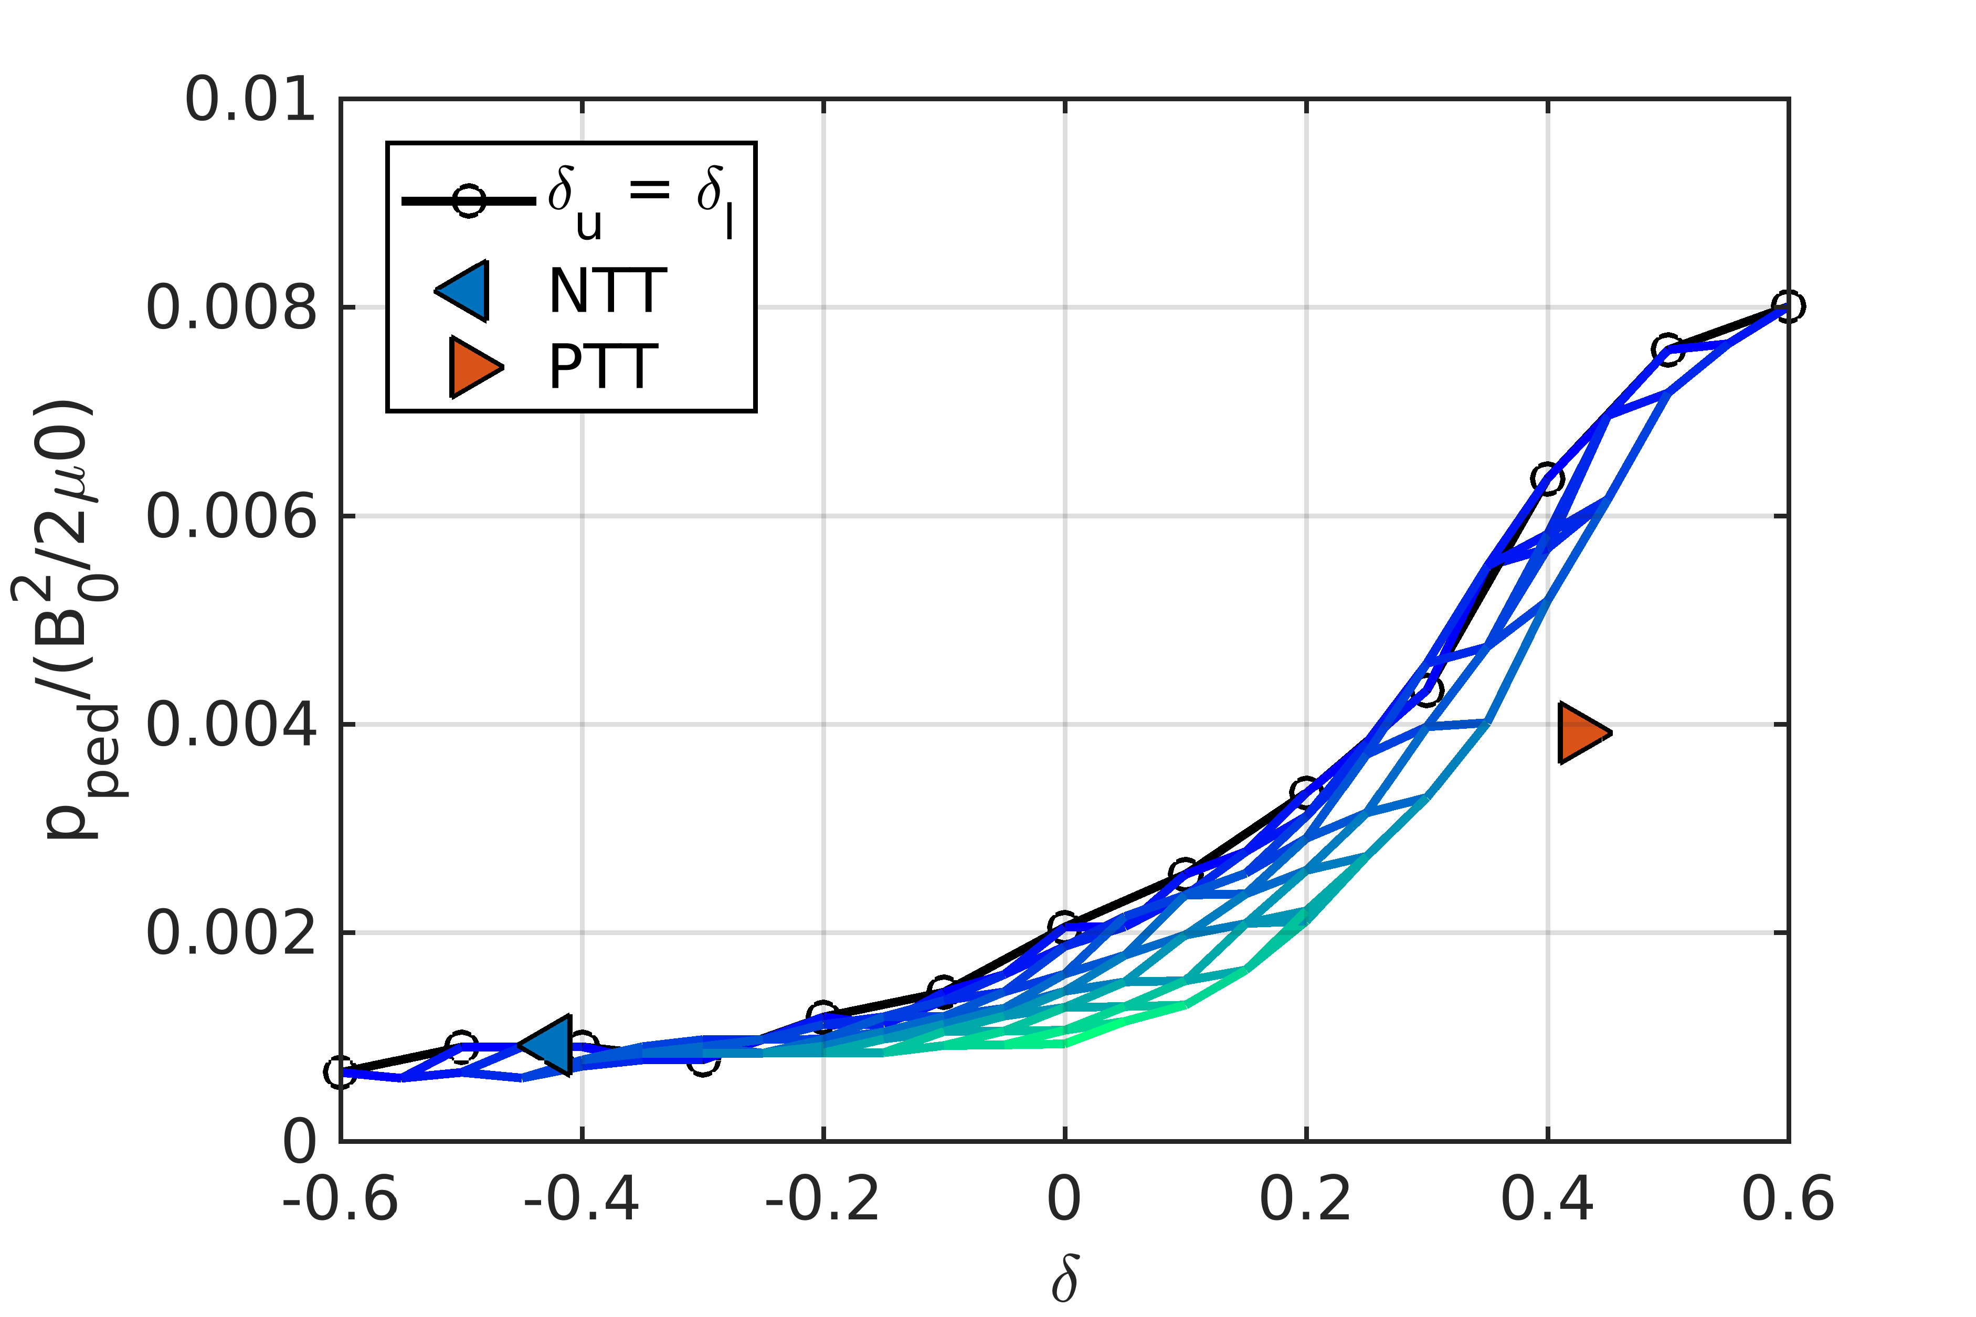
IAEA-CN/258/FIP/3-4 , 27th IAEA Fusion Energy Conference, Ahmedabad, India
6. Reducing risk for large ELM energy loss
Large pedestal pressure is the source of risk of huge ELM energy loss
NTT tends to stay at L-mode edge but still has risk to be H-mode and ELM.
NTT edge pedestal pressure limit is at least 4 times smaller than D-shaped.
Thus reducing risk of large ELM energy loss.

Slide 8
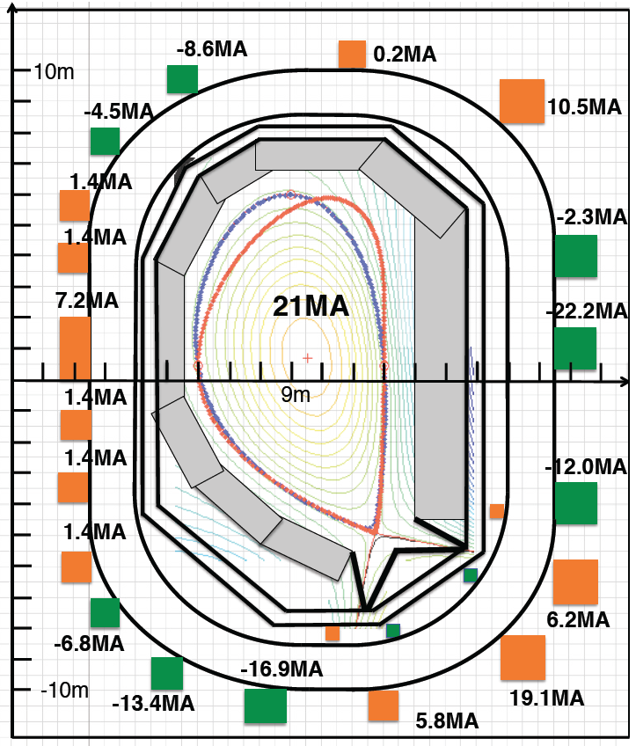
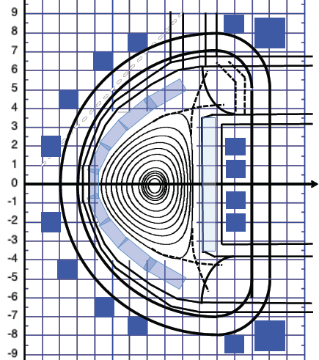
IAEA-CN/258/FIP/3-4 , 27th IAEA Fusion Energy Conference, Ahmedabad, India
7. Double and Single Null NTT in FEC 2014 and 2016
IAEA FEC 2014 S. Medvedev, M. Kikuchi, et al. R_{p}=7m, a=2.7m (A=2.6), I_{p}=15MA, B_{t}=6.2T, κ_{x}=1.5,δ_{x}=-0.9, β_{N} ^{lim}>3, γ_{n=0}=95/s
IAEA FEC 2016 S. Medvedev, M. Kikuchi, et al. R_{p}=9m, I_{p}=21MA, 3GW fusion power at β_{N}=2.1, B_{max}=13.6T, H_{H}=1.12
κ_{x}=2
OK

Slide 9
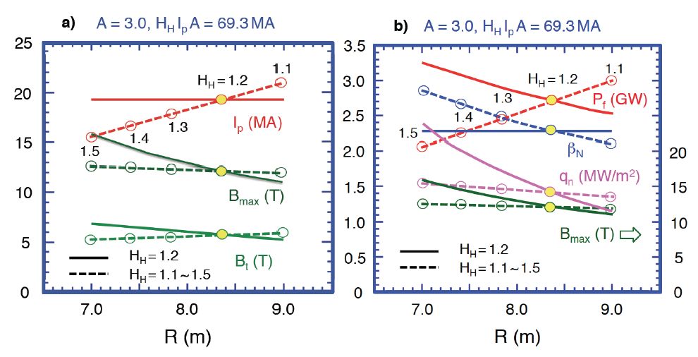
IAEA-CN/258/FIP/3-4 , 27th IAEA Fusion Energy Conference, Ahmedabad, India
8. Parameter scan of SN-NTT Configuration for compact reactor
A=3, H_{H}I_{p}A= 69.3MA : Given
- Solid line : H_{H}=1.2 fixed,
- Broken line : H_{H} varied (1.1-1.5) with R_{p}

Slide 10
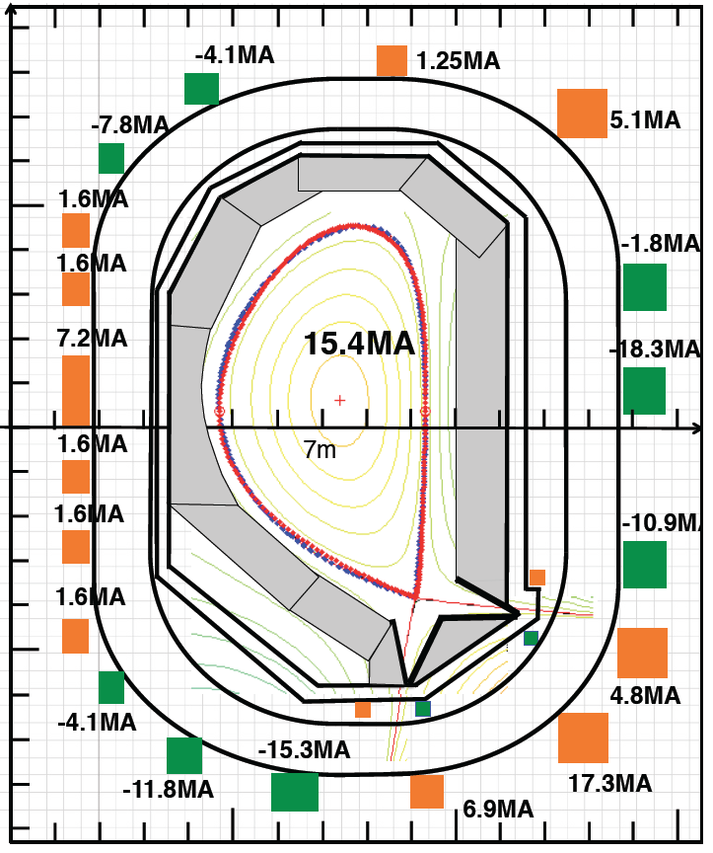
IAEA-CN/258/FIP/3-4 , 27th IAEA Fusion Energy Conference, Ahmedabad, India
9. Reactor Configurations in NTT with Race-track shaped TF coils
a)
b)
Significant size reduction is possible by enhanced confinement H_{H}=1.5.
R_{p}=7m, I_{p}=15.4MA, 2GW fusion power at β_{N}=2.7, B_{max}=13.5T
IAEA FEC 2016 S. Medvedev, M. Kikuchi, et al. R_{p}=9m, I_{p}=21MA, 3GW fusion power at β_{N}=2.1, B_{max}=13.6T, H_{H}=1.12

Slide 11
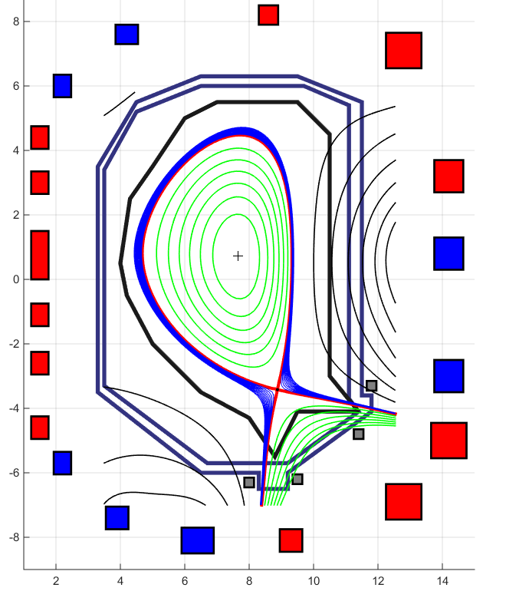
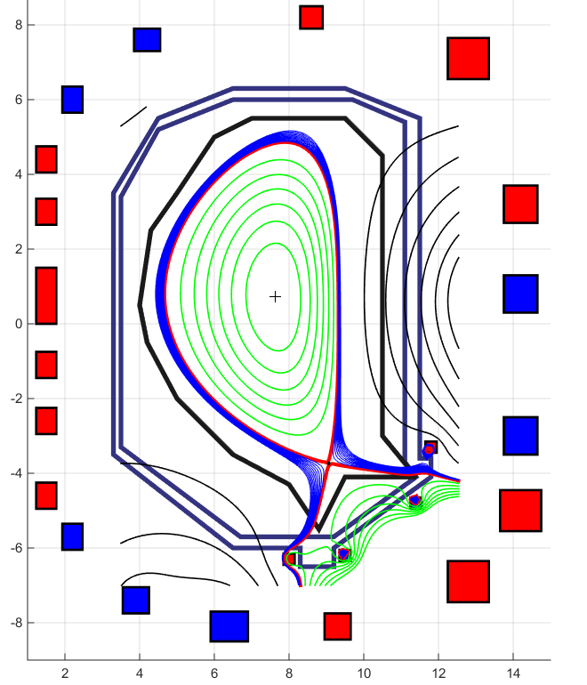
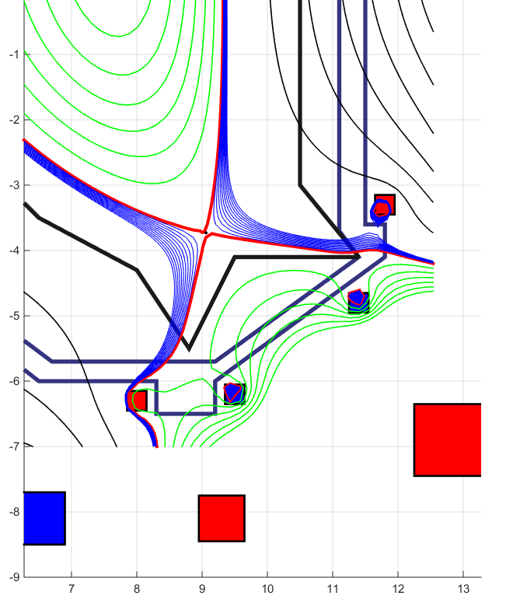
IAEA-CN/258/FIP/3-4 , 27th IAEA Fusion Energy Conference, Ahmedabad, India
10. Flux Tube Expansion Divertor in NTT
15MA equilibrium a) without FTE, b) with FTE, c)Expanded magnetic structure with FTE
α=2.1 º
I_{FTE}=2.5MA
G_{FTE}=4.2
G_{FTE}=2.0
I_{FTE}=2.5MA
G_{FTE}=4.2
G_{FTE}=2.0
FTE coil current to expand flux tube to satisfy a=1-1.5º is only 2.5MA
Active control of flux expansion for both legs are possible.
Coils can be sector coils by NbTi wires
L-mode edge ay enable power handling more easier than H-mode edge.
α=2.6 º

Slide 12
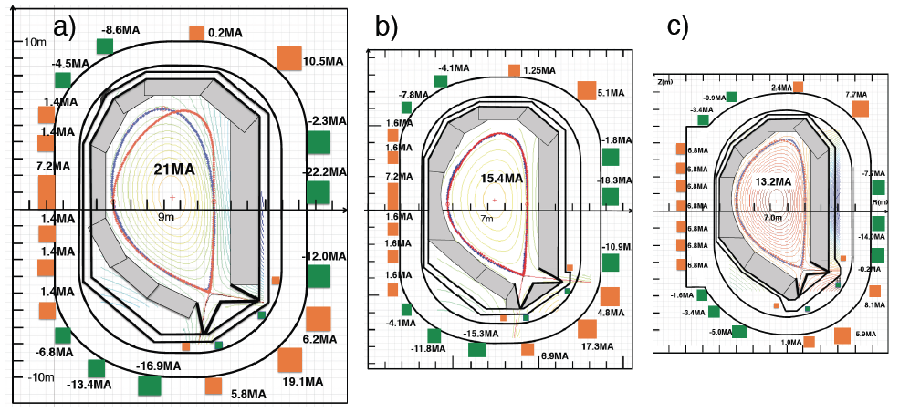
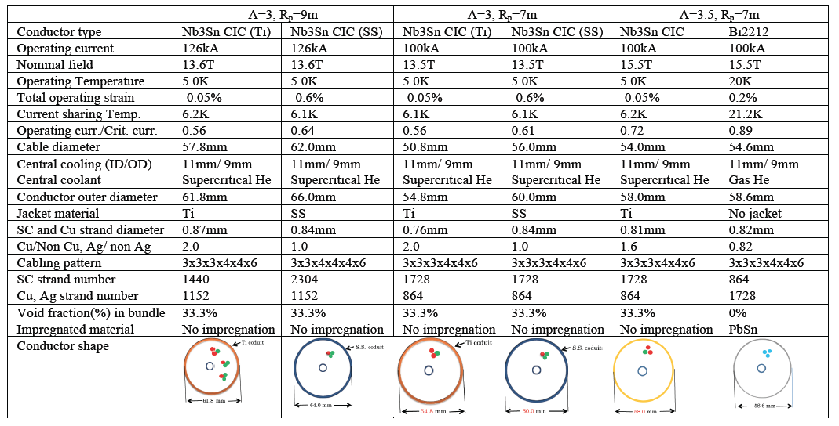
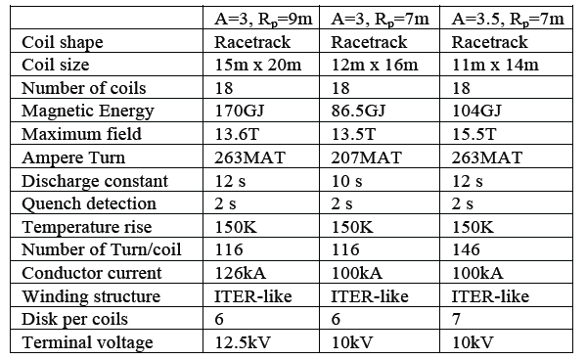
IAEA-CN/258/FIP/3-4 , 27th IAEA Fusion Energy Conference, Ahmedabad, India
11. Magnet Designs in NTT
Magnet design of NTT is technically feasible (J_{c}=1000A/mm²)

Slide 13
IAEA-CN/258/FIP/3-4 , 27th IAEA Fusion Energy Conference, Ahmedabad, India
12. Summary
D-shaped H-mode is the standard operation mode in tokamak.
It brings many critical issues (ELM, narrow heat channel, small particle flux, heat and particle exhaust at small R)
Efforts has been made to resolve these issues but still challenging.
Divertor for Negative triangularity provides maximum wetted surface with flux tube expansion.
L-mode edge observed in NTT experiments enhances its merit much further.
Low edge pedestal beta limit is safer for ELM damage.
Long-pulse power handling is 1st priority for 1st generation tokamak reactor.
L-mode edge NTT may provide possible solution.
We are ready for medium to large test NT tokamak.

