Slide 1
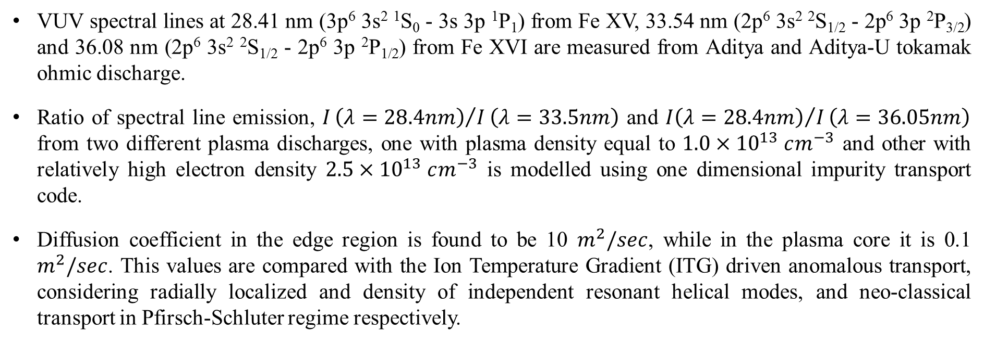
STUDY OF IRON IMPURITY BEHAVIOUR USING VUV SPECTROSCOPY IN ADITYA AND ADITYA-U TOKAMAK S. PATEL et al. (EX/P4-3)
VUV spectral lines at 28.41 nm (3p⁶ 3s² ¹S₀ - 3s 3p ¹P₁) from Fe XV, 33.54 nm (2p⁶ 3s² ²S_{1/2} - 2p⁶ 3p ²P_{3/2}) and 36.08 nm (2p⁶ 3s² ²S_{1/2} - 2p⁶ 3p ²P_{1/2}) from Fe XVI are measured from Aditya and Aditya-U tokamak ohmic discharge.
Ratio of spectral line emission, $I{\left(λ=28.4nm\right)}/I\left(λ=33.5nm\right)$ and ${I\left(λ=28.4nm\right)}/I\left(λ=36.05nm\right)$ from two different plasma discharges, one with plasma density equal to $1.0×{10}^{13} cm^{−3}$ and other with relatively high electron density $2.5×{10}^{13} cm^{−3}$ is modelled using one dimensional impurity transport code.
Diffusion coefficient in the edge region is found to be 10 $m^{2}/sec$, while in the plasma core it is 0.1 $m^{2}/sec$. This values are compared with the Ion Temperature Gradient (ITG) driven anomalous transport, considering radially localized and density of independent resonant helical modes, and neo-classical transport in Pfirsch-Schluter regime respectively.

