Slide 1
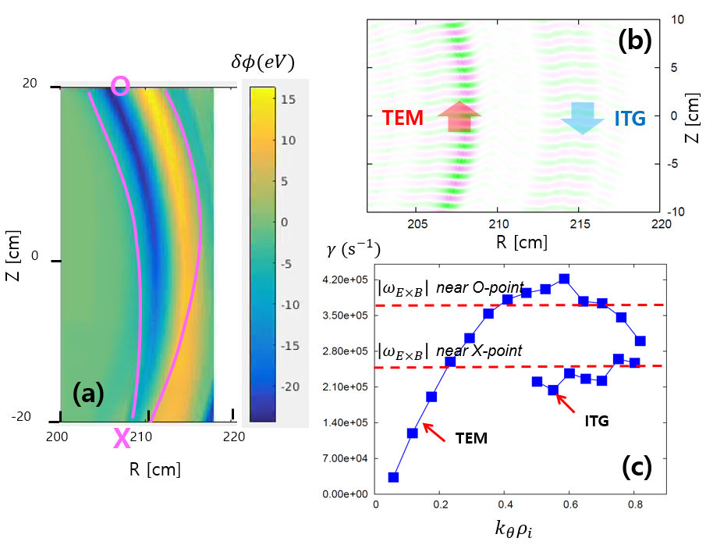
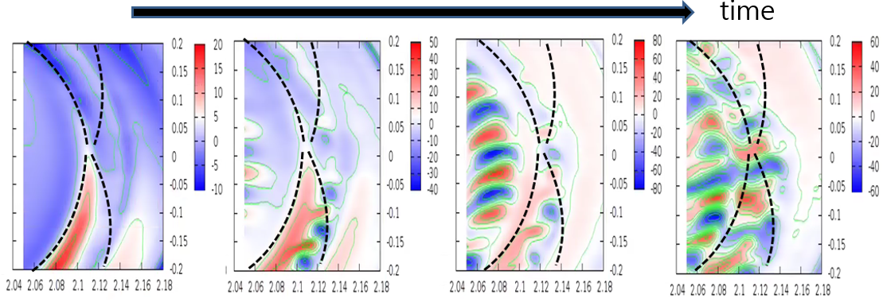
(TH/8-1, Jae-Min Kwon et al.) Gyrokinetic XGC1 Simulation Study of Magnetic Island Effects on Neoclassical and Turbulence Physics in a KSTAR Plasma
(a)
(b)
(a) Perturbed equilibrium potential by magnetic island, (b) Contour plot of TEM and ITG excited near the magnetic island, and (c) Comparison of the TEM, ITG growth rates with the $E×B$ shearing rate of the equilibrium potential.
Turbulence evolution near (a) O-point of magnetic island and (b) X-point of magnetic island. The blacked dashed lines represent the separatrix of the magnetic island.
Global XGC1 neoclassical simulation of perturbed equilibrium potential by (2,1) magnetic island
(2,1) mode structure of perturbed electrostatic potential ➔ Strong $E×B$ shearing near the O-point of magnetic island
Stabilization of ambient TEM and ITG by strong $E×B$ shearing near O-point ➔ Consistent with experimental observation in KSTAR
Global XGC1 nonlinear turbulence simulation with (2,1) magnetic island and self-consistent neoclassical and turbulence physics
Difference turbulence evolution patterns near O-point and X-point of magnetic island ➔ In O-point region, turbulence spreading is blocked. In X-point region, turbulence spreads through the island
Different flow structure near O-point and X-point of magnetic island ➔ In O-point region, equilibrium flow dominates the flow dynamics. In X-point region, turbulence driven zonal flow becomes important.
Ref: M.J. Choi et al, Nucl. Fusion Lett. 57, 126058 (2017); Jae-Min Kwon et al, Phys. Plasmas 25, 052506 (2018)

