Slide 1
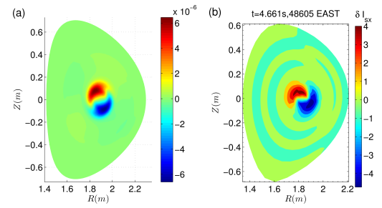
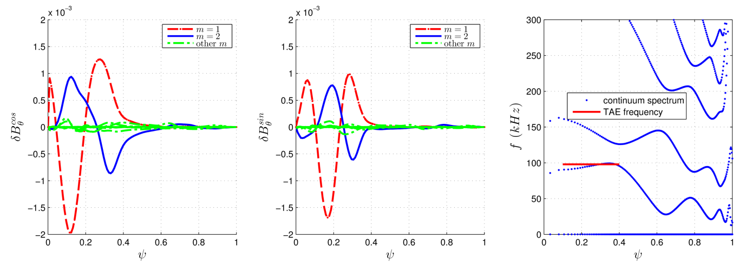
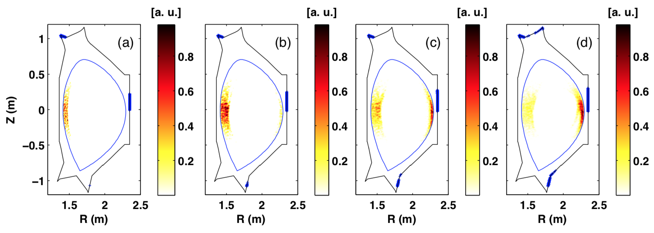
Simulations of energetic particle driven instabilities and fast particle redistribution in EAST tokamak
Fishbone simulation by M3D-K: The simulation results are consistent with the experimental measurement with respect to mode frequency and mode structure. Nonlinear simulations show that the frequency chirps up and down, and a high frequency BAE is excited during the nonlinear evolution.
TAEs simulation by MEGA and M3D-K: Parameter scans show that the TAEs simulated by the two codes agree with each other. The analysis of the resonant interaction shows that the TAE exchanges energy with the co-current passing particles with parallel velocity equaling to 1/3 or 1/5 of the central Alfvén speed.
Fast ion loss due to RMPs simulated by GYCAVA: The loss fraction increases when the RMP coil current increases. Without RMPs, the initial positions of lost fast ions are near the edge on the high field side. However, the initial positions of lost fast ions are located near the edge on both the low and high field side with RMPs.
M3D-K simulation
EAST measurement
n=-1
(a) without RMPs; (b) I_{RMP}=5 kAt; (c) I_{RMP}=10 kAt; (d) I_{RMP}=15 kAt.

