Slide 1
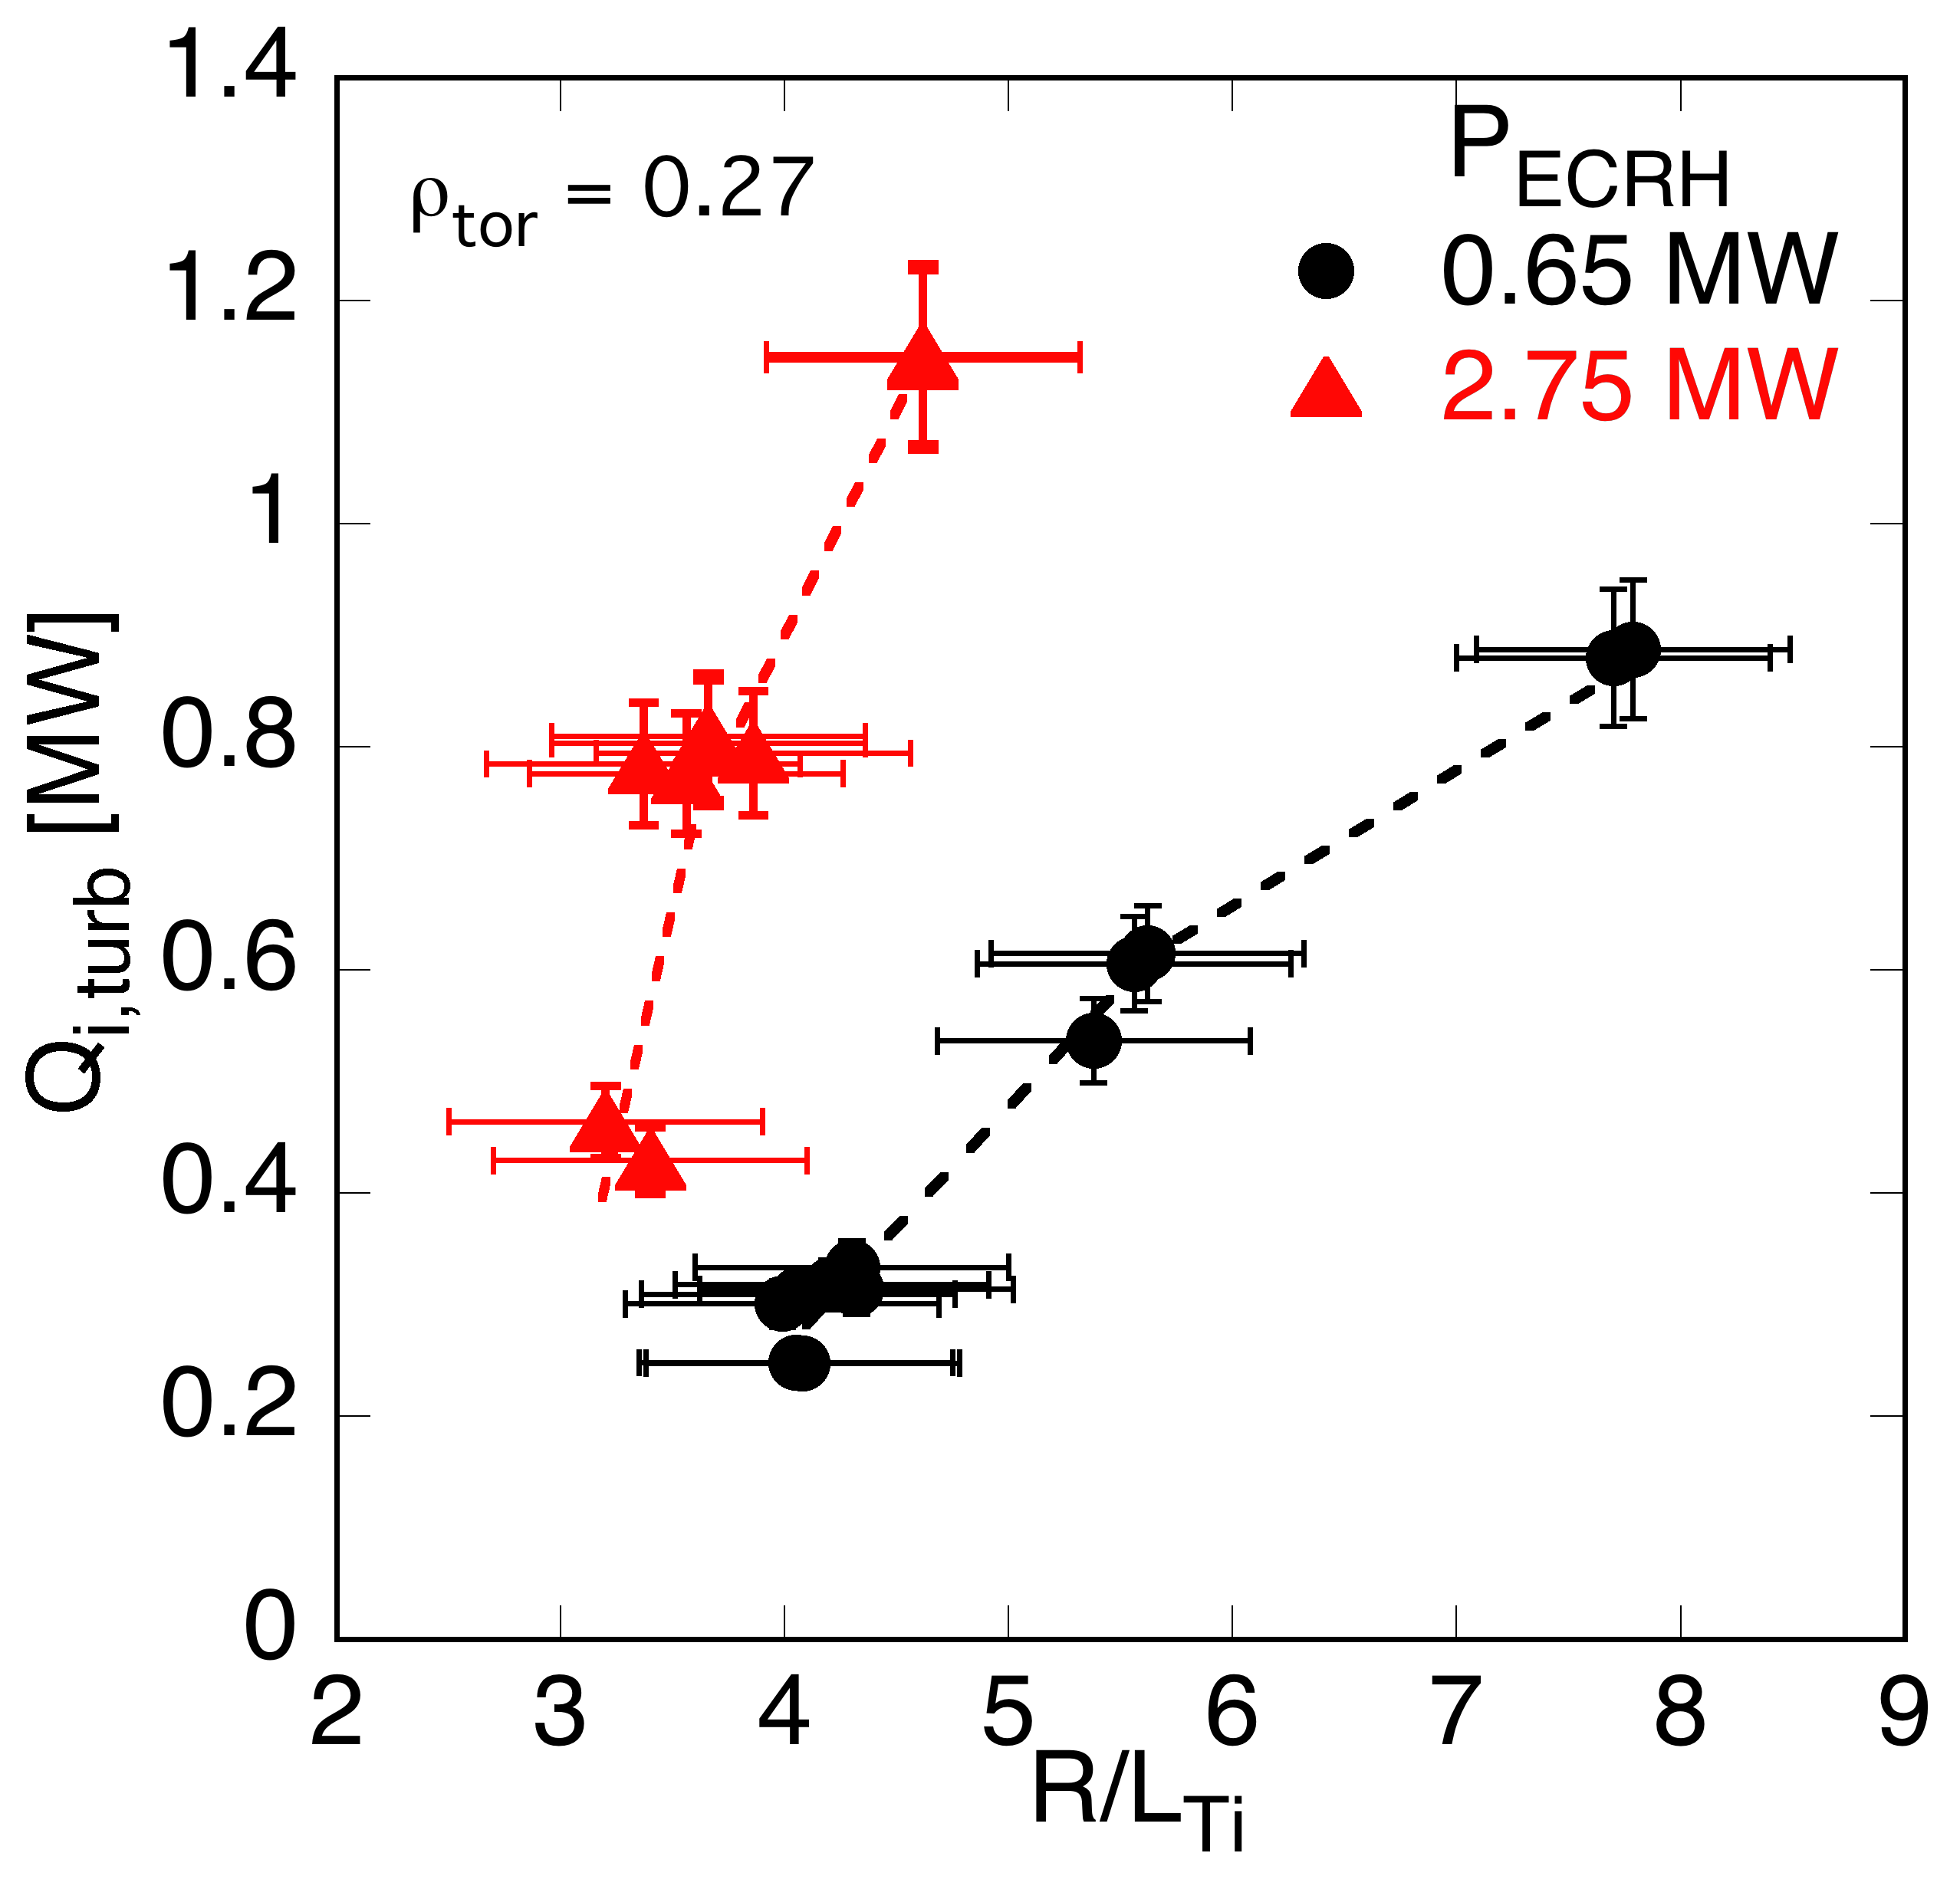
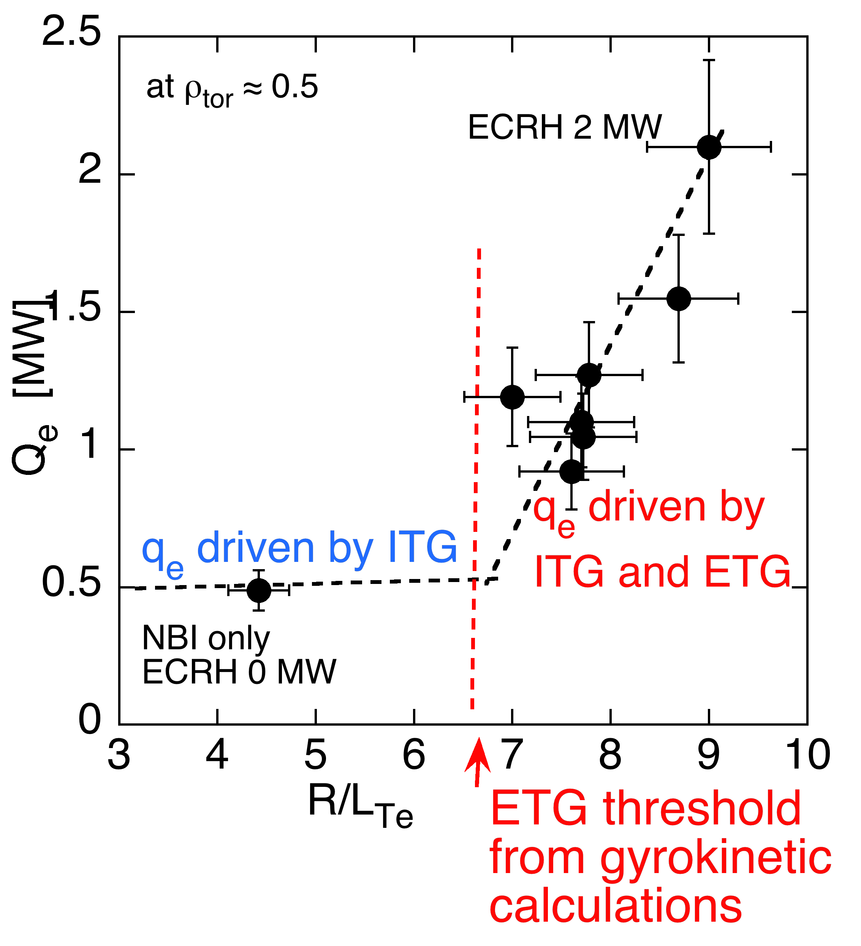
Ion and electron heat flux study
in ASDEX Upgrade
Max-Planck-Institut
für Plasmaphysik
EX/P8-3 F. Ryter, C. Angioni, M.Dunne, R. Fischer, B. Kurzan, A. Lebschy, R.M. McDermott, W. Suttrop, G. Tardini, E. Viezzer, M. Willensdorfer and the ASDEX Upgrade Team
Ion heat flux
Electron heat flux
Variation of experimental ion heat
flux exhibits threshold and stiffness
ITG insufficient => ETG required
to drive high electron heat fluxes
T_{e}/T_{i} ≈ 2
T_{e}/T_{i} ≈1.3
Agrees with gyro-kinetic calculations:
- ITG-driven heat flux
- stiffer at high T_{e}/T_{i} , fast ions stabilize

