Slide 1
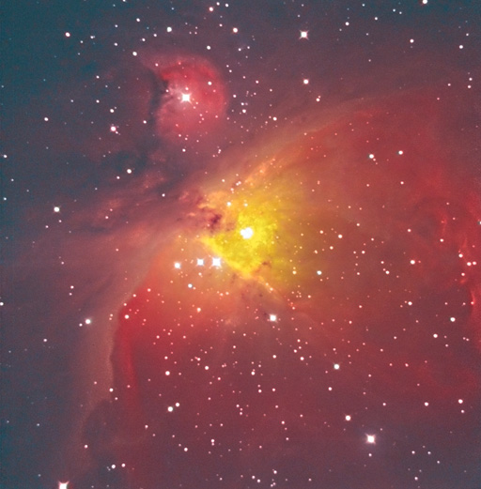
Sustainable Future Energy Scenarios and Possibility of Fusion
Satoshi Konishi： SEE/3-1Ra FUTURE POSSIBILITY OF CARBON SEQUESTRATION BY “Emission Credit” BIOMASS FUSION HYBRID SYSTEMS
Shutaro Takeda : SEE/3-1Rb ECONOMIC PERFORMANCE OF FUSION POWER PLANT ON “Future Electricity” FUTURE DEREGULATED ELECTRICITY MARKET
Nam Hoseok : SEE/3-1Rb TECHNO-ECONOMIC ANALYSIS OF DIESEL AND HYDROGEN “Synthetic Fuel” PRODUCTION VIA FUSION BIOMASS HYBRID MODEL
Institute of Advanced Energy, Kyoto University
Oct.26, 2018
Mahatma Mandir Convention and Exhibition Center, Gujarat, India
27th IAEA Fusion Energy Conference

Slide 2


Introduction
What should fusion do in the future energy?
1. Electricity
- Electricity Market is rapidly changing.
Large fraction of renewables, smaller grids in developing countries,
dispersed system, increased vulnerability, and deregulated market require:
increased demand response, less impact and effect of stabilizing grids
2. Fuel, Heat, Industrial
- Fuels to substitute fossil with less (zero) CO₂ emission (hydrogen?)
- freights, aviation and heavy transport, residential and industrial fuels
3. Global environment and climate change issues
- Competition with nuclear and renewables does not reduce emission.
- Carbon Capture and Sequestration (CCS) for fossil combustion needed.
- No technology other than Bio-CCS can reduce CO₂ (Negative emission).

Slide 3
Introduction-2
What CAN fusion do in the future energy market?
…we have to know the market and maximize the chance of fusion
1. Electricity SEE/3-1Rb Takeda The Economic Performance of Fusion Power Plant on
Future Deregulated Electricity Market
- Electricity price varies by bidding market.
- Fusion will sell in forward market and balancing market.
responding power highly evaluated/unplanned outage penalty
2. Fuel, Heat, Industrial SEE/3-1Rc Nam Techno-economic analysis of diesel and
hydrogen production via Fusion-Biomass Hybrid Model
- Fusion heat used for conversion of biomass to hydrogen or carbon-free diesel
- freights, aviation and heavy transport, residential and industrial fuels
3. Global environment and climate change SEE/3-1Ra Konishi
Future Possibility of Carbon Sequestration by Biomas-Fusion Hybrid Systems
- Charcoal production by fusion heat for carbon stabilization from atmosphere
- Emission credit can be sold as energy product, other than electricity or fuel
- Fusion as an ultimate energy-environment solution since the industrial revolution

Slide 4
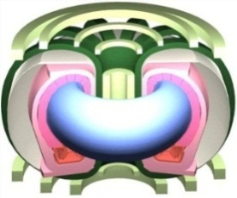
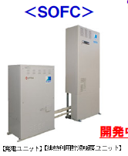
  Future low carbon electricity
Fusion
(to come)
Nuclear
(??)
Fire
(fade out)
renewables
(dominates?)
Both large grid and local systems are needed.
Grids are smaller
unstable
not responding demands
Local generators and
fuel cells Stabilizes fluctuation by renewables.
Large scale grid
Small energy devices available and preferred
Local systems
Already clean
25
Solar cell
Solar cell
Electricity
20
Solid Fuel
Liquid Fuel
generators
15
Gaseous Fuel
Battery
Energy demand(GTOE)
10
5
Fuel demand
larger
Fuel cells
0
SOFC
PHV,EV
2000
2020
2040
2060
2080
Year (IPCC92)

Slide 5
Value of the electricity (California duck)
Fig. Change of electricity demand in a sunny day
California Independent
System OperatorCAISO)
In the deregulated market,
Price of electricity varies.
Due to large share of renewable,
electricity market price drops in
day time.
Instability of grid (frequency
change and outage) is
Serious when share of
Renewable increased.
Value of the electricity (even clean base load) can be negative.
→Fusion Electricity may not recover investments!

Slide 6
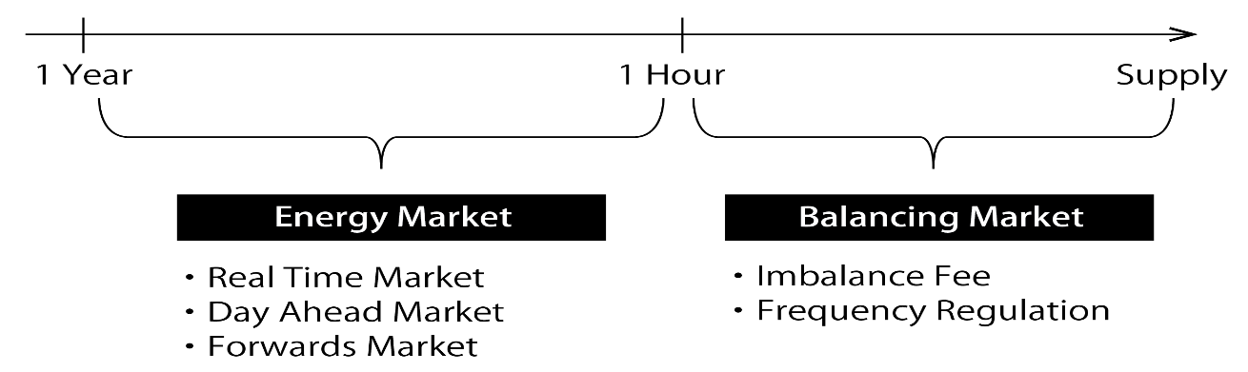
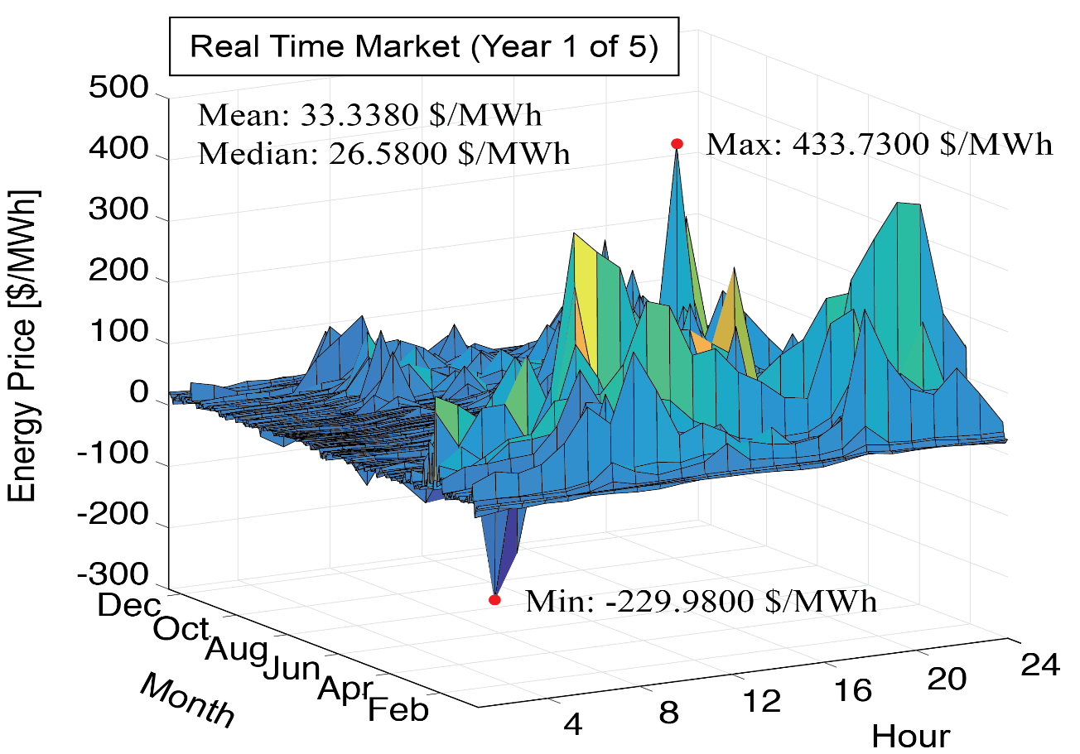
economic competitions in future electricity markets
The electricity is no longer sold for per kWh -
conventional economic metrics like Levelised Cost of Electricity (LCOE) are inapplicable on future electricity markets!
Fig. 1 PJM Deregulated Market Structure.
economic performance of fusion power plants on future deregulated electricity markets was evaluated with PJM market model.
Modeled fusion power plant, 1.2GW steady
System Parameter | Value
Operation Mode | Steady-state
Electricity Output (sending-end) | 1,200 GW
– Major Radius | 7.728 m
– Minor Radius | 2.208 m
– Beta Value | 4.274
– Fusion Output | 2,801 MW
Frequency of Unplanned Plant Outage | 0.001 – 0.00001 hour⁻¹
Service Time before Plasma Restart | 10 days
Bidding Market | Real-time or Day-ahead or Year-Forward
Fig. 2 PJM Real Time Energy Market Historical Value.

Slide 7
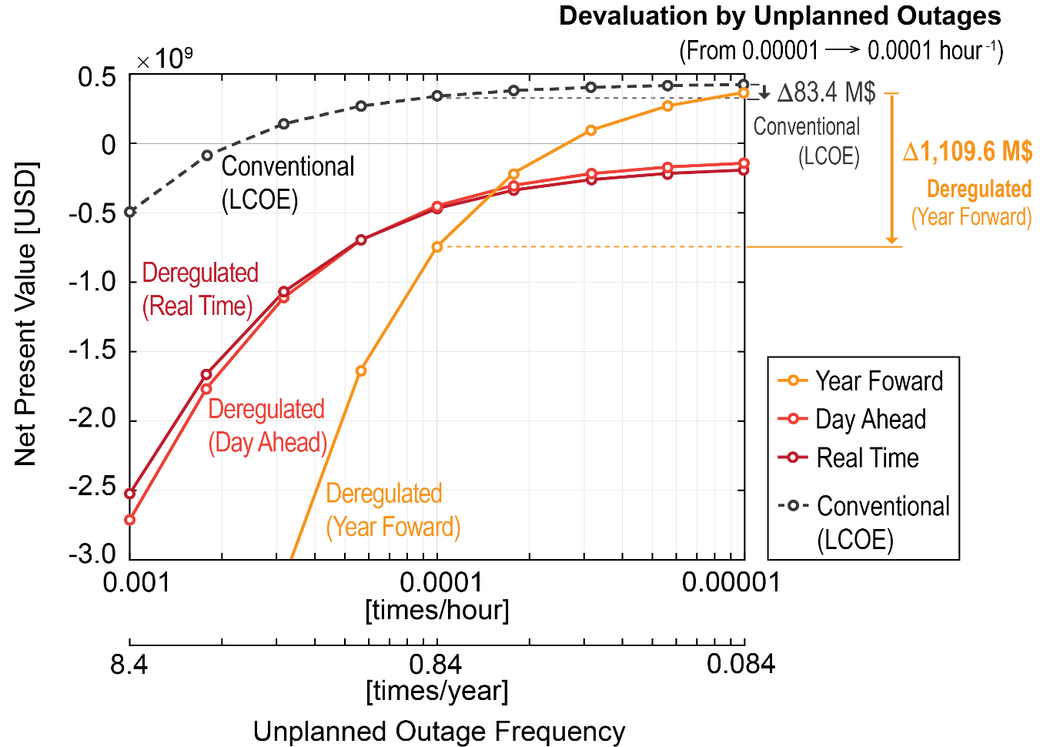
Fusion electricity in the future electricity markets
Fusion electricity is sold in the bidding market
Under a long-term contract as a steady source.
Revenue of fusion power plants had higher sensitivity to the unplanned outage frequency on deregulated electricity markets.
1. Electricity Selling Revenue
2. Frequency Regulation Revenue
3. Start-up Electricity Expense
4. Imbalance Fee
Disruptions have large impact on the total value of fusion as a generator of base load electricity
The unplanned plant outage (including plasma disruption) frequency target should be lowered to < 0.3 times/year on deregulated electricity markets.
Fig. Net Present Value of Fusion Power Plant on Deregulated Electricity Market vs. Conventional Market.

Slide 8

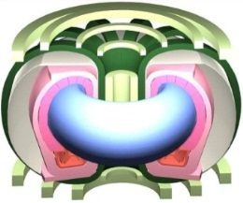

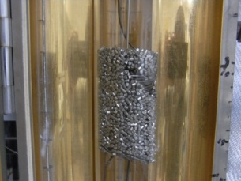
Chemistry of biomass fusion hybrid
Waste
Garbage
Agriculture
byproducts
forestry
Biomass
(1kg)
External Heat，900℃
Fusion
Reactor
Plasma 8.2MJ
Chemical 16MJ
H₂O
H₂,CO
+
Hydrogen 24.2MJ
Biomass gasification
Chemical Reactor
cellulose：（C₆H₁₀O₅）_{n/6}+ n/6H₂O → nH₂ + nCO – 136n [kJ]
hydrogen
Shift Reaction
CO + H₂O ⇔ H₂ + CO₂ + 32 [kJ]
Fischer-Tropsch reaction
Carbon Neutral
2H₂ + CO → -CH₂- + H₂O + 160 [kJ]
Heat 8.1MJ
diesel(hydrocarbon)
for generation
Carbon free oil 0.5 liter
Sold in the market
Chemical 15.6MJ
Notes:
こちらが、それぞれセルロース、リグニンの代表的な元素組成のCHO比から想定される水蒸気と反応した理想的なガス化を示す式です。
一方、このときに起こると考えられる代表的な平行反応には。これらの反応式が示すようにメタンを生成する反応や、一酸化炭素と水蒸気から水素と二酸化炭素を生成するシフト反応があります。簡略化のために炭素２個以上の反応は考慮していません。
こちらが本研究で用いる、パラメータである水素生成率、炭素分解率の定義式です。水素生成率は、全ての反応が理想的に上式で起こったときの水素生成量を100%とし、実際の生成量より求めます。炭素分解率は、バイオマスのもつ炭素原子数が一酸化炭素、二酸化炭素、メタンの炭素ガスにどれぐらい分解されたかを示します。
(0:55)

Slide 9
Fusion Energy Balance
Fusion reactor ( Pf=3GWt)
Energy Multiplication
fusion energy
P_{d}
Net plant energy output(fuel)
Driver
Energy
P_{d}
Blanket
Output
Q =
6~8GWt
Conversion
Efficiency
η 2.0~2.7
Generation
Efficiency
η ~0.33
Biomass fuel production
1GWe
Electricity generation
Waste heat
◯Large energy gain Q (>20) needed for DEMO because of poor generation efficiency.
○If fusion plant can produce more energy output by fuel production,
required energy multiplication Q could be as low as 5.

Slide 10
Biomass –fusion Hybrid
In Lawson’s criteria, generation efficiency of 1/3 is unavoidable.
With energy utilization factor of 2~2.7, break even is lower.
10
22
Electricity
generation
Ｑ＝20，
η_{e}＝0.33
High Plasma Q not required
10
21
Driven and pulsed operation is acceptable
Target easier than ITER.
-~6
Net power
DEMO
ITER
-~8
Net power
Low neutron/ Heat flux
ｎt
10
20
biofuel
Ｑ＝５，
η_{ｆ}＝２．７
Small reactors <1GWt are preferred.
Break-even
Ｑ＝１，η＝１
10
19
Particularly suitable for Small tokamaks.
-0.6
Negative power
10
18
1
10
100
High output temperature is required for gasification efficiency is required
Ｔ（ｋｅｖ）
Notes:
In order to satisfy these criteria, we proposed the non-nuclear hybrid of Fuel production from biomass with fusion energy.
Dr. Konishi presented this concept 2 days ago.
The feature of hybrid enables small DEMO reactor with a low plasma large Q.
Driven and pulsed operation is acceptable because it does not supply electricity to grid.
Fuel production from biomass requires high temperature blanket for biomass gasification.

Slide 11
fusion-Biofuel energy system
Fuel cells respond to the demand change
-preferred for grid stability
Start-up and
driving
Fuel Cell
Local
Electricity
Fusion
core
Consumers install
No generation plant needed
Grid
Electricity
“apparent”
energy multiplication
Fuel Cell
Demand response
Stabilized the grids
Turbine
Gasification reactor
H₂+CO
Fischer Tropsch process
Liquid
Fuel
Biomass

Slide 12
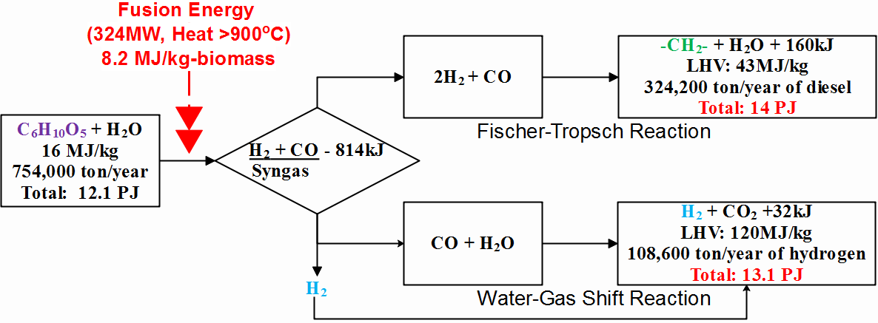
Economical analysis of Biofuel by fusion
Parameter for economic analysis
Parameter |  | Value
Feedstock * |  | 0 $/ton
* Feedstock price can be negative as abandoned biomass is collected and transported to this system paid by government tax or waste producers.
Carbon Capture and Storage |  | 43 $/tCO2
Fusion heat cost * |  | 27 $/MWh_{th}
Thermal efficiency |  | 33%
Fusion reactor load factor |  | 80 %
Reference Biomass Plant | Total Capital Investment (TCI) | 503 Million$
 | Operating and Maintenance | 6% of TCI
 | Capacity | 1,000 ton/day
 | Operating years | 30 years
 | Income tax | 30 %
 | Discount rate | 10 %
 | Overall efficiency | 85 %
 | Availability | 7,880 hours
 | Depreciation | MACRS with a 7-year recovery period
LHV: Low Heat Value
8.2 MJ/kg of endothermic heat is calculated to be required for the complete conversion to syngas.
Energy output reaches 105 % for diesel 108 % or hydrogen comparing to the biomass.
Conversion of waste biomass into diesel or hydrogen can be economically competitive
* DRAGOJLOVIC, Z et al., "An advanced computational algorithm for systems analysis of tokamak power plants," Fusion Engineering and Design, vol. 85, pp. 243-265, 2010.

Slide 13
Carbon Budget (by IEA)
Carbon budget of post-Paris agreement age will run out after 2040,
CCS resource is more critical than fossil fuels.
What we will run out is not fossil resource,
but carbon budget.
“Negative Carbon” will be
Most precious energy resource beyond 2050.
Oil and coal canot be sold not because of high price, but
High penalty.
Fusion can provide alternative
CCS technology

Slide 14
biomass conversion for Charcoal production
Fusion Heat，300℃
Biomass
(1kg)
8.2MJ
+
H₂O
H₂O,C
rt
270℃
310℃
350℃
Carbon Sequestration
lignin: (CH_{1.4}O_{0.3})n + 0.7nH₂O → ０.4nH₂ H₂O+ nC –290n[kJ]
Hydrogen to sell (as byproduct)
Charcoal itself is the “proof of collected CO₂ from air”.
Emission credit to be sold in the
There are insufficient CCS capacity in the world.
Only Fusion Charcoal can isolate the carbon from the environmental Carbon Cycle forever！
→Fusion has unlimited market chance of “negative carbon” by abundant energy.
100,000 unit-operation year of 3GW fusion plant market.(7.4 TtonCO2 to solidify)
Notes:
こちらが、それぞれセルロース、リグニンの代表的な元素組成のCHO比から想定される水蒸気と反応した理想的なガス化を示す式です。
一方、このときに起こると考えられる代表的な平行反応には。これらの反応式が示すようにメタンを生成する反応や、一酸化炭素と水蒸気から水素と二酸化炭素を生成するシフト反応があります。簡略化のために炭素２個以上の反応は考慮していません。
こちらが本研究で用いる、パラメータである水素生成率、炭素分解率の定義式です。水素生成率は、全ての反応が理想的に上式で起こったときの水素生成量を100%とし、実際の生成量より求めます。炭素分解率は、バイオマスのもつ炭素原子数が一酸化炭素、二酸化炭素、メタンの炭素ガスにどれぐらい分解されたかを示します。
(0:55)

Slide 15
Charcoal production As energy application
Solar energy
1 GW electricity equivalent
CO₂
photosynthesis
Fusion
3GW heat
Fusion charcoal can be made at the break even
Price of 50$/ton CO2.
440M$/y assuming
5 cent/kwh
Biomass
C, H₂O, H₂
32PJ/y electricity
Hydrogen fuel
Fusion can choose
electricity,
fuel, and
emission credit
As energy products.
Charcoal
CO₂ stored as solid charcoal at ambient temperature and pressure
2.5Mt/ycarbon=9.3MtCO₂/y
Emission reduction credit
450M$/y assuming 50$/tonCO₂
Sold as emission credits in the emission trade market
Notes:
こちらが、それぞれセルロース、リグニンの代表的な元素組成のCHO比から想定される水蒸気と反応した理想的なガス化を示す式です。
一方、このときに起こると考えられる代表的な平行反応には。これらの反応式が示すようにメタンを生成する反応や、一酸化炭素と水蒸気から水素と二酸化炭素を生成するシフト反応があります。簡略化のために炭素２個以上の反応は考慮していません。
こちらが本研究で用いる、パラメータである水素生成率、炭素分解率の定義式です。水素生成率は、全ての反応が理想的に上式で起こったときの水素生成量を100%とし、実際の生成量より求めます。炭素分解率は、バイオマスのもつ炭素原子数が一酸化炭素、二酸化炭素、メタンの炭素ガスにどれぐらい分解されたかを示します。
(0:55)

Slide 16





Sustainable energy system with fusion-biomass
Restoration of
Environment,
Forest and
farmland
irrigation
forests
Desalination of
Sea water
farm
Woody biomass
waste：
CO2
absorption
heat
biomass
(CxHyOz)n
heat
waste
Atmosphere CO2
Capture and reduction
Fusion plant
Grid parity
Electricity
And
stabilization
熱
charcoal
Carbon sequestration
gasification
PV
Returning the carbon from air to coal mines.
Electricity
In future grid
FC
Bio-fuels
Notes:
以上のセルロース、リグニンの吸熱分解実験の結果を用いて、産業廃棄物である木くずの年間排出量596万トンを処理することを目的に、熱交換型反応器の概要設計を行いました。木くずはセルロース７０％、リグニン３０％でなるものとしました。
設計時に用いるガス化パラメータとして、吸熱量と反応時間がありますが、これらについて本研究のデータを用いました。
コチラの図は、実験で得られたパラメータをもとに必要な物質収支、熱供給量、反応時間を満たすように設計した装置の概念です。
バイオマスは細かく粉砕して反応器上部より投入し、水蒸気も同じ流路を上から下に流通します。
一方、伝熱管に反応器下部から上部へと熱媒体を向流で流し、バイオマスへと熱伝達を行い、ガス化を行います。高温ガス炉、または高温の核融合炉を想定して熱媒体はヘリウムと仮定し、伝熱管材料はSiC複合材としました。
こちらが反応器断面の一部になります。このように内径１７ｍｍ、外径２０ｍｍの伝熱管が密に配置され全長は１０ｍ、総本数は29500本となっています。反応熱による吸熱量が大きいために設計上は熱供給が一番厳しい条件になりました。

Slide 17
Summary of future energy system study
Future Energy Systems analyzed to reconsider fusion target.
1.Base load electricity may not make expected return of investment.
Levelized Cost of Electricity (LCOE) is not suitable for economical evaluation,
Electricity will be sold by bidding ;price is determined by the market mechanism.
- as a base load electricity, outage frequency has strong impact.
More conservative design required
2.Biomass-fuel by fusion is economically viable to replace fossil (diesel) and hydrogen.
Required Q is <5, easier for near future reactor target.
Estimated break-even cost is competitive for diesel/H₂.
3.Carbon Sequestration by Fusion-Charcoal
Can be sold as CO₂ credit in emission trade market.
Alternative CCS technology with unlimited capacity has large possibility.
Results suggest new possibility of fusion and Requirements for R&D target.

Slide 18
Conclusion
If the final target of the fusion development is the pursuit of the
“sustainable development” of humankind, Generating electricity is not sufficient.
we have to develop and design fusion to meet the future requirements (not past).
The entire scope of the fusion deployment may be
・to achieve best grid compatibility in the clean electricity supply mix, to adopt to future grids
・Clean Fuel (gas and liquid) production from waste biomass to provide fossil substitute, and
・to provide technology to capture and decrease CO₂ from atmosphere, by charcoal
production for negative carbon cycle
・Future market study provides better chance for fusion to identify the moving target.
- R&D and design of fusion should reflect the updated requirements.

Slide 20
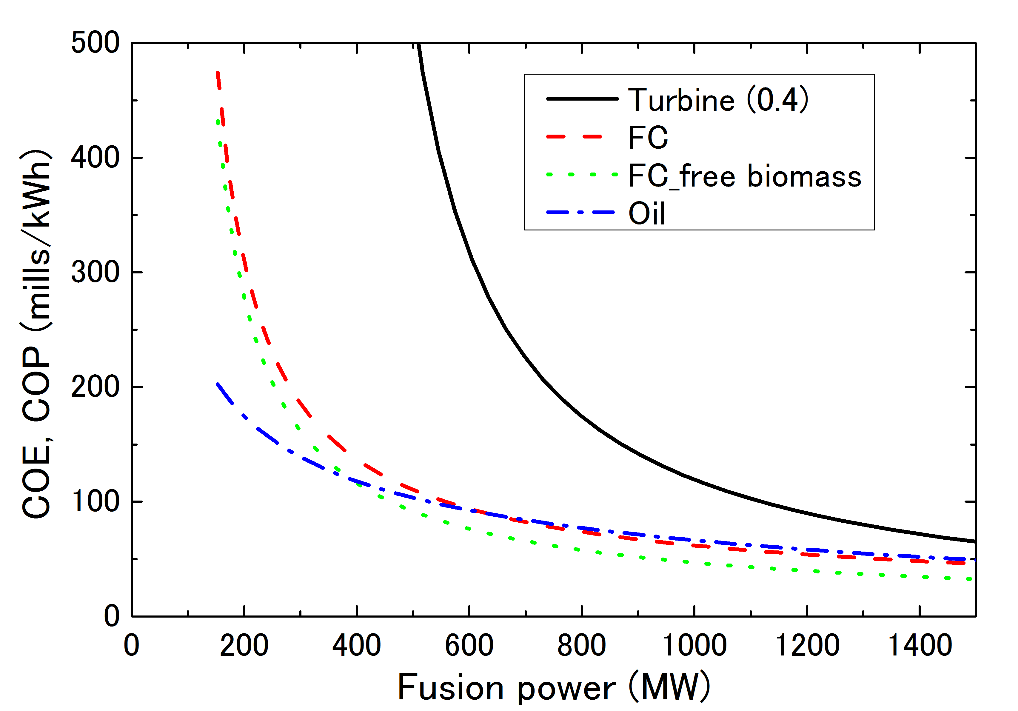
  Fusion electricity by fuel cells
FT plant case, P_{CD} is supplied by 100 mills/kWh
FCs
Turbine
Oil

