Slide 1








First principles and integrated modelling achievements towards trustful fusion power predictions for JET and ITER
J. Garcia¹, L. Garzotti², M. Nocente³, T.W. Bache², A. Banon-Navarro⁴, Y. Baranov², F. J. Casson², C. Challis², J. Citrin⁵, R. Dumont¹, D. Gallart⁶, T. Goerler⁴, A. Ho⁵, J. Joly¹, K. Kirov², J. Mailloux², M. Mantsinen⁷, J. Morales¹, S. Saarelma² and JET contributors∗
1 CEA, IRFM, F-13108 Saint-Paul-lez-Durance, France.
2 CCFE, Culham Science Centre, Abingdon, OX14 3DB, UK
3 Università degli Studi di Milano-Bicocca Milano, Lombardy, Italy
4 Max Planck Institute for Plasma Physics,Boltzmannstr. 2, 85748 Garching, Germany
5 DIFFER - Dutch Institute for Fundamental Energy Research
6 Barcelona Supercomputing Center (BSC-CNS) C. Gran Capità 2-4, 08034 Barcelona, Spain
7 ICREA-Barcelona Supercomputing Center, Barcelona, Spain

Slide 2
Outline-Relevant questions for a burning plasma campaign
Is the physics of pedestal, transport/turbulence, MHD and heating very different in DT with respect to DD plasmas?
Are the usual models used for predicting DD also valid for different isotopes?
Can we predict the neutrons generated in DD and extrapolate to DT?
Can optimum plasmas in DD be also optimum for DT operation?
Can JET-DT integrated operation be ITER relevant? i.e. it can help to minimize ITER risks in DT operation?
J. Garcia, 27th IAEA Fusion Energy Conference, Gandhinagar 25 October 2018|

Slide 3
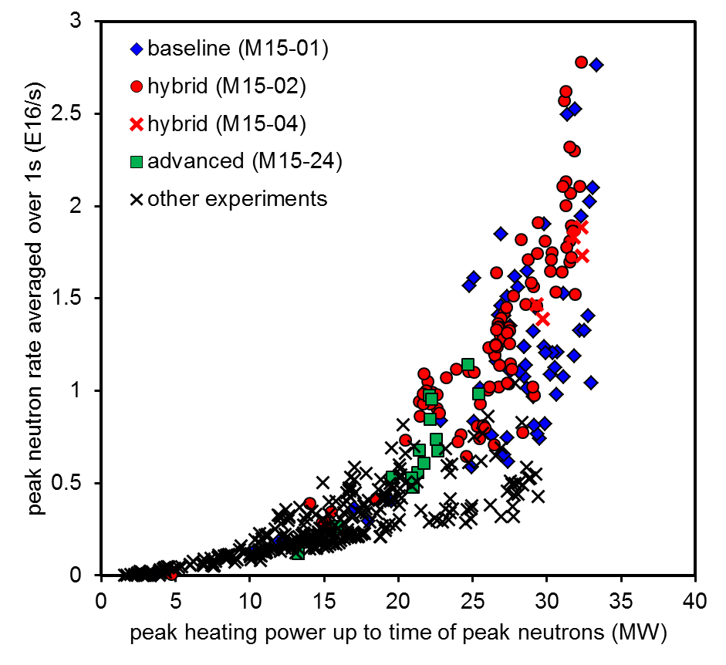
Content: Modelling/analyses/extrapolation strategy
Strong modelling program at JET in support of DD operation and credible DT predictions
Use of the DD plasmas with highest neutron rate or with ITB’s from the latest campaigns for:
Neutron rate vs Power
  Validation of models on existing D and H plasmas
  Verification of a extrapolation capability with existing D plasmas when changing power, Ip and Bt.
  Verification of the extrapolation strategy with future D plasmas
  Close the ‘gap’ with respect to DT physics: Validation of models with first DT JET campaign and future isotope experiments (T)
  First-principle modelling supporting the extrapolation strategy
JET-DT predictions
E. Joffrin et al. this conference
J. Garcia, 27th IAEA Fusion Energy Conference, Gandhinagar 25 October 2018|

Slide 4
Outline
Transport model validation with D and H plasmas
Neutron rate generation validation
DT extrapolations and physics of the DT isotope effect
Physics of alpha born particles
Conclusions
J. Garcia, 27th IAEA Fusion Energy Conference, Gandhinagar 25 October 2018|

Slide 5
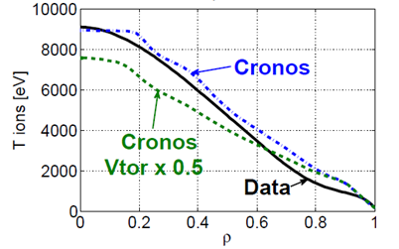
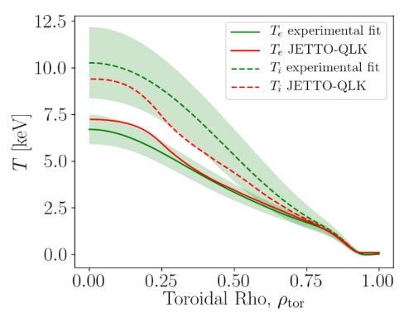
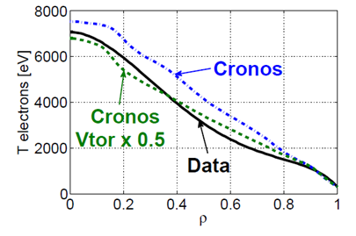
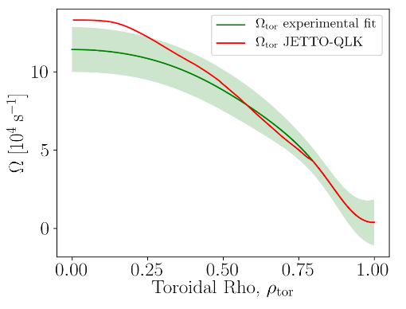
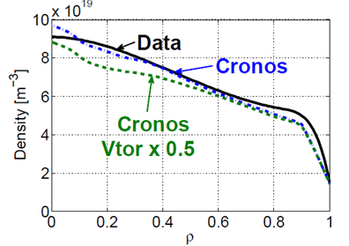
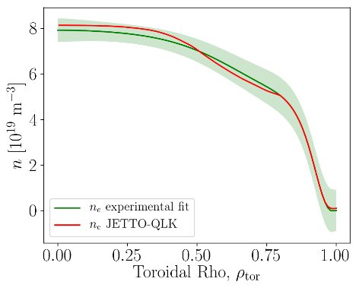
Validation of QL models with D : reasonable results
J. Morales EPS 18
A. Ho EPS18
  Validation of TGLF with JET D shot discharge 92436 using CRONOS
  Pedestal self-consistently simulated and experimental rotation used
  Results in reasonable agreement showing strong dependence on ExB shearing [Hyun-Tae Kim et al NF18]
  Validation of Qualikiz with JET D shot discharge 92436 using JINTRAC
  Fixed boundary at rho=0.8 but rotation self-consistently simulated
  Very good results for ne, Te, rot but Ti understimated
J. Garcia, 27th IAEA Fusion Energy Conference, Gandhinagar 25 October 2018|

Slide 6
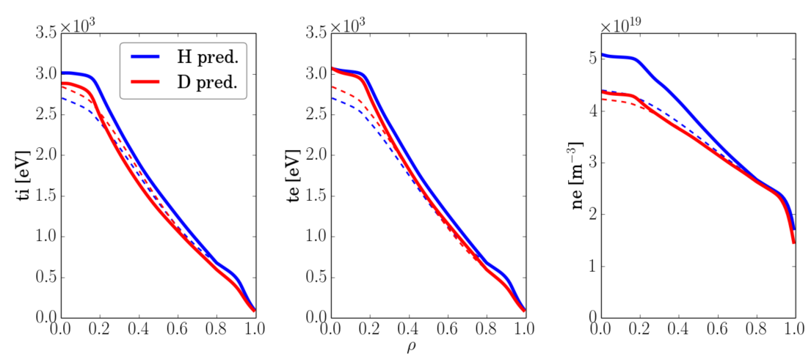
Validation of TGLF with H plasmas: discrepancies
4.5MW NBI H
3.2MW NBI D
  H campaign for comparing with D discharges [maggi C. F. et al PPCF18]
  Validation of TGLF with JET D and H discharges in L mode using JINTRAC and TGLF
  Temperatures well reproduced for both H and D but predicted particle confinement for H too high
  This trend is not universal, other simulations correctly predict H profiles [H. Weisen et al. this conference]
  Is the physics of the isotope effect well included in QL models?
J. Garcia, 27th IAEA Fusion Energy Conference, Gandhinagar 25 October 2018|

Slide 7
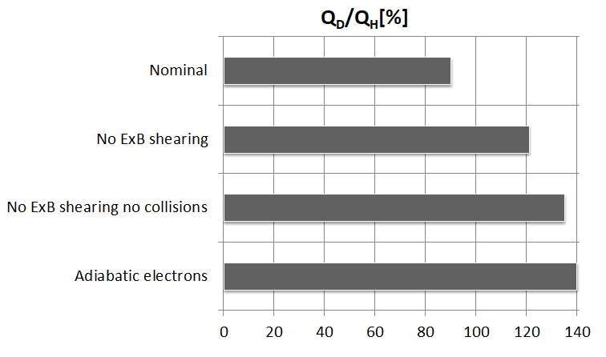
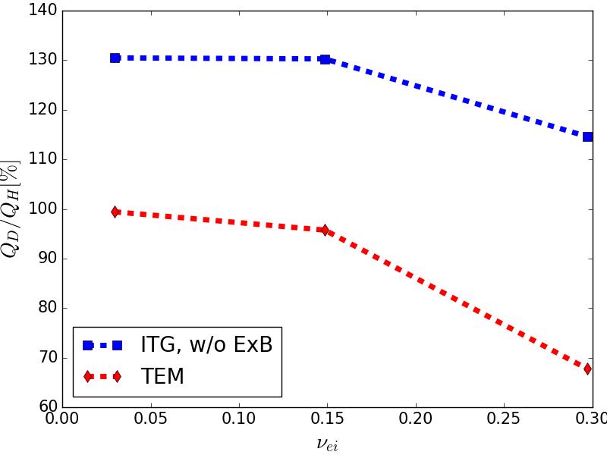

Conditions for anti-GB scaling
Q_{D}/Q_{H} $\sim$GB
  GENE [Jenko et al., PoP 2000] non-linear local simulations for H L-mode discharge. Only the mass changed from H to D
  ExB shearing, collisionality and electron transport: deviations from GB scaling.
  Impact of collisionality is turbulence regime dependent: ITG-TEM (weak) or pure TEM (strong)
  Some effects captured by QL models but not clear if all of them [H. Weisen et al. this conference]
  Message 1: Extrapolations to different D isotopes based on simplified modelling for transport must be carefully analyzed with first principle modelling
J. Garcia, 27th IAEA Fusion Energy Conference, Gandhinagar 25 October 2018|

Slide 8
Outline
Transport model validation with D and H plasmas
Neutron rate generation validation
DT extrapolations and physics of the DT isotope effect
Physics of alpha born particles
Conclusions
J. Garcia, 27th IAEA Fusion Energy Conference, Gandhinagar 25 October 2018|

Slide 9
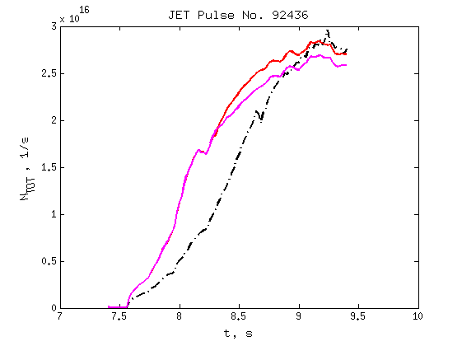
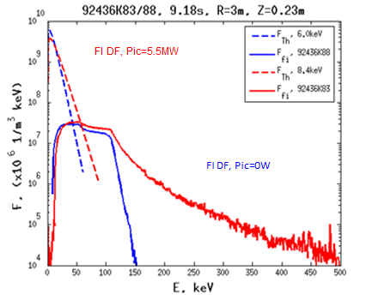
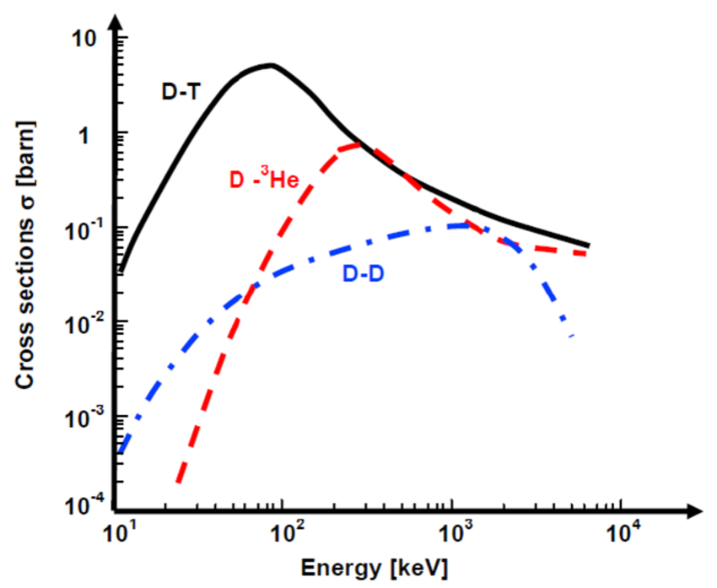
Neutron rate predictions and ICRH+NBI synergy
Strong activity on the neutron rate predictability in DD
TRANSP/TORIC gives on average 6% higher neutron rate when 5.5MW of ICRH power in H minority scheme
Enhancement in DD neutrons is due to fast ions (E>110keV) accelerated by ICRH;
In hybrid regimes up to 20% boost due to synergetic effects [D. Gallart et al NF18]
Not straightforward extrapolable to DT plasmas due to different DT cross-section [D. Gallart et al NF18]
Message 2: Optimum DD plasmas for neutron rate generation at JET are not straightforward extrapolable to DT.
J. Garcia, 27th IAEA Fusion Energy Conference, Gandhinagar 25 October 2018|

Slide 10
Outline
Transport model validation with D and H plasmas
Neutron rate generation validation
DT extrapolations and physics of the DT isotope effect
Physics of alpha born particles
Conclusions
J. Garcia, 27th IAEA Fusion Energy Conference, Gandhinagar 25 October 2018|

Slide 11
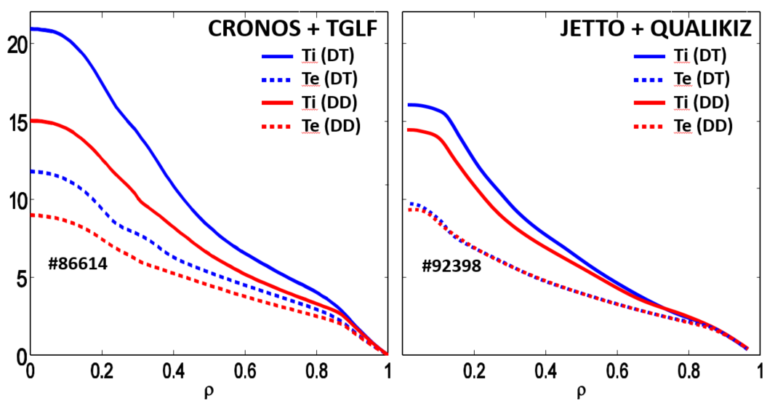
DT extrapolations with QL models: isotope effects
CRONOS+TGLF:
  JETTO+QLK:
Pedestal scales as ~ P_{in}^{0.41}m_{i}^{0.2}
No electron temperature gradient scales (ETG)
Alpha power contribution included.
No pedestal scaling
With electron temperature gradients (ETG)
Alpha power contribution included
J. Garcia PPCF 2016
F.J. Casson et al this conference
  DT extrapolation to 40 MW with different models (TGLF, Qualikiz) and integrated modelling suites
  Isotope effect for the hybrid route: better core thermal confinement in DT than DD and higher density peaking
  Several mechanisms playing a role: ExB shearing, Ti/Te, electrons and ions heat exchange, pedestal increasing
  How confident can we be in QL DT extrapolations? What can be the impact on ITER?
J. Garcia, 27th IAEA Fusion Energy Conference, Gandhinagar 25 October 2018|

Slide 12
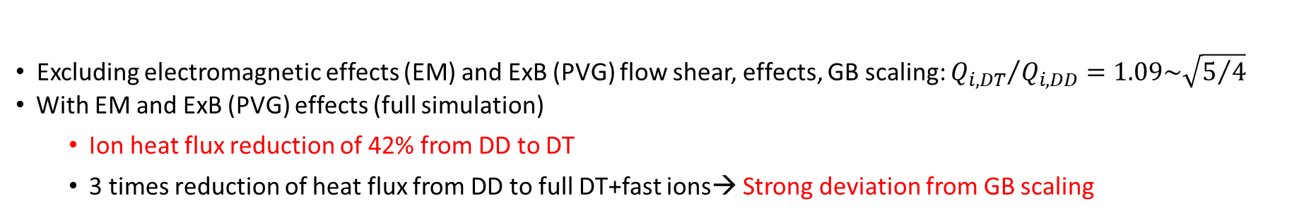
Isotope effects in DT ITER plasmas: strong heat flux reduction
Non-linear results of ITER hybrid scenario with GENE at $ρ=0.33$
J. Garcia et al. NF17
J. Garcia et al. POP18
Excluding electromagnetic effects (EM) and ExB (PVG) flow shear, effects, GB scaling: ${Q_{i,DT}}/{Q_{i,DD}=1.09\sim \sqrt{5/4}}$
With EM and ExB (PVG) effects (full simulation)
  Ion heat flux reduction of 42% from DD to DT
  3 times reduction of heat flux from DD to full DT+fast ions→ Strong deviation from GB scaling
Some of these effects are non-linear (zonal-flows) still have to be included in QL models, but some trends are captured
Message 3: DT isotope effects are complex and simplified modelling can only partially capture (for instance ExB shearing)
The physics of the DT isotope effect can be studied at JET for minimizing ITER risks
J. Garcia, 27th IAEA Fusion Energy Conference, Gandhinagar 25 October 2018|

Slide 13
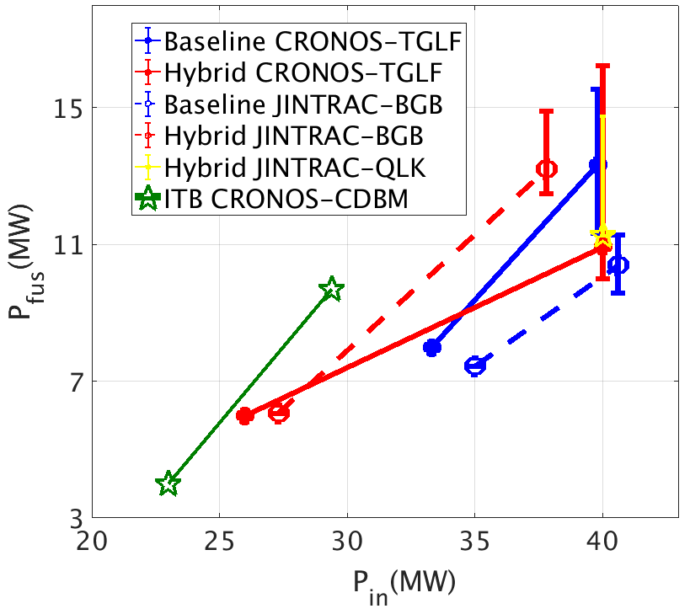
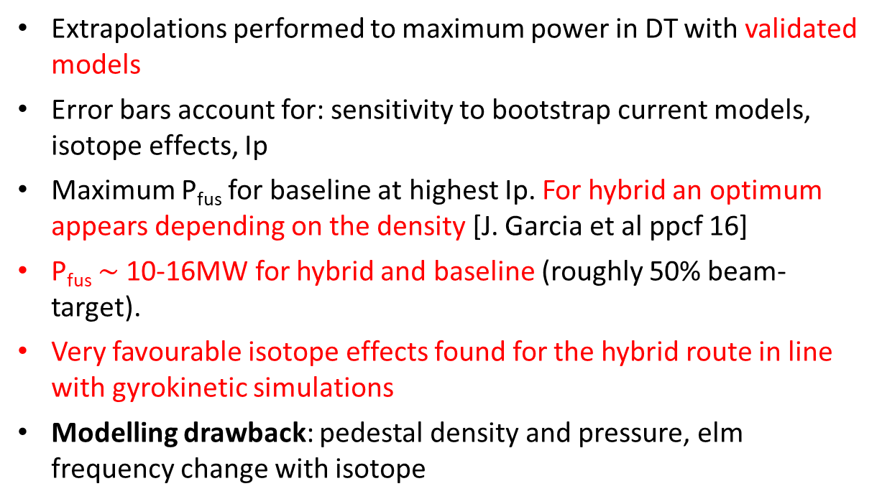
DT fusion power at JET extrapolation: significant isotope effects
Extrapolations performed to maximum power in DT with validated models
Error bars account for: sensitivity to bootstrap current models, isotope effects, Ip
Maximum P_{fus} for baseline at highest Ip. For hybrid an optimum appears depending on the density [J. Garcia et al ppcf 16]
P_{fus} $\sim$10-16MW for hybrid and baseline (roughly 50% beam-target).
Very favourable isotope effects found for the hybrid route in line with gyrokinetic simulations
Modelling drawback: pedestal density and pressure, elm frequency change with isotope
J. Garcia et al ppcf 16
S. Saarelma et al. ppcf 18
Message 4: Similar P_{fus} than the first DT campaign at JET but with plasmas closer to ITER conditions. The DT isotope effect obtained could be even underestimated
J. Garcia, 27th IAEA Fusion Energy Conference, Gandhinagar 25 October 2018|

Slide 14
Outline
Transport model validation with D and H plasmas
Neutron rate generation validation
DT extrapolations and physics of the DT isotope effect
Physics of alpha born particles
Conclusions
J. Garcia, 27th IAEA Fusion Energy Conference, Gandhinagar 25 October 2018|

Slide 15
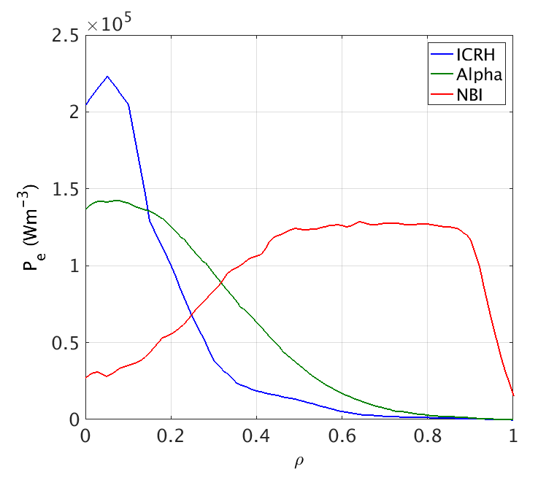
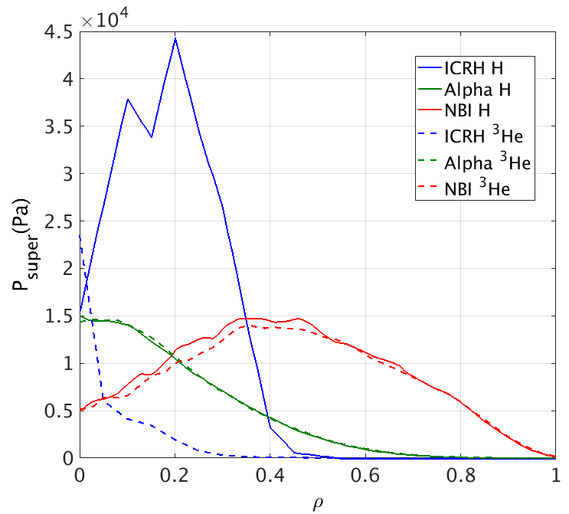
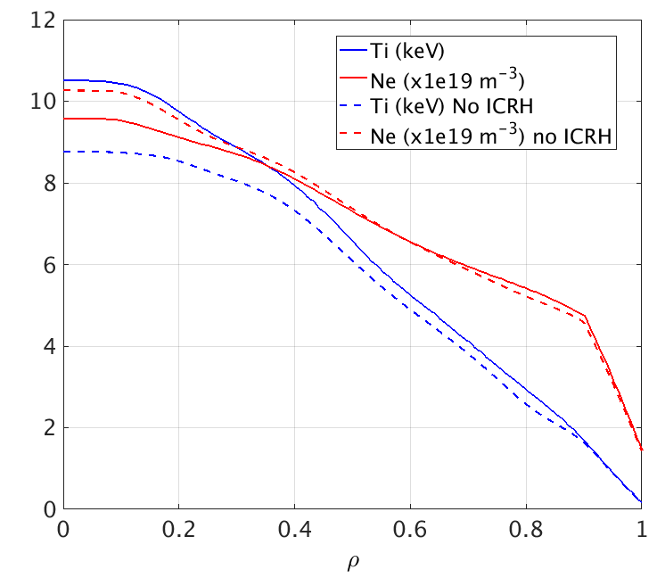
Alpha physics analyses at JET
Alpha physics analyses possible in JET-DT scenarios
Quite significant alpha heating to the electrons and fast ions pressure…
… but direct competition of ICRH: how to clearly see alpha effects?
Two possible solutions:
  Using ³He as alternative to H minority (ITER scheme)
  Removing ICRH for two slowing down time→ W accumulation? [F.J. Casson et al. this conference]
J. Garcia, 27th IAEA Fusion Energy Conference, Gandhinagar 25 October 2018|

Slide 16
Outline
Transport model validation with D and H plasmas
Neutron rate generation validation
DT extrapolations and physics of the DT isotope effect
Physics of alpha born particles
Conclusions
J. Garcia, 27th IAEA Fusion Energy Conference, Gandhinagar 25 October 2018|

Slide 17
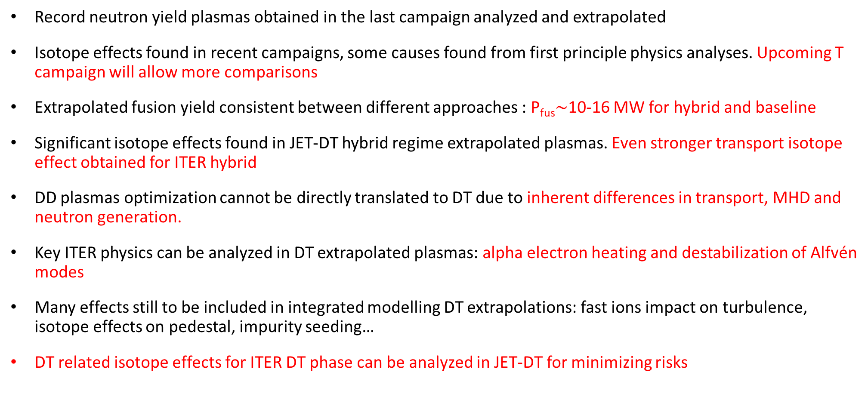
Conclusions
Record neutron yield plasmas obtained in the last campaign analyzed and extrapolated
Isotope effects found in recent campaigns, some causes found from first principle physics analyses. Upcoming T campaign will allow more comparisons
Extrapolated fusion yield consistent between different approaches : P_{fus}$\sim$10-16 MW for hybrid and baseline
Significant isotope effects found in JET-DT hybrid regime extrapolated plasmas. Even stronger transport isotope effect obtained for ITER hybrid
DD plasmas optimization cannot be directly translated to DT due to inherent differences in transport, MHD and neutron generation.
Key ITER physics can be analyzed in DT extrapolated plasmas: alpha electron heating and destabilization of Alfvén modes
Many effects still to be included in integrated modelling DT extrapolations: fast ions impact on turbulence, isotope effects on pedestal, impurity seeding…
DT related isotope effects for ITER DT phase can be analyzed in JET-DT for minimizing risks
J. Garcia, 27th IAEA Fusion Energy Conference, Gandhinagar 25 October 2018|

Slide 18
J. Garcia, 27th IAEA Fusion Energy Conference, Gandhinagar 25 October 2018|

