Slide 1
Core Density Peaking Experiments in JET, DIII-D and C-Mod in Various Operational Scenarios − Driven by Fueling or Transport?
Tuomas Tala

Slide 2
Core Density Peaking Experiments in JET, DIII-D and C-Mod in Various Operational Scenarios − Driven by Fuelling or Transport?
T. Tala¹, S. Mordijck², H. Nordman³, A. Salmi¹, C. Bourdelle⁴, J. Citrin⁵, A. Czarnecka⁶, F. Eriksson³, E. Fransson³, C. Giroud⁷, J. Hillesheim⁷, A. Hubbard⁸, J.W. Hughes⁸, C. Maggi⁷, P. Mantica⁹, A. Marioni⁹, M. Maslov⁷, G. McKee, L. Meneses¹⁰, S. Menmuir⁷, V. Naulin¹¹, M. Oberparleiter³, T. Rhodes, G. Sips¹², A. Skyman³, D. Tegnered³, M. Tsalas¹³, E. Tolman⁸, H. Weisen¹⁴ and JET contributors*
¹VTT, P.O. Box 1000, FI-02044 VTT, Espoo, Finland
²The College of William and Mary, Williamsburg, 23187, USA
³Chalmers University of Technology, Göteborg, Sweden
⁴CEA, IRFM, F-13108 Saint-Paul-lez-Durance, France
⁵DIFFER, Eindhoven, Netherlands
⁶IPPLM, Warsaw, Poland
⁷CCFE, Culham Science Centre, Abingdon, OX14 3DB, UK
⁸MIT Plasma Science and Fusion Center, Cambridge, MA, USA
⁹Istituto di Fisica del Plasma, via Cozzi 53, Milano, Italy
¹⁰Instituto de Plasmas e Fusão Nuclear, IST, Lisbon, Portugal
¹¹Danish Technical University Physics, Lyngby, Denmark
¹²Commission, Brussels, Belgium
¹³ITER Organisation, Cadarache, France
¹⁴CRPP, Lausanne, Switzerland
*See the author list of X. Litaudon et al (2017), Nucl. Fusion 57 102001.

Slide 3
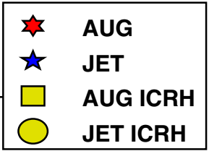
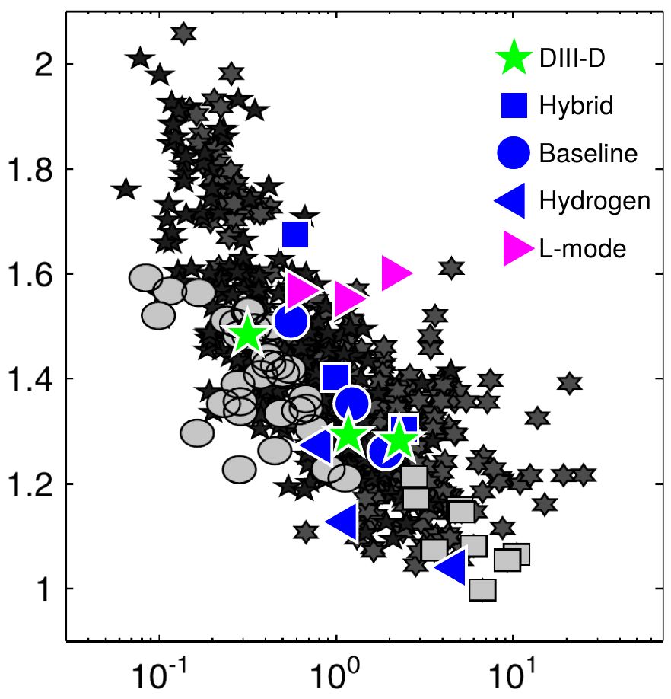
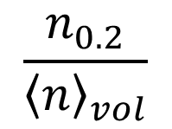
Do We Understand Where Core Density Peaking is Coming from?
Angioni, NF 2007
High density in the core is desirable for fusion $P_{fus}\sim n_{e}^{2}$
Previous works [1-5] have identified strong dependency between density peaking and collisionality υ* or υ_{eff}
Multi-machine steady state databases
Theory + GK modelling have identified mechanisms
In this talk, we will clarify what is still missing:
Origin of the peaking (transport versus fueling)
Linear regression limited to database averages
Test of models against dedicated υ* scans
This is the first time when electron particle transport coefficients in H-mode have been measured in tokamaks with high resolution diagnostics yielding a unique dataset
Dimensionless nu* scans
ITER
$$\frac{n_{0.2}}{{〈n〉}_{vol}}$$
[1] H. Weisen, PPCF 2006
[2] C. Angioni, NF 2007
[3] M. Greenwald, NF 2007
[4] M. Valovic PPCF 2004
[5] L. Garzotti, NF 2006
$$ν_{eff}$$
$$ν_{eff}=ν_{ei}/ν_{De}$$

Slide 4
Gas Puff Modulation Experiment to Obtain Electron Particle Diffusivity D and Convection v
Density
Gas puff modulation at 2-4Hz frequency at the top of the vessel
Both high resolution Thomson Scattering and density profile reflectometry diagnostics to follow the propagating density wave
Modulation amplitudes of the order of 1% in the core measured
Using perturbative approach, $\tilde{n}=A\sin\left(ωt+φ\right),$ and linearization and some algebra, we will obtain the electron particle transport coefficients D and v
Core
Edge

Slide 5
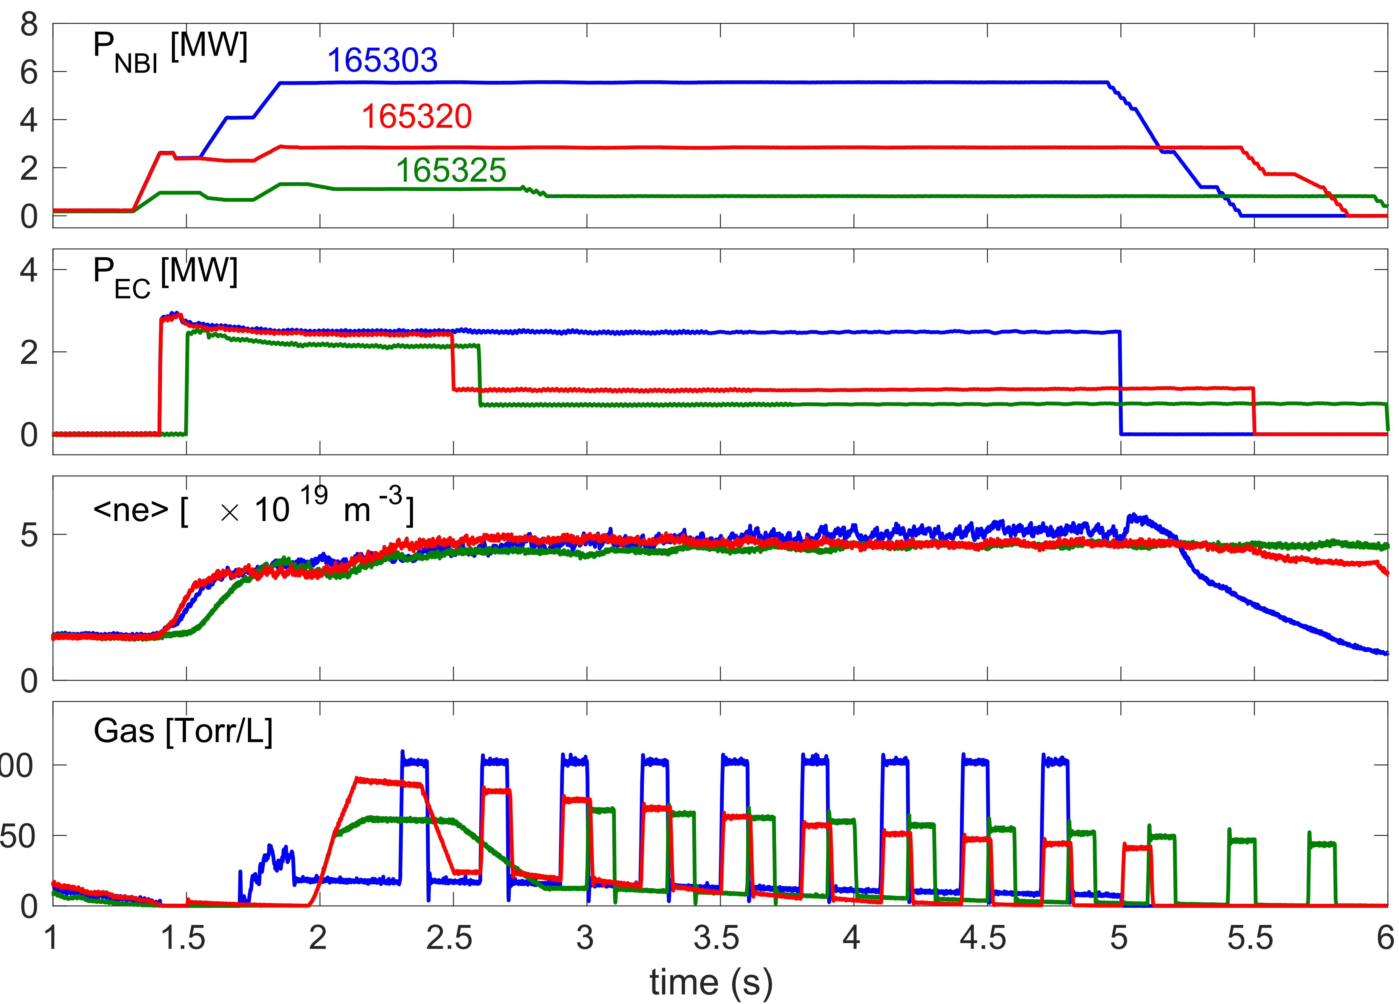
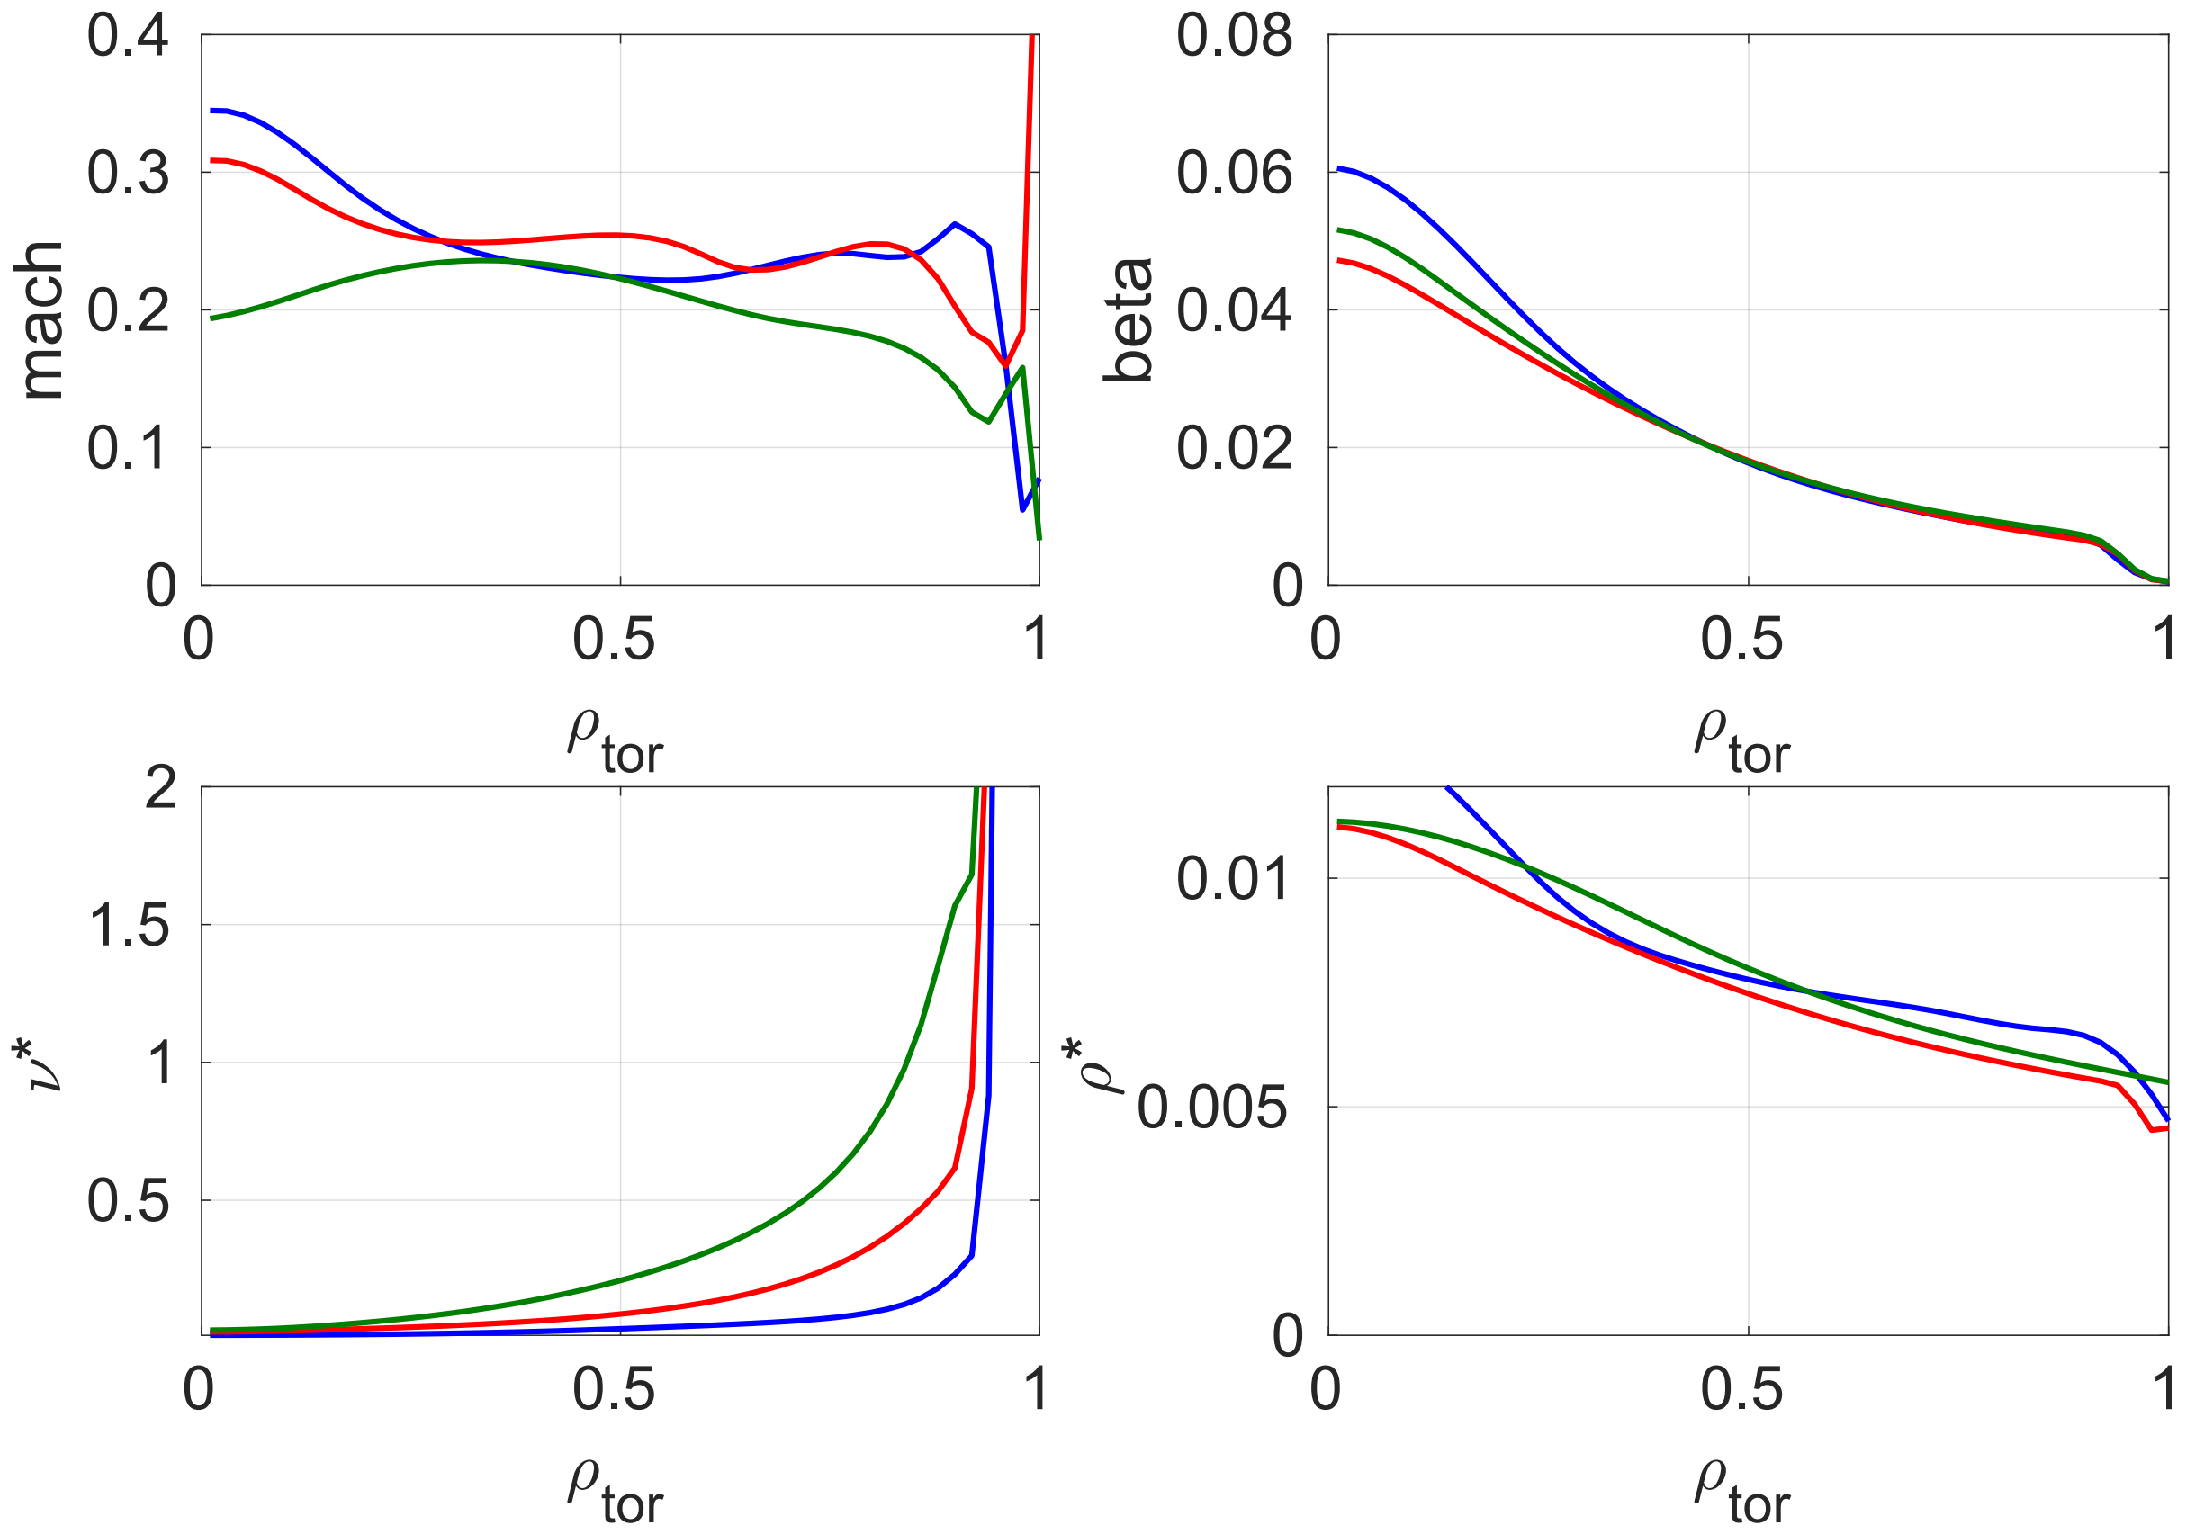
The Experimental Set-up for the 3-point ʋ* Scans ̶ the DIII-D Scan Here as an Example
Collisionality scan is obtained by changing $B_{T}, I_{P},$ NBI power, torque and fueling
Dimensionless parameters matched typically to within 10% both in DIII-D and JET
Change in ʋ* in each scan a factor of 5-6
Excellent dataset for code validation
(low υ*) (middle υ*)
(high υ*)
Mach
β
Analysis window
ʋ*
ρ*
Time (s)

Slide 6
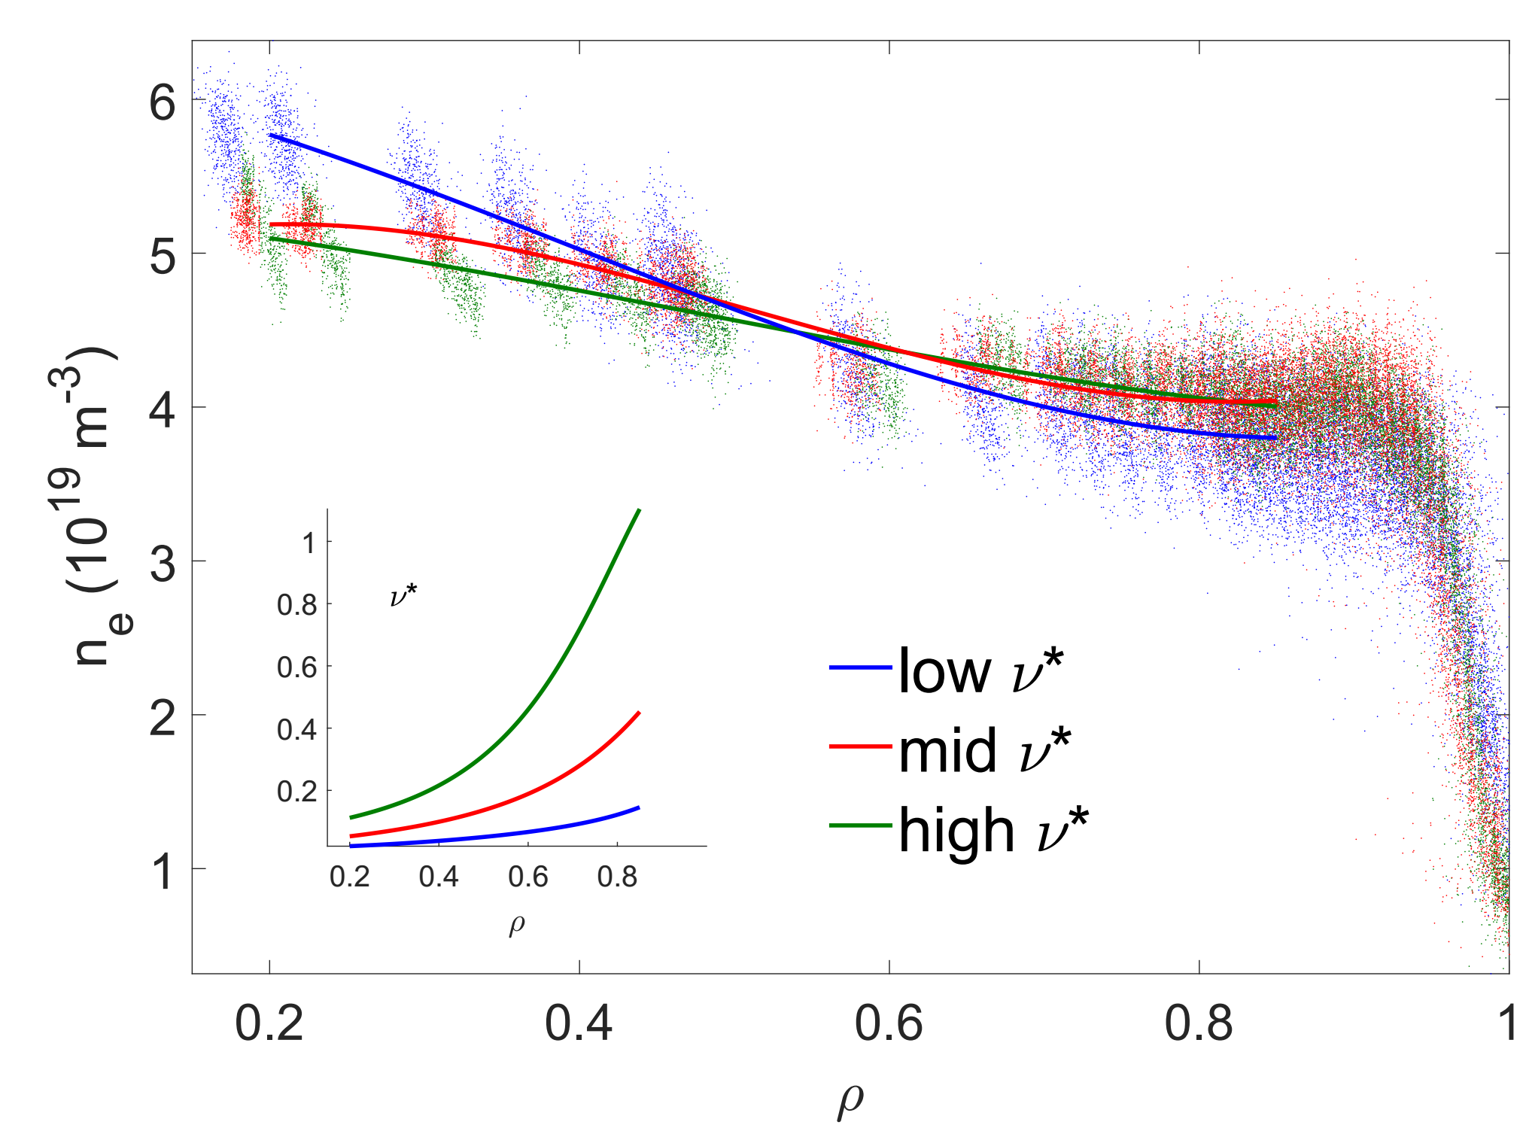
Five Separate Dimensionless ʋ* Scans Performed in Total on JET and DIII-D ̶
Density Peaking Increases with Decreasing ʋ* in All H-mode Scenarios
Baseline ELMy H-mode
Hybrid-like scenario
(low υ*) (middle υ*)
(high υ*)
DIII-D
How does I-mode
on C-Mod compare?
ELMy H-mode in Hydrogen
L-mode plasma

Slide 7
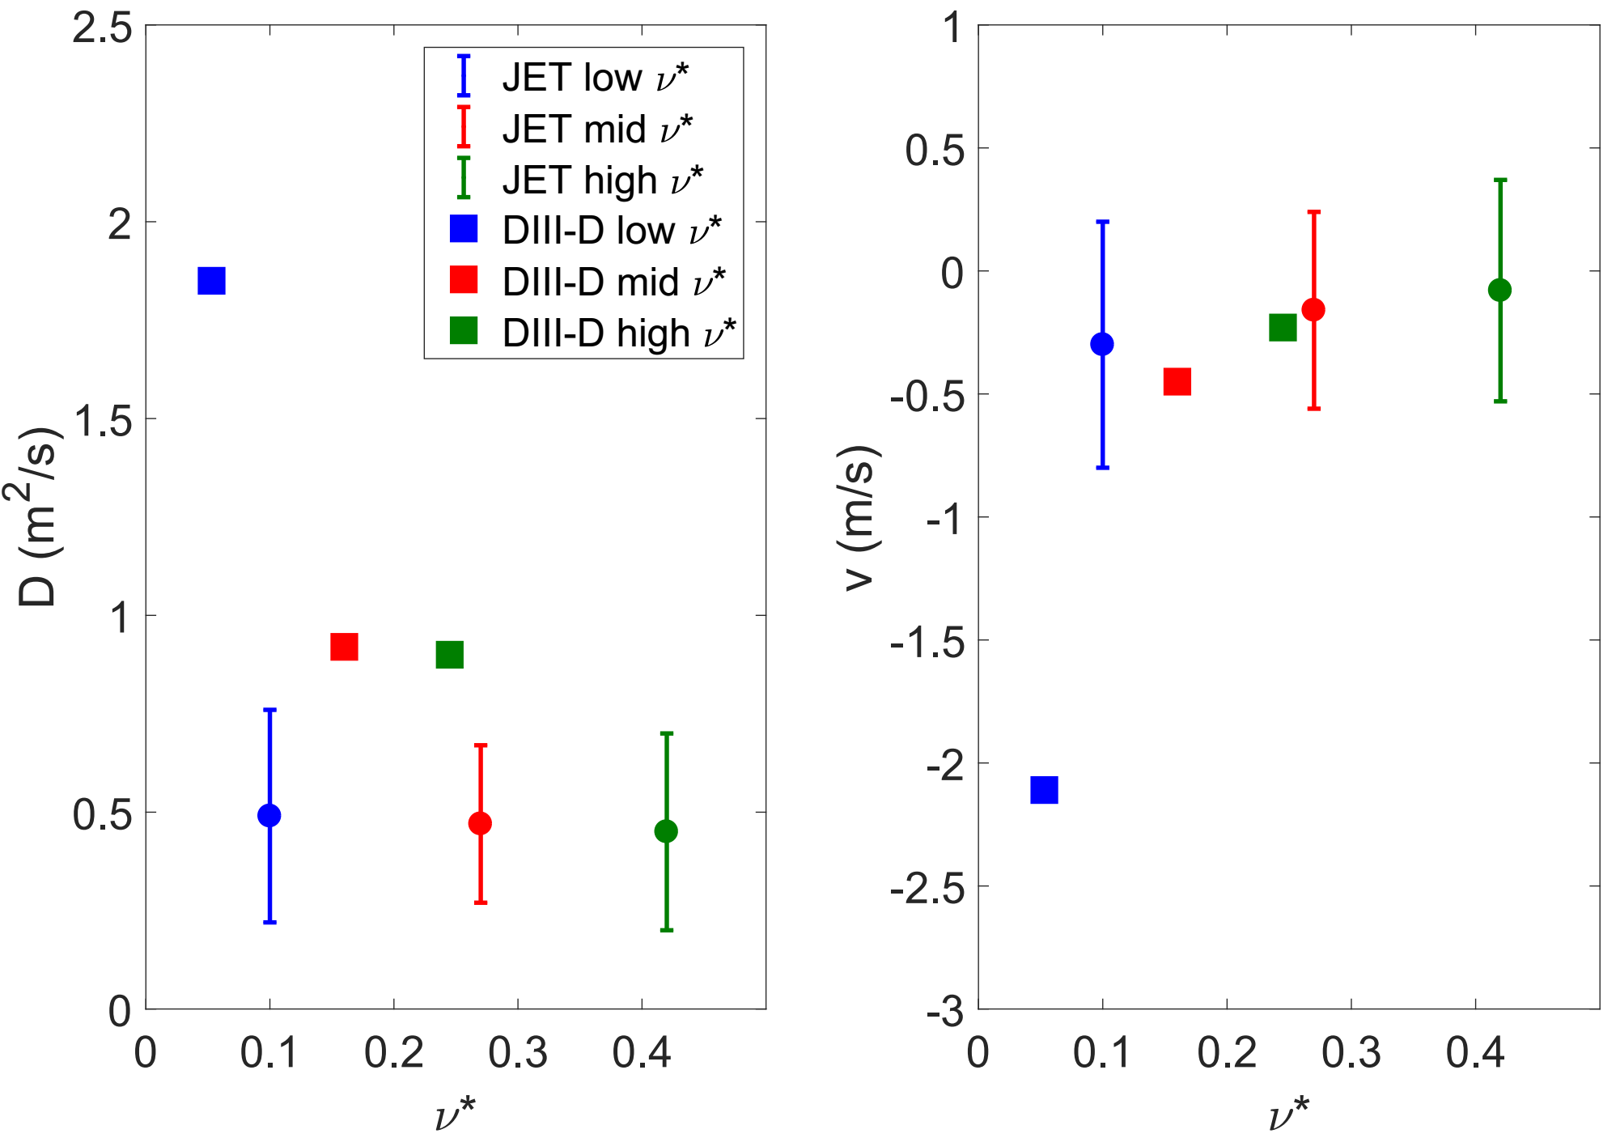
Inward Pinch Increases with Decreasing υ*
Averaged over ρ=[0.5,0.8]
Particle transport coefficients are higher on DIII-D than on JET
Higher transport coefficients on DIII-D due to larger plasma volume and higher NBI power density and ECH consequences on the origin of the density peaking
Lowest υ* discharge on DIII-D jumps off the scan
DIII-D:
JET:
$$−D∇n_{e}$$
$$−D∇n_{e}$$
$$n_{e}$$
$$n_{e}$$
$$S_{NBI}$$
$$S_{NBI}$$

Slide 8
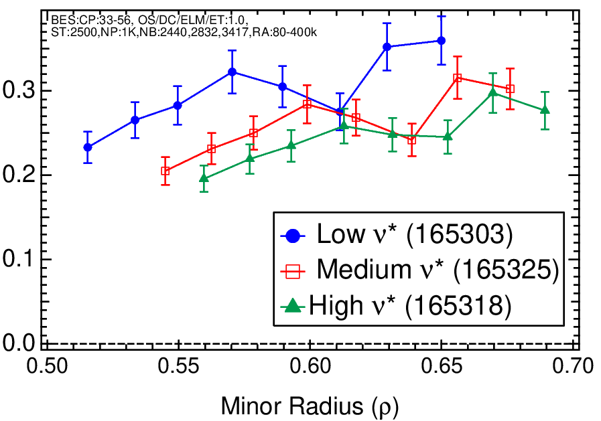
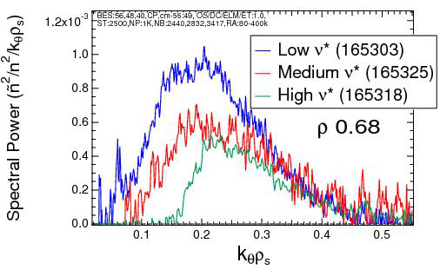
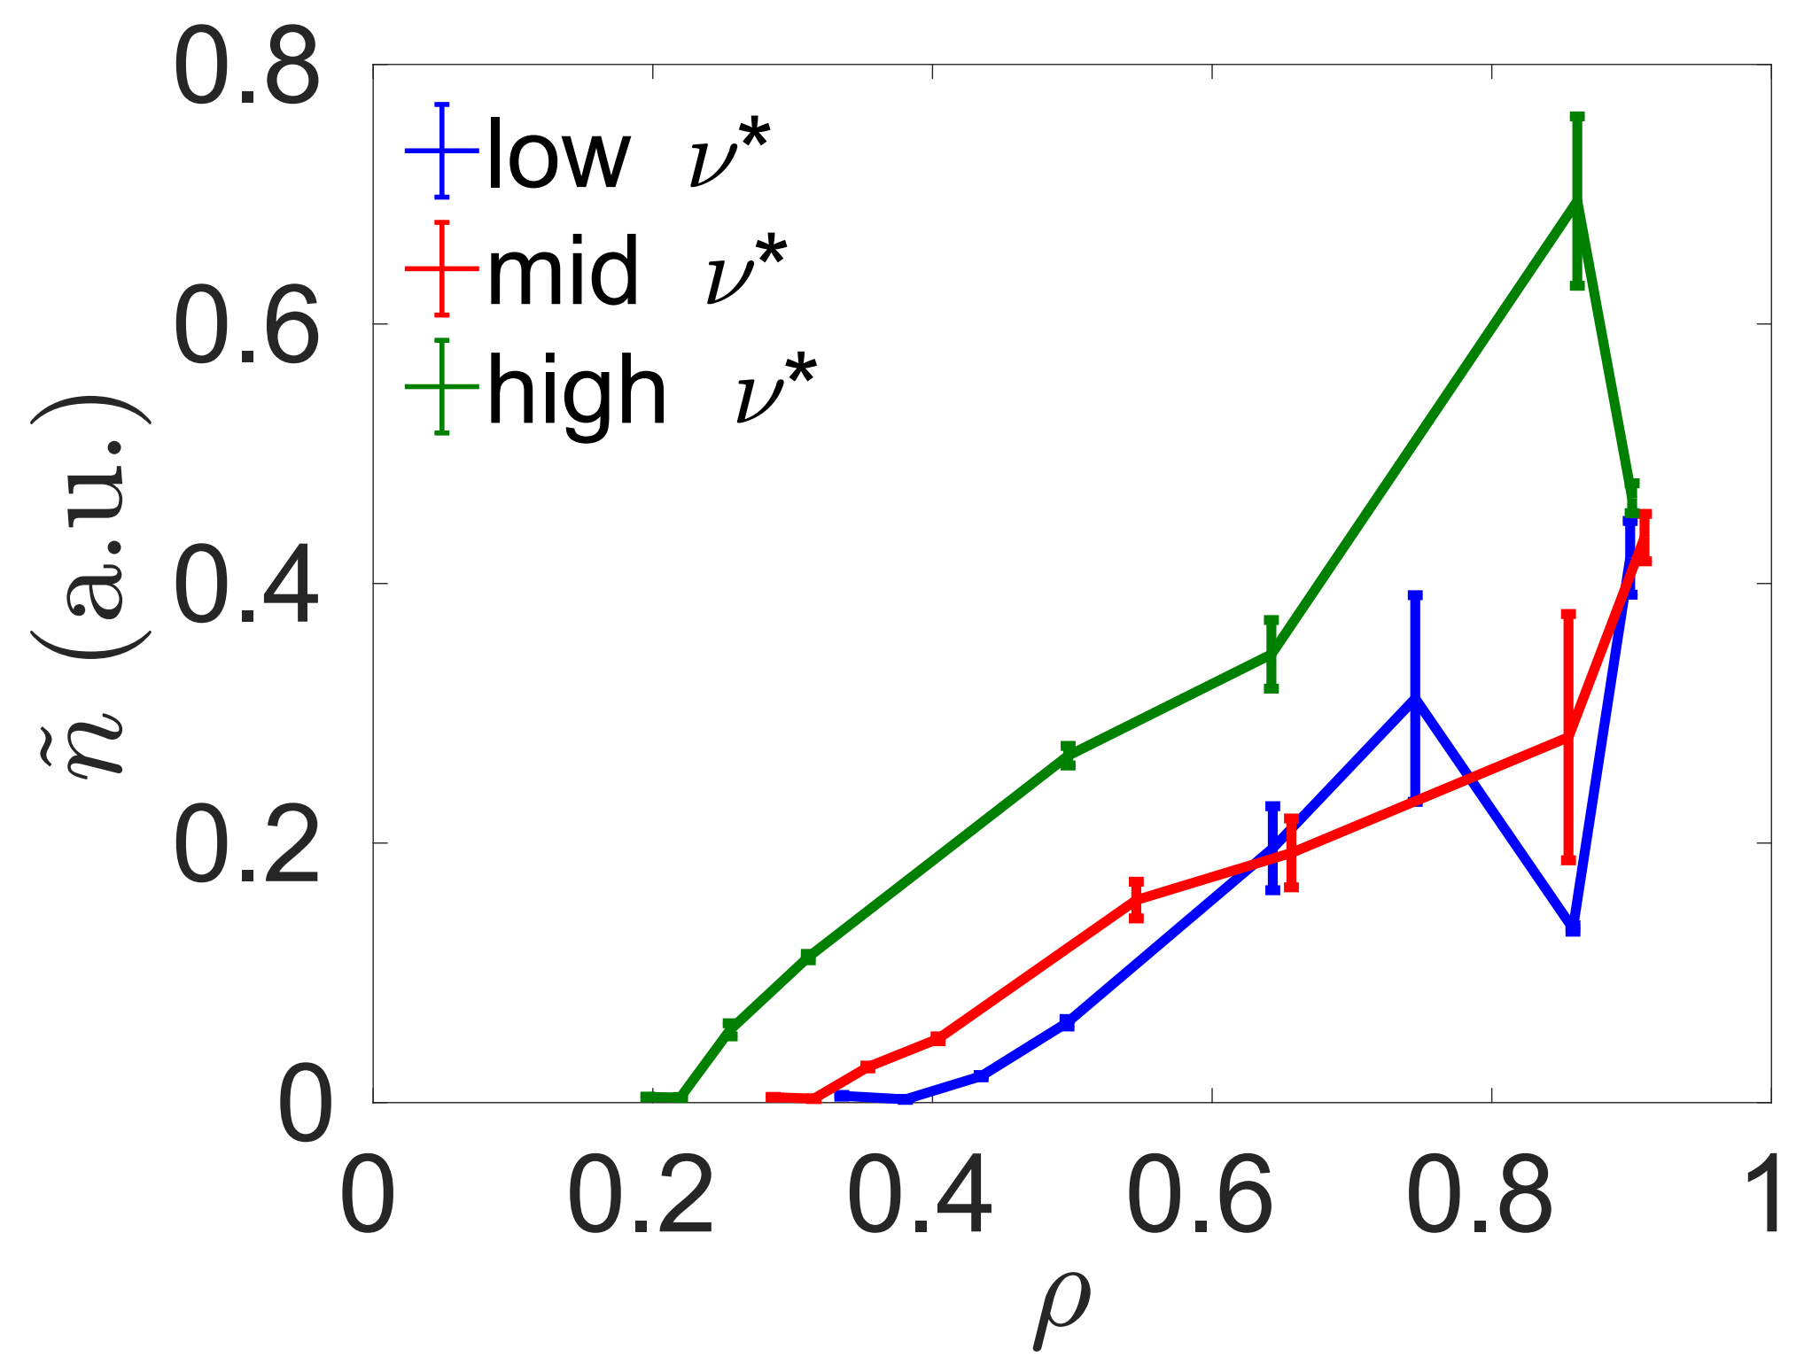
Beam Emission Spectroscopy (BES) Data Suggests an Increase in ITG at low υ* – Indicative of Increase in the Inward Thermo-Diffusion Pinch
Beam Emission Spectroscopy (BES), ITG range
Doppler Back Scattering (DBS)
Low-k fluctuations $(k_{θ}ρ_{s}<1$) increase moderately with lower collisionality
Higher k fluctuations $(k_{θ}ρ_{s}\sim 1−5$) decrease moderately with lower υ*
$\tilde{n}$ [%]

Slide 9
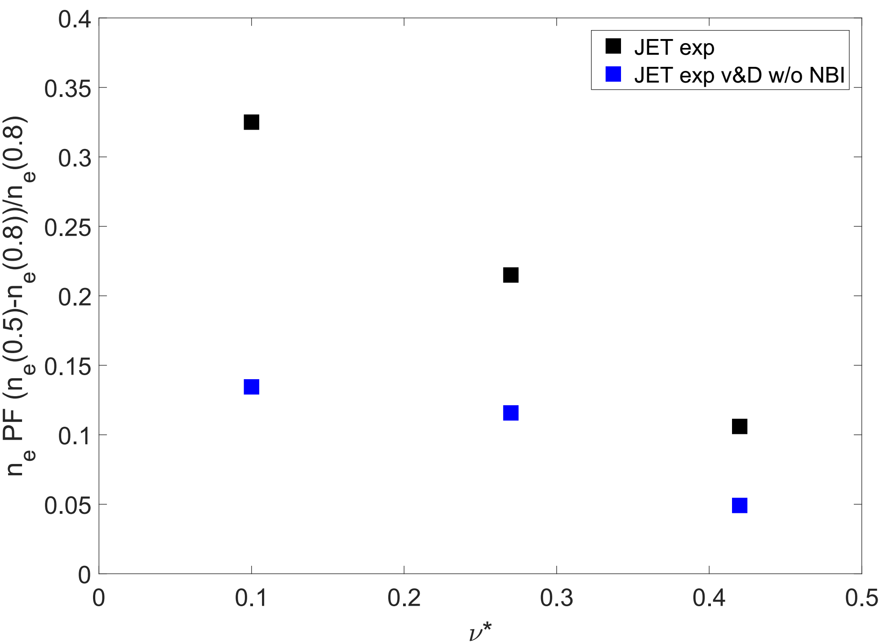
NBI Fueling Contributes around 50-70% to the Density Peaking in JET H-mode Plasmas
Core density peaking factor
The experimental D and V show that the contribution of NBI fueling to n_{e} peaking is 50-70% in the ELMy H-mode scan in JET
This fraction is independent of υ*
In this parameter regime (3-point υ* scan) at q₉₅=5, T_{i}/T_{e}=1, β_{N}=1.4, ρ∗=0.003 and υ*=[0.1,0.5], the NBI fueling is dominant
PF due to NBI source
PF due to inward pinch

Slide 10
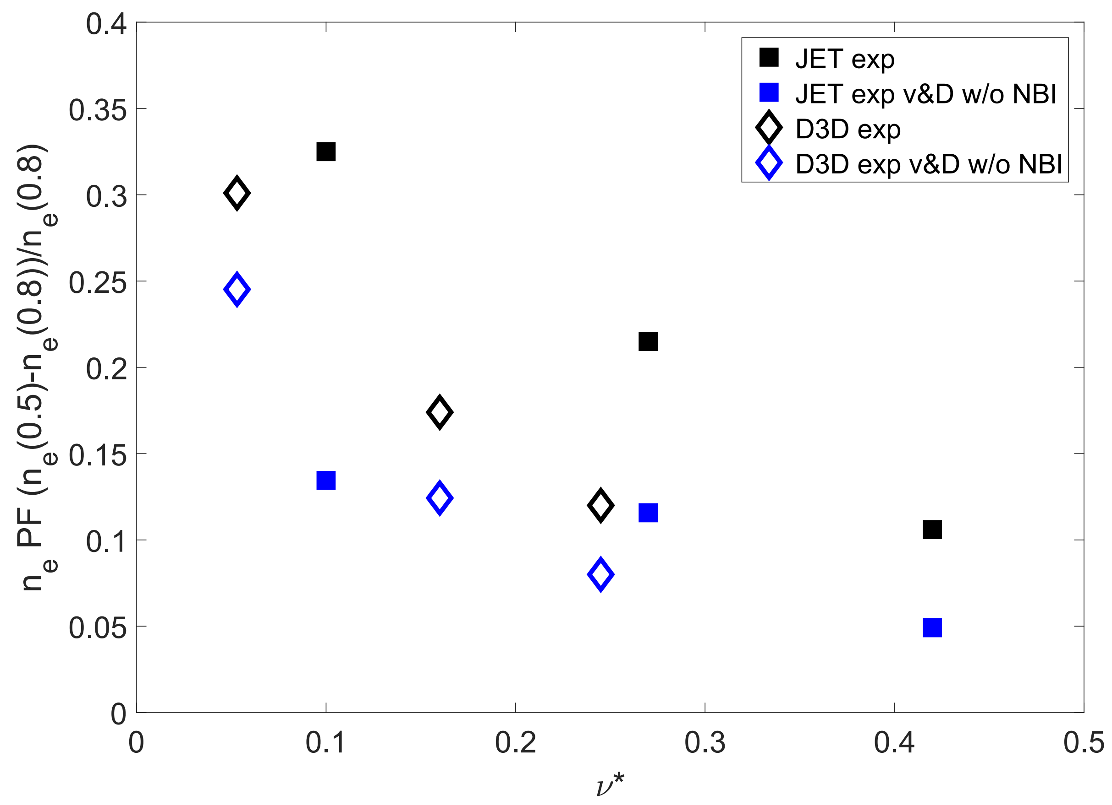
On DIII-D, Density Peaking from NBI is 15-30%
Core density peaking factor
The experimental D and V show that the fraction of NBI fueling is 15-30% on DIII-D
This fraction decreases with decreasing υ*
Clearly JET and DIII-D are different wrt density peaking. Why?
NBI particle source – no, DIII-D source stronger
Transport – yes, Trapped Electron modes (TEM) stronger than in JET, JET is deeply ITG dominated
Diffusion larger on DIII-D than on JET, JET has larger confinement time, thus the source stays in the plasma way longer in JET
PF due to NBI source
PF due to inward pinch

Slide 11
Model and Code Validation ….

Slide 12
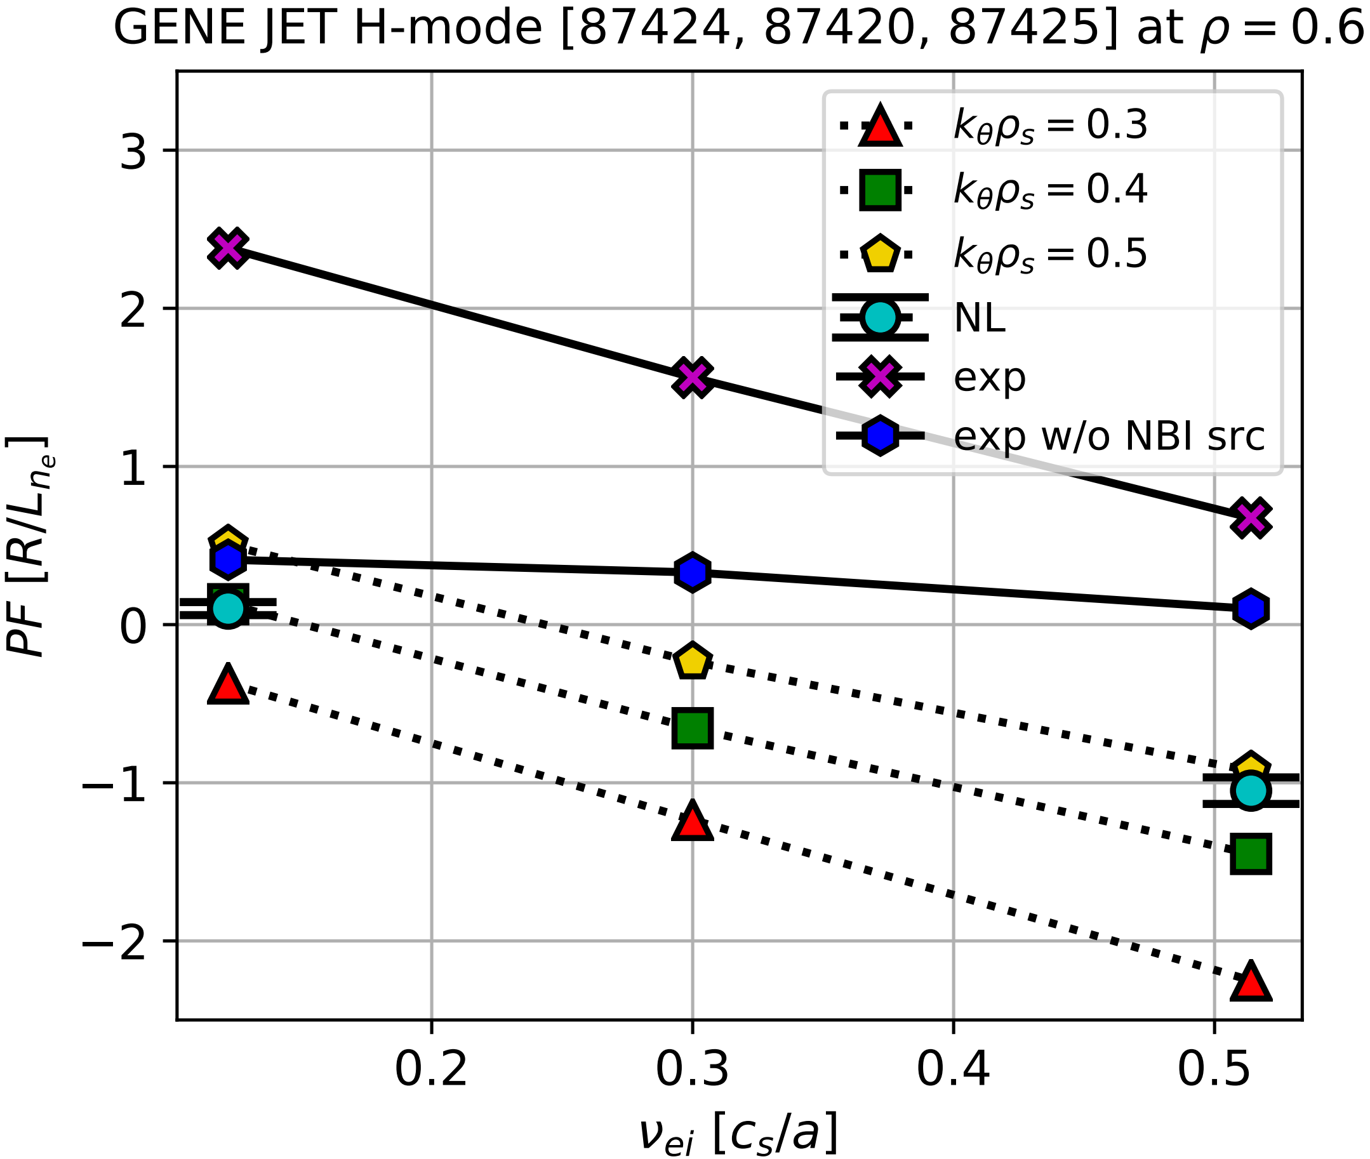
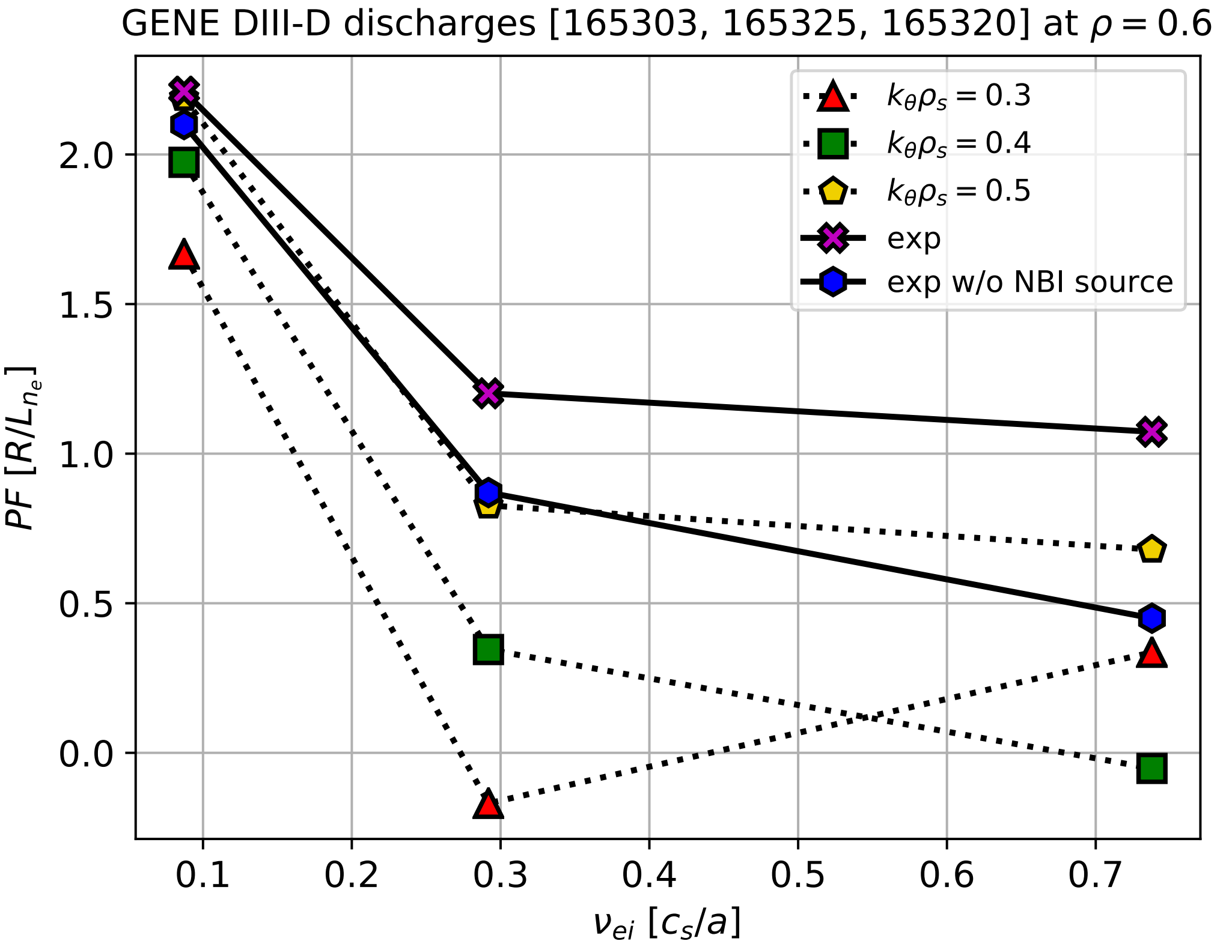
GENE Simulations Predict Zero Peaking in JET H-mode, but Peaked Profiles in DIII-D H-mode Plasma in Agreement with Experiments
JET
DIII-D
GENE in agreement with “transport versus fueling” contributions to the density peaking.
GENE [1] predicts flat or even hollow (at high υ*) density profiles, implying that the NBI particle source dominates in contributing to density peaking.
[1] F. Jenko, PoP 2000

Slide 13
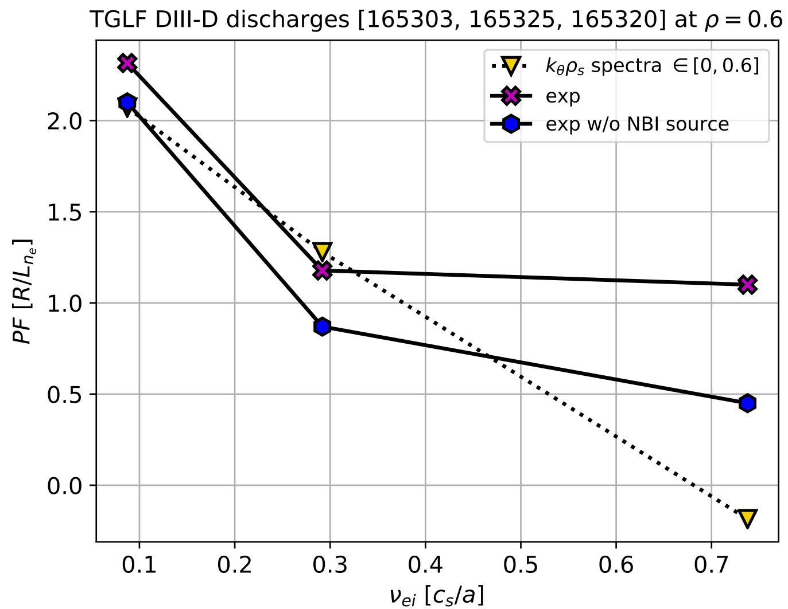
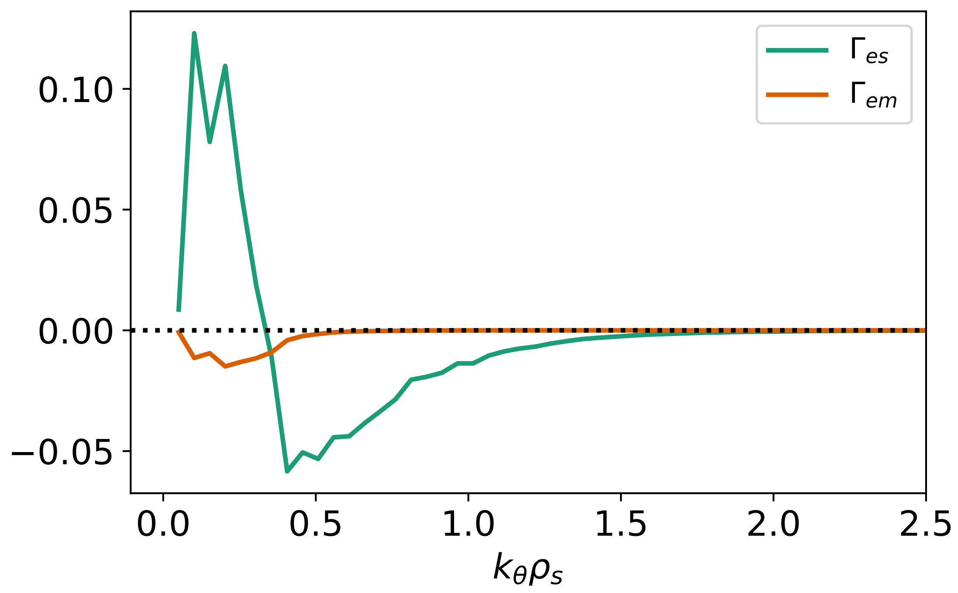
Non-linear GENE Simulation Predict Zero Peaking in JET H-mode – Stand-alone TGLF Runs in Good Agreement against the DIII-D υ* Scan
JET
DIII-D
Stand-alone TGLF predicts the peaking factor in agreement with experimental density peaking
Non-linear GENE predicts also flat density profile in JET, suggesting that the NBI particle source dominates in contributing to density peaking.
Particle flux

Slide 14
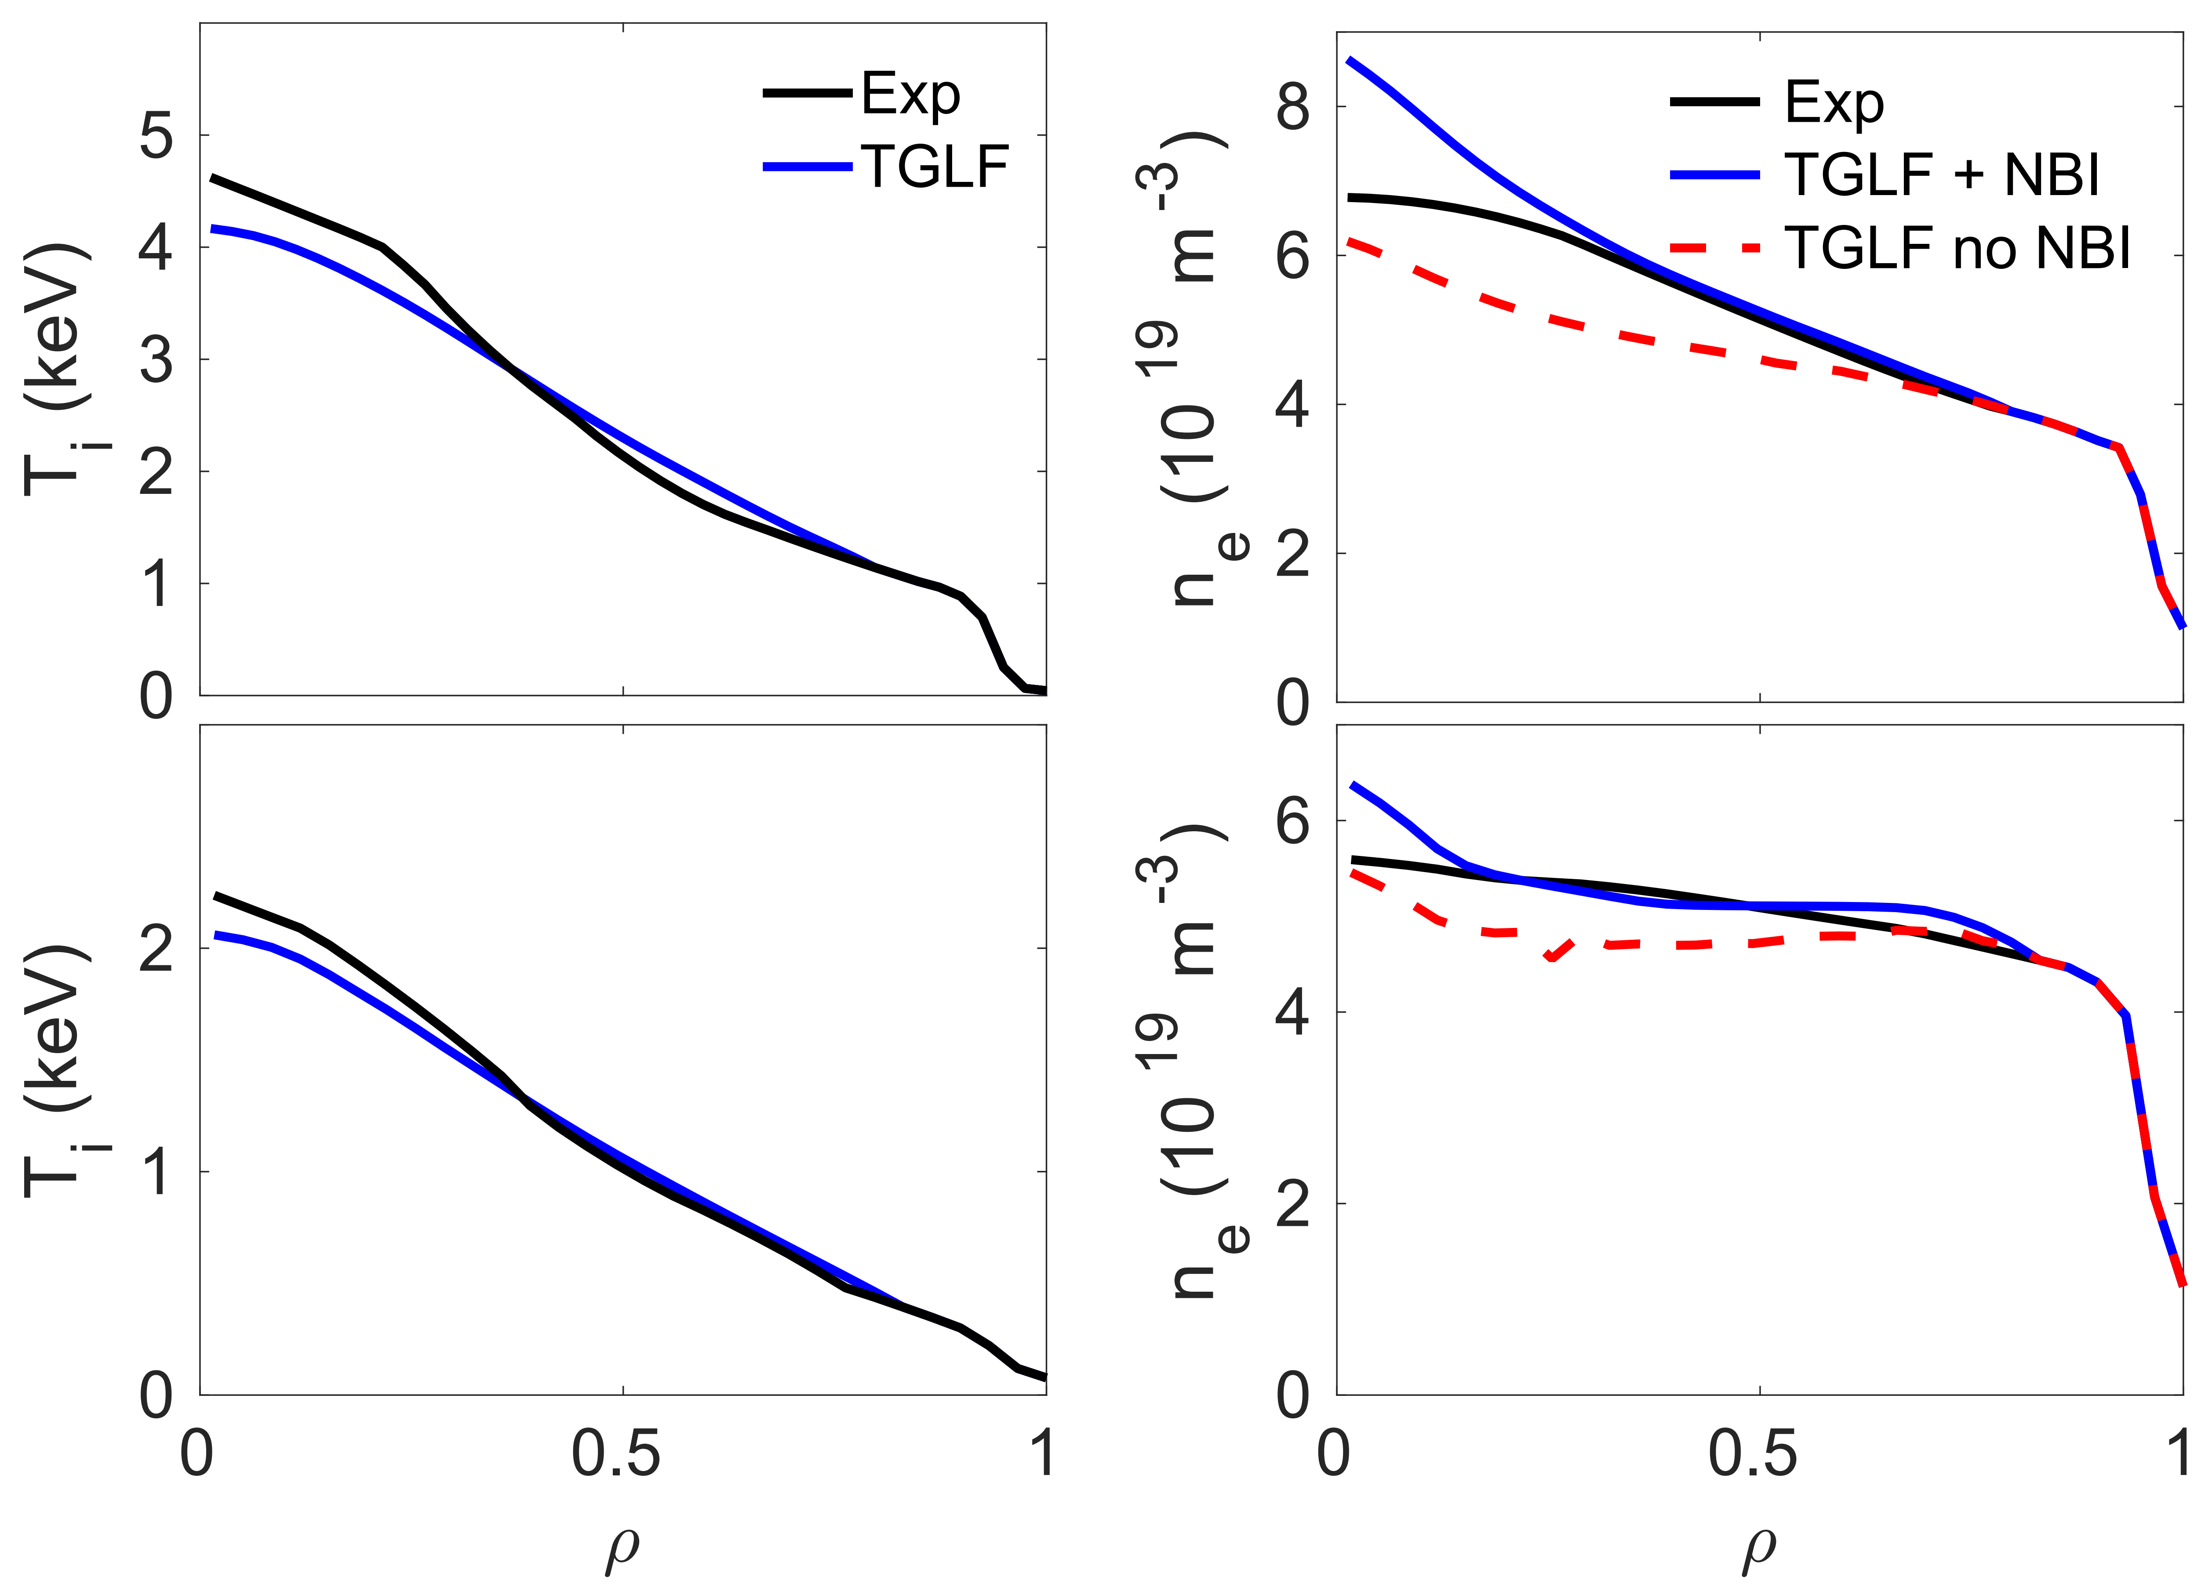
TGLF Modelling of the JET υ* Scan in H-mode – NBI Source Contributes to Density Peaking at 50-90% Fraction
TGLF [1] peaking factor from NBI source using the JINTRAC transport code [2]:
Low υ*: 47%
High υ*: 90%
TGLF predicts similar results for Hybrid and ELMy H-mode in Hydrogen 3-point υ* scans
In L-mode, NBI source less important ~10%
TGLF performs well against JET discharges for each υ*
[1] G. Staebler, PoP 2005
[2] M. Romanelli, Plasma and Fusion Research 2014
Low υ*
Low υ*
High υ*
High υ*

Slide 15
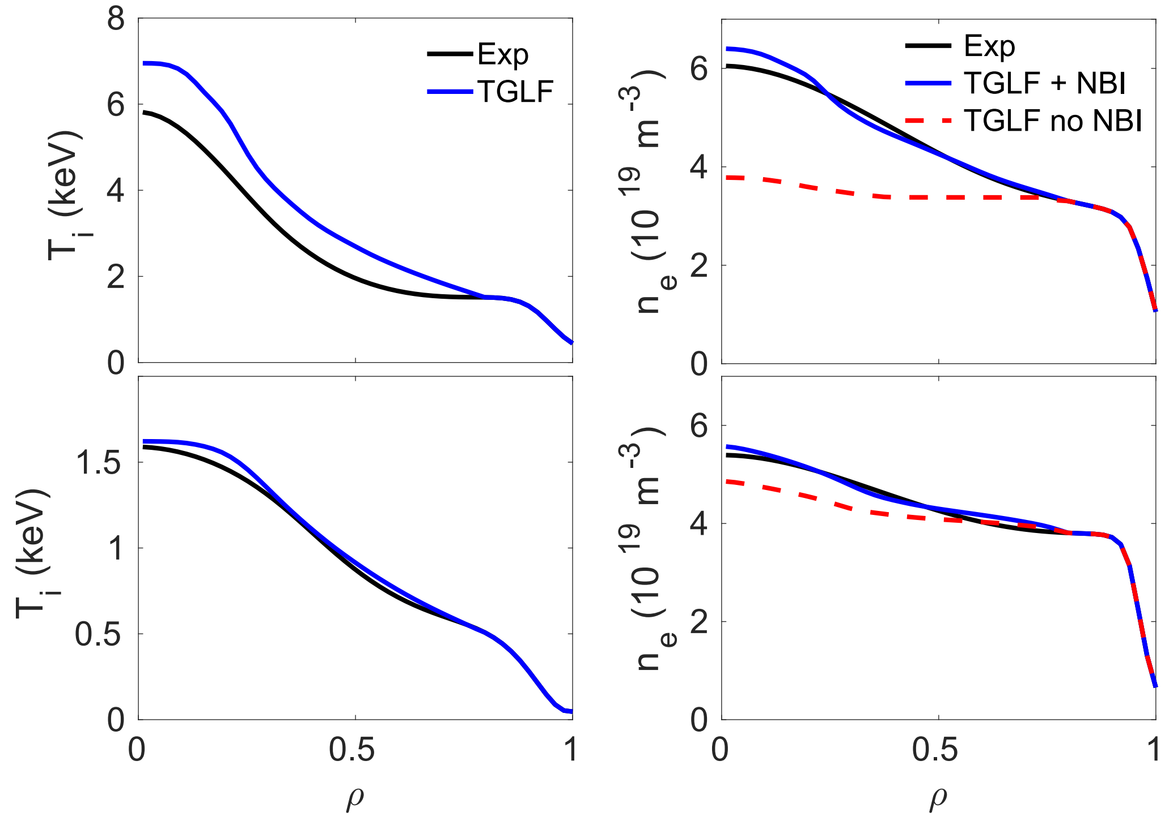
Predictive Capability of TGLF Is Good in DIII-D Provided That T_{i} Is Predicted Well
TGLF predictions for the high υ* case in agreement with experiment
TGLF does not predict the flat T_{i} profile at ρ=0.5-0.8 for the low υ* case
Leads to an overestimation of NBI contribution
Predictive capability of TGLF is fairly good in JET and DIII-D υ* scans except for the low υ* case on DIII-D
Low υ*
Low υ*
High υ*
High υ*

Slide 16
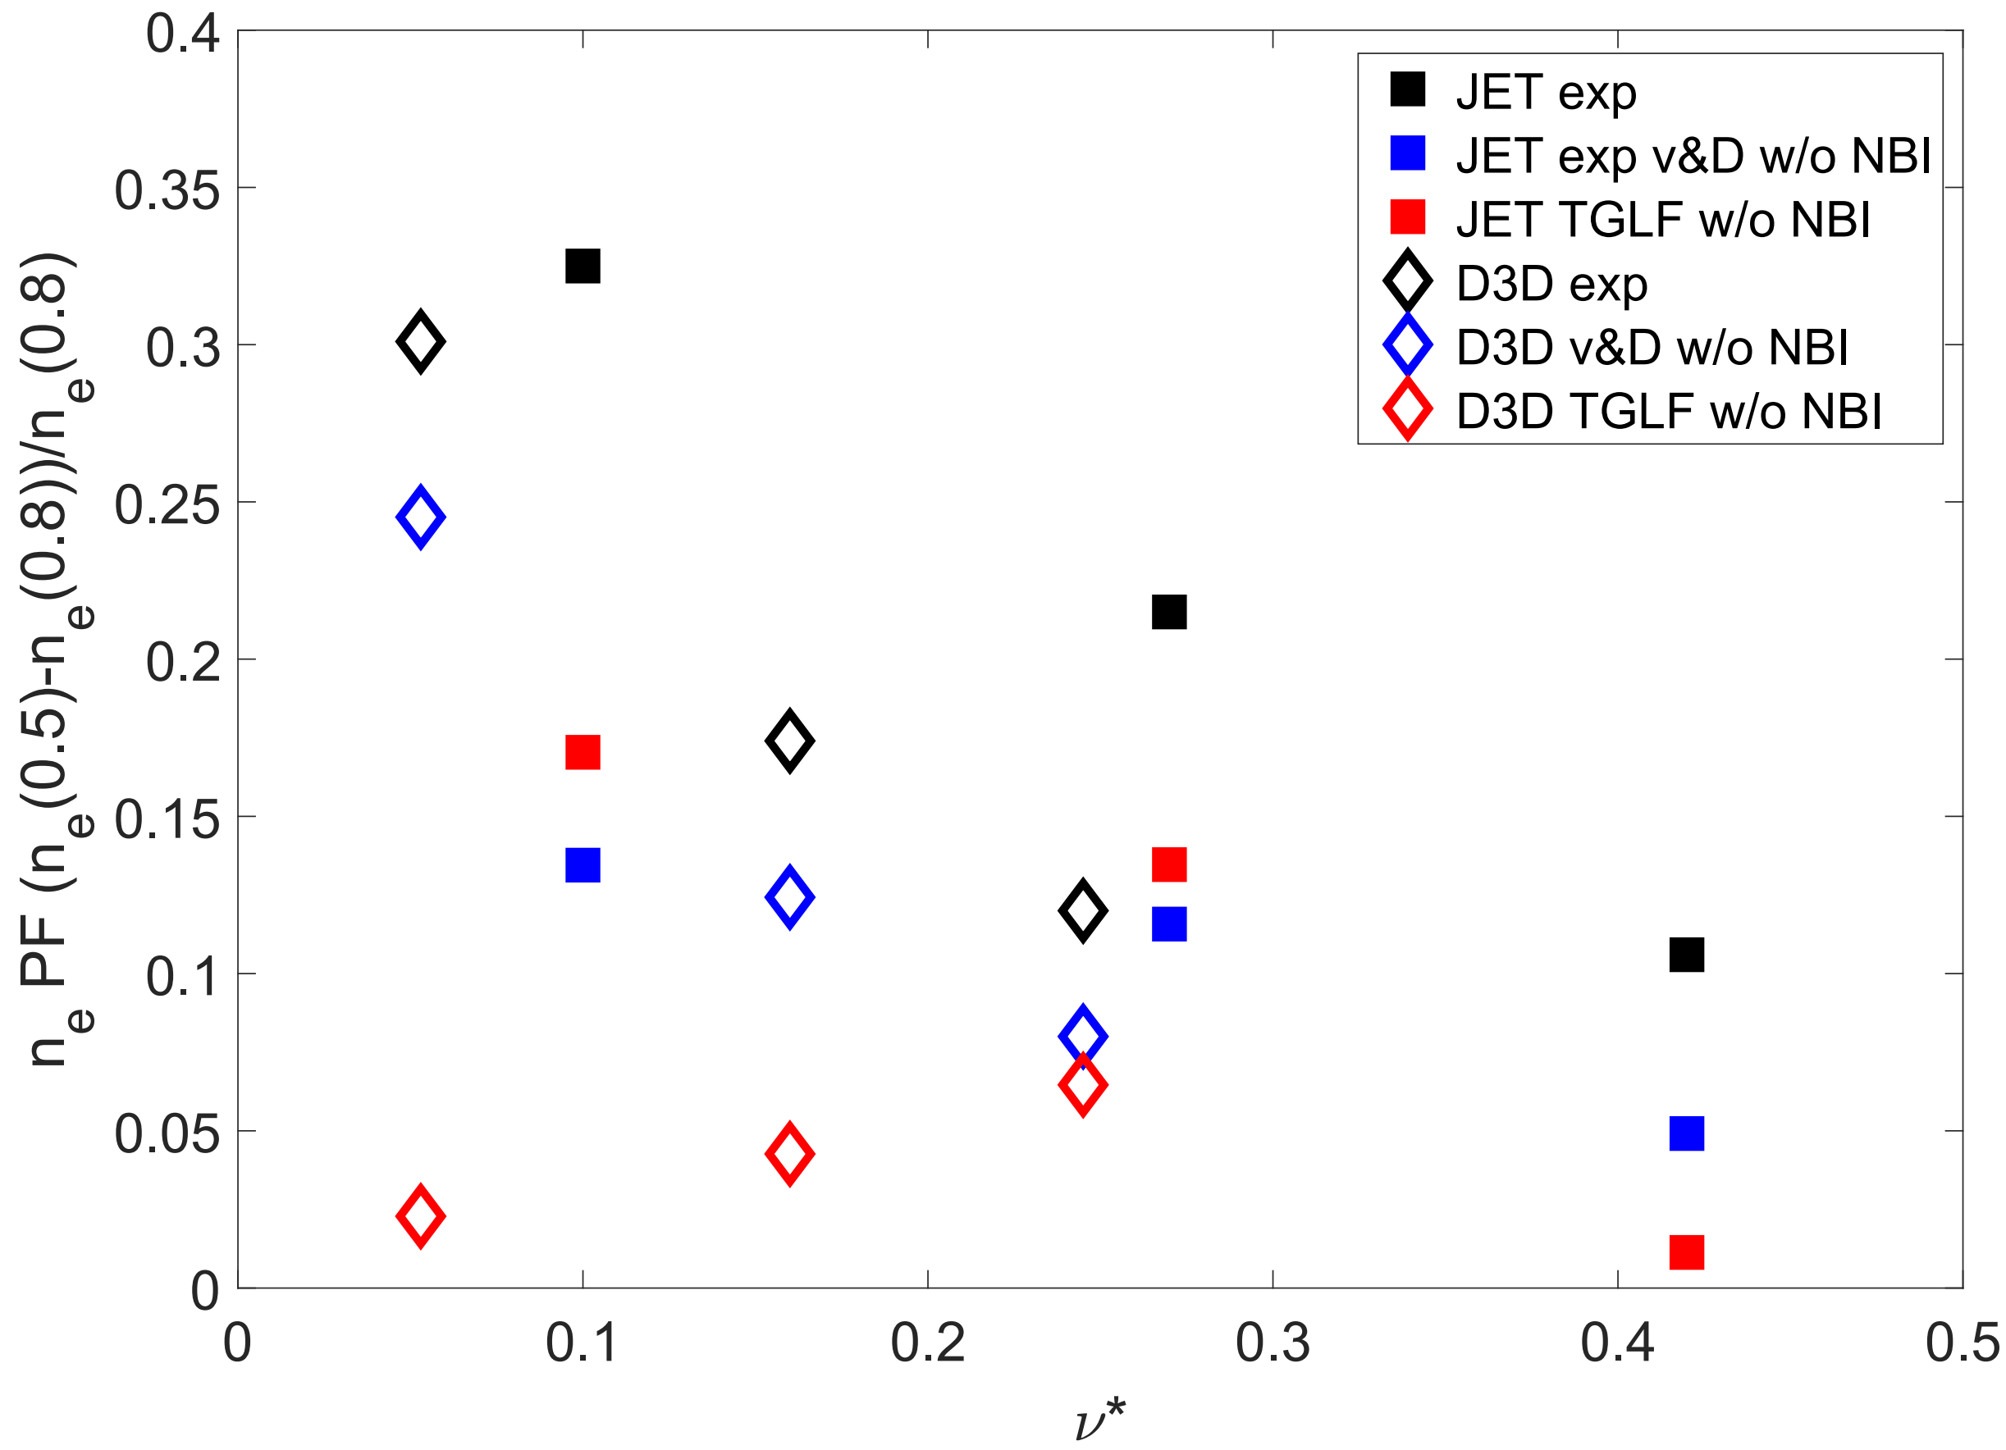
TGLF Simulations Reproduce the Experimental Peaking Factors When the Temperature Predictions Are in Agreement
Core density peaking factor
TGLF simulations are in agreement with experimental peaking factors only when the predicted T_{i} and T_{e} profiles are in agreement with experimental ones
This is also seen in stand-alone TGLF simulations
What happens at lower υ* in JET?
Does NBI fueling lose its dominance to inward pinch?
TGLF with experimental T_{e} and T_{i}
DIII-D Exp
JET exp and TGLF
DIII-D TGLF

Slide 17
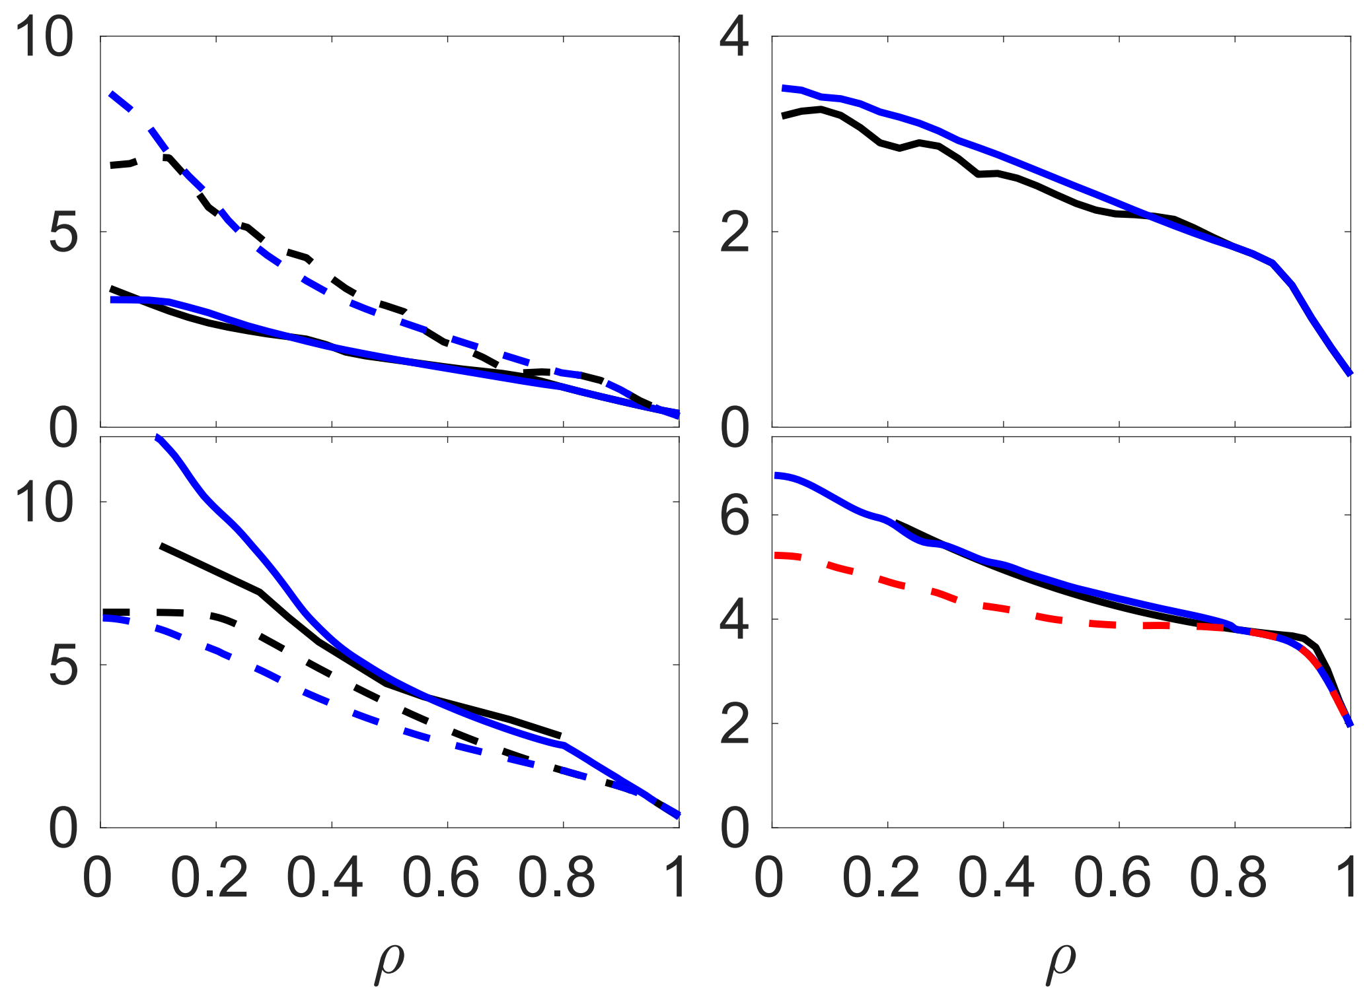
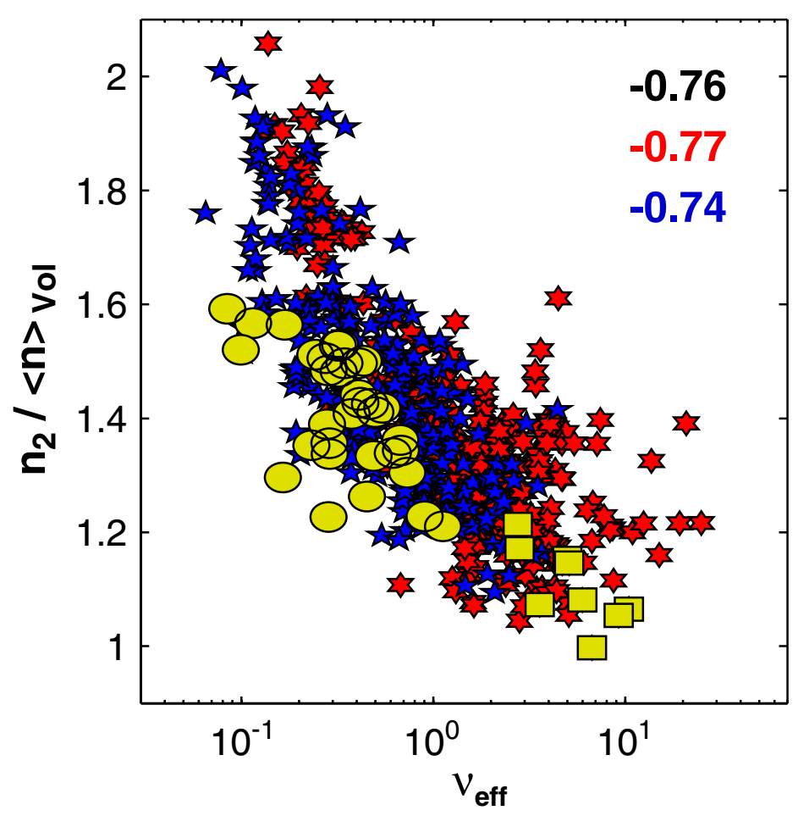
Predictive Transport Modelling Can Reproduce the Lowest υ* JET Discharges
TGLF captures density peaking with ICRH only $T_{e}>T_{i}$
Very low density + 8MW of ICRH
GENE also predicts density peaking correctly
Revisit database corners (no modulation)
Ne
Te
ICRH only
Exp. TGLF
Ti
Ti
Ne
>20MW NBI
TGLF reproduces density peaking in low density JET hybrid plasma
Simulation without fueling suggests ~50% NBI contribution as in the H-mode υ* scan
Te
ITER
NBI source=0

Slide 18
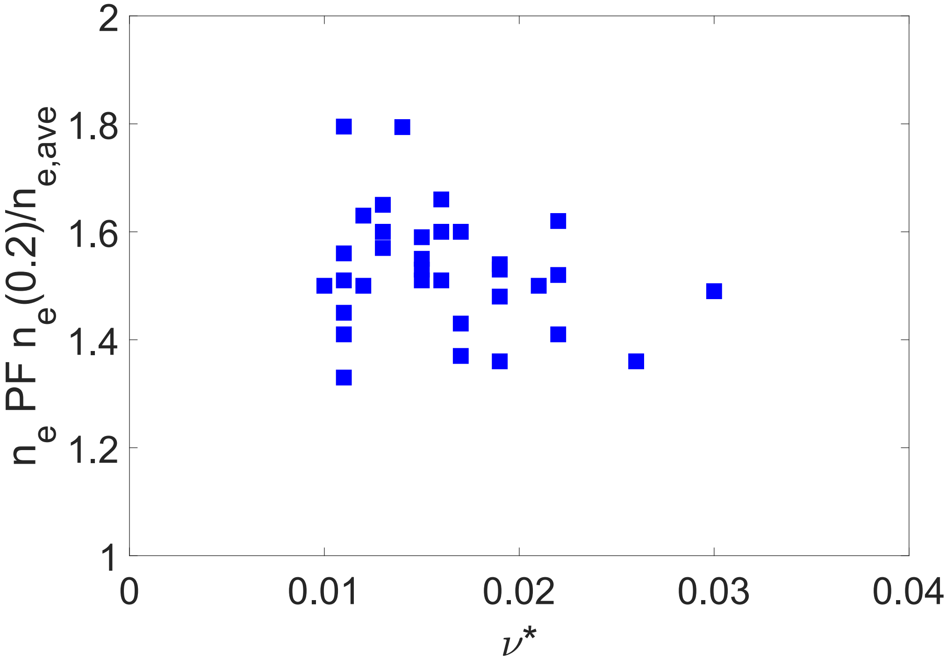
Density Peaking in non-Fuelled I-Mode Plasmas on C-Mod Are Similar with Respect to Core Density Peaking to Those of L-mode in JET and DIII-D
The C-Mod discharges do not have NBI fueling – relevant information on the role of NBI fueling and I-mode particle transport is a special case with no density pedestal
L-mode plasmas have different q-profile and T_{e}/T_{i} ratio and thus, density peaking originating from different reasons
In line with the JET and DIII-D L-mode results, i.e. the I-mode core density peaking does not have any υ* dependence.
Gas puff modulation was also performed on C-Mod, but the modulated density data is too noisy to able to extract the particle transport coefficients.
Core density peaking factor
low υ*
middle υ*
high υ*

Slide 19
Conclusions: Core Density Peaking – Driven by Fueling or Transport?
JET is NBI source dominant 50-70% and DIII-D transport dominant (only 15-30% from NBI)
Trapped Electron modes (TEM) play a stronger role than in JET (JET is deeply ITG dominated)
Lower υ*, higher magnetic shear, larger R/L_{Te} and higher β in DIII-D than in JET
JET has larger confinement time than DIII-D, thus the source stays in the plasma way longer in JET
Validation of TGLF and GENE against the unique experimental particle transport dataset:
TGLF quite convincing against various experimental results provided that T_{i} predicted accurately enough
GENE qualitatively agreeing well with various experimental trends, underestimates the pinch at T_{e}/T_{i}~1
Density peaking (also in future devices) depends critically on the parameter regime, such as υ*, T_{e}/T_{i}, L_{Te}/L_{Ti}, β and q-profile
I-mode particle transport characteristics (core density peaking) are similar to those of L-mode in JET and DIII-D

Slide 20
Particle balance transport coefficients from the experiment in 2 steps
Inside rho<0.8
Steady state (1 eq 2 unknowns):
$$\frac{∂n_{e}}{∂t}+∇⋅Γ≈S_{NBI}$$
$$−D∇n_{e}+Vn_{e}=\frac{1}{𝕍′}\int_{v}{S_{NBI}dv}$$
$A$ and $φ$ from Fourier transformed $n_{e}\left(ρ,t\right)$
Step 1:
Use perturbative approach is to obtain absolute values for the transport (takes the code validation to the next level)
Standard approach is to linearize using the ansatz:
Core
$$\tilde{n}\left(ρ,t\right)=A\sin\left(ωt+φ\right)$$
$$D_{inc}=−ω\frac{\sin{φ}⋅\int_{v}{A\sin{φ}dv−}\cos{φ}⋅\int_{v}{A}\cos{φ}dv}{Aφ′⋅〈{\left|∇ρ\right|}^{2}〉⋅𝕍′}$$
Edge
Step 2:
Collisionality scan is also a density gradient scan thus providing $D_{inc}=f\left(∇n\right)$. Integration yields [1]:
$$D≈\frac{1}{∇n}\int_{0}^{∇n}{D_{inc}d\left(∇n\right)}$$

Slide 21
Various Analysis Techniques Employed to Obtain the Particle Transport Coefficients
Density evolution:
In steady state:
To disentangle transport from the source perturbative approach is needed
Use ansatz: $\tilde{n}=A\left(ρ\right)\sin\left(ωt+φ\left(ρ\right)\right)$
After some algebra [1]:
JET H-mode plasma shot #87420
$$D≈−ω\frac{\sin{φ}⋅\int_{v}{A\sin{φ}dv−}\cos{φ}⋅\int_{v}{A}\cos{φ}dv}{Aφ′⋅〈{\left|∇ρ\right|}^{2}〉⋅𝕍′}$$
in JET
$$v≈−ω\frac{{(A}^{′}Y−{φ^{′}AX)sinφ}+{(φ}^{′}AY+{A′X)cosφ}}{A2φ^{′}⋅〈{\left|∇ρ\right|}^{2}〉⋅𝕍′}$$
in DIII-D
$$v≈\frac{D∇n}{n}+\frac{1}{n}\int_{v}{S_{NBI}dv}$$
[1] H Takenaga et al 1998 PPCF 40 183

Slide 22
Similar 3-Point υ* Scan Performed on DIII-D –
And Density Peaking Increases with Decreasing υ* as in JET
165303
165325
165318

Slide 25
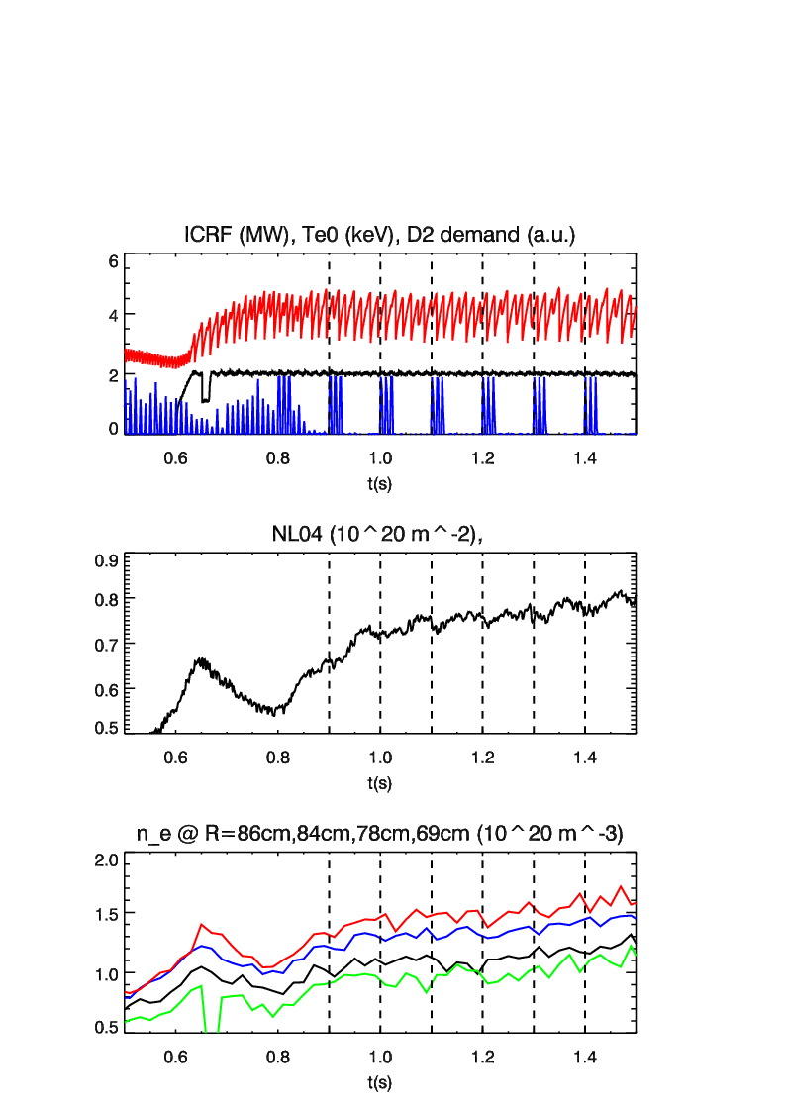
C-Mod: Gas Puff Modulates Density in I-mode at 5.6T

Slide 26
No Evidence on Time-Dependent Plasma Background from Fluctuations at 3Hz
No effect of gas puff modulation on fluctuation level from the correlation reflectometry
The assumption of the time independent background seems justified

Slide 27
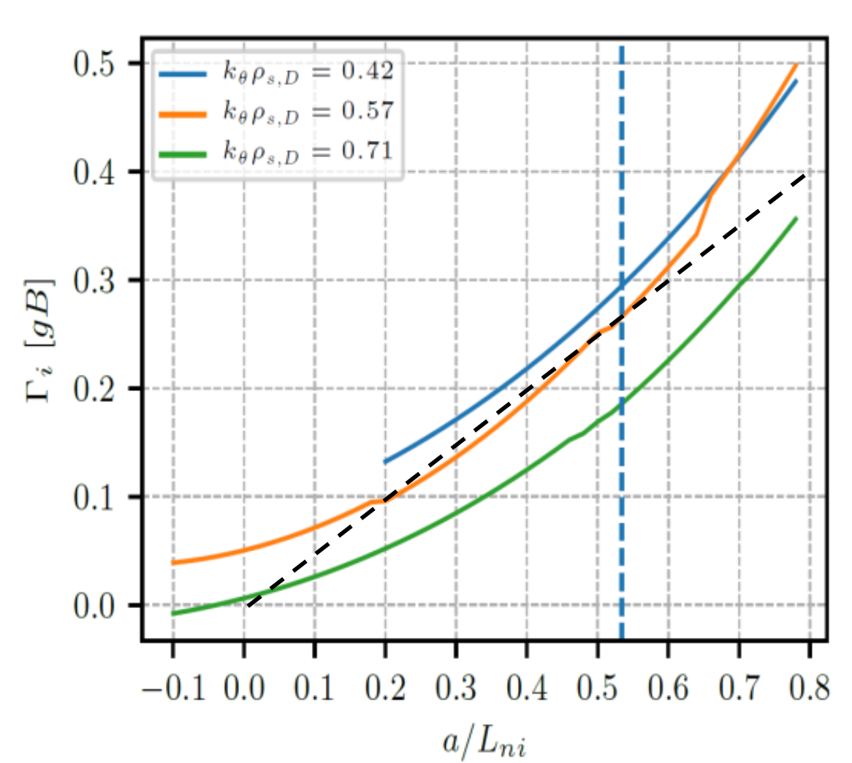
TGLF Simulation around the Operational Parameters of the JET ʋ* Scan

