Slide 1
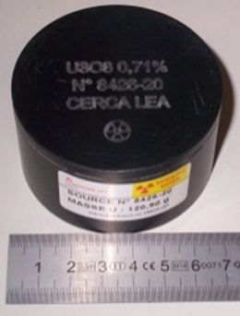
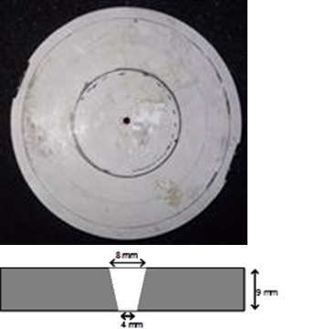
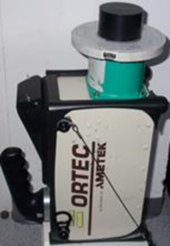
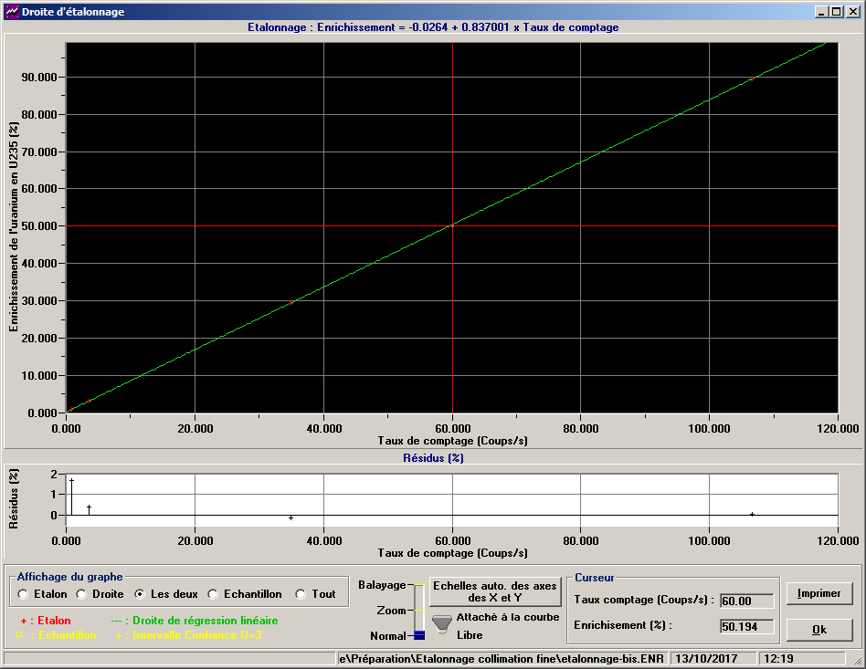
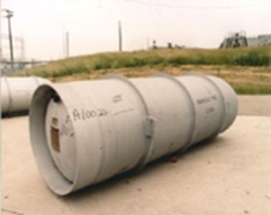
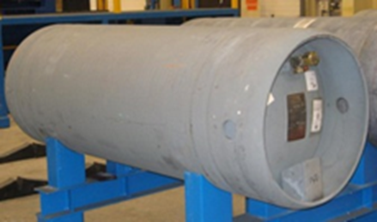
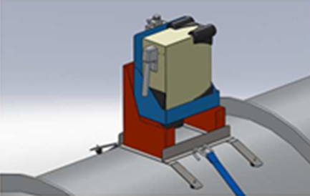
Uranium enrichment measurement in UF6 cylinders by HRGS : an evaluation of the measurement uncertainty
Jean-Luc DUFOUR, Nicolas PEPIN, Clément DEYGLUN, Anne-Laure WEBER
Institut de Radioprotection et de Sûreté Nucléaire
Jean-luc.dufour@irsn.fr
ID: 270
ABSTRACT
OUTCOME
Optimization of the traditional enrichment meter method applied to uranium enrichment measurement in 30B and 48Y UF6 cylinders.
Calibration between 235U enrichment and net count rate in the 185.7 keV in collimated geometry with small U3O8 sources and electrically cooled high resolution gamma-ray spectrometer.
Net count rate measured on site in non-collimated geometry and corrected from container wall attenuation, measurement geometry and physico-chemical differences before applying the inverse calibration.
On-site measurement campaign used to calculate a calibration transfer factor, estimate measurement time , evaluate uncertainty components of each parameter of influence and total measured enrichment uncertainty.
CALIBRATION UNCERTAINTY BUDJET (given at 1σ)
Counting rate = TC (1%)
TC correction due to the reference material container wall (0.03%)
Calibration factors ⬄ weighted linear least squares regression
UF6 CYLINDERS VERIFICATIONS UNCERTAINTY BUDJET (given at 1σ)
TC (1%)
TC correction due to UF6 container wall (μρ calculated using X-MUDAT assuming ASTM A516 Grade 65 => 0.47% ; thickness unc. 0.118 mm )
TC correction due to the non-collimated geometry:
Experimental (for 1 cylinder from TC with/without collimator) ⬄ 5.5%
MCNP (from modeled TC with/without collimator) ⬄ 9%
Optimization by bias minimization using 2x30B and 2x48Y containers and an average bias of 0.001% ⬄ 1% (0.01% on declared %²³⁵U)
Inverse calibration
TC correction due to the difference in chemical composition between reference material and item to be measured ⬄ 0.24%.
Precision (1.35% for 20 measurements with 1 container), trueness (0.37%), detector position influence (1.1% for 7 locations of 1 isolated container)
Overall uncertainty : 5-10% (cf. table, formulas developed in the paper)
-0.37<Δ/3σ<0.23 for the set of 34 measurements done on 8 containers
BACKGROUND
On-site non destructive assay of nuclear material as technical support to the Authority responsible for the protection and control of nuclear material in France.
HRGS routinely performed by operators and inspectorates to verify 235U enrichment in large UF6 cylinders in conjunction with an ultrasonic measurement of the container wall thickness => reliable method for inspection purposes.
Methodology and instrumentation need to be optimized to achieve reasonable inspection time based on available standards at IRSN.
Parameters of influence and associated uncertainties need to be mastered
CHALLENGES / METHODS / IMPLEMENTATION
 | Type | Counting Time (s) | Ref. ²³⁵U% (wt %) | Measured²³⁵U% (wt %) | Unc. (wt %) | Relative Unc. (%) | Bias (wt%) | Rel. Bias (%)
1 | 30B | 523 | 1.4133 | 1.4486 | 0.082 | 5.68 | 0.0366 | 2.6
2 | 30B | 90 | 4.1885 | 4.3340 | 0.230 | 5.28 | 0.1554 | 3.7
3 | 30B | 90 | 4.9202 | 5.0237 | 0.264 | 5.24 | 0.1055 | 2.1
4 | 30B | 90 | 4.1923 | 4.2564 | 0.229 | 5.36 | 0.0738 | 1.8
5 | 48Y | 7203 | 0.3661 | 0.3506 | 0.036 | 10.35 | -0.0176 | -4.8
6 | 48Y | 7050 | 0.4697 | 0.4663 | 0.039 | 8.48 | -0.0051 | -1.1
7 | 48Y | 3060 | 0.7110 | 0.7170 | 0.049 | 6.83 | 0.0050 | 0.7
8 | 48Y | 120 | 4.9240 | 4.9159 | 0.270 | 5.48 | 0.0035 | -0.1
 |  |  |  |  |  | Mean | 0.0446 | 0.64
 |  |  |  |  | Trueness Unc. |  | 0.0258 | 0.37
MEASUREMENT PRINCIPLE
E = K * TC * CFmat * CFmT
With K = calibration constant
TC = net count rate at 185.7 keV
CFmat = matrix material composition correction factor
CFmT = container wall correction coefficient
Practical limitation ⬄ size of the calibration reference material vs infinite thickness requirements and better compromise between parallel beam collimation and reasonable measurement time.
MEASUREMENT SYSTEM AND CALIBRATION REFERENCE MATERIALS
Typical calibration using a collimated and laterally shielded portable high resolution gamma spectrometer connected to a computer equipped with Gammavision and in-house Enrichissement software, and four U₃O₈ reference material (104-120 g. U₃O₈, 0.7-89% ²³⁵U, 48 mm diameter, ≥ 26 mm height, embedded in an acetal copolymer container).
ON SITE IMPLEMENTATION
Measurements performed at the top of 4x30B and 4x48Y containers (2/12 tons of UF6, 0.3 to 5% ²³⁵U, 12.9 to 16.8 mm container wall thickness) with no collimation. Important deadtime => use of shorter rise time.
UF6 235U enrichment given by DA with 0.01% uncertainty.
Container wall thickness measured with a Positector ultrasonic gauge with 0.118 mm uncertainty (calibration, resolution, paint thickness, T°effects).
Measurement results
U3O8 reference material
Collimator 4x8x9 mm
Calibration configuration
Calibration ²³⁵U Enr (%) vs TC (c/s)
CONCLUSION
On-site verifications compatible with time inspection constraints
Evaluation of an overall measurement uncertainty propagating uncertainty components of each parameter of influence (5-10% LEU-DU)
Possible improvements :
Design of a new collimator to reduce UF6 measurements deadtime
Additional peak fitting algorithms to be investigated to extract net peak area from a high continuum background with better accuracy
Evaluation of the geometry transfer function from a larger U reference sample.
30B container (D 76cm)
48Y container (D 122cm)
Measurement config.

