Slide 1
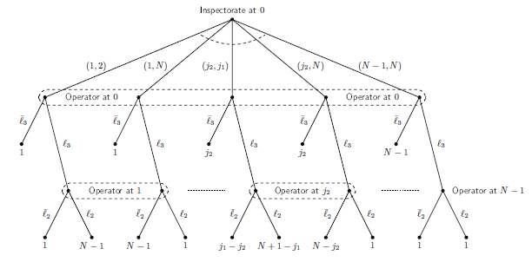
OPTIMAL SCHEDULING OF INSPECTIONS: Models and Approaches 7. 11. 2018 I Th. Krieger; R. Avenhaus

Slide 2
Content
What is an inspection game?
Probabilistic models for random inspection schemes
Assumptions
Two inspection games:
Operator´s illegal behavior has to be detected within a critical time
They differ by only one assumption
Expected number of inspections
Fixed number of inspections
Effectiveness and efficiency considerations

Slide 3
What is an inspection game?
It is …
a mathematical model of a conflict situation between
Inspectorate and Operator (person, organization, State), where
the Inspectorate verifies that the Operator adheres to certain agreed rules, formal agreements or an international treaty
The Operator may have an interest in violating these rules/ agreements/treaty where it must be assumed that an illegal behavior is planned strategically.
This defines a game theoretical problem between an Operator and the Inspectorate.

Slide 4
Prob. models for random insp. schemes
Classification of assumptions
Inspection philosophy: What is the objective of the random inspection scheme?
playing for time vs. critical time
Time: When does the Inspectorate performs its inspections and when does the Operator behaves illegally?
continuous time vs. discrete time
Planning: How does the Inspectorate and the Operator plan their inspections resp. the illegally behavior?
non-sequentially vs. sequentially
Sampling: Which statistical errors may occur during inspection?
# of inspections: Fixed #, expected #, at least … #

Slide 5
Two inspection games
Assumptions (1)
There are two players: Operator and Inspectorate
The Inspectorate performs $k$ inspections at steps$L,L−1,…,1$
The Operator behaves illegally exactly once at one of the steps $L,L−1,…,1$.
Model 1 | Model 2 (Thomas-Nisgav insp. game)
$k$: expected number of inspections | $k$: fixed number of inspections

Slide 6
Two inspection games
Assumptions (2)
During an inspection the Inspectorate may commit a statistical error of the second kind with probability $β$
The number $k$ of inspections is known to the Operator
At each step/event both players decide independently of each other
whether to behave illegally at that step (if not behaved illegally before) and
whether to inspect at that step (if inspections are left).
Asymmetric information situation: Operator can observe the Inspectorate’s behavior.

Slide 7
Two inspection games
Assumptions (3)
The payoffs to both players (Operator, Inspectorate) are given by
i.e. zero-sum games are considered.
The game ends either after an inspection at which the illegal behavior is detected or after step $1$.
$$\begin{matrix}(1,−1) & \begin{matrix}for untimely inspection or timely inspection and \\ no detection of the illegal behavior \end{matrix} \\ (−1,1) & \begin{matrix}for timely inspection and \\ detection of the illegal behavior\end{matrix} \end{matrix}$$

Slide 8
Two inspection games
Game theoretical solution
Optimal strategy: no player has an incentive to deviate from
Comments:
Higher costs/effort might be associated with model 1
No deterrence effect in model 2 (because $k$ fixed)
$k∈ℕ$ only possible in model 1

Slide 9
EFFECTIVENESS AND EFFICIENCY
Definitions and results
If we define:
IAEA safeguards is effective if the equilibrium strategy of the State is legal behavior (i.e. deterrence from behaving illegally) in the sense of the purpose of the inspections.
an equilibrium strategy of the IAEA is efficient if the legal behavior equilibrium is achieved at minimum cost.
State’s utilities
$$\begin{matrix}d & \begin{matrix}for untimely inspection or timely inspection and \\ no detection of the illegal behavior \end{matrix} \\ −b & \begin{matrix}for timely inspection and \\ detection of the illegal behavior\end{matrix} \\ 0 & for legal behavior \end{matrix}$$
IAEA safeguards is effective if and only if
technical
parameters
political
parameters

Slide 10
THANK you for your attention
This presentation was prepared as an account of work sponsored by the Government of the Federal Republic of Germany within the Joint Programme on the Technical Development and Further Improvement of IAEA Safeguards between the Federal Republic of Germany and the IAEA. Neither the authors of this presentation, nor the organization or industrial company they are affiliated with, nor the Federal Government assume any liability whatsoever for any use of this presentation or parts of it. Furthermore, the content of this presentation does not reflect any policy of the Federal Government.

