Slide 1
Safeguards Implementation in India
India’s SG Agreement is INFCIRC/754 with AP in force, & has 26 facilities (INFIRC/754 add.9) which includes FF, NPPs & storage facilities
The Agreement & AP facilitates implementation of RDT for Tarapur NM stores
The NM reports are sent electronically to IAEA SG Mbox.
The seal data is sent (RDT) on daily basis to IAEA.
India has gone beyond the 2008 separation plan (INFCIRC/731) by notifying KAPS 3-4 under IAEA SG

Slide 2
Remote Data transmission in India
After the initial testing (from 2016 to 2017), the RDT was fully implemented as of 1 April 2017 at Tarapur.
The RDT system at Tarapur consists of a number of electronic seals (EOSS) connected serially.
The encrypted seals data are transmitted to the IAEA on a daily basis, via a secure VPN internet connection.
The RDT includes the State-of-Health (SoH) summary along with detailed electronic seals data monitored daily.
Inspections planned originally for May, July, October and December 2017 were performed remotely through the evaluation of the seals data and accountancy reports provided by India at the IAEA Headquarters

Slide 3
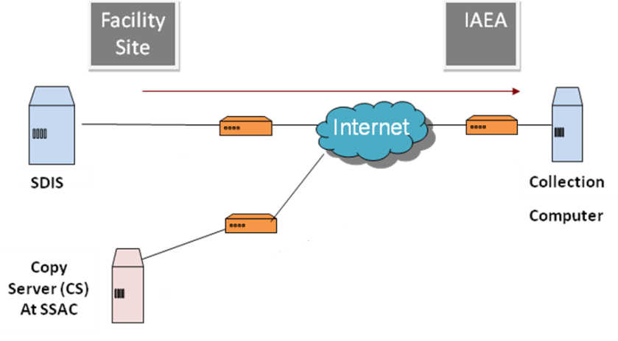
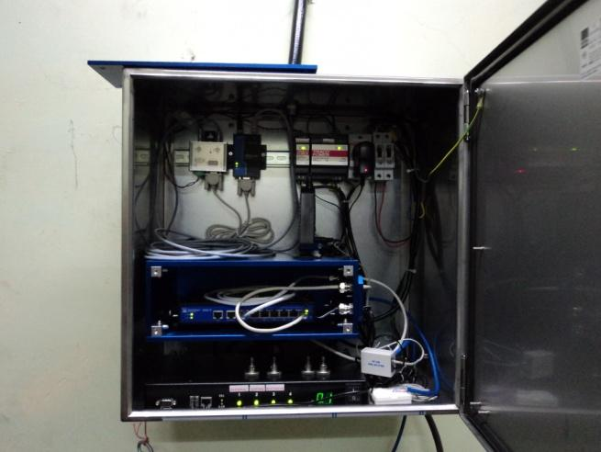
Block Schematic of RDT at Tarapur
Hardware at Tarapur facility

Slide 4
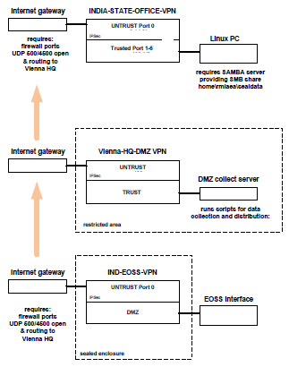
Information flow diagram

Slide 5
Declarations, procedures & timeline
RDT at Tarapur: EOSS seal information is sent to the Agency HQ daily (secured VPN internet)
A declaration to the Agency is made through secured mailbox on OP history & NMA data monthly (within 5 days of starting of month).
An auto acknowledge is received from Agency.
Within a couple of days, the monthly data from the Agency is sent to State Authority (DAE) through secured VPN.
State authority examines this information & archives.
This system is working well ever since the start of operation.

Slide 6
Technical issues during implementation
Some technical issues encountered :
Power failure at the facility (maintenance)
Internet unavailability (ISP issues)
Safeguards mailbox system issues
All these issues were resolved with consultations
all seals data have always been recovered in a timely manner
None were related to failures of the EOSS seals.

Slide 7
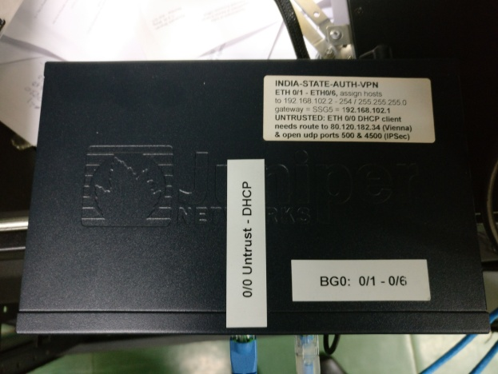
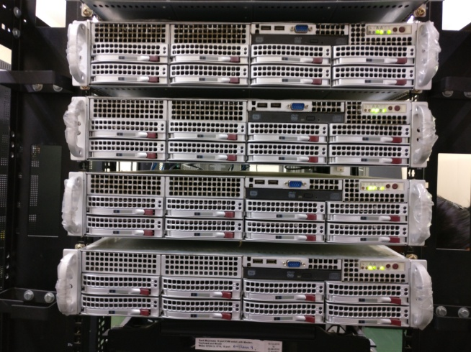
Data transmission to State (DAE)
Hardware at State Auth(DAE)

Slide 8
Advantages of RDT at Tarapur
Reduced field verification (inspection) efforts and reduced level of intrusiveness to the operation of the facility; in the field inspections were reduced on average from 12 to 6 per year.
More flexibility in the planning of inspections;
Early detection of possible Agency equipment failures and early intervention to correct failure
Reduced radiation exposure to IAEA inspectors and facility operators during verification activities
Reduced support requirement from the facility operator for Agency inspections.

Slide 9
Data security while implementing RDT
The data is transmitted to IAEA & back to DAE is through secured VPN tunnel.
Deploys hardware encrypted VPN tunnel both side.
A dedicated public telephone line with internet provided by local ISP is used.
Not linked to facility internet services.
At state level (DAE) also, same philosophy is used.
The data security ensured as above.

Slide 10
Conclusions
The results of implementing RDT at Tarapur are very positive and encouraging.
The required accountancy records have been received in a timely manner (both ways)
data review by Agency indicated no failures of safeguards significance.
Minor technical glitches with the internet connection were resolved with the assistance of State and the facility operator in a timely manner.
Number of IAEA inspections at this facility have been reduced without compromising the efficacy.
An excellent example of State-Operator-Agency cooperation

Slide 11
Thank you
Discussions

