Slide 1
Numerical Method for High Count-Rate Dead-Time Correction in Neutron Multiplicity Counting using Multi-Channel List-Mode Recorders
L. HOLZLEITNER
European Commission – Joint Research Centre (JRC), Karlsruhe, Germany
E-mail: Ludwig.Holzleitner@ec.europa.eu
D. HENZLOVA, M.T. SWINHOE, V. HENZL
NEN-1 Safeguards Science Technology Group, Los Alamos National Laboratory, Los Alamos, USA

Slide 2
A neutron detector in safeguards has a body of polyethylene with a cavity for the sample. Around it, gas proportional counters, often ³He tubes, are embedded in the polyethylene body.
Traditional neutron counters/detectors sum up the signals from different preamplifiers, possibly using a de-randomizer.
Multi-channel list mode recorders provide both accurate time and channel information of recorded signals. Recording signals from individual preamplifiers using such devices provide additional possibilities for data analysis and other advantages. One of it is advanced dead-time correction as described here.
MC list-mode Counter
Multiplicity
Evaluation
Data-Link
Preamplifier
De-Randomizer replaced by
Multi-Channel List-Mode recorder
Sample cavity
³He Tube
Detektor
Office
Polyethylene

Slide 3
Lost pulses on channels are estimated from observed ones on all other channels. This is done simultaneously (using matrix equat.) since probabilities of pulse arrival are interlinked!
Dead-time loss $l_{i}\left(t\right)$ can be estimated by repeatedly solving the matrix - eqn. 7 for evert time $t$ and for every meaningful (means non-zero) right hand → second, estimated pulse train.
$$\left[\begin{matrix}\begin{matrix}\begin{matrix}1 \\ −\frac{p_{2}\left(τ_{2}\right)e_{2}}{{1−e}_{2}}\end{matrix} & \begin{matrix}−\frac{p_{1}\left(τ_{1}\right)e_{1}}{{1−e}_{1}} \\ 1\end{matrix}\end{matrix} & ⋯ & \begin{matrix}−\frac{p_{1}\left(τ_{1}\right)e_{1}}{{1−e}_{1}} \\ −\frac{p_{2}\left(τ_{2}\right)e_{2}}{{1−e}_{2}}\end{matrix} \\ ⋮ & ⋱ & ⋮ \\ \begin{matrix}−\frac{p_{k}\left(τ_{k}\right)e_{k}}{{1−e}_{k}} & −\frac{p_{k}\left(τ_{k}\right)e_{k}}{{1−e}_{k}}\end{matrix} & ⋯ & 1\end{matrix}\right]\left[\begin{matrix}l_{1}\left(t\right) \\ l_{2}\left(t\right) \\ \begin{matrix}⋮ \\ l_{k}\left(t\right)\end{matrix}\end{matrix}\right]=\left[\begin{matrix}\frac{p_{1}\left(τ_{1}\right)e_{1}}{{1−e}_{1}}\sum_{j≠1}{C_{j}\left(t\right)} \\ \frac{p_{2}\left(τ_{2}\right)e_{2}}{{1−e}_{2}}\sum_{j≠2}{C_{j}\left(t\right)} \\ \begin{matrix}⋮ \\ \frac{p_{k}\left(τ_{k}\right)e_{k}}{{1−e}_{k}}\sum_{j≠k}{C_{j}\left(t\right)}\end{matrix}\end{matrix}\right]$$
(eqn.7)
$t$ … global time of the detector
$C_{i}(t)$ count is a observed pulse accounted for at channel i and time t.
$τ_{i}$ … time at certain channels from a specific event (leading pulse)
$e_{i}$ relative efficiency of channel i where of course $\sum_{i}{e_{i}}=1$.
$p_{i}\left(τ_{i}\right)$probability (betw. 0 - 1) for losing a pulse at channel $i$ has as time $τ_{i}$, time from the last recorded pulse on channel i.

Slide 4
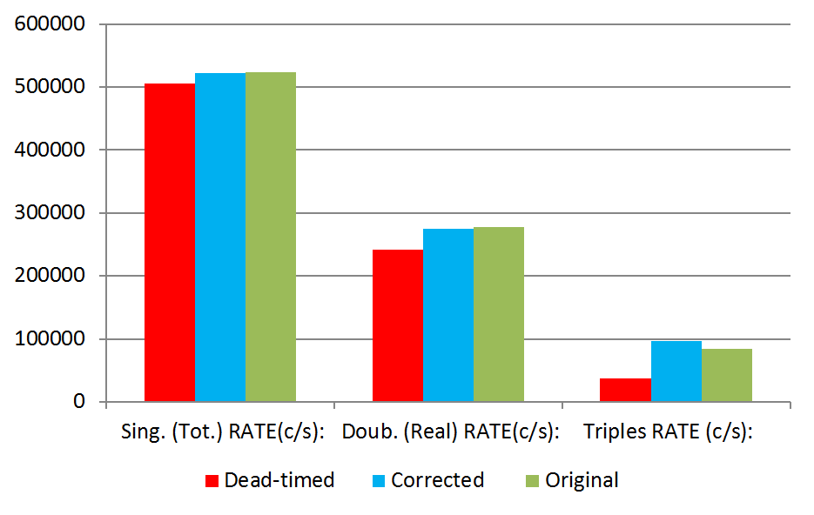
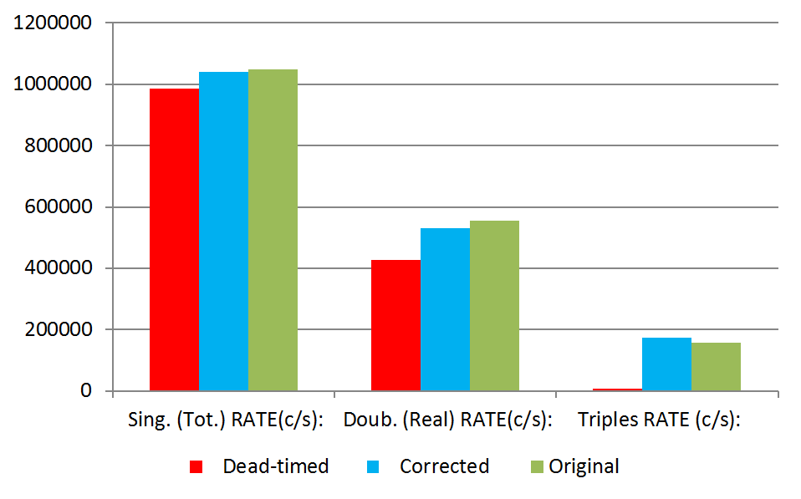
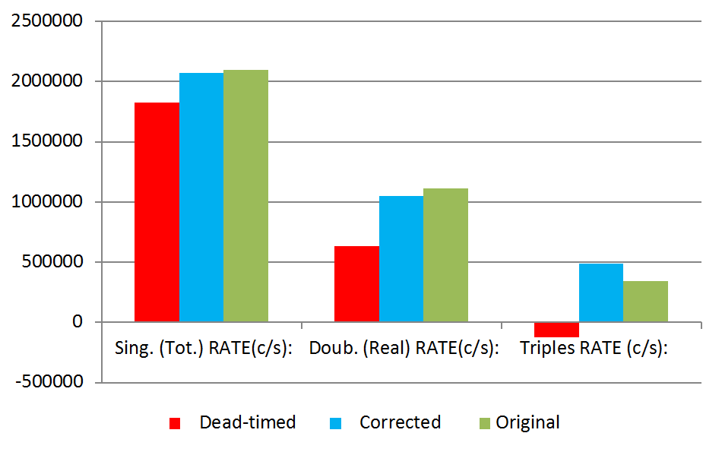
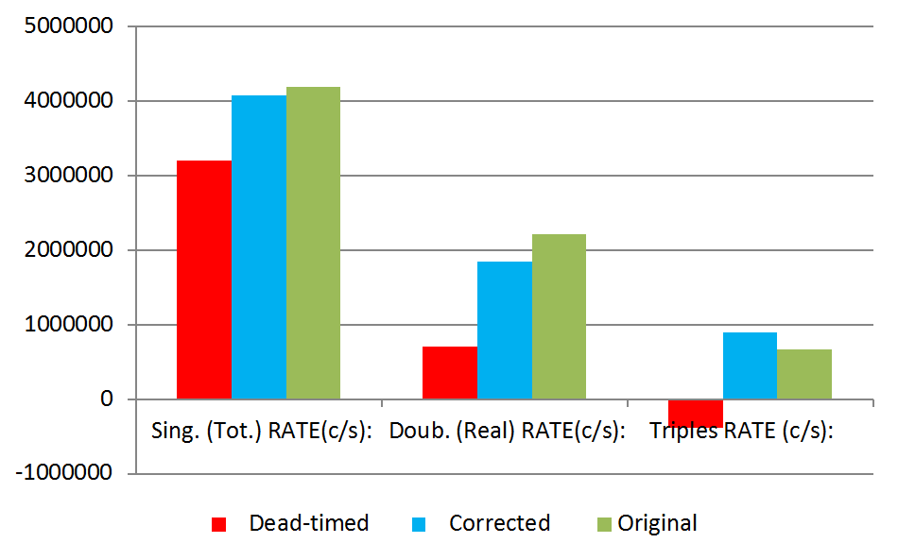
Dead-time probabilities $p_{i}\left(τ_{i}\right)$ can be estimated using a iterative process involving eqn. 7.
Multiplicity histograms can be corrected by sorting-in lost pulses using statistical methods.
This results in corrected Singles / Doubles / Triples.
MCNP simulations show that the estimation of lost pulses is quite precise;
The results for multiplicity correction by sorting-in of lost pulses are reasonable, however it still needs some refinement.
(a) Original count rate 0.52 M c/s
(b) Original count rate 1.05 M c/s
(d) Original count rate 4.19 M c/s
(c) Original count rate 2.09 M c/s
Notes:
New approaches to all individual links of the traditional neutron counting chain from the detector, to signal processing, to a interpretation.
The objective is to report results to ENER along the way, and demonstrate integration of all new developments in a high efficiency counter in PERLA by 2020.

Slide 5
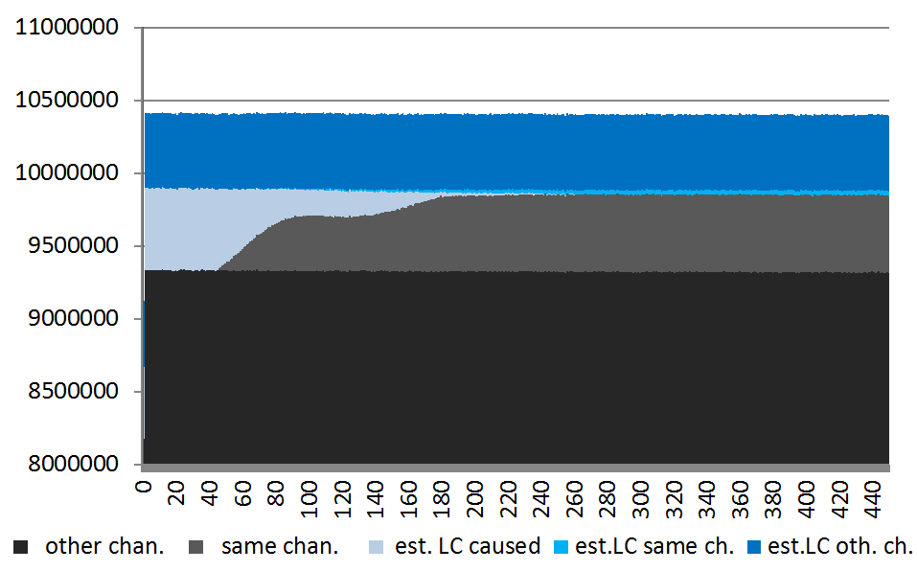
Advantage over other methods:
Rossi-Alpha distribution first (4.5 µs) from MCNP simulation
Using multi-channel list-mode recorders:
Suitable for very high count-rates
No prior calibration necessary: is self-calibrating from measurement data.
Compensates for double pulsing is as long as it does not exceed dead-time loss. Double-pulsing correction could be built in future using a similar technique.
Transfer of channel-information provides increased diagnostics capabilities
Original count rate 1.05 M c/s:

Slide 6
Thank you!
Questions?
Ludwig.Holzleitner@ec.europa.eu

