Slide 1
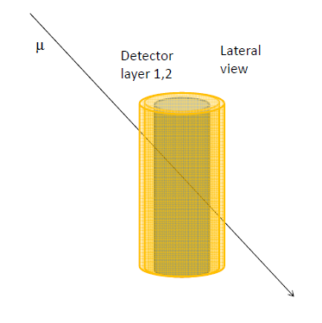
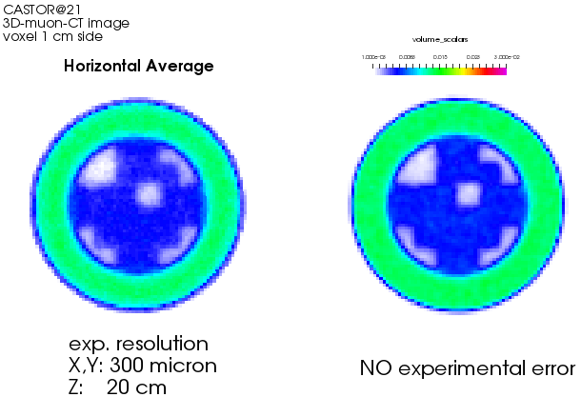
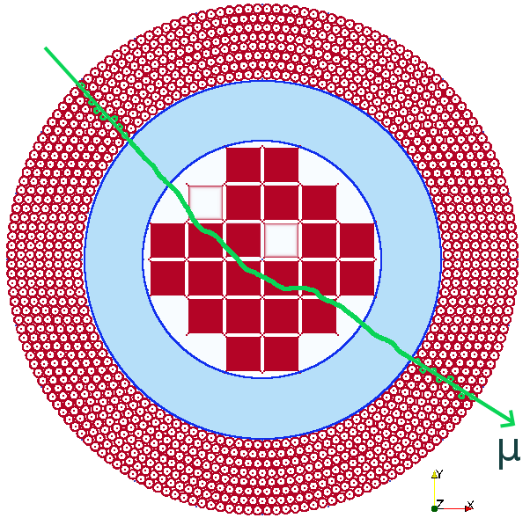
Muography of spent fuel containers for safeguards purposes
A feasibility test in proximity of a CASTOR® container.
Muon radio/tomography is a technology candidate to verify the content of spent fuel containers without opening them
Detectors positioned around the container ⇒ Absorption, Transmission and multiple Coulomb scattering
Simulation Results

Slide 2
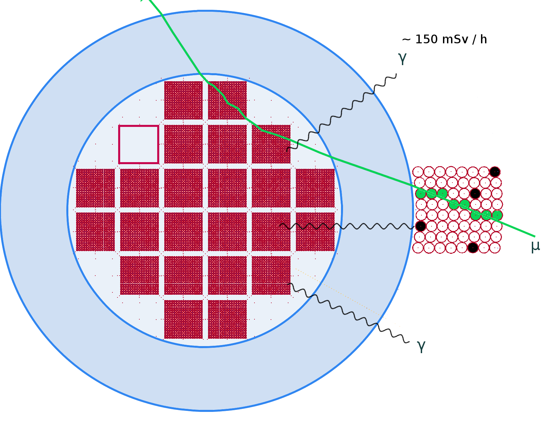
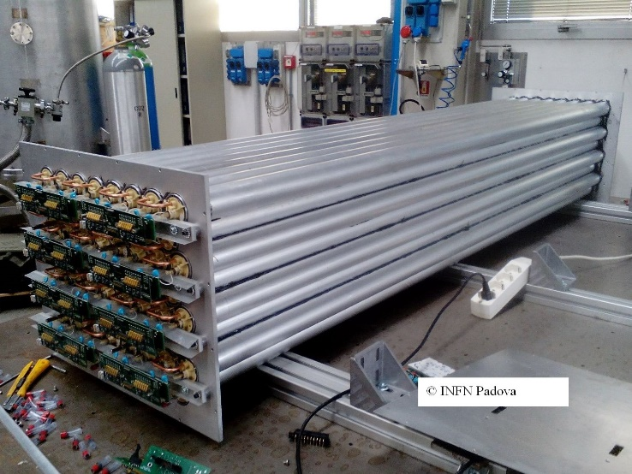
A radioactive environment
How much does radioactivity emitted by nuclear material stored inside Canisters interfere with the detector response?
Is the (low) cosmic-ray intensity (~.1 μSv/h) compatible with the noise induced by radioactivity?
Purpose of the test is to prove that it is possible to record muon tracks and to measure the effects induced by radioactivity
A small prototype: 8 layers of 8 Al tubes:
50 mm diameter, 1.5 mm thickness, 2 m length, central 100 μm anode wire (+3000 V),
Ar-CO₂ (85%-15%) gas mixture
realized by INFN Padova group
~0.60 m
~2 m
~0.50 m

Slide 3
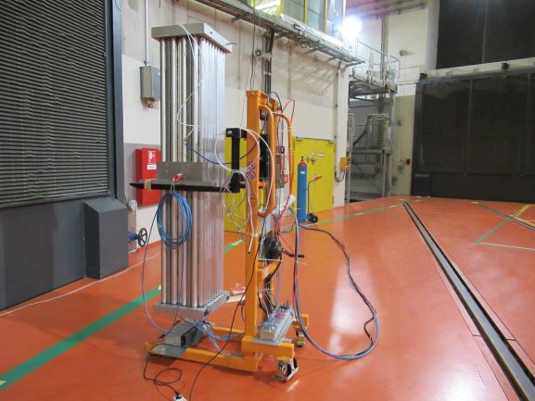
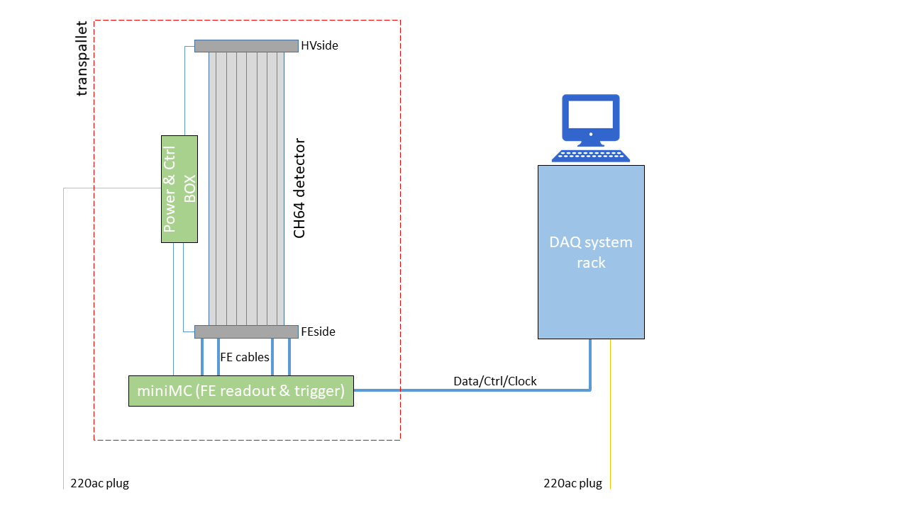
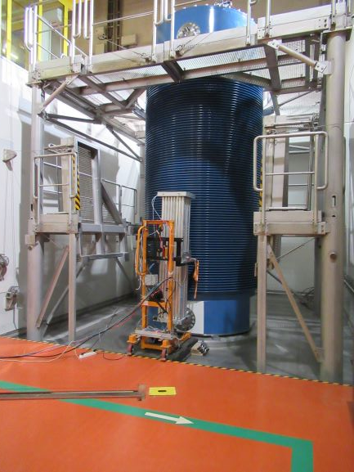
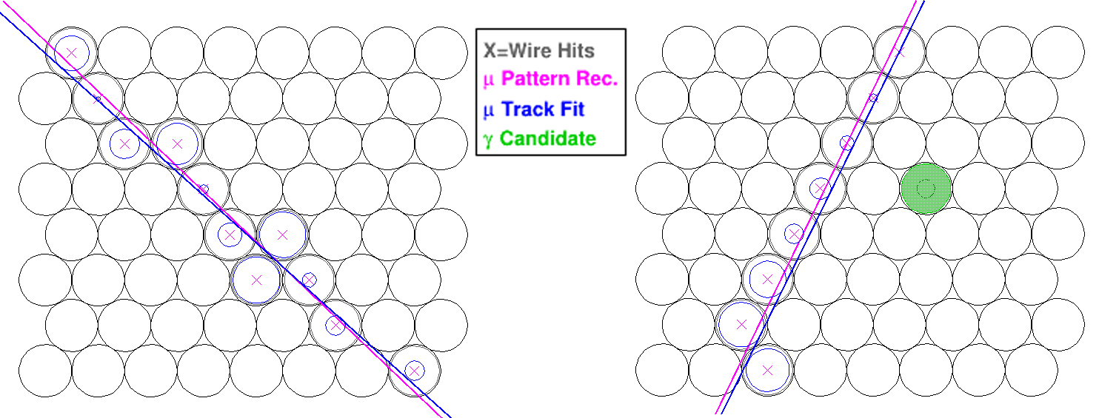
Field test in nuclear power station at Neckarwestheim
Two positions for data taking
Near CASTOR® ~14μSv/h γ
Far (~no radioactivity)
Layout of the apparatus.
Main result: it is possible to reconstruct muon tracks with very little additional background:
Probability for a tube to have a hit in coincidence with a muon <1%
Display of reconstructed muon tracks.

Slide 4
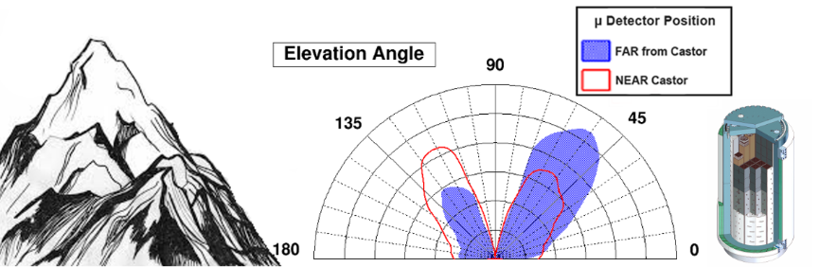
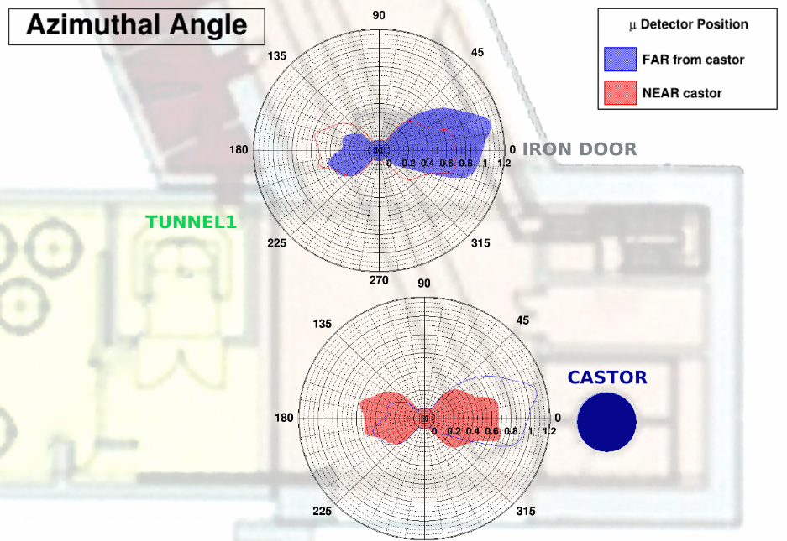
Field test in nuclear power station at Neckarwestheim
The test was not conceived to study the CASTOR® content but we can show the influence of the container to modify the muon flux
Elevation angle distribution: effects of the geological environment and of CASTOR® presence. The blue area and the red curve are normalized to the total number of entries of the corresponding data-taking.
Azimuthal angle distribution, superimposed to the hall map sketch, for the far (blue) and near (red) data.
The flux reduction in correspondence of CASTOR® is evident.

Slide 5
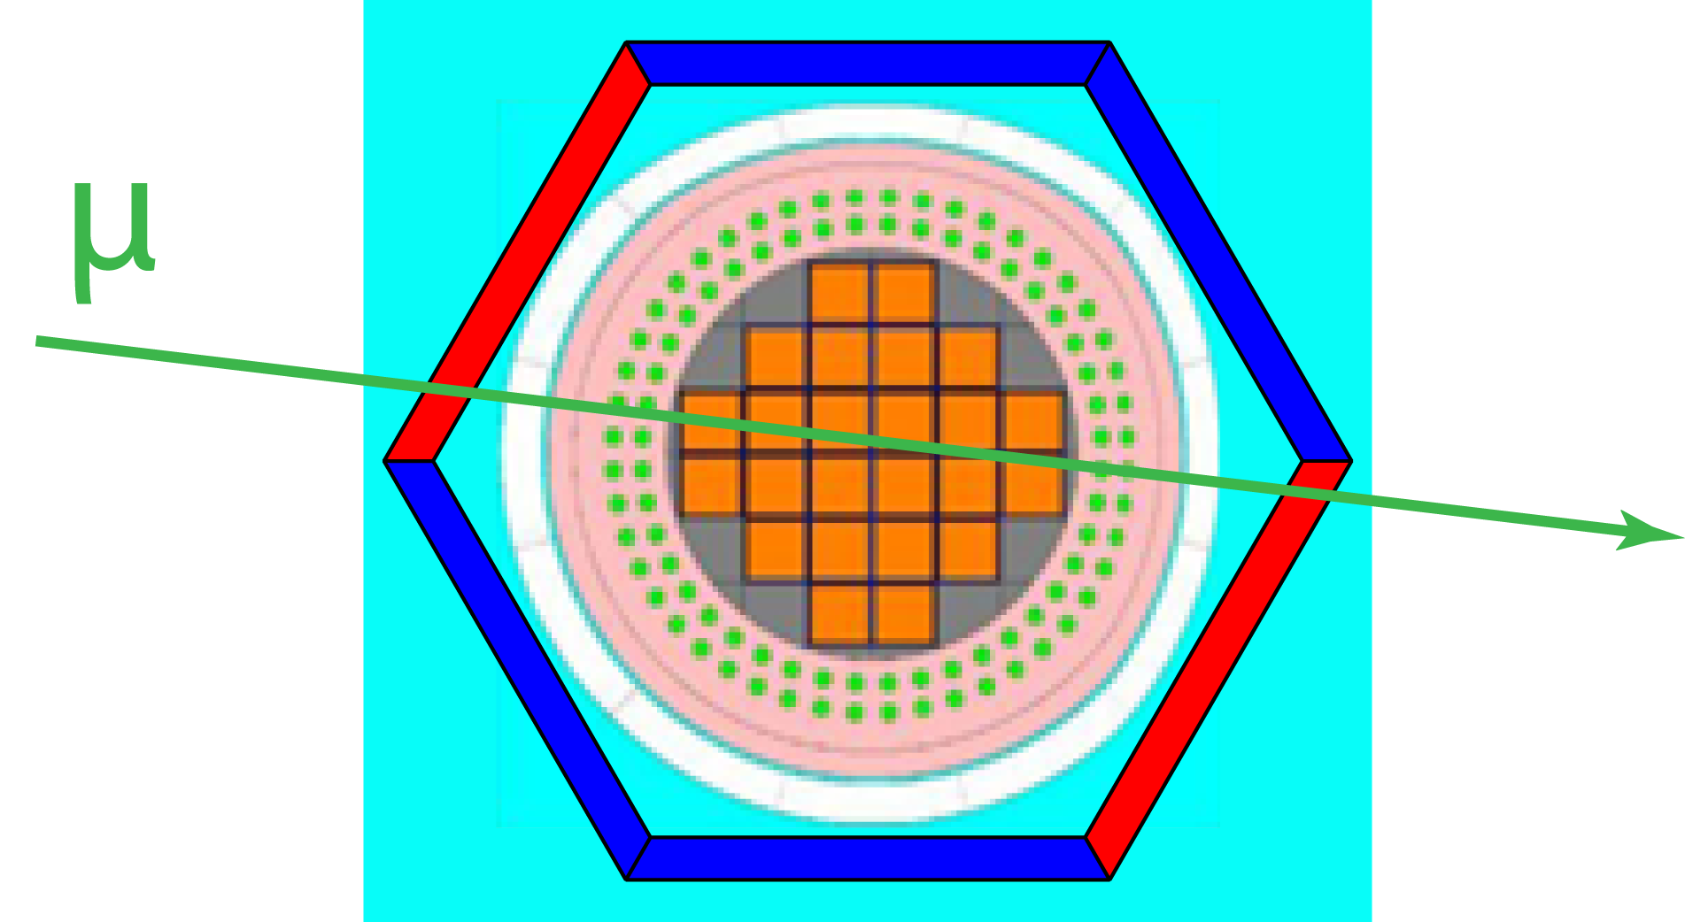
Conclusions and future perspective
The technique works: it is possible to study CASTOR content using cosmic muons measured with a gas drift detector
Given the test positive results: next step is to realize a prototype covering a large fraction of a spent fuel container

Slide 6
Backup slides

Slide 7
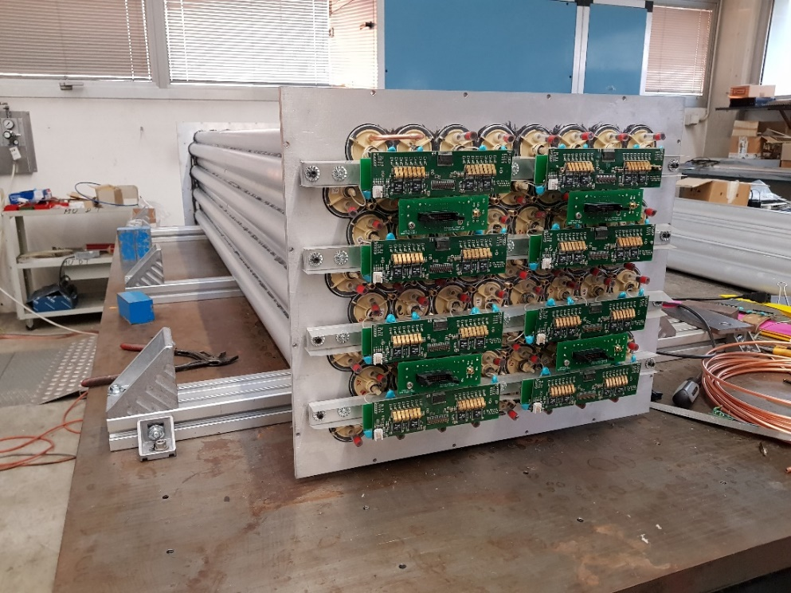
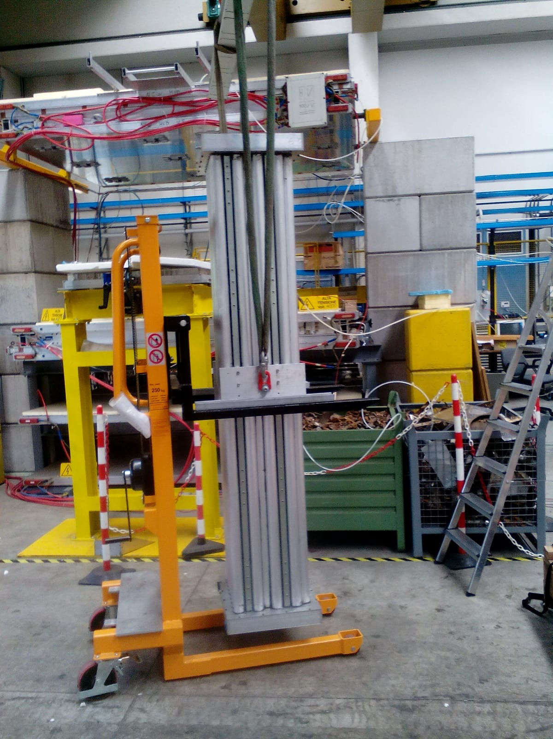
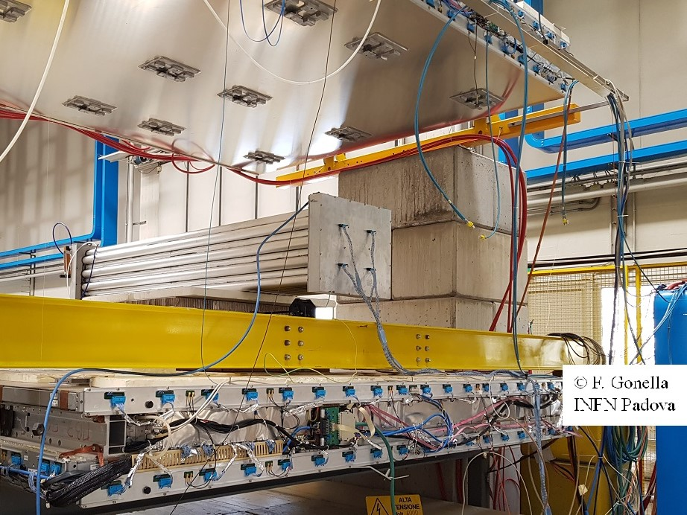
The detector for a test
construction
commissioning
ready

Slide 8
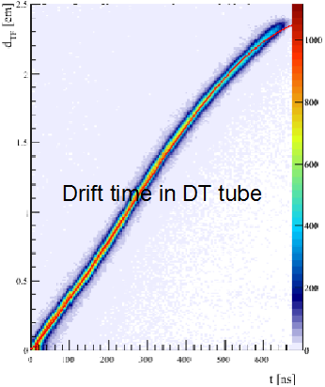

A possible detector
Drift tubes technique is adequate for industrial production
A charged particle crossing the tube ionizes the gas
(e.g. Ar 85% CO₂ 15%)
Electrons drift in presence of the electric field and in proximity of the wire (E~1/r) an avalanche process starts allowing signal detection
μ⁺
++++
- - - -
Typical drift time: ~1 μs for 2.5 cm

