Slide 1
Examining Inspection Frequency under the State-Level Concept
Presented by Ken Jarman with Ty Otto, Mark Schanfein*, and Ben Wilson
Pacific Northwest National Laboratory
* M. Schanfein now at Idaho National Laboratory
PNNL-SA-138943
Notes:
About the Image: PNNL Aerial Photo
Aerial photo of the Pacific Northwest National Laboratory campus from the west.
https://www.flickr.com/photos/pnnl/42712951642/in/album-72157670058514908/

Slide 2
Examining Inspection Frequency under the SLC
Safeguards has evolved…
…but inspection plan decisions may be less transparent.
A quantitative framework for inspection frequency could:
Increase Member State confidence
Enhance transparency, consistency
Eliminate unintentional bias
Declared facilities
Criteria-driven accountancy
Transparent ‘formula’
Acquisition paths
State as a whole
Notes:
Bullet points are long, might suggest some simple phrases, like
Member State confidence
Rigor and consistency
Eliminates unintentional bias
Clear objectives

Slide 3
A Need for a Quantitative Framework
State-Level Concept
Using APA and SSFs, analyzes acquisition paths and prioritizes technical objectives
Objectives link what verification activities are performed with why they are performed
The IAEA implements formal measures to ensure consistency and rigor, but:
Publications provide no explicit info on inspection frequency, intensity adjustments to reflect knowledge of State’s nuclear fuel cycle and other relevant factors.
Is inspection frequency driven by expert judgment? Quantitative calculations?
A mathematical/quantitative framework for inspection frequency—e.g., a “timeliness goal equation”—can be developed that:
Provides needed clarity and consistency, and
Does not return to mechanistic, criteria-based inspection resource allocation

Slide 4
Quantitative Framework Information Flow
Plausible Paths ($p$)
Time to completion ($T_{APA}$)
Technical objectives
APA
State Evaluation Group
Ingredients for a “Timeliness Goal Equation” and inspection frequency
Level of ‘confidence’ in absence of undeclared activities ($P_{absence}$)
SSFs
Early-detection lead time ($T_{lead}$)
Performance targets ($P_{detect}$)
→ inspection intensity (not our focus)

Slide 5
An Idea for a Timeliness Goal Equation
True time to complete an acquisition path $p$ ($T_{complete,p}$) is unknown, may be among a range of times with different likelihoods → a distribution $P\left(T_{complete,p}=T_{i}\right), i=1,…, N$
Really want to know the “detection time window” ($T_{detect,p}$) within which an acquisition attempt must be detected
IAEA mandate is to “deter diversion and misuse through risk of early detection”
Accounting for a lead time hedges against uncertainty
Derive a single value (avg., percentile, ?) to determine inspection frequency
$$T_{goal,p}=\sum_{i=1}^{N}{T_{i}P\left(T_{detect,p}=T_{i}\right)}$$

Slide 6
An Idea for a Timeliness Goal Equation
Special case: suppose either
State has not undertaken any undeclared activity on the acquisition path, so $T_{detect,p}=T_{APA,p}−T_{lead,p}$, with probability $P_{absence,p}$; or
State has all infrastructure on that path to convert material to weapon, so $T_{detect,p}=T_{convert,p}$, with probability $1−P_{absence,p}$.
Then $$T_{goal,p}=\left(T_{APA,p}−T_{lead,p}\right)P_{absence,p}+T_{convert,p}\left(1−P_{absence,p}\right)$$
for path $p$.

Slide 7
An Idea for a Timeliness Goal Equation
$$T_{goal,p}=\left(T_{APA,p}−T_{lead,p}\right)P_{absence,p}+T_{convert,p}\left(1−P_{absence,p}\right)$$
This equation has several desirable properties:
Where the agency has high confidence in the absence of undeclared activities (e.g., States with the BC), the goal is closer to estimated path completion time
Where the agency lacks this confidence (e.g., States w/o an AP), the goal is closer to material conversion time
For facilities with a very short time to path completion (e.g., industrial-scale enrichment or reprocessing), the timeliness goal will not be relaxed relative to historical baseline

Slide 8
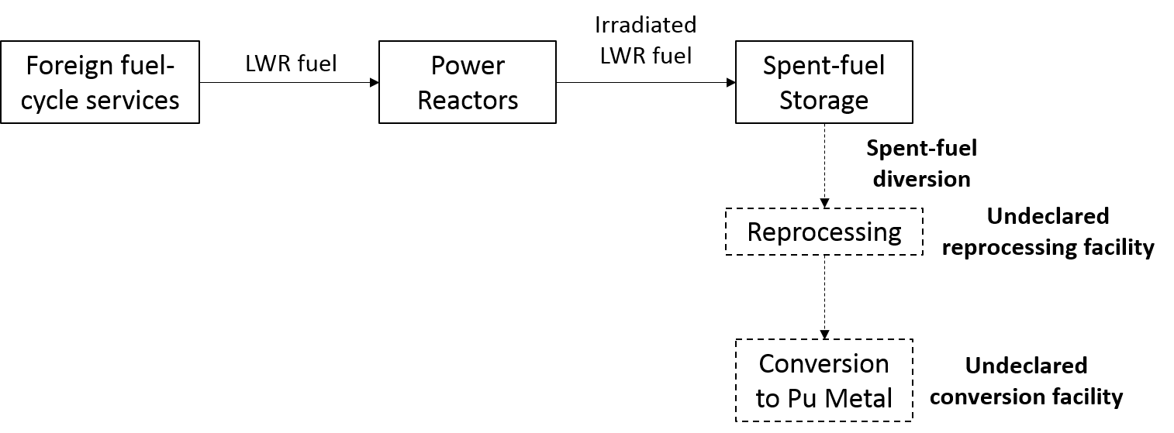
Case Study #1: State with low technical capability
Facilities and capabilities | 4 LWR, 1000 Mwe
Technical objectives | Detect diversion of spent fuel
Time to complete path | 5 years
Target lead time | 6 months
“Worst-case” time window | 1 month
Safeguards status | CSA + AP only | CSA + AP + BC
Probability of absence of undeclared activities | 50% | 90%
$$\text{T}\text{Pu}\text{−}\text{goal}\text{ = (60 – 6 }\text{months}\text{)}P_{absence}\text{+ (1 }\text{months}\text{)(1−}P_{absence}\text{)}$$

Slide 9
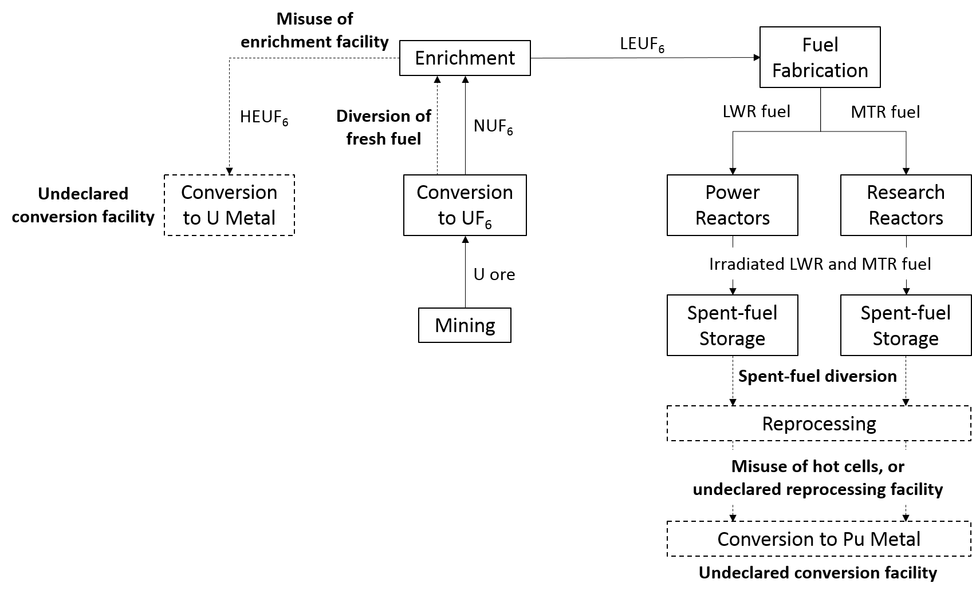
Case Study #2: State with high technical capability
Facilities and capabilities | 2 MTR (5 MWth and 35 MWth), 4 hot cells, 2 LWR (1000 MWe), 1 R&D GCEP, conversion, fuel fabrication, U mining
Technical objectives | Detect diversion of fresh or spent fuel
Time to complete path | 6 months (HEU path); 12 months (Pu path)
Target lead time | 0.5 months
“Worst-case” time window | 3 months (HEU path); 1 month (Pu path)
Safeguards status | CSA + AP only | CSA + AP + BC
Probability of absence of undeclared activities | 20% | 90%

Slide 10
Case Study #2: State with high technical capability
$$\text{T}\text{HEU}\text{−}\text{goal}\text{ = (6 – 0.5 }\text{months}\text{)}P_{absence}\text{+ (3 }\text{months}\text{)(1−}P_{absence}\text{)}$$
$$\text{T}\text{Pu}\text{−}\text{goal}\text{ = (12– 0.5 }\text{months}\text{)}P_{absence}\text{+ (1 }\text{months}\text{)(1−}P_{absence}\text{)}$$
Facilities and capabilities | 2 MTR (5 MWth and 35 MWth), 4 hot cells, 2 LWR (1000 MWe), 1 R&D GCEP, conversion, fuel fabrication, U mining
Technical objectives | Detect diversion of fresh or spent fuel
Time to complete path | 6 months (HEU path); 12 months (Pu path)
Target lead time | 0.5 months
“Worst-case” time window | 3 months (HEU path); 1 month (Pu path)
Safeguards status | CSA + AP only | CSA + AP + BC
Probability of absence of undeclared activities | 20% | 90%
Calculated timeliness goal | ~3 months | ~5 months (HEU); ~10 months (Pu)

Slide 11
Conclusions
A quantitative framework for inspection frequency is possible, but faces many challenges that could be addressed with additional study
A timeliness-goal equation is a step in a useful direction, not the final answer
Calculated timeliness goal is a guide, not a criterion
Helps make assumptions behind decisions more explicit and transparent for SEG consideration
Provides SEGs with a starting point that they can modify based on all available safeguards-relevant information
Provides a common framework for consistency across States
Can be used to highlight the extent to which in-field verification plans are sensitive to assumptions about the effectiveness of certain safeguards activities

Slide 12
Acknowledgments
Research for this paper was funded by the U.S. Department of Energy’s National Nuclear Security Administration
Project Team
Ken Jarman, math/statistics for nonproliferation
Ty Otto, nonproliferation policy
Ben Wilson, safeguards/analysis
Mark Schanfein, nonproliferation advisor

Slide 13
Some Challenges to a Timeliness Goal Equation
1. Difficult to estimate input parameters ($P_{absence}$, time windows, etc.)
SEGs cannot be expected to quantify these
Parameters are highly uncertain
Solution: Adapt expert elicitation and structured probabilistic methods used in other fields (e.g., nuclear safety, public policy analysis)
2. Multiple overlapping paths and objectives
Solution: Expand the timeliness-goal model to a “path-level” probabilistic model, combining objectives and incorporating estimates of detection probabilities over time¹
3. Must be able to evaluate inspection plan effectiveness
Solution: Build on the expanded “path-level” model, combining detection probability over time across paths²
¹ See Anzelon et al. in Proc. INMM Annual Meeting (2016)
² See Budlong Sylvester et al. in Nuclear Safeguards, Security, and Nonproliferation (2008)

Slide 15
Historical Perspective
Inspection frequency: the frequency with which inspectors visit a declared facility (e.g., annual PIV, monthly IIV, less frequent SNRI)
Prior to AP and Integrated Safeguards: the Safeguards Criteria
Material type and amount, facility → formula for frequency (e.g., detect diversion of 1 SQ LEUF₆ at GCEP → monthly inspection)
Simple, non-discriminatory
No flexibility for using SG-relevant info to guide inspection resource allocation
Integrated Safeguards and the Broader Conclusion
Allowed for less frequent inspection at declared facilities (e.g., timeliness goal for spent fuel at reactors increased from 3 months to 1 year)
State-Level Concept
Using APA and SSFs, analyzes acquisition paths and prioritizes technical objectives
Objectives link what verification activities are performed with why
Notes:
I would change to analyzes acquisition paths and prioritizes technical objectives

Slide 16
Quantitative Framework Requirements
Inspection frequency determination should:
Address the need for timely detection of diversion or misuse along plausible acquisition paths
Be transparent, objective, technically defensible, technically achievable
Be consistent with the practices embodied in the SLC, especially:
Use of APA and supporting SG-relevant info to identify, prioritize objectives
Reliance on the 6 SSFs for differentiation among States
A focus on achieving technical and generic objectives (not mechanistic criteria)
Notes:
Change to ”plausible”

