Slide 1
5 min
Development of Active Neutron Non-Destructive Assay (NDA) Techniques
– An Overview of Collaboration Projects of the JAEA, EC-JRC, and Kyoto University –
Japan Atomic Energy Agency (JAEA):
M. Koizumi, Y. Toh, A. Ohzu, H. Tsuchiya, K. Furutaka, M. Maeda,
F. Kitatani, M. Kureta, D.C. Rodriguez, F. Rossi, M. Seya,
J. Takamine, T. Takahashi, H. Tomikawa, M. Hori
Joint Research Centre (JRC):
P. Schillebeeckx, K. Abbas, B. Pedersen, T. Bogucarska,
J.-M. Crochemore
Institute for Integrated Radiation and Nuclear Science, Kyoto University:
J. Hori
IAEA Symposium on International Safeguards: Building Future Safeguards Capabilities, 5–8 November 2018, Vienna, Austria
Acknowledgement: This technological development was supported by the subsidiary for “promotion of strengthening nuclear security and the like” of the Japanese government (MEXT).
Notes:
ご紹介いただきましたJAEAの直井でございます。
それではさっそくJAEAの取り組みについてお話をさせていただきます。

Slide 2
Motivation
Commonly used passive NDA techniques are not applicable to measure a high-level radioactive NM sample.
Sample | Low-level radioactive | High-level radioactive (from FPs and MAs)
Example of sample | Purified reprocessed Pu New UO₂ MOX fuel | Spent fuel assembly Sample from reprocessing tanks Fuel for innovative reactors
methods | Passive NDA (*) | to be developed (Active NDA)
*Active coincidence counting technique is used for U-235 mass measurement in UO₂ sample.
Active neutron NDA techniques, which utilize neutron to induce nuclear reactions to produce a radiation signature form the sample, are potentially applicable to high-level radioactive NM analysis if the induced differences appear significantly.
Four active neutron NDA techniques are chosen

Slide 3
Four active neutron NDA techniques under development
Active Neutron NDA Techniques | Quantification
Differential Die-away Analysis (DDA) Pulsed neutron interrogation method that measures a time-dependent neutron die-away curve depending on the neutron emission of induced fission reactions. | ²³⁹Pu-effective mass
Prompt Gamma-ray Analysis (PGA) Measurement of prompt gamma rays induced by (n, gamma) and the other reactions. Characteristic gamma rays are used to determine nuclides within the sample. | Existence, and qualification/ quantification of specific nuclide
Neutron Resonance Transmission Analysis (NRTA) Neutron time-of-flight (TOF) measurement, in which nuclide characteristic dips of nuclear reaction resonance energies are observed in an energy-dependent transmission spectrum. | Quantity of each of U/Pu nuclides
Delayed Gamma-ray Analysis (DGA) Measurement of gamma rays from radioactive nuclei produced by neutron induced fission reactions | Ratio of ²³⁵U/²³⁹Pu/²⁴¹Pu
Each technique provides different kind of information of a sample object.

Slide 4
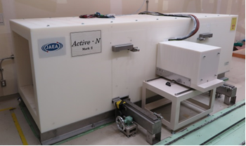
Development of each technique
The first stage of the project is for confirmation of basic technology with low-level radioactive NM sample.
Design study using simulation and experimental study were carried out.
An integrated apparatus for DDA and PGA measurement
PGA
This system was constructed at the NUclear fuel Cycle safety Engineering research Facility (NUCEF) in JAEA.
DDA
DDA and PGA: Construction measurement was constructed at the NUclear fuel Cycle safety Engineering research Facility (NUCEF) in the JAEA Tokai-site.

Slide 5
DDA development
Pu-239 samples in a vial bottle (φ26×40 mm) in a 60-mm-thick moderator were measured. The measurement time was 600 sec using D-T neutron generator (1.0×10⁹-n/sec neutron production rate and 100-Hz repetition rate).
Measurement of Pu-239 from 10-1000 g in a vial bottle were potentially available with this system.
DGA development
Gamma-ray signals indicating the existence of elements of N, As, P, Cl, and S were successfully observed.
Further development is in progress for reducing the background by changing the structure materials, and passive and active detector shielding.

Slide 6
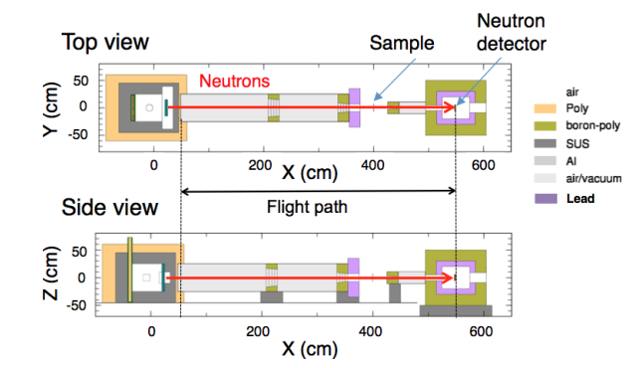
NRTA development
Simulated transmission spectra
H.Tsuchiya et al., Plasma and Fusion Research 13, 2406004 (2018)
sample:
a spent fuel of 30 GWd/t
1 cm thick
flight path length:
5 m
The vertical positions of the plots are moved for the sake of clarity.
P9, P0, P2, U5, U6, and U8 represent ^{239,240,242}Pu and ^{235,236,238}U, respectively.
Areal densities of ²³⁸U and ^{239,240,242}Pu can be deduced by using a DT neutron source (pulse width of 10 µs).
Experimental study is also in progress at EC-JRC Geel and Kyoto University.

Slide 7
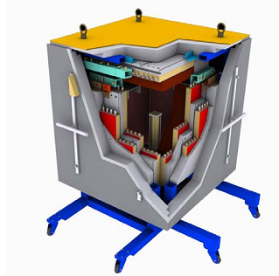
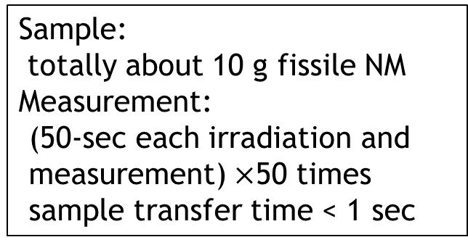
DGA development
PUNITA:
Pulsed Neutron Interrogation Test Assembly
²³⁵U : ²³⁹Pu
An apparatus at EC-JRC Ispra equipped with a DT neutron source
1:0
1:1
Sample:
totally about 10 g fissile NM Measurement:
(50-sec each irradiation and measurement) $×$50 times
sample transfer time < 1 sec
0:1
Change of peak intensity ratios according to the fissile NM ratio was observed. A potential for analyzing relative concentration of fissile nuclides was confirmed.
Development study is continued at PERLA (Performance Laboratory ) of EC-JRC Ispra.
High energy delayed gamma-ray spectra measured with PUNITA of EC-JRC Ispra.
The vertical positions of the plots are moved for the sake of clarity.

Slide 8
Examples of combinations of NDA techniques
Combination | Measured quantities | Deduced nuclides masses
DDA + DGA | fissile mass + ratios of fissile nuclides | U: 235 Pu: 239, 241
HKE + DDA + DGA | masses of elements + fissile mass + ratios of fissile nuclides | U: 235, 238; Pu: 239, 241; sum of the other Pu isotopes
NRTA (10-µs) | masses of nuclides | U: 238; Pu: 239, 240, 242
NETA (10-µs) + DGA | masses of nuclides + ratio of fissile nuclides | U: 235, 238, Pu: 239, 240, 241, 242
HKE: hybrid k-edge densitometry: Masses of each element
PGA would be useful to diagnose matrix material of a sample, such as neutron poisons.
We will continue the development for high-level radioactive NM sample measurements.
(1) Development of an Integrated system for DDA, PGA, and NRTA
(2) Development of a practical DGA system
(3) Development of a laser driven neutron source for an NRTA measurement

Slide 9
Development of active neutron NDA technique at JAEA
(1) Development of an Integrated system
Basic technological development of interrogation methods for mutual complement analysis.
DDA
PGA
DT neutron generator
NRTA
5 m neutron flight path
sample
(2) Development of a practical DGA system
highly radio active sample
hot cell
low energy γ-ray filter
(3) Development of a laser driven neutron source for an NRTA measurement
compact NRTA system
γ-ray detector
neutron source
sample tube
neutron moderator
neutron source
neutron detector
sample
Development of a compact DGA system equipped with a DD neutron generator or ²⁵²Cf neutron source.
Development of a laser driven neutron source, of which short-pulse-neutron generation improves the accuracy in measurement of NRTA.

Slide 10
おわり
Thank you for your attention

