Slide 2
REINFORCING NUCLEAR SAFEGUARDS
EFFECTIVENESS THROUGH COOPERATION
LEONARDO PARDO, GUSTAVO DIAZ, STELLA MARIS BONET DURAN
Nuclear Regulatory Authority
Buenos Aires, Argentina
SONIA FERNANDEZ MORENO, LUIS MACHADO DA SILVA
Brazilian-Argentine Agency for Accounting and Control of Nuclear Materials
Rio de Janeiro, Brazil
MALIK DERROUGH, ALTA BROODRYK
International Atomic Energy Agency
Wien, Austria

Slide 3
Presentation Outline
Background Information
Argentinean Nuclear Fuel Cycle
Cooperation.
Unattended monitoring system for spent fuel transfers at the Embalse Nuclear Power Plant
Dry storage at Atucha I Nuclear Power Plant - 2D laser curtain barrier
Conversion facilities – SNRI
Uranium hexafluoride sampling methodology – ABACC / Cristallini
Ultrasonic seals system for Atucha I NPP ponds
Future Work
Conclusions

Slide 4
Background Information
To describe the application of safeguards in Argentina, the improvements implemented in the recent years, the incorporation of new technologies to meet technical safeguards objectives in a more efficient manner.
Agreement between the Republic of Argentina and the Federative Republic of Brazil for the Exclusively Peaceful Use of Nuclear Energy (published at the IAEA website as INFCIRC/395 on 26 November 1991) - Bilateral Agreement.
Mutual verification of nuclear materials
Creation of the Brazilian-Argentine Agency for Accounting and Control of Nuclear Materials (ABACC)
Agreement of 13 December 1991 between the Republic of Argentina, the Federative Republic of Brazil, the Brazilian-Argentine Agency for Accounting and Control of Nuclear Materials (ABACC) and the International Atomic Energy Agency for the Application of Safeguards (published at the IAEA website as INFCIRC/435) - Quadripartite Agreement
Quadripartite Agreement encourage cooperation among all the parties to achieve and maintain the effective and efficient application of safeguards

Slide 5
Argentinean Nuclear Fuel Cycle
The fuel cycle developed by Argentina includes a broad spectrum of activities that includes small research & development facilities and labs, production plants , research reactors and nuclear power plants.
Two nuclear power plants in operation and one nuclear power plant undergoing a life extension program, with associated dry spent fuel storage facilities
One small modular reactor (SMR), the CAREM 25, under construction
Five research reactors; one of which is exclusively dedicated to the production and supply of radioisotopes for medicine and industrial applications
One open pool research reactor RA-10 under construction with unique characteristics to the region
Fuel fabrication of different types of fuel elements and the purification and conversion of natural and enriched uranium. New uranium conversion plant under construction
There are also smaller facilities and locations outside facilities (LOFs) that support the Argentine nuclear sector, including R&D laboratories in uranium enrichment techniques, waste management, analytical tests, and storage.

Slide 6
Cooperation
Unattended monitoring system for spent fuel transfers at the Embalse NPP
Embalse Nuclear Power Plant (NPP) is a pressurized heavy water reactor (PHWR). CANDU-6
Dry storage at Embalse was commissioned in 1993 .
Historically, spent fuel transfers to difficult access storage silos had been resource intensive for both the IAEA and ABACC as the approach required the presence of inspectors throughout the campaign.
To improve the efficiency and effectiveness of verification activities, an unattended monitoring system (UMS) was developed.
To maintain continuity of knowledge (CoK) of spent fuel during the entire transfer process
In order to achieve a high level of confidence of the nuclear material involved in transfers:
Unannounced inspections (UIs)
Mailbox declarations;
The development and approval of UMS required extensive negotiation and coordination amongst all parties.
Two-step approval process. (Technical reliability test and inspection field trial)

Slide 7
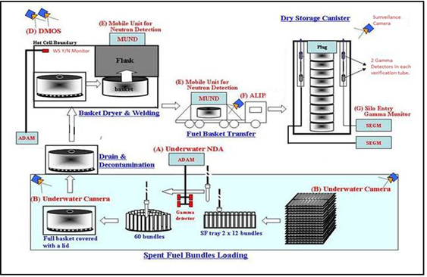
Cooperation
Unattended monitoring system for spent fuel transfers at the Embalse NPP
Safeguards systems were designed combining Non-destructive Assay (NDA) measurements, remote monitoring (surveillance) and containment measures.
joint use procedures were written to ensure facility operators, State authorities and international inspectors work in a coordinated manner while they are in the field.

Slide 8
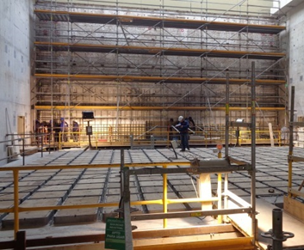
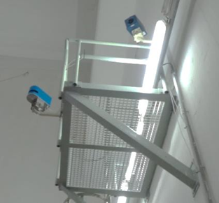
Cooperation
Dry storage at Atucha I Nuclear Power Plant - 2D laser curtain barrier
Atucha I NPP is a Siemens-KWU on-load refueling power reactor. It uses slightly enriched uranium as fuel and heavy water as coolant and moderator.
New dry storage is composed of 316 silos with each silo containing a canister for nine fuel assemblies. Relatively high expected anticipated dose rates.
In order to assure CoK, the IAEA floated the idea of a laser system that would monitor the movement of canisters into each silo in the form of a Laser Curtain for Containment (LCCT) system.
The LCCT is being developed by the IAEA with the technical assistance of the European Commission’s Joint Research Center in Ispra and with support of ABACC and Argentina under its member state support programme.
Extensive field tests under real conditions are conducted. Argentina has made two of its facilities available for testing.
LCCT will not only have applications in Argentina …

Slide 9
Cooperation
Conversion facilities – SNRI
The Uranium Conversion Plant (DIOXITEK) is a commercial plant for the production of natural uranium (NU) dioxide from uranium ore concentrate (UOC) and the recycling of NU and low enriched uranium (LEU). Campaigns for the recovery of uranium from scrap material .
Short notice random inspections (SNRIs) allow for full verification coverage of the nuclear material flow while employing reduced inspectorate resources.
The SNRI regime was first introduced in Argentina in 2007 at their fuel fabrication plant and again in 2018 at their conversion facility.
To support of SNRIs
Near real-time accountancy method - “mailbox” concept
facility operator - daily declarations on the flow of nuclear material, production, receipts and shipments.
The SNRI procedure was successfully verified during a trial carried out in 2017. The findings and lessons learned led to improvements in the procedure, mailbox scope and other elements of the procedure being implemented during routine implementation.

Slide 10
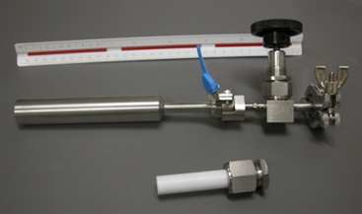
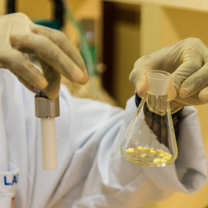
Cooperation
Uranium hexafluoride sampling methodology – ABACC / Cristallini
Uranium hexafluoride sampling (UF₆) is performed in gaseous phase from process lines at enrichment facilities via desublimation occurring inside a metal sampling cylinder cooled with liquid nitrogen or via a fluorothene P-10 type tube.
Dr. Cristallini developed a new UF₆ sampling method
This method collects UF₆ (gaseous phase) by adsorption in alumina (Al₂O₃) in the form of uranyl fluoride (UO₂F₂) (solid). Water retained inside alumina pellet
Fluorothene P-10 type tube containing alumina pellets.
Advantages
Flexibly in meeting current nuclear material transport regulations.
Results can be obtained with lower residual material at facilities.
Requires simpler treatment of the sample.

Slide 11
Cooperation
Uranium hexafluoride sampling methodology – ABACC / Cristallini
The IAEA submitted a task proposal for this project to Argentina and Brazil under the scope of the technical cooperation programme. ABACC is the coordinating organization for the project.
“Develop and implement techniques for determination of new chemical and physical attributes for strengthening safeguards verification using nuclear material samples,”
IAEA Department of Safeguards Long-Term R&D Plan, 2012-2023
The sampling procedure has been validated- It Works!
Methodology Standardization - American Society for Testing Materials (ASTM). Final steps for approval.

Slide 12
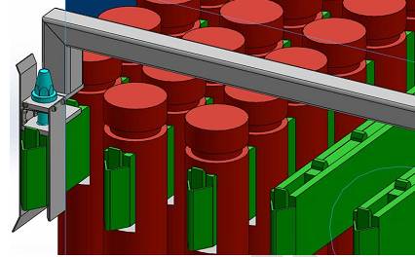
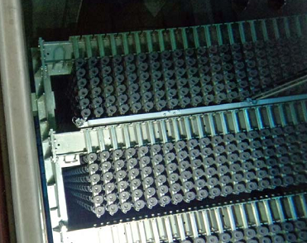
Cooperation
Ultrasonic seals system for Atucha I NPP ponds
ABACC led joint technical project, with technical assistance provided by Joint Research Centre (JRC)_in Ispra
Containment tool, focused on the application of ultrasonic seals technologies.
Main objective - Application of safeguards measures to contain irradiated fuels stored at a two layers spent fuel pool.
Final system vulnerability tests are underway

Slide 13
Future Work
New Uranium Conversion facility at Formosa province
CAREM Small modular reactor of Argentinean design
Research reactor RA-10

Slide 14
Conclusions
The Quadripartite Agreement calls for States parties, ABACC and the IAEA to cooperate in safeguards implementation.
ABACC and the IAEA shall avoid unnecessary duplication of safeguards activities.
Identification, testing and use of novel technologies and methods and the development of new approaches are essential to the reliable and efficient implementation of safeguards.
IAEA, ABACC and Argentina work together to improve the nuclear safeguards verification schemes applied to nuclear material during all fuel cycle activities occurring in Argentina.

Slide 15
Gracias por su tiempo
(Thank you for your time)
Autoridad Regulatoria Nuclear

