Slide 1


R&D on NDA Techniques for Nuclear Safeguards and Security within the JAEA-JRC Partnership in Ispra
K. ABBAS, J.M. Crochemore, T. Bogucarska, B. Pedersen, S. Nonneman
European Commission, Joint Research Centre, Directorate for Nuclear Safety and Security, Nuclear Security Unit, Via Enrico Fermi 2749, 21027 Ispra (VA), Italy
kamel.abbas@ec.europa.eu
D.C. RODRIGUEZ, F. ROSSI, T. Takahashi, M. Seya, M. Koizumi
Integrated Support Center for Nuclear Nonproliferation and Nuclear Security, Japan Atomic Energy Agency, Shirakata Shirane 2-4, Tokai, Naka, Ibaraki, Japan
Vienna, November 5-8, 2018

Slide 2
Contents
R&D infrastructure and capabilities at the JRC Ispra site
Preliminary results on the development of an innovative NDA technique for nuclear safeguards and security under JAEA–JRC collaboration ()
  JAEA-JRC Collaboration
  JAEA Delayed Gamma Spectrometry experimental set-up being tested in PERLA
  Preliminary results
  Conclusion
see also the paper 153 of this symposium!
  -
  -

Slide 3

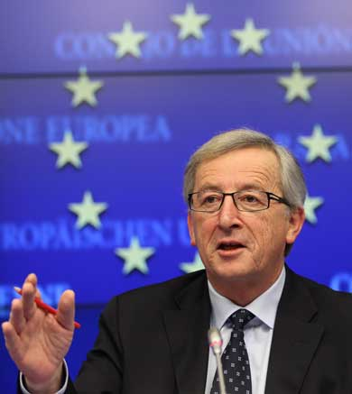

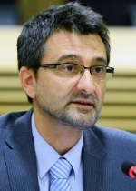
The JRC in the Commission
President Jean-Claude Juncker
27 Commission Members
…
DG Environment
DG Climate Action
DG Agriculture and Rural Affairs
DG Mobility and Transport
Commissioner Tibor Navracsics
Education, Culture, Youth and Sport
DG Energy
Joint Research Centre (JRC)
DG Education and Culture
JRC Director-General
Vladimir Šucha
Notes:
3

Slide 4
Part 1
  Infrastructure and capabilities in Ispra
  R&D in ESSOR Area
  PERLA Facilities
Neutron detection material alternative to 3He
Development and testing of neutron and gamma detector including the associated electronic
Development of method for characterization of fresh and spent fuel
Validation of instruments and methods for nuclear decommissioning and waste management (ND&WM)
Capacity building in imaging techniques such as gamma cameras
Building a pilot experiment for tomography of waste as a support to the JRC ND&WM programme
Calorimetry for safeguards
Support to EURATOM in terms of R&D such as development of a dedicated instrument for fresh MTR fuel verification.

Slide 5
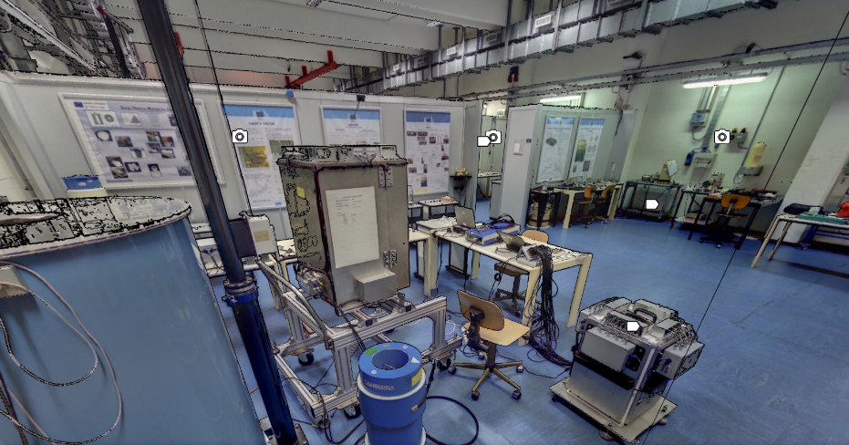

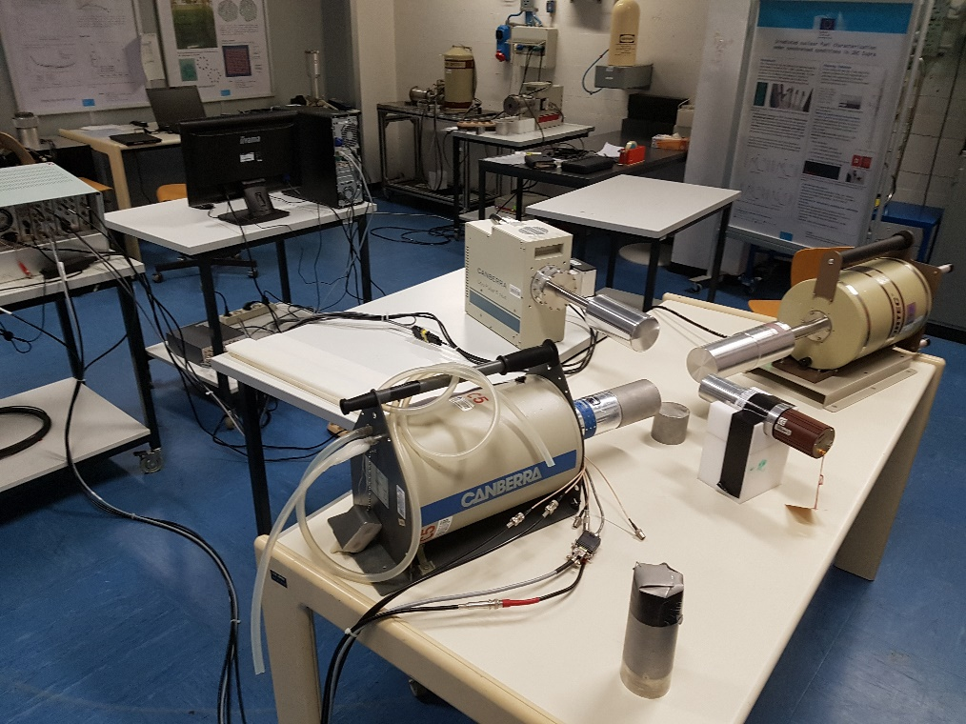
  PERLA Facilities
FIG. 1: View of a side of PERLA (Ispra, Iatly)

Slide 6
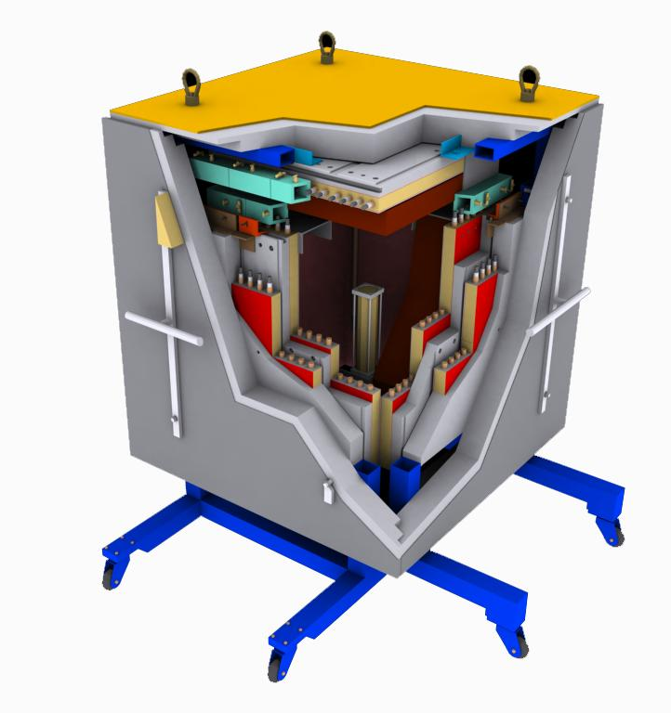
Pulsed Neutron Interrogation Test Assembly - PUNITA
A facility for Research in NDA methods and instrumentation For applications in nuclear safeguards and security
Nuclear Safeguards:
Mass determination of small quantities of fissile material
Method: Differential Die-Away technique with neutron correlation analysis
Applications: e.g. nuclear waste assay
Nuclear Security:
Detection of special nuclear material (SNM) in shielded containers.
Method: detection of fission signatures
Application: e.g. air cargo containers (ULDs)
6

Slide 7
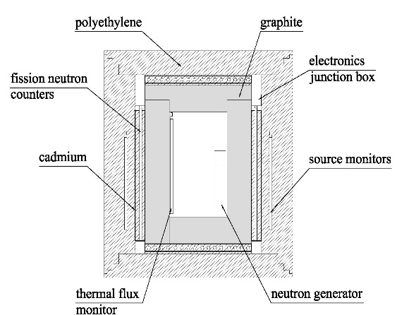
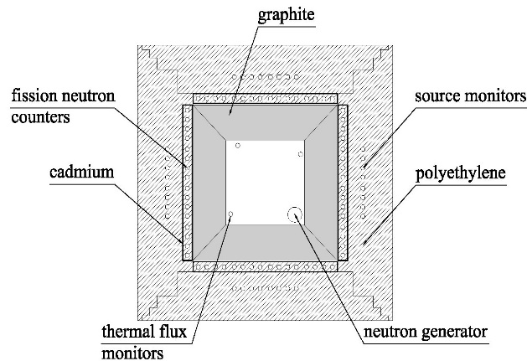
Pulsed Neutron Interrogation Test Assembly - PUNITA
Features
• sample cavity: 50 cm x 50 cm x 80 cm
• thick graphite linear on all six side
• fission neutron counters: He-3 in polyethylene
• low pressure, thermal flux monitors
• monitor for neutron generator output
• HPGe, LaBr3, scintillators in cavity
top view
side view
14-MeV neutron generator: MF Physics Model A-211
neutron emission
2⋅10⁸ /s, 10⁶/burst in 4π angle
sealed, D-T mixed beam
300-500 hours life
pulsing of ion source and acceleration voltage
no emission between bursts
neutron burst width: 10 µs
burst repetition rate: 1 – 150 s⁻¹

Slide 8
Innovative Techniques/Technologies and Standardisation of Practices in Decommissioning (ITSP)
Development of standards for decommissioning and environmental remediation
Perform Research & Development for site characterisation in view of waste minimisation
Development of new characterisation methods of waste (NDA and imaging) Application of safeguards verification technologies & methodologies based on laser verification in nuclear decommissioning and waste management

Slide 9
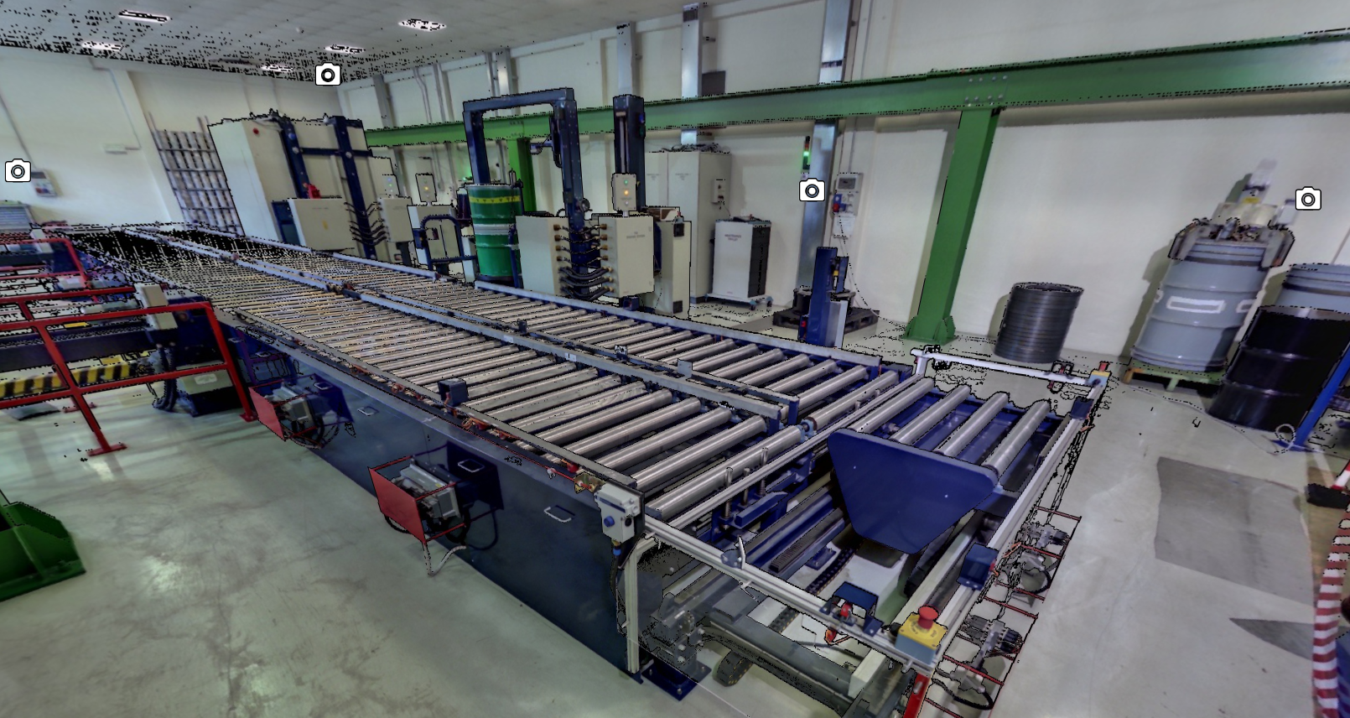
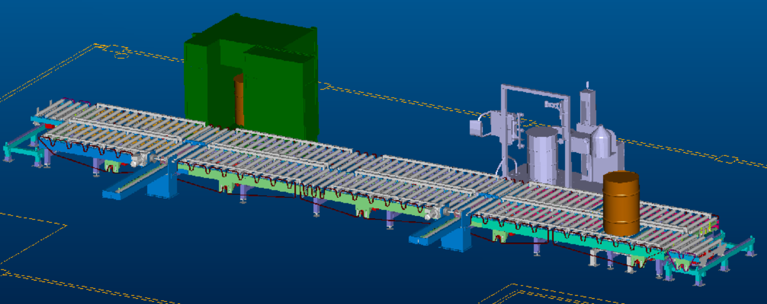
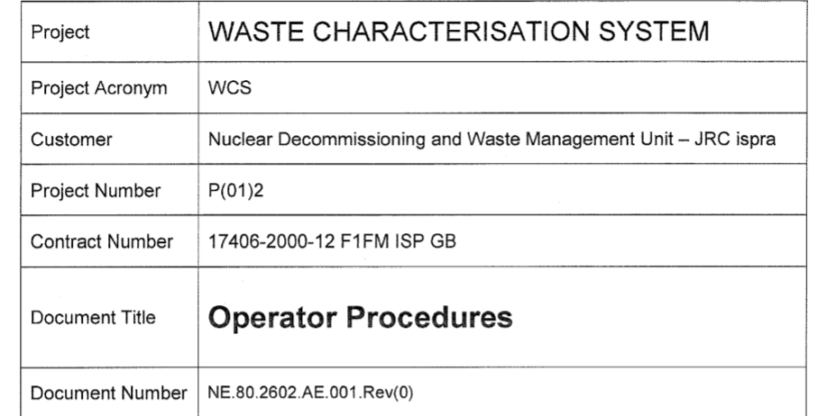
NDADecomm
Tomography of waste drums in the characterisation/clearance stage

Slide 10
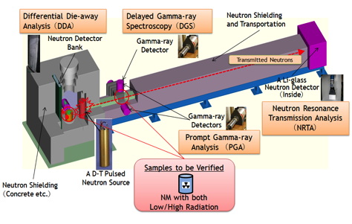
Part 2
  JAEA-JRC Collaboration
JAEA ISCN Active Neutron Nondestructive Assay Program
in collaboration with EC JRC
(Neutron) Differential Die-away Analysis (DDA) | Neutron Resonance Transmission Analysis (NRTA) | Prompt Gamma-ray Analysis (PGA/NRCA) | Delayed Gamma-ray Spectroscopy (DGS)
²³⁹Pu_{eff} Fissile Mass | Nuclide Content | Matrix Materials | Fissile Nuclide Ratio
JRC-Ispra (PUNITA) | JRC-Geel (GELINA) | JRC-Geel (GELINA) | JRC-Ispra (PUNITA/PERLA)

Slide 11
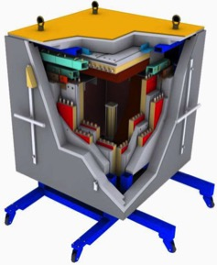
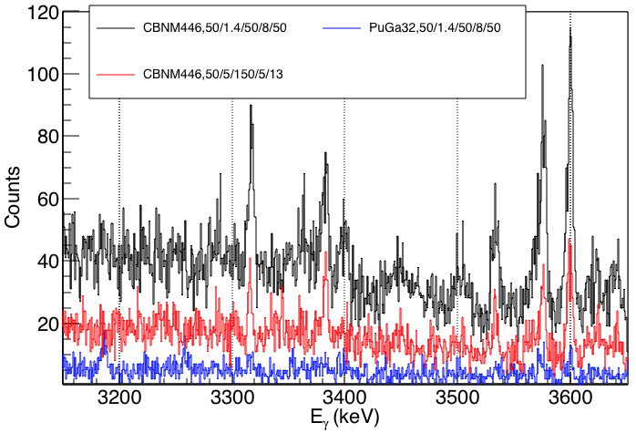
Part 2
  JAEA-JRC Collaboration
  Test of DGS technique in PERLA

Slide 12
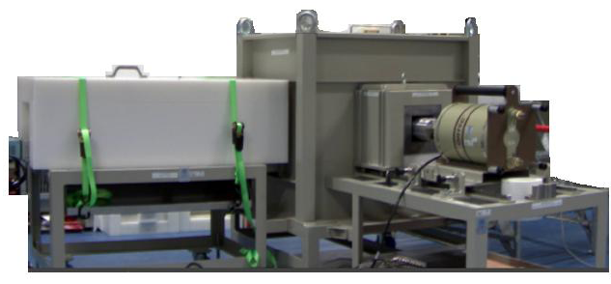
  JAEA DGS experimental set-up being tested in PERLA
  Application DGS technique
  Preliminary system using Cf-252 as a surrogate for a pulsed neutron generator
The remote operation of the system is considered

Slide 13
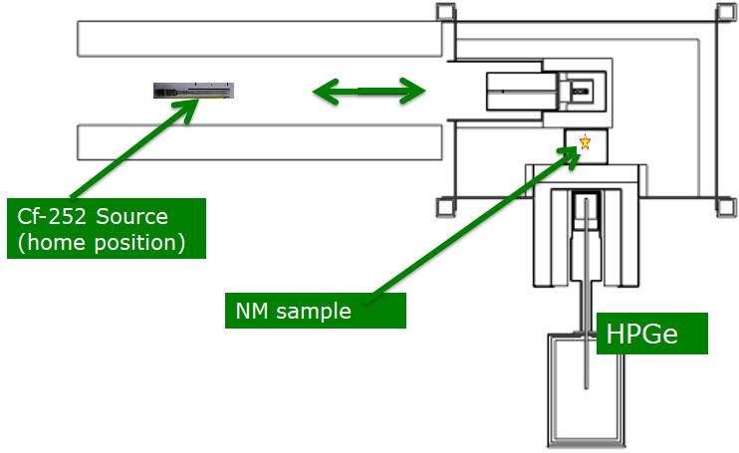
  System installed in PERLA
Static measurement configuration: the sample remains fixed in front of the detector and the neutron irradiation position

Slide 14
  Some fission products considered for DGS
Nuclide | Half-life (min) | Gamma-ray (keV) | Branching ratio (%)
⁸⁹Kr | 3.2 | 3533 2866 1533 | 1.4 2 5
⁹⁰Rb | 2.6 | 3383 4366 4646 | 7 8 2.2
^{90m}Rb | 4.3 | 3317 3503 1739 | 14.3 2.4 1;9
¹³⁶I | 1.9 | 2869 2634 2289 | 4 6.7 10
^{99m}Nb | 2.5 | 2641 2851 2134 | 4 3 1
¹³⁸Cs | 33.4 | 2639 2218 1436 | 7.6 15 76
⁹¹Rb | 1 | 2563 3600 1971 4265 | 12.6 10.4 6.7 1.4
Nuclide | Half-life (min) | Gamma-ray (keV) | Branching ratio (%)
¹⁰⁶Tc | 0.6 | 2238 1968 2789 3186 3258 | 13.6 8.9 7.9 5 2.7
¹³⁶Te | 0.3 | 2078 2569 3050 | 22.4 15.4 2.1
⁹⁵Y | 10.3 | 2175 3575 2631 954 | 7 6.4 4.8 15.8
⁹⁵Sr | 0.4 | 2718 2933 2248 | 4.6 4.1 3.8
⁹⁰Kr | 0.5 | 1780 1538 1119 | 6.7 9.7 39
¹³⁴Te | 42 | 2077 2569 3049 2497 | 22.4 14.4 2 4.9
¹³⁸Xe | 14 | 1767 2016 2251 | 16.7 12.3 2.3

Slide 15
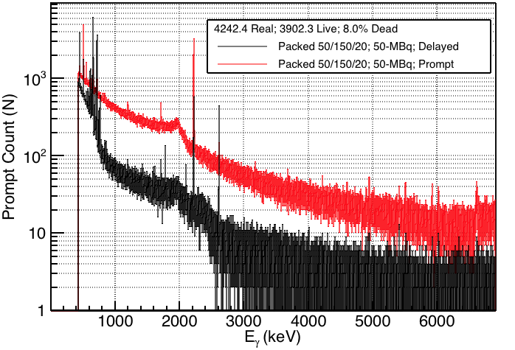
  Part 2
  Preliminary Results
  Gamma background measurement
Count
Prompt gammas from Fe-56 activation
A high gamma background from system activation and insufficient fission rate is preventing visibility of the gamma-ray peaks of interest!
The DGS spectra with 50-MBq during irradiation (red) and during measurement (black).

Slide 16
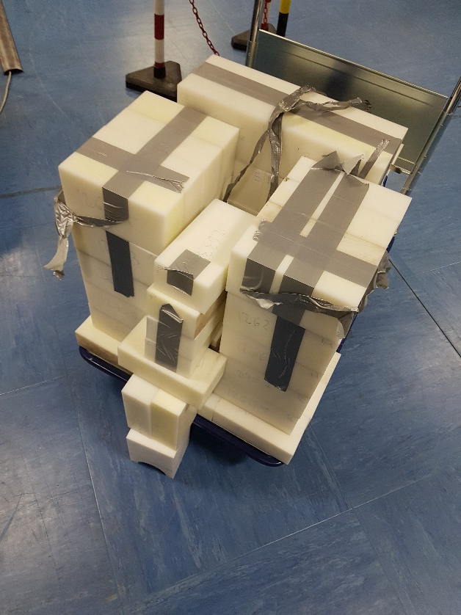
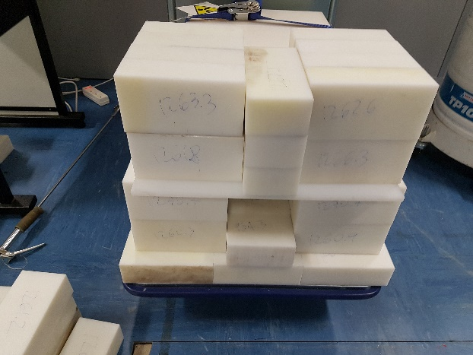
Investigation of a stand alone HDPE moderator to test improvements of the fission rate
NM sample
Front view
Overhead view
Cf-252 source

Slide 17
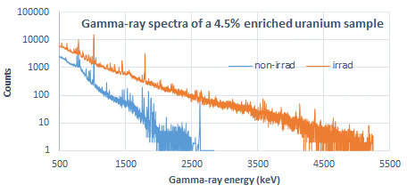
Gamma ray spectrum of an enriched (4.5%) uranium sample (200 g total U mass) showing well resolved delayed gamma ray peaks (>2.5 MeV). The upper spectrum is of the ²⁵²Cf irradiated uranium sample while the lower is of the sample prior to its ²⁵²Cf irradiation.

Slide 18
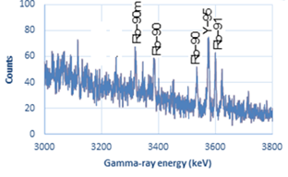
Energy range (3 – 3.8 MeV) of the gamma spectrum showing well resolved delayed gamma-ray peaks

Slide 19
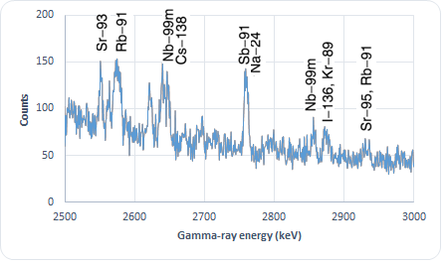
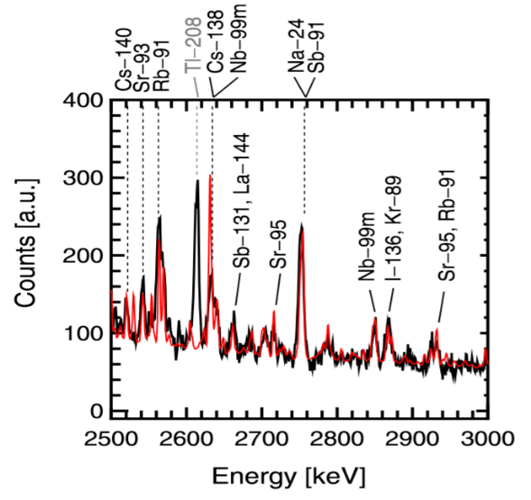
Gamma-ray spectra of a 4.5% enriched uranium sample irradiated
with ²⁵²Cf in PERLA
The gamma-ray peaks of interest are well resolved!
with a D-T generator in PUNITA (K

Slide 20
Conclusion
  Preliminary Results on the Application of DGS as an NDA technique for the Characterisation on NM are promising!
      Fissions of LEU samples irradiated with a ²⁵²Cf source (10MBq) are observed
      Gamma ray peaks at high energy (>2.5 MeV) are well resolved despite a substantial background
      Improvement of the experimental set-up supported by MCNP modelling is ongoing
      The high energy resolution gamma detector requires to be strongly shielded to prevent detection of a variable background of the measurement environment
      The fine tuning of the ²⁵²Cf irradiator of the JAEA DGS system including its neutron moderator is on-going thanks to the extensive MNCP modelling input and the exploration of new neutron flux characterisation at key position of the DGS system
      Further experimentation with both U and Pu samples are planned

Slide 21
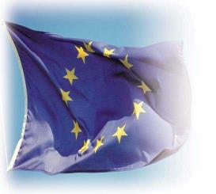
Thank you for your attention!
  kamel.abbas@ec.europa.eu

