Slide 1
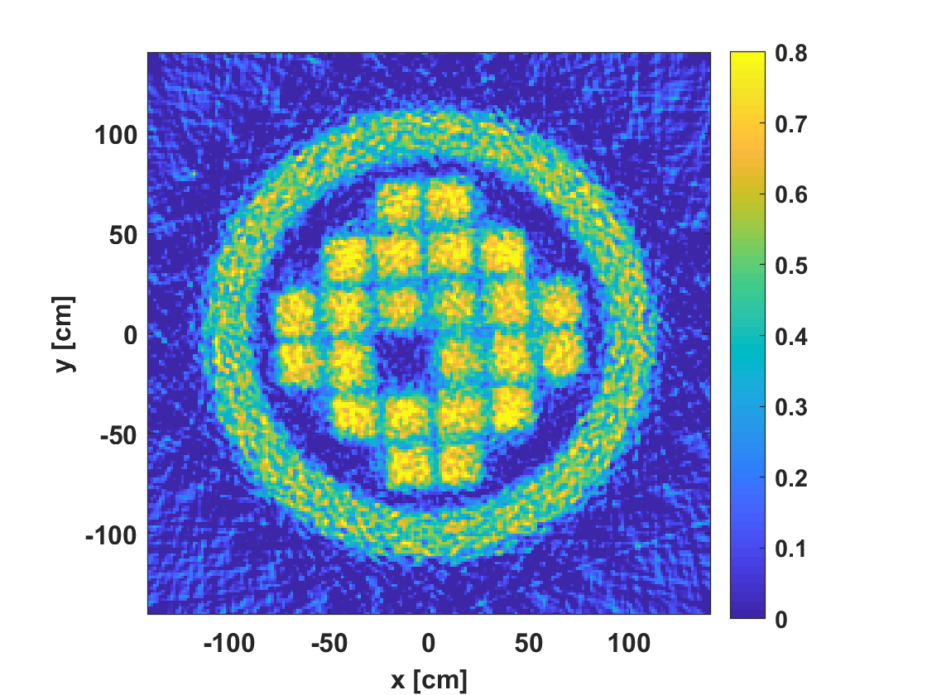
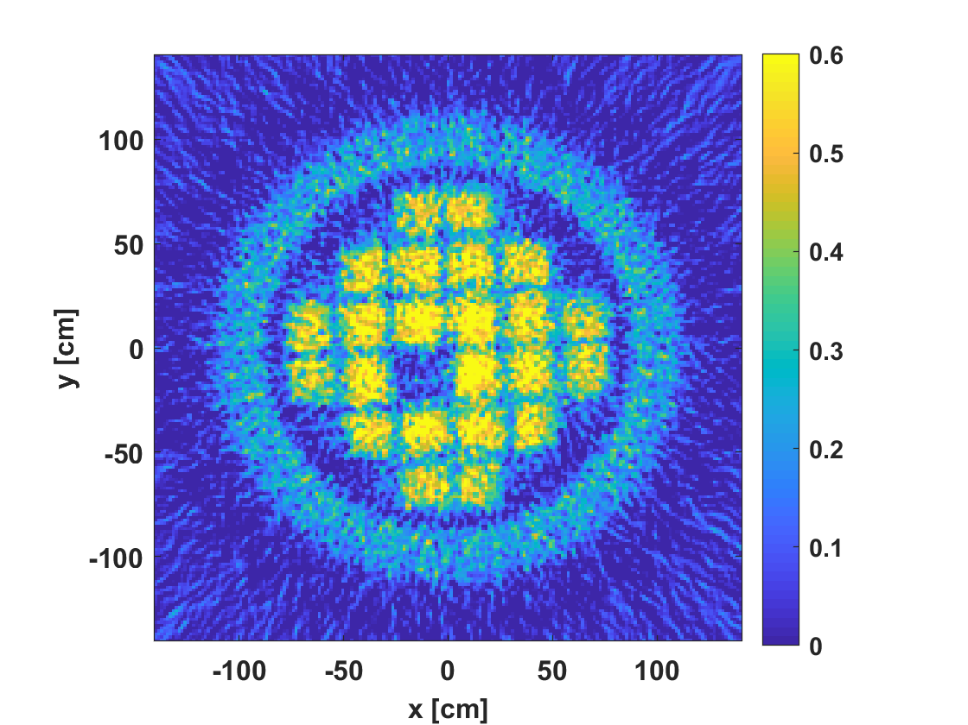
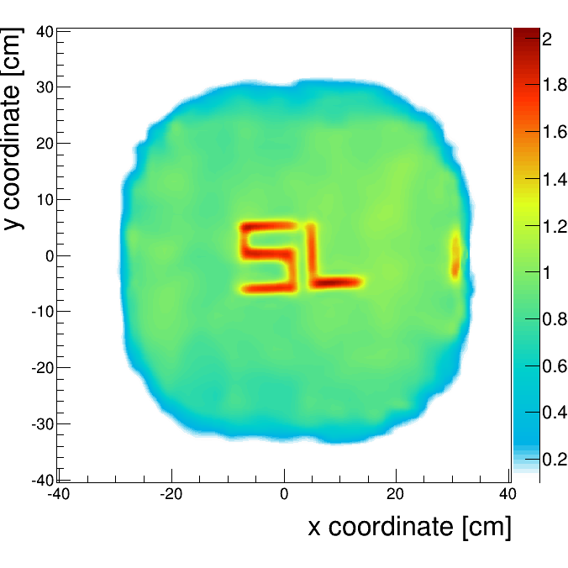
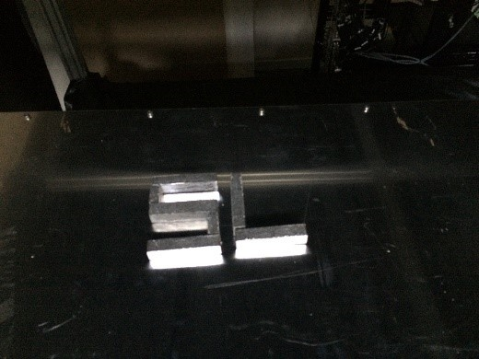
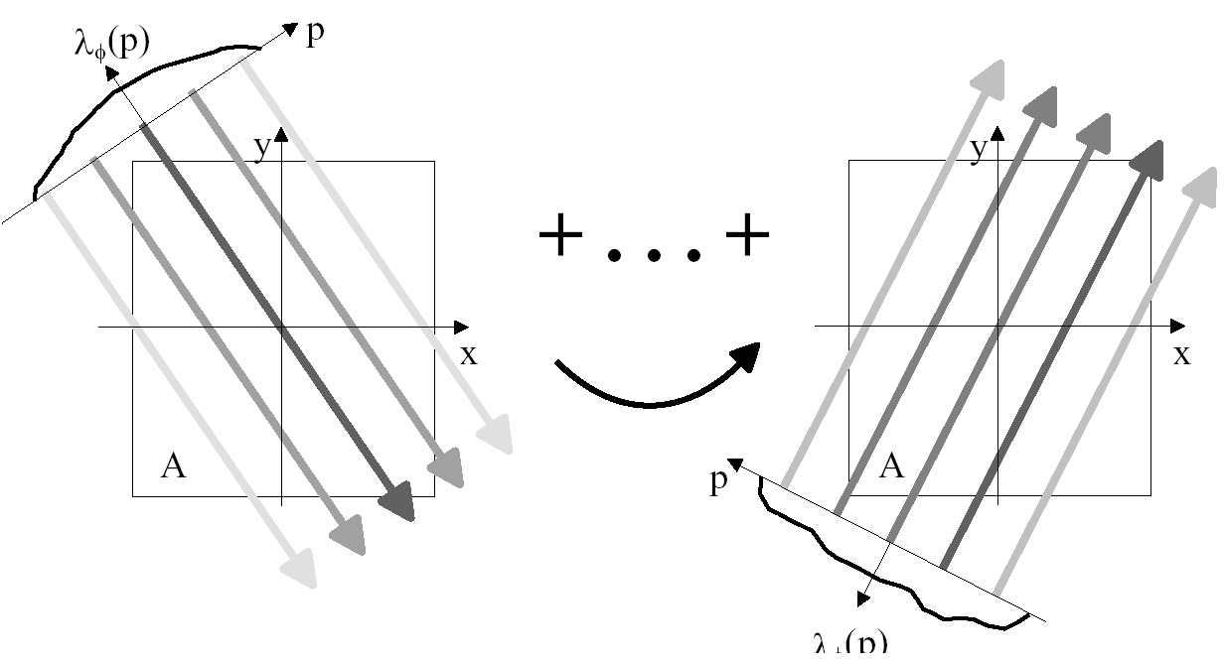
MUON IMAGING FOR SAFEGUARDS APPLICATION
G.L. YANG¹, A. CLARKSON ¹, R. KAISER ¹, D. MAHON ¹, S. GARDNER ¹
M. RYAN ¹
¹ University of Glasgow and Lynkeos Technology Ltd., ² National Nuclear Laboratory
guangliang.yang@glasgow.ac.uk
ID: 179
ABSTRACT
GEANT4 SIMULATION
Due to the high penetrating power of muons, muon imaging can be used to image large and dense objects where other techniques such as x-ray imaging often fail.
There are several ways muons may interact with matter which can be used for imaging, these include: multiple scattering, energy loss and production of secondary particles, and beam intensity loss (absorption).
Muon multiple scattering imaging and muon absorption imaging can both be used for safeguards applications.
To demonstrate the capability of muon imaging techniques, Geant4 simulation studies were carried out. Planar detectors on the opposite sides of the object were used in the simulation, the active area of each tracker modules are 2.8 m by 2.8 m. In order to cover every direction, the detector system was rotated around the centre of the object by an angle step of 11.25 degrees, and in total 32 steps were used, and about 2 million muon tracks were measured at each steps.
A Westinghouse MC-10 vertical dry storage spent fuel cask was chosen to represent dry storage casks in the simulation.
INTRODUCTION
Muons are relatively large elementary particles and travel at relativistic speeds, can penetrate tens of meters into rocks and other matter before attenuating as a result of absorption or deflection by other atoms.
Cosmic ray muons occur naturally and they are ubiquitous, cost-free and health-and-safety neutral.
Muon multiple scattering imaging utilizes the charged particle multiple scattering effect in matter to reconstruct object images. The total effect of muon multiple scattering can be described by the muon scattering angle and displacement, where the muon scattering angle is the angle between the incoming muon vector and the outgoing muon vector, and the scattering displacement is the difference between the outgoing muon striking position and the expected striking position by extending the incoming muon tracks.
Muon absorption imaging uses information of the muon beam intensity attenuation along a muon beam path to do the image reconstruction. In order to get the muon attenuation value, the muon source intensity has to be known. In the case of the cosmic ray muon, the open sky muon spectrum has to be known.
Both muon absorption and multiple scattering imaging techniques use particle tracking detectors to measure a trajectory for every muon. At least a pair of tracking detectors are needed for the muon absorption imaging technique, and two pairs of tracking detectors located on the opposite sites of the objects are needed for the muon multiple scattering imaging. An additional pair of detectors located on the opposite side of the first pair of detectors for a muon absorption imaging system can provide additional information about the muon source, which is very helpful in some situations.
Both the muon multiple scattering and absorption imaging can be seen as solving an inverse Radon transform or a linear system of equations.
OUTCOME
Tomographic images reconstructed using the FBP method
A photo of lead letters “SL” and their muon tomographic image
CONCLUSION
The capability of muon absorption and multiple scattering imaging was demonstrated by a Geant4 simulation. It is obvious that these muon imaging techniques can be used to image the contents of heavily shielded nuclear spent fuel casks.
However, this technique still needs to be demonstrated experimentally to demonstrate its full capability.
Nuclear Waste drum
Nuclear Waste drum
ACKNOWLEDGEMENTS / REFERENCES
This work was partially supported by the EPSRC and STFC Impact Accelerator Accounts at the University of Glasgow and by Lynkeos Technology Ltd.
Muon imaging data can be rearranged into the Radon transform data format

