Slide 1
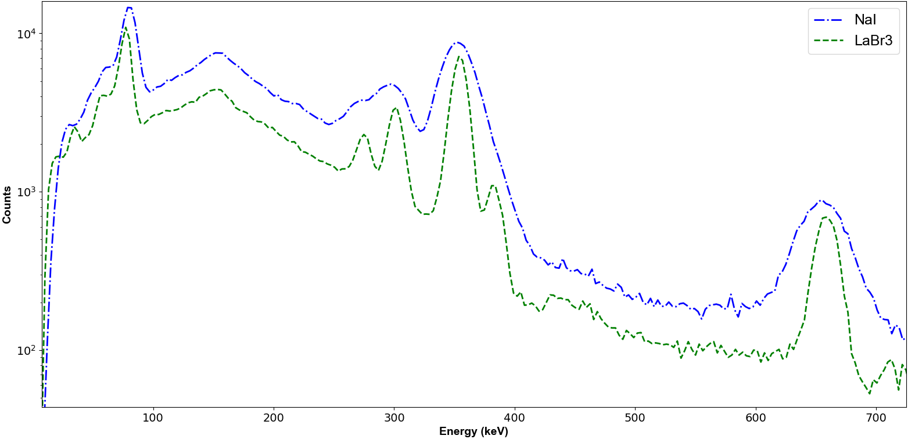
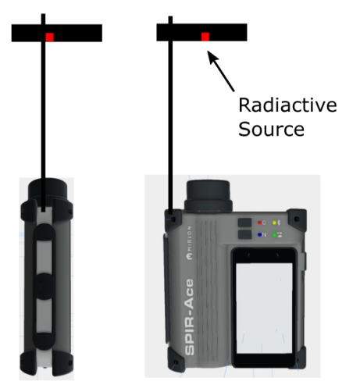
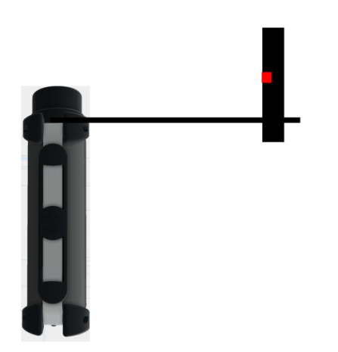
Activity Quantification with the SPIR-Ace RID
David Sullivan
Henrik Persson, and Julien Spruytte
Mirion Technologies
dsullivan@mirion.com
ID: 181
ABSTRACT
OUTCOME
The SPIR-Ace radionuclide identification device (RID) was characterized to allow the calculation of gamma ray efficiency responses through compatibility with the In Situ Object Counting System (ISOCS™) and associated software packages.
Confirmatory measurements show agreement to certified nuclide activities to be between 2 – 25% for almost all energies and geometries evaluated.
ISOCS CHARACTERIZATION
The SPIR-Ace RID detectors were successfully characterized with uncertainties consistent with other NaI(Tl) and LaBr3 detectors. The uncertainties in the characterization calculations are 25% for energies between 45—150 keV, 20% between 150– 400 keV and 15% for energies above 400 keV.
CHARCTERIZATION VERIFICATION
Measurements were made of a U-235 source on the endcap and a mixed gamma source in a 208 L waste drum. The calculated activities derived with the ISOCS generated efficiencies were between 2– 25% with the exception of Am-241, which was in interference with Ba-133.
INNOVATIVE ADVANTAGE
The SPIR-Ace platform offers access to GPS, Wi-Fi, accelerometer data and cellular service. This unlocks potential to remotely monitor, control and aggregate data from a distance. In addition to ISOCS™ compatibility, recent efforts include the ability to export spectra in Genie 2000™ format, allowing for the analyst to determine nuclide activity in a consistent analysis workflow.
BACKGROUND
ISOCS™ was introduced in the late 1990’s as a method for mathematically determining the full energy peak efficiency of a given gamma ray detector.
The SPIR-Ace device was developed in 2016 as a modern RID, capable of measuring alpha, beta, gamma and neutron radiation, with rapid identification of the gamma emitting nuclides. The SPIR-Ace is available with either a NaI(Ti) detector or LaBr3 detector for gamma detection.
Earlier this year (2018), ISOCS and SPIR-Ace were combined, allowing activity quantification capability with the same tools available to the analyst in the laboratory.
METHODS
CHARACTERIZATION MEASUREMENTS
A series of gamma ray measurements were made at various orientations and distances around the detector to determine the full energy peak efficiency for a range of energies between 60 – 1115 keV.
COMPUTATIONAL MODEL
A validated MCNP model of the detector was created based on manufacturing drawings and refined using these measurements as a benchmark. The model was used to create the ISOCS Characterization, a grid of point efficiencies in a vacuum that correspond to a sphere of 500m around the detector. This, along with the ISOCS software that includes a material library to account for attenuation and buildup, allows an analyst to create a representation of the sample geometry to calculate the measurement efficiency.
Comparison of NaI and LaBr3 Spectra with multi-line source
Representative MDA values for approx. 5 minute count of 208 L drum
Nuclide | NaI(Tl) |  | LaBr3
 | MDA (kBq) | Decision Limit (kBq) | MDA (kBq) | Decision Limit (kBq)
U-235 | 5.5 | 2.4 | 3.9 | 1.7
Cs-137 | 2.5 | 1.1 | 2.3 | 1.0
Co-60 | 4.3 | 1.9 | 2.6 | 1.1
Characterization measurements of the SPIR-Ace
Comparison of measured to certified activities for various geometries
Nuclide | Geometry | Certified (kBq) | NaI(Tl) |  | LaBr3
 |  |  | Measured (kBq) | Ratio | Measured (kBq) | Ratio
Am-241 | Drum | 689 | 1048 | 1.52 | 1536 | 2.23
Ba-140 | Drum | 1851 | 1821 | 0.98 | 1817 | 0.98
Cs-137 | Drum | 353 | 361 | 1.02 | 360 | 0.98
Co-60 | Drum | 255 | 223 | 0.88 | 234 | 0.92
U-235 | Endcap | 74 | 70 | 0.95 | 56 | 0.75
Some of the geometries used to measure with the SPIR-Ace
CONCLUSION
The development of a way to mathematically evaluate an efficiency calibration for the SPIR-Ace RID with ISOCS™ provides a modern device that is capable of not only remote monitoring, identification and control, but also robust and accurate nuclide activity quantifications.

