Slide 1
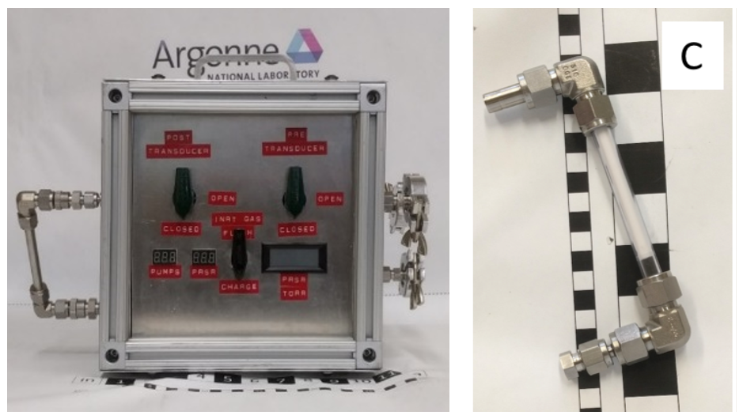
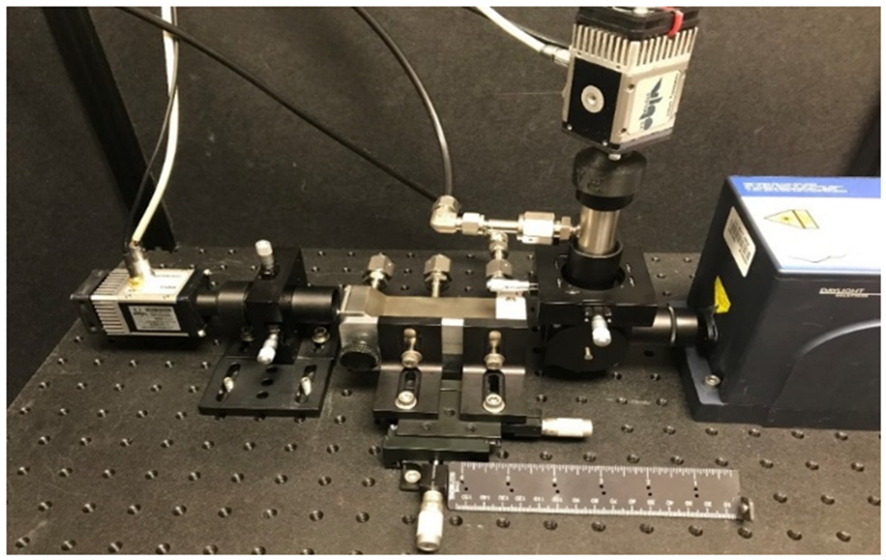
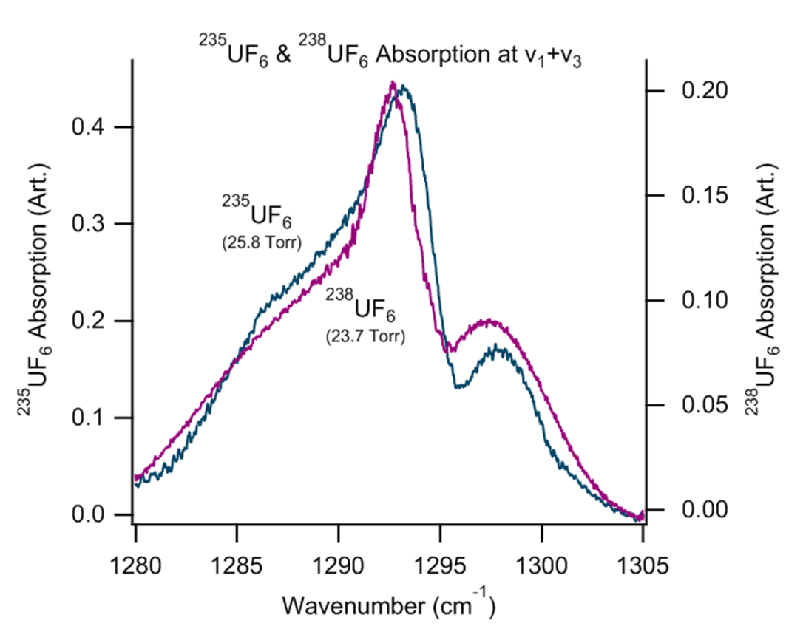
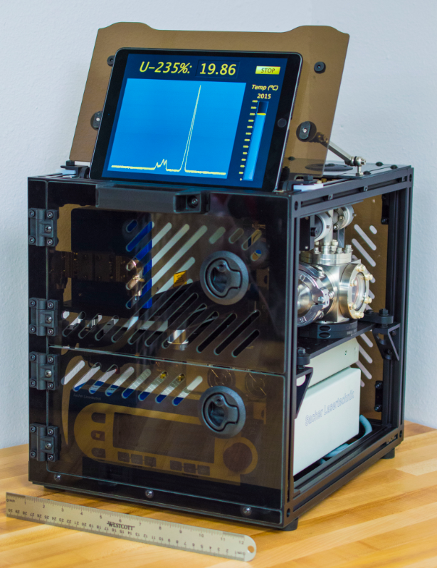
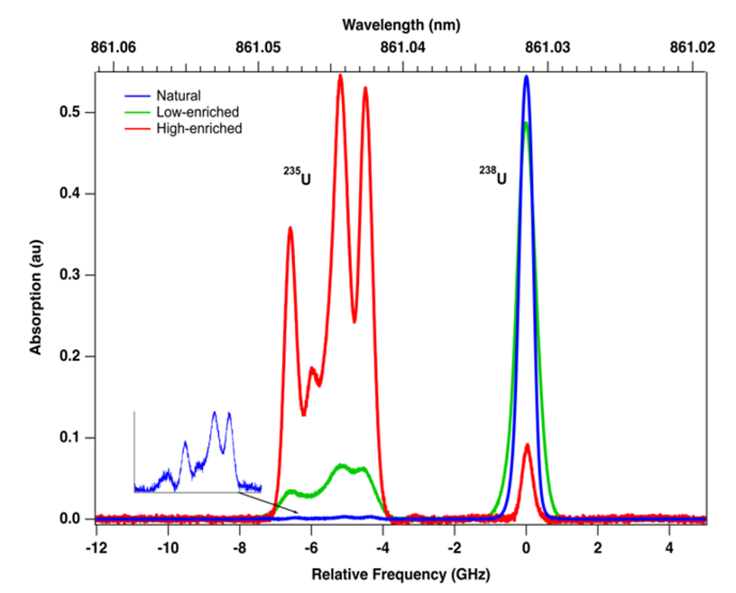
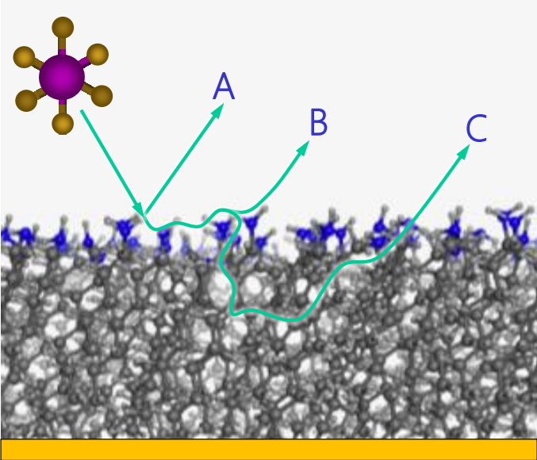
Alternative Destructive Analysis Methods for Safeguards
Christopher Ramos
Chris Pickett
U.S. DOE/National Nuclear Security Administration Office of Defense Nuclear Nonproliferation
christopher.ramos@nnsa.doe.gov
ID: 253
ABSTRACT
FIG. 1. HORUS 4 with simplified controls and a reduced footprint/mass. Right: Sample cartridge loaded with a clear tube for visual inspection of deposition.
Traditional destructive analyses methods require extensive efforts for obtaining, preparing, and analyzing samples; making these analyses costly and time consuming.
Past R&D efforts (i.e.. Portable mass spectroscopy) provided systems that were difficult to field leading DNN R&D Safeguards to investigate five fieldable laser-based DA and alpha-based options that will potentially provide TIMS comparable results in the field at a fraction of the cost.
The five methods currently being investigated are:
A) Handheld Operation for Uranium Sampling (HORUS) 4 - a fieldable method based on the Argentine-Brazilian Agency for Accounting and Control Cristallini technique (ABACC-Cristallini) technique.
B) A fieldable atomic beam laser spectrometer for isotopic analysis that can measure isotopic composition of uranium samples with high sensitivity, resolution, and speed.
C) A field-deployable High Performance Infrared (HPIR) analysis technique for real-time uranium isotope measurements.
D) Laser Induced Spectrochemical Assay for determination of Uranium Enrichment (LISA-UE).
E) Near Real Time Determination of UF6 Enrichment Detection Levels.
The basic science and the results to date associated with each of these alternative DA methods will be discussed.
FIG.2 HPIR Instrument laboratory prototype.
FIG. 3 Prototype fieldable atomic beam absorption spectrometer.
BACKGROUND
The key technical challenges are development of field portable, rapid, destructive analysis techniques for samples containing U or Pu while maintaining low overall measurement uncertainty.
The DNN R&D Safeguards portfolio focuses on basic R&D needed for demonstrating prototype technologies and capabilities that:
Improve the efficiency and effectiveness of current safeguards and
Strengthen existing safeguard measures to ensure timely detection of material diversion and undeclared material production.
FIG. 4 Left: Off-line; Right: On-line configurations of LISA-UE.
FIG. 5. Atomistic molecular dynamics o fUF6 interacting with functionalized SAMs. A: Quick scatter, no residence time, B: Thermalization of UF6, resides at interface before thermal desorption. C: Thermalization and penetration into the surface.
CHALLENGES / METHODS / IMPLEMENTATION
CHALLENGES
Develop prototype technology to rapidly analyse U and Pu isotopics.
Produce prototype that can later be developed as a fieldable instrument.
Design for precision, accuracy, and ease of use.
Methods
Develop several technologically promising concepts into prototype devices for the analysis of uranium enrichment. A combination of laser methods, alpha-counting, and chemical methods were examined for suitability for use as in-field actinide analysis tools.
Implementation
Examples of each technology prototype are discussed in Figures 1 to 5.
CONCLUSION
Five promising prototype technologies are being prepared for field evaluations that feature new developments in the treatment and/or measurement of samples containing uranium or plutonium.
Reliable miniature power supplies for unattended monitoring systems remain a key challenge.
Completed prototypes have demonstrated that the advancement of in-field, high-quality DA techniques is possible.
ACKNOWLEDGEMENTS / REFERENCES
OUTCOME
The authors acknowledge the dedicated efforts by scientific and engineering staff at Argonne National Laboratory, Los Alamos National Laboratory, Oak Ridge National Laboratory, Lawrence Berkeley National Laboratory, and Savannah River National Laboratory for their collective R&D efforts mentioned in this poster. These efforts also may involve collaborations with the other U.S. Government institutions, universities and private corporations. The research and development reported herein is supported by the Office of Defense Nuclear Nonproliferation R&D in the U.S. Department of Energy/National Nuclear Security Administration (DOE/NNSA).
TECHNOLOGY FOR DEVELOPMENT
Each of the prototype technologies described here can be further developed by partner offices and agencies to provide reasonable alternatives for performing timely, high-quality DA analysis in the field. Each basic R&D project was designed to provide cost-effective, time efficient sampling, and low size, weight, and power analysis methods for uranium or plutonium assay determination.

