Slide 1
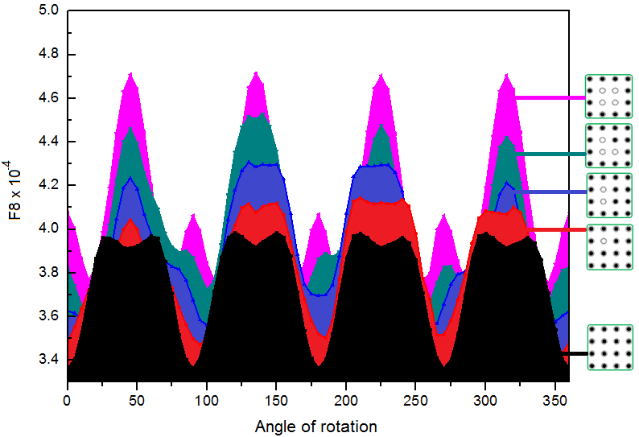
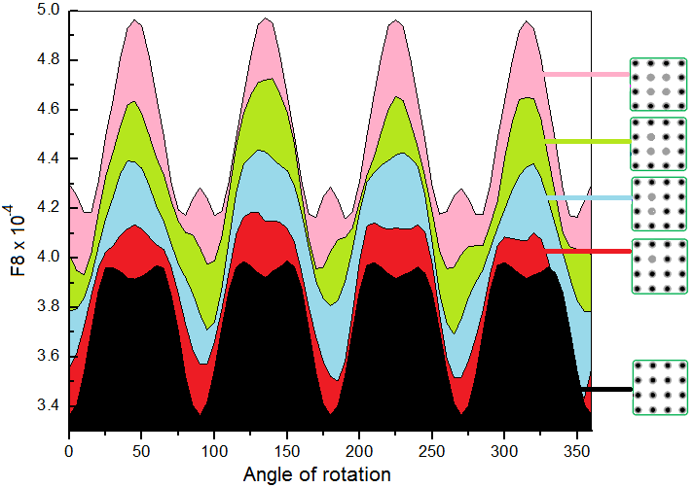
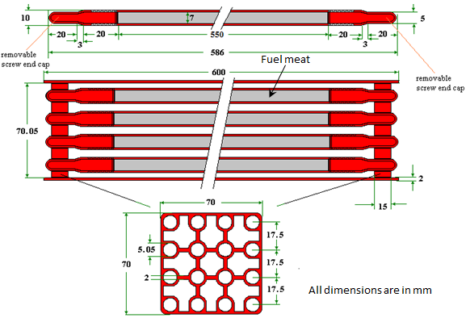
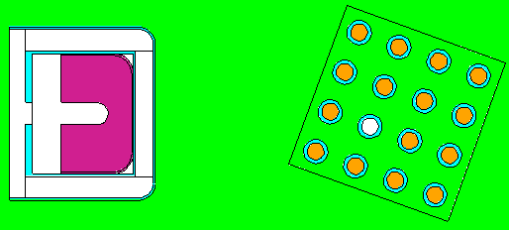
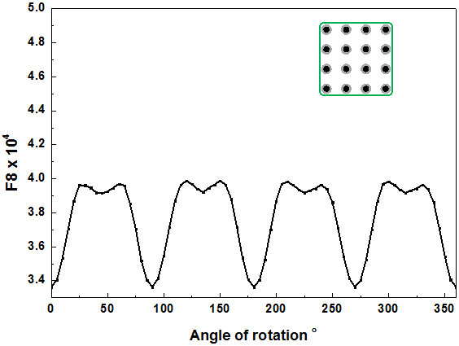
Investigation of a Dynamic Measurement Methodology for Fast Detection
of Gross Defects in Regularly Distributed Nuclear Material Samples
W. El-Gammal , M. Darweesh , S. Shawky
Department of Safeguards and Physical Protection
Egyptian Nuclear and Radiological Regulatory Authority
wgammal66@yahoo.com
ID: 249
ABSTRACT
OUTCOME
A Non-Destructive Dynamic (NDD) method is investigated to detect gross defects (missing sources or dummy items) in a regularly-distributed NM.
The response of a radiation detector due to gamma rays emitted from such samples while rotation was generated using Monte Carlo method.
The response results in a certain pattern. This pattern will differ if any gross defect exists.
The results showed that the investigated method could be applied to detect gross defects in the regularly distributed NM sample.
Additional work is still developed to timely-respond to any detection of deviation from normal pattern.
Figs. 4 and 5 show the generated patterns for defected NM samples due to missing sources and existence of dummy items, respectively. In both figures the results illustrate the differences due to defects in 1, 2, 3 and 4 items.
It is clear from the two figures that the investigated method could be applied to detect defects in regularly distributed NM samples.
However, additional effort is still needed to implement the method experimentally. Also different factors affecting the generated patterns (e.g. sample-to-detector distance and speed of rotation) are still need more investigation.
BACKGROUND
Dynamic measurements are considered whenever fast measurements are needed.
Fast measurements minimize the interruption to the operation of the facility.
In addition it allows the selection of larger representative sample which, in turns, increases the probability of detection of inconsistency.
FIG. 4. Generated spectra patterns for one (●), two (●) three (●)
and four (●) missed sources in comparison with non-defected
Source (●).
CHALLENGES / METHODS
Challenge
Gross defects in regularly distributed NM samples have to be detected using a fast and simple method.
Method
The MCNP5 Code is used to generate specific patterns for gamma ray spectra due regularly distributed NM samples. These spectra were assumed to be accumulated while rotating the sample in front of a HPGe detector. Fig. 1. shows a schematic diagram for the NM sample (EK-10 fuel type). Fig. 2 shows the MCNP model for the sample and the detector.
If any defect is exist, the generated pattern will differ depending on the type of the defect (missed source or existence of dummy item), and the number of defected items.
FIG. 1. schematic diagram for the NM FIG. 2. MCNP model for the detector
Sample. and the rotating NM sample.
The System compares the patterns due to complete sample Fig. 3, and that due to defected one. Once a difference between the two patterns is detected , the system may immediately respond and the inspector is notified.
FIG. 5. Generated spectra patterns for one (●), two (●) three (●)
and four (●) dummy items in comparison with non-defected
Source (●).
CONCLUSION
The use of a Non-Destructive Dynamic (NDD) method is investigated to detect gross defects in regularly distributed NM (fuel assembly of EK-10 type).
Different scenarios were considered and studied using Monte Carlo calculation method employing the MCNP5 Code.
The results showed that the investigated method could be easily applied to detect gross defects in such nuclear materials.
Additional work is still needed to investigate the method in more details and implement it experimentally
FIG. 3. Pattern of spectrum generated by
MCNP5Code for a complete NM sample.

