Slide 1
Change Detection with Sentinel-1 PolSAR imagery on the GEE
Mort Canty, Joshua Rutkowski,
Irmgard Niemeyer
Jülich Forschungszentrum, Germany
Allan A. Nielsen, Knut Conradsen,
Henning Skriver
Technical University of Denmark

Slide 2
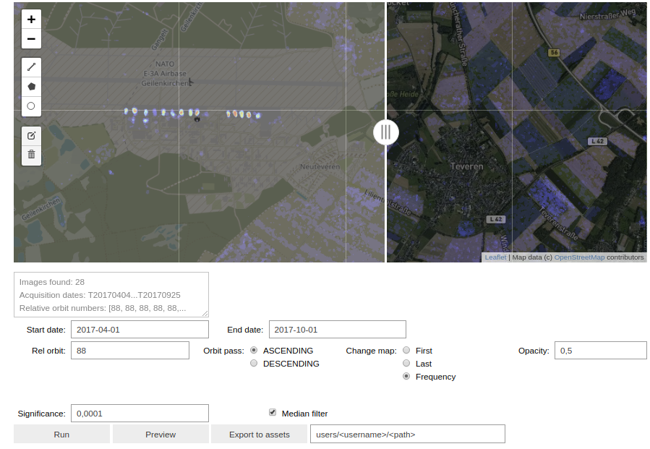

Slide 4
Hambach open cast coal mine

Slide 5
McArthur River Uranium Mine

Slide 6
Cluff Lake Uranium Mine

Slide 7
Honeymoon uranium mine south Australia

