Slide 2
Strengthening Safeguards laboratories – A benefit to the IAEA SAFEGUARDS
Joint Research Centre, Directorate G.II.6
E. ZULEGER
K. LÜTZENKIRCHEN, K. CASTELEYN, L. DUINSLAEGER, S. MIALLE,
SANCHEZ-HERNANDEZ, R. BUDA, S. MOREL, H. SCHORLÉ, M. TOMA,
G. TOMA, J. ZSIGRAI
IAEA- Symposium 5.-8.11.2018

Slide 3
Safeguards
Verification of activities with nuclear material involved
High Performance Analysis
A ) Verifying declared nuclear activities
B) Detecting undeclared activities
Mandate
Tool
Aim

Slide 4



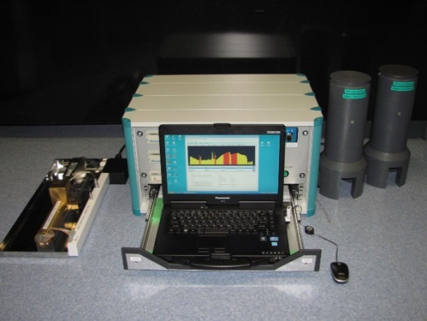
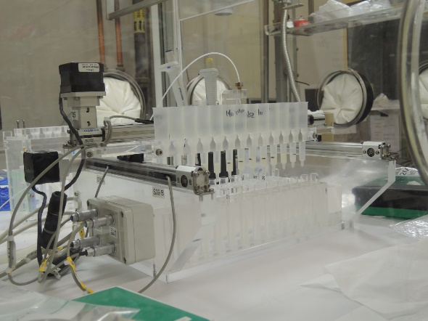
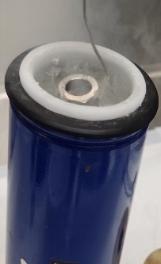
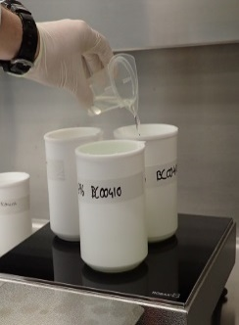
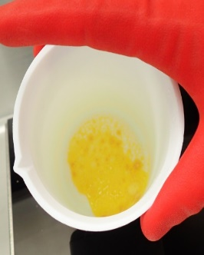

Safeguards Laboratories
round the world
Inter- laboratory comparison (ILC)
Reference Material (CRM)
Method develop-ments
Technical Support
Large size dried spike (LSD) = improvement of important CRM
Sample preparation for mass spectrometry ASU
Provide credible verification measurements in the future
U concentration and enrichment by COMPUCEA

Slide 5

Any questions?
You can find me
Evelyn.Zuleger@ec.europa.eu
EU Science Hub: ec.europa.eu/jrc

