Slide 1
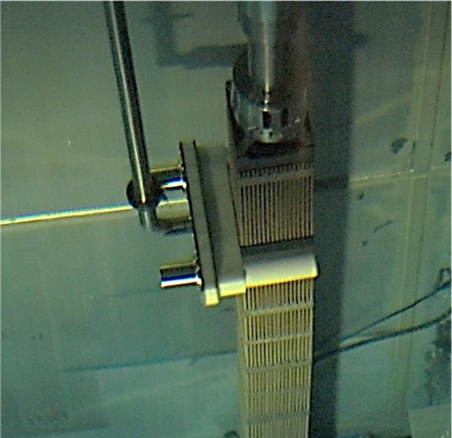
CHALLENGES AND ADVANCEMENTS IN SPENT FUEL SAFEGUARDS IN THE EUROPEAN UNION
Stefano Vaccaro
D. Ancius, P. Klumpp, C. Kroeger Negoita, J. Pekkarinnen, P. Schwalbach, A. Smejkal, A. Tomanin
European Commission, Directorate General for Energy, Euratom Safeguards

Slide 2
Background
European Energy Union Strategy
European Energy Security Strategy
Nuclear Illustrative Programme (PINC)
EU's Member States need to apply the highest standards of safety, security, waste management and non-proliferation, as well as diversify nuclear fuel supplies. Doing so will help achieve the objectives of the 2030 EU climate and energy framework.
Attention to challenges and opportunities related to increased activities in the back-end of the fuel cycle and especially to spent fuel and radioactive waste management.

Slide 3
Challenges in SF verification
Continuous rise of the number of cask loadings for interim dry storage
91 loadings in 2017
100 and 200 casks per year for the coming years
New types of installation
final storage
encapsulation
geological disposal
intrinsic long-term nature: need for integrated Safety, Security, Safeguards (S³) approach
Pressure towards improving efficient use of their resources
Constant need of highly trained personnel
Availability of technologies allowing different impact of human intervention in-presence

Slide 4
Addressing challenges in SF verification
Need to improve efficiency in Spent fuel verification
Reduce inspector presence on-site without decreasing safeguards quality
Less burden to the operator
Better use of human and technical resources
Pursue complementarity between verification methods
Example: use of unattended Fork detector, in RDT and with data review at the HQ.

Slide 5
Lessons learned from in-field deployment
Field test in real unattended inspection conditions
A field test has been carried out over a full campaign of 7 casks loadings for a total of 168 fuel assemblies;
The acquisition system was in RDT and the loadings were completely unattended: the measurements were carried out by the operator under surveillance;
We were able to observe details like never before:
e.g. dependencies from the fuel design and from the poison type and quantities;
Anomaly management policy to be implemented.

Slide 6
Thank you!

Slide 7
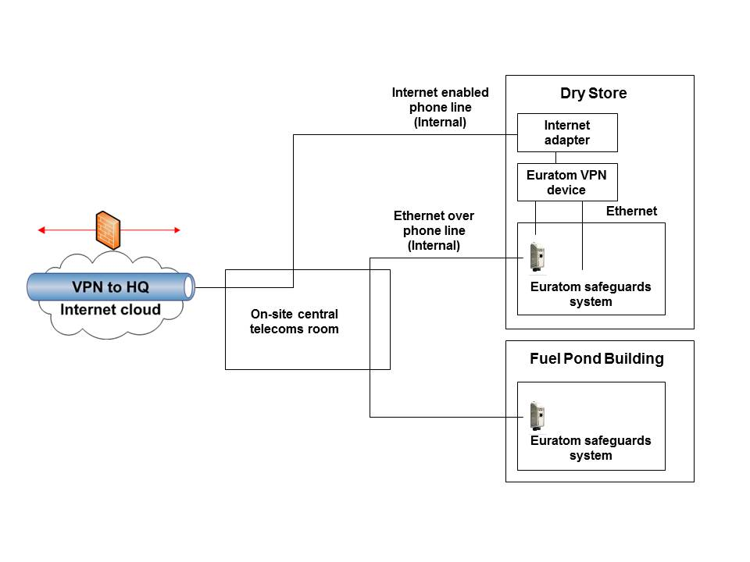
Unattended Fork Architecture

Slide 8
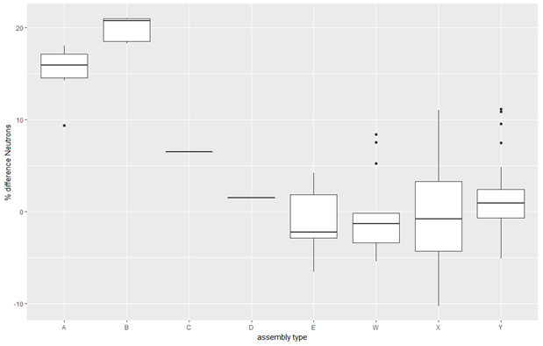
ORIGEN IRAP workflow and Outcome

