Slide 1

Asia-Pacific regional
Safeguards Network(APSN)
2018 IAEA Safeguards Symposium
Hosik Yoo
Korea Institute of Nuclear Nonproliferation and Control(KINAC)

Slide 2
CONTENTS
01. Introduction of APSN
02. Activities
03. Working Groups
04. Future Plan

Slide 3
Introduction of APSN
Purpose of APSN
APSN has helped its members improve the quality, effectiveness, and efficiency of safeguards implementation by:
Supporting sustainable national nuclear safeguards capabilities
Promoting regional cooperation in appropriate nuclear safeguards applications and practices
Facilitating the coordination and provision of nuclear safeguards technical assistance
Providing a forum for sharing appropriate knowledge on nuclear safeguards
Developing a network of national nuclear safeguards practitioners in the region

Slide 4
Introduction of APSN
History
ASNO(Australia Safeguards & Non-Proliferation Office) suggested to formulate a new regional network in 2006
The first TOR(Terms of Reference) was adopted in April, 2009 and established APSN in October, 2009
The 1st meeting was held in Indonesia in June, 2010
The 9th meeting was held in Austria in November 1~2, 2018, in conjunction with IAEA Safeguards Symposium

Slide 5
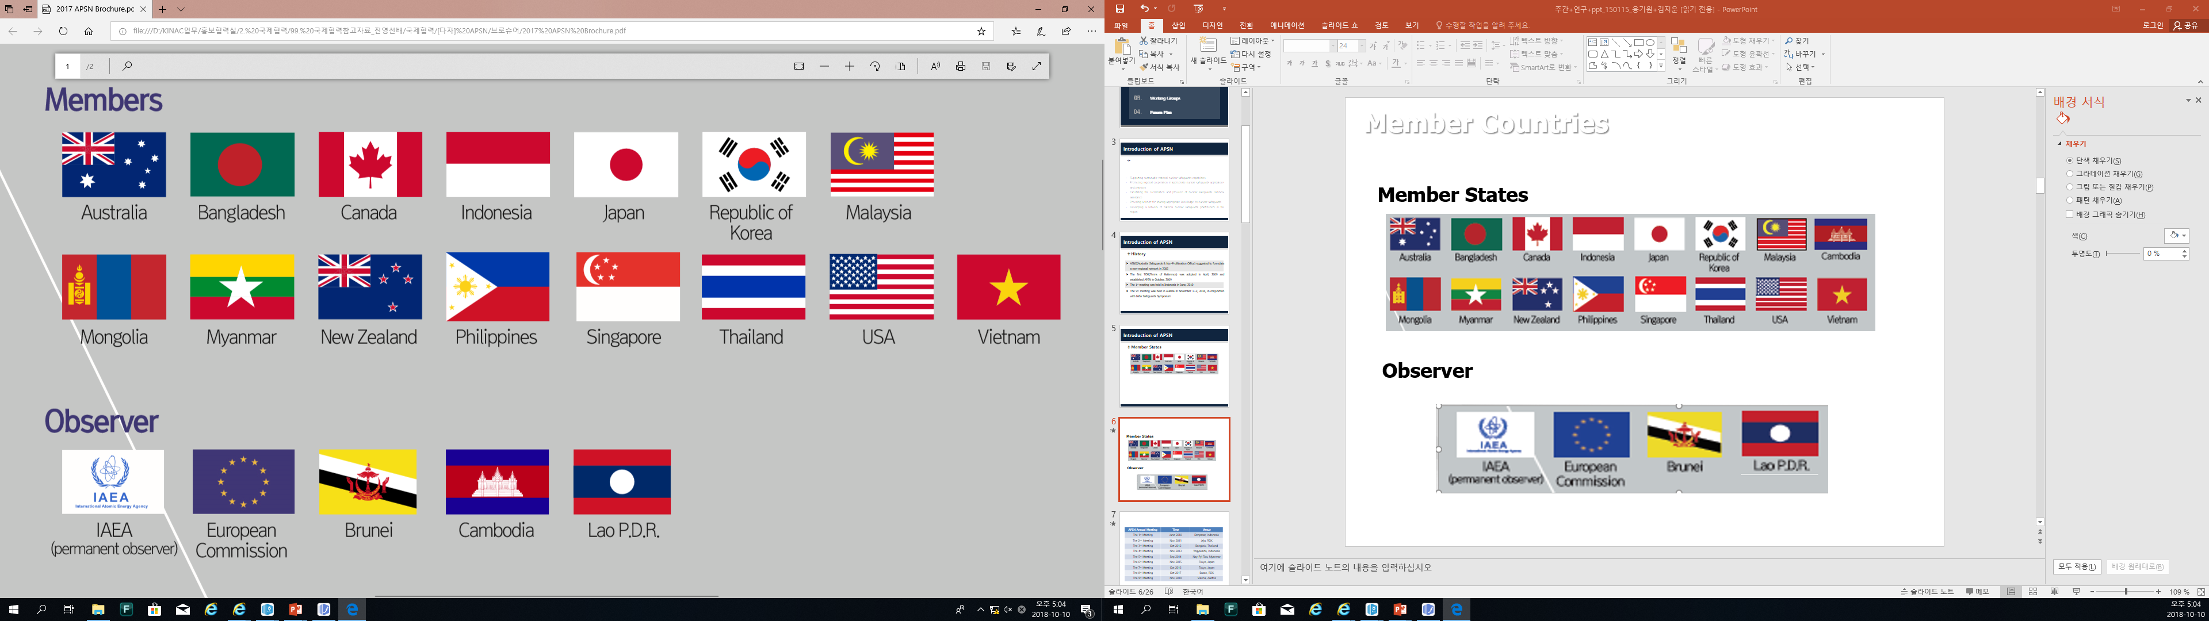
Introduction of APSN
Member States
Observers

Slide 6
Introduction of APSN
Organization
Chair Person
Steering Committee
AS, Jpan, ROK, Indonesia
Secretriat
WG 1
Australia
WG 2
Japan
WG 3
USA
WG 4
Indonesia
WG 5
ROK

Slide 7
Acitivities
Purpose of APSN
Holding meetings and other such activities
Developing an internet portal for convenient and rapid interchange of information
Coordinating and supporting training on safeguards issues
Cooperating in making available to professionals of member organizations information on resources and assistance
Providing opportunities for professional exchange programs
Facilitating collaboration in research and development
Providing other technical support and assistance on safeguards issues
Undertaking other activities of interest to member organizations.

Slide 8
Working Groups
WG1 | Safeguards infrastructure implementation and awareness
WG2 | Capacity Building
WG3 | IT Support, communication, and information
WG4 | Model safeguards and security legislation
WG5 | Physical Protection in Support of Nuclear Safeguards

Slide 9
Working Groups
WG1
Safeguards infrastructure implementation and awareness facilitated by Australia
Discuss on safeguards infrastructure implementation and awareness
Introduce legal status and implementation of each states related to safeguards
coordinates APSN programs and activities in the areas of: infrastructure; implementation and R&D collaboration

Slide 10
Working Groups
WG2
Capacity building facilitated by Japan
Discuss on safeguards infrastructure implementation and awareness
Introduce legal status and implementation of each states related to safeguards
coordinates APSN programs and activities in the areas of: infrastructure; implementation and R&D collaboration

Slide 11
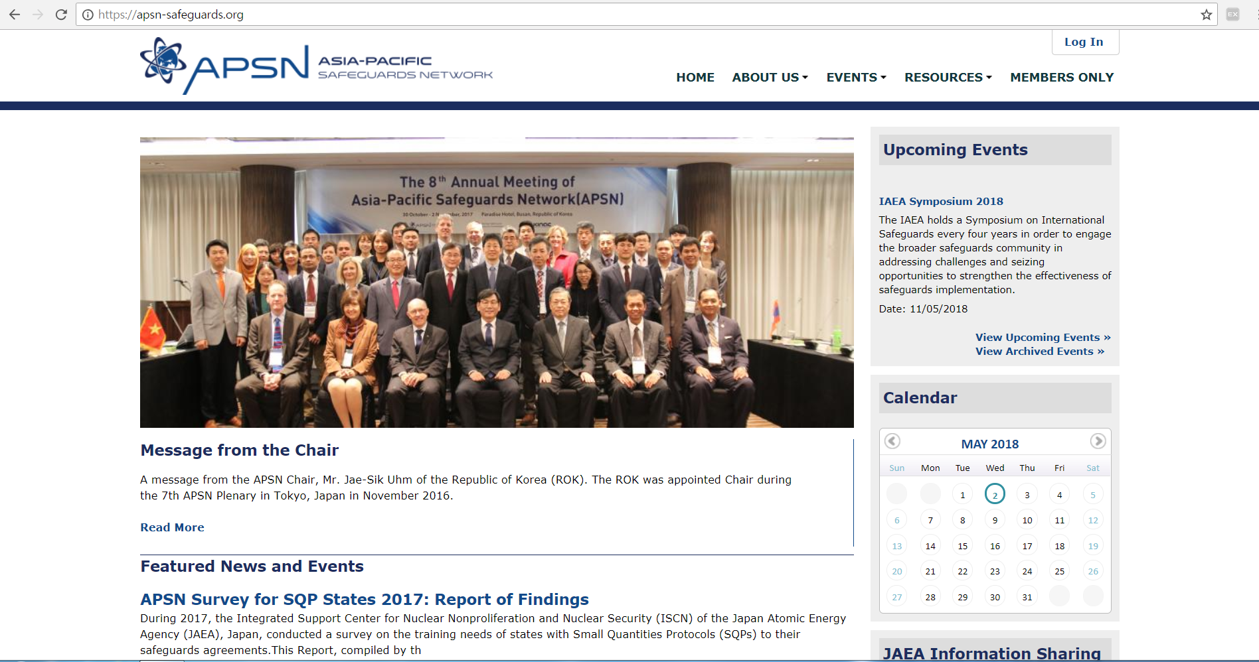
Working Groups
WG3
IT Support, communication, and information facilitated by USA
Establish APSN website
Discuss on IT support, communication, and information with respect to APSN activities through APSN website
Ensures whether the APSN web-site satisfies members’ needs, examines other IT issues relevant to APSN operations and develops communication plans for raising APSN’s profile.

Slide 12
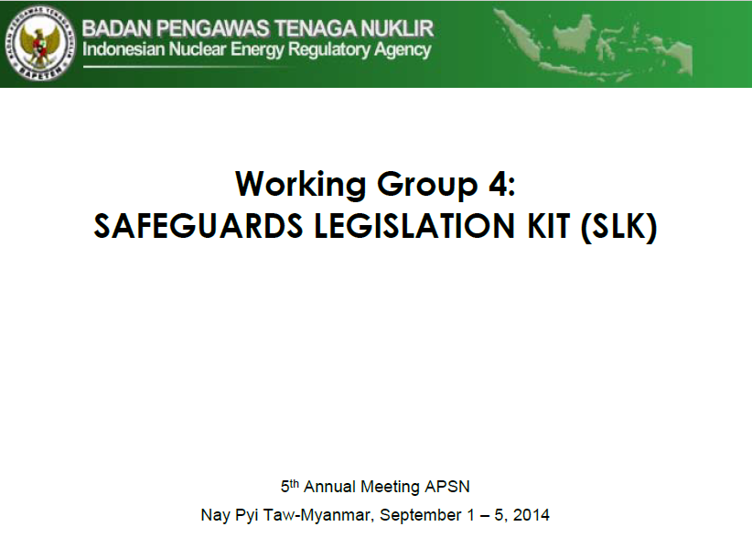
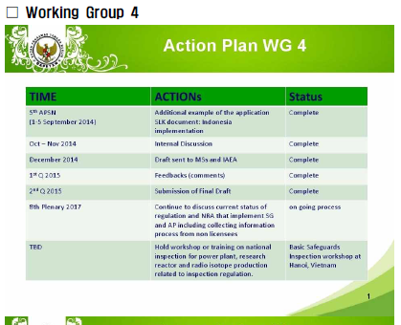
Working Groups
WG4
Model safeguards and security legislation facilitated by Indonesia
Provides member states with references to a wide array of consolidated elements and provisions contained in the global framework for nuclear safeguards
Develop a more comprehensive national legislation on nuclear safeguards

Slide 13
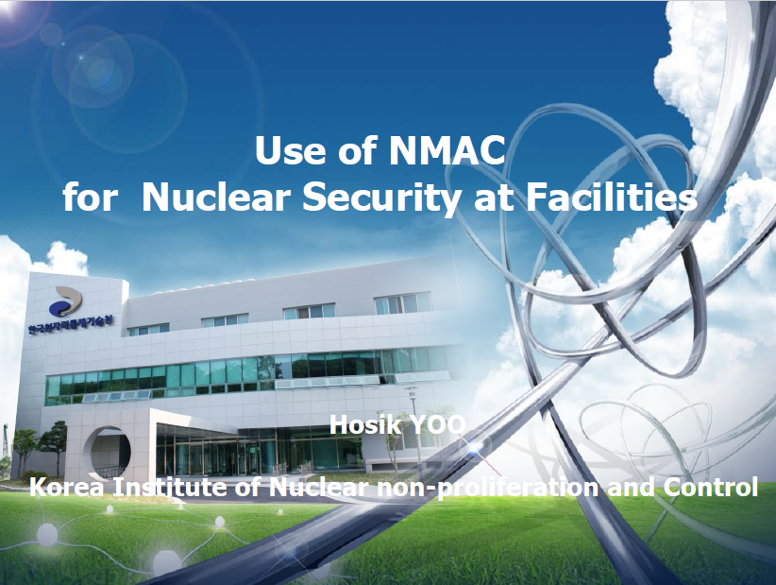
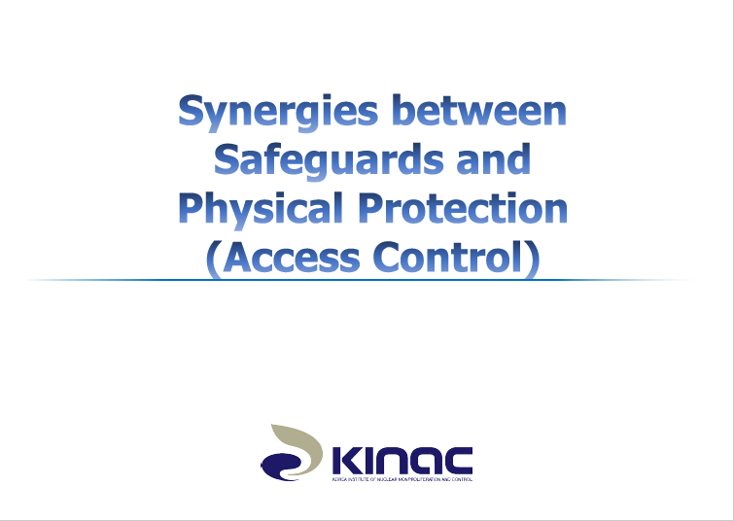
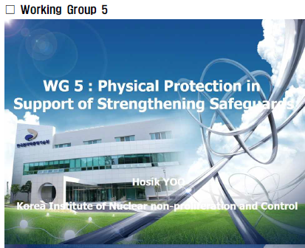
Working Groups
WG5
Physical Protection in Support of Nuclear Safeguards facilitated by ROK
Discuss on physical protection matters that can support national safeguards activities.
Interface between safeguards and other areas

Slide 14
Future plans
Strengthen the cooperation with other regional entities such as ASEANTOM and ESARDA
Establish a network of networks panel to bring together representative from different regional networks
Compare experiences with cultivating collaboration on capacity building and explore how the work of regional networks could be enhanced further
Assist member states to establish their own non-proliferation regime

Slide 15
Thank You
Q&A

