Slide 1
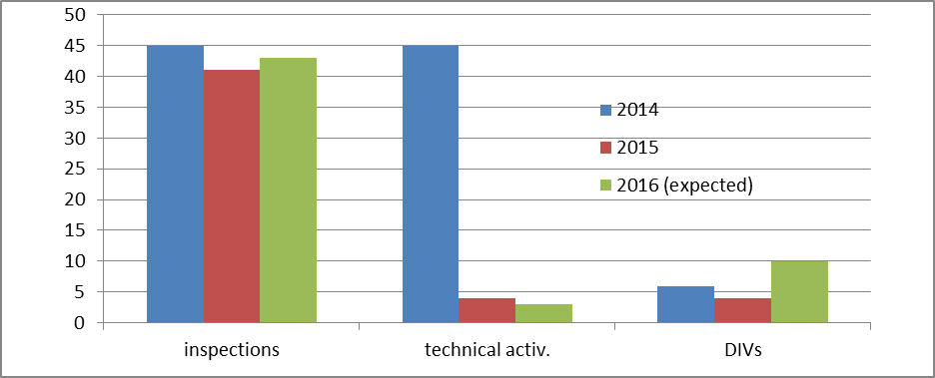
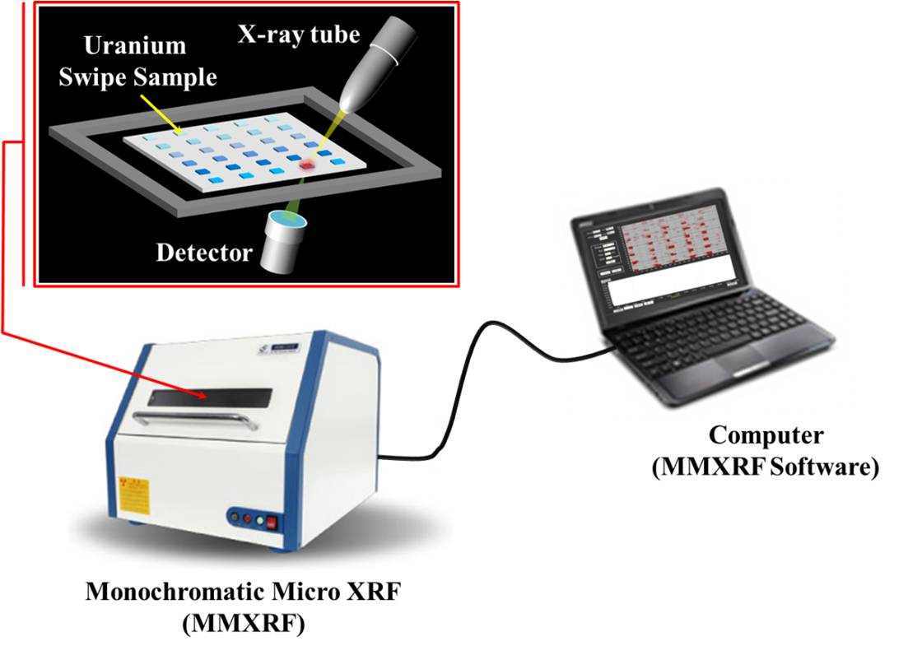
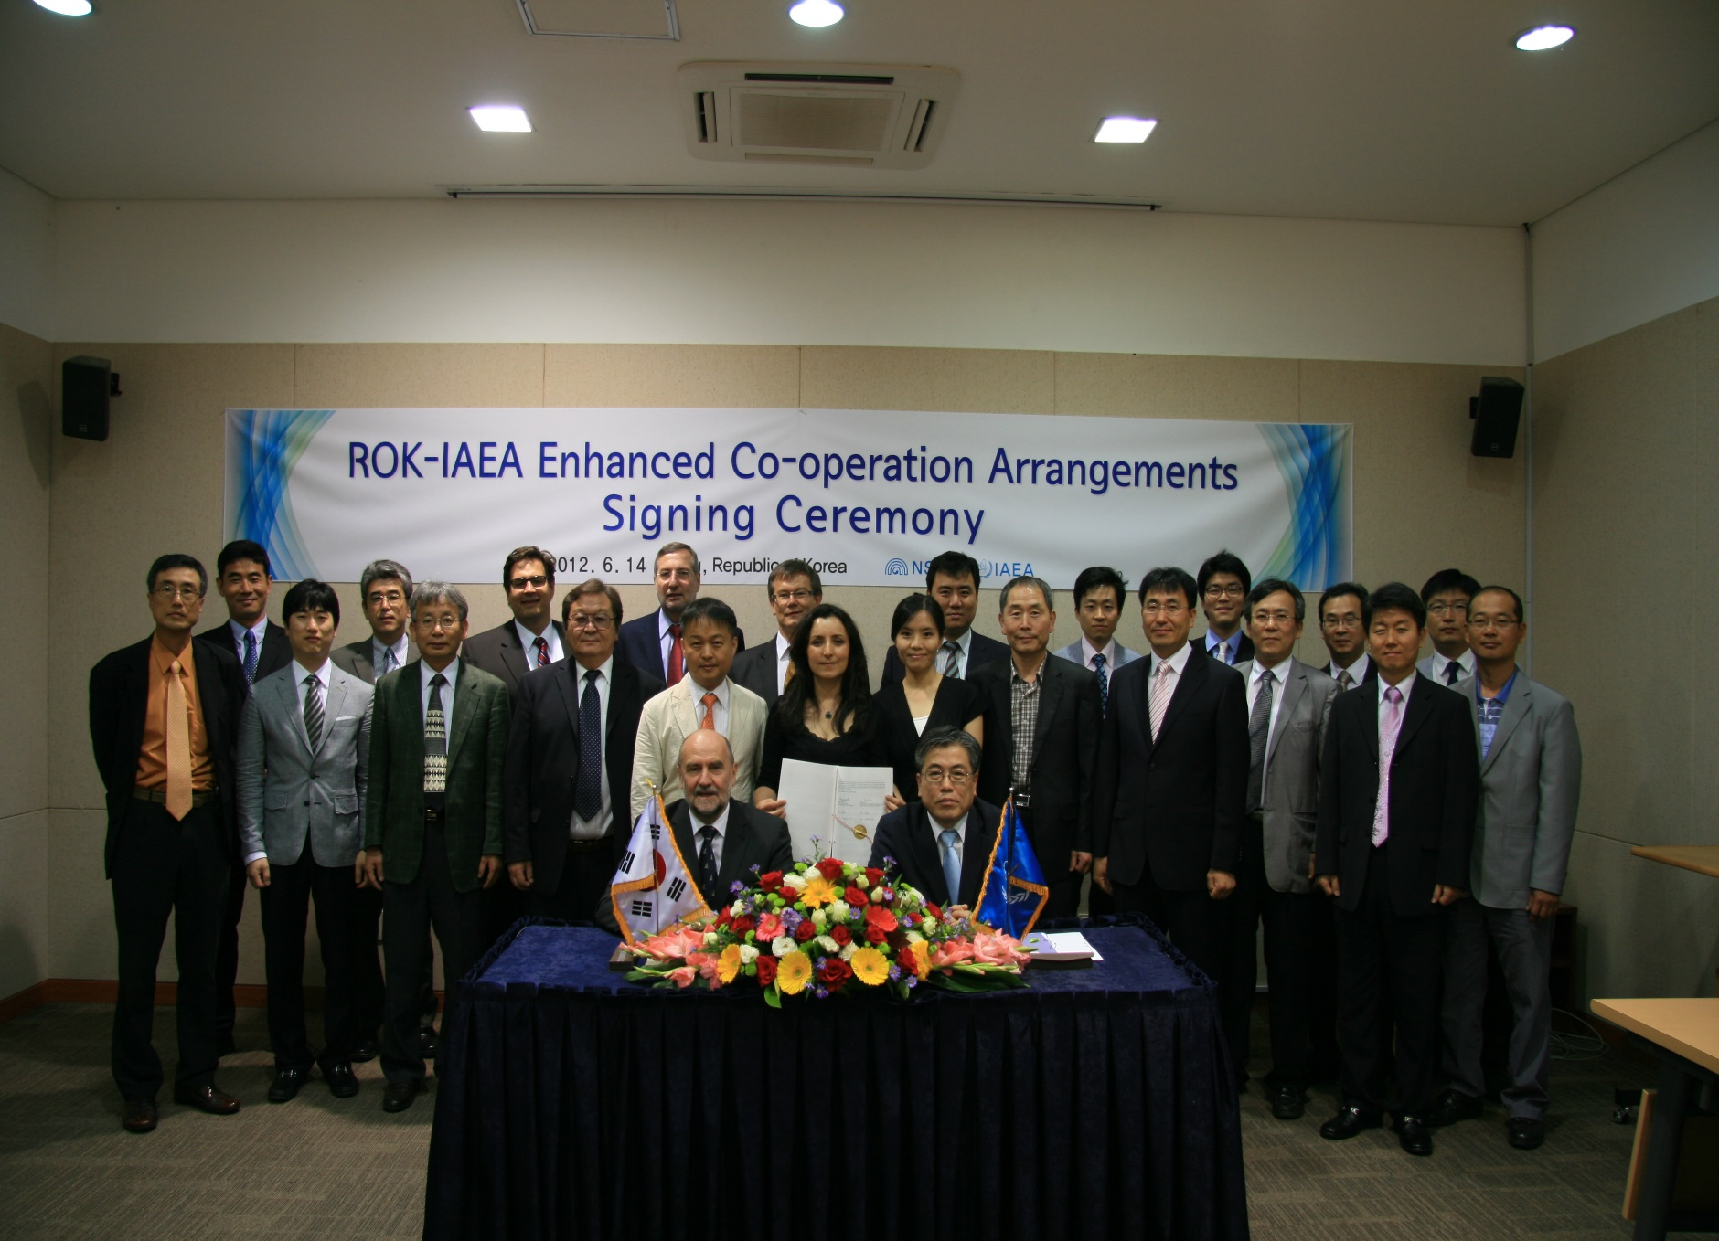
ROK-IAEA ENHANCED COOPERATION ARRANGEMENTS
Yunjo Hwang, Hosik Yoo, Ryszard Zarucki, So Young Son, Seung Ho Ahn
Nuclear Safety and Security Commission, Korea Institute of Nuclear Nonproliferation and Control, International Atomic Energy Agency
shahn@kinac.re.kr
ID: 245
ABSTRACT
OUTCOME
Enhanced co-operation (EC) arrangement between the IAEA and the ROK was signed in 2012 in line with evolving safeguards implementation.
EC covered all nuclear fuel cycle-related facilities, activities and nuclear material in the ROK, requiring full use of the SSAC and avoiding unnecessary duplication of the State’s accounting and control activities.
Until now, EC between the ROK and the IAEA has brought about benefits in safeguards implementation, technology development, and training.
Work on specifying the implementation of additional areas of cooperation is on-going smoothly and will soon make additional contributions to improving the effectiveness and efficiency of the safeguards in the ROK.
UIs implementation at LWRs
The UI was introduced on May 1, 2016. The application of UI has improved efficiency of the safeguards activities in the ROK. In particular, the technical activities of the IAEA at LWRs in 2015 & 2016 have been reduced by 80% compared to 2014, when UI was not applied.
Joint-Use Equipment
the Joint-Use Equipment (JUE) procedure for ICVD was approved by the DDG-SG in 2016. Additionally the approval of the JUE procedure for the OFPS, which was developed by the ROK and authorized by the IAEA as a category A equipment, is underway.
MMXRF
In 2017, the ROK proposed a newly developed technology for environmental sample screening, namely Monochromatic Micro X-ray Fluorescence (MMXRF). It is screening equipment to search the location of uranium particle in samples through detection of characteristic X-ray emitted from small spot. Currently consultation with the IAEA is progressing to develop the portable MMXRF version for on-site inspections under the MSSP.
Roaming Camera Procedure
In order to streamline the transfer of IAEA cameras for LWRs in the ROK, both side agreed on the Roaming Camera Procedure. It minimized the movement of IAEA cameras for LWRs and contributes to more efficient implementation of UIs in the ROK.
BACKGROUND
The ROK SSAC can be a good reference for newcomer countries introducing nuclear power plants as it has evolved in parallel with developments in the IAEA safeguards system. The technical capability of the ROK SSAC reached to the level of providing sufficient support for IAEA verification activities.
The first enhanced cooperation between the IAEA and the ROK SSAC took place in LWRs in October 2001, and thus the efficiency of the IAEA’s LWRs inspections has been improved based on the remote monitoring scheme.
The efforts to continue and expand co-operation within the framework of integrated safeguards and in line with evolving safeguards implementation, led to finalization of the new EC arrangements.
METHODS
Enhanced Cooperation Task Force Group
Both parties agreed to established the EC Task Force Group (TFG) to review the matters on various aspects of EC. Based on the EC TEG report which was finalized in 2008, the new arrangements would be elaborated and agreed in a new document to cover the avoid duplication of verification work, joint use of equipment and cost sharing, joint development for the use of pioneer technology and transparency policy.
Coordination Group for Enhanced Cooperation
Both parties agreed on the prioritization of five identified areas as described in the TOR (prescribed SSAC activities, training, joint-use equipment, modalities of reporting to the IAEA of all relevant activities performed by the SSAC in the absence of the IAEA) and a joint ROK-IAEA CGEC (Coordination Group for EC) was established for identifying, prioritizing and implementing prescribed SSAC actions in an agreeable manner. By the beginning of 2018, the ROK and the IAEA has held the 12th CGEC meeting.
Only LWRs | 2014 | 2015 | 2016
Inspections | 45 | 41 | 43
Technical and others* | 45 | 4 | 3
DIVs | 6 | 4 | 10
Total efforts | 96 | 49 | 56
Reduction % in total efforts | Reference | 49% | 41%
Reduction % in pure technical activities | Reference | 85% | 85%
Reduction % in pure inspection | Reference | 8% | 4%
 | IAEA Tripod | KINAC MMXRF
Resolution [mm²] | 36 | 9
Detection time [hr] | 4 | 2
Detection limit [ng] | 14 | 2.3
Uncertainty [%] | 30 | 35
Implementation of UI at LWRs in ROK
MMXRF
CONCLUSION
The IAEA’s efforts for enhancing efficiency of safeguards is critical for not only saving IAEA’s inspection resources but also rendering ultimate benefits on the part of member states.
A state with a well-organized and trained SSAC could improve its nuclear transparency while providing high-level support with the IAEA.
The ROK SSAC has well exemplified the IAEA safeguard, especially in the area of safeguards implementation.
The ECA can be the good practice of the advanced SSAC upon its completion.
Continued EC will bring about further improved efficiency in IAEA safeguards, which will facilitate successful implementation of national inspections and strengthened technical capability of ROK SSAC.
CGEC
IAEA
SH-SGOA3
Chairpersons
ROK
Assistant DIR-NSSC
ACKNOWLEDGEMENTS
Specific SG Activities
Joint-Use Equipment
Modalities of Reporting to the IAEA
Training
New technology development
Special thanks to Mr. Ryszard Zarucki for his devotion and contribution for the development of the ROK safeguards and cooperation between ROK and IAEA.
Identified Areas
ECA Signing Ceremony
CGEC Framework

