Slide 1
Safeguards and Multimedia Data: Appraisal of New Techniques
Mr Lorand Bodo
Ridgeway Information Ltd

Slide 2
Research Methodology
OSIF plays an important role
New technologies would provide greater sophistication and reach for IAEA verification activities
We assessed the suitability for verification analysis of a range of commonly-available open license and commercial tools for analyzing audio and video data
Use-case approach in order to test the efficacy of tools & techniques in scenarios directly relevant to IAEA Safeguards research
In total, over 45 tools were identified – of these tools a shortlist of 16 were selected for further evaluation
Four were selected for an in-depth evaluation
ISO/IEC standard 25010:2011 + vendor related criteria + nuclear nonproliferation related criteria
Setup & Limitations

Slide 3
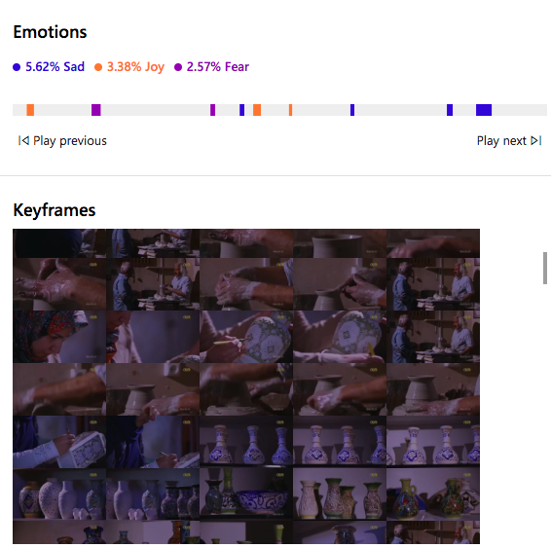
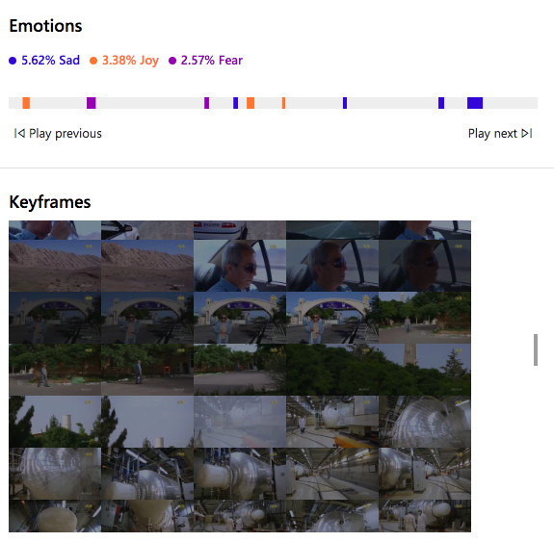
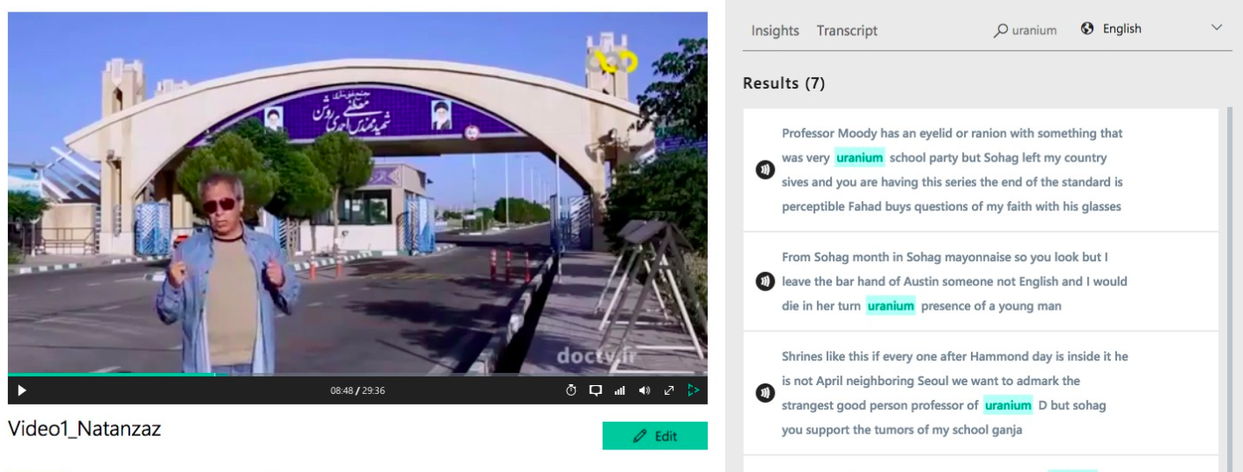
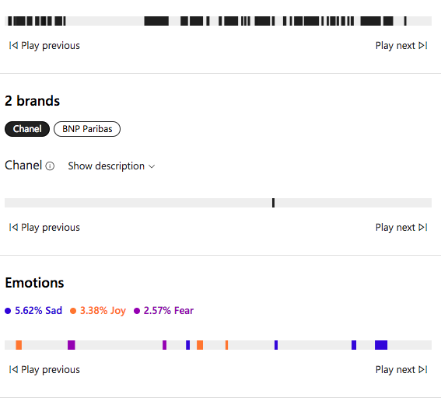
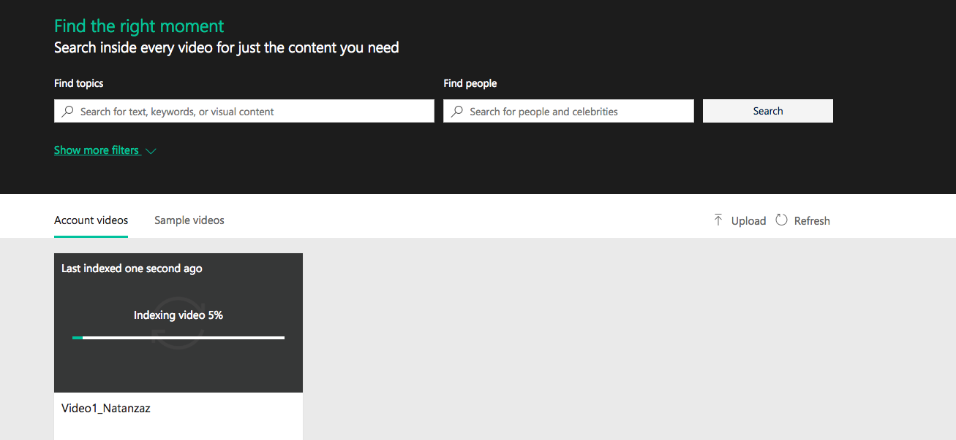
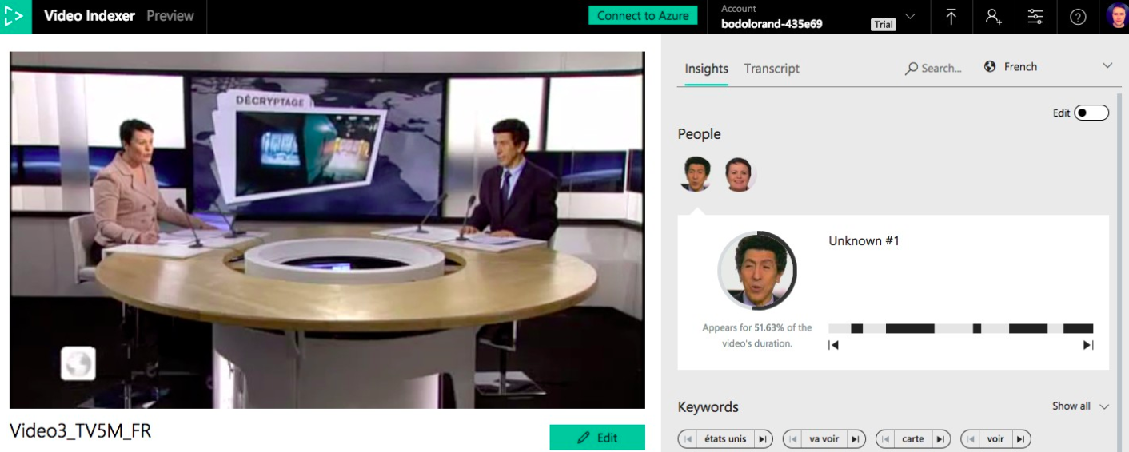
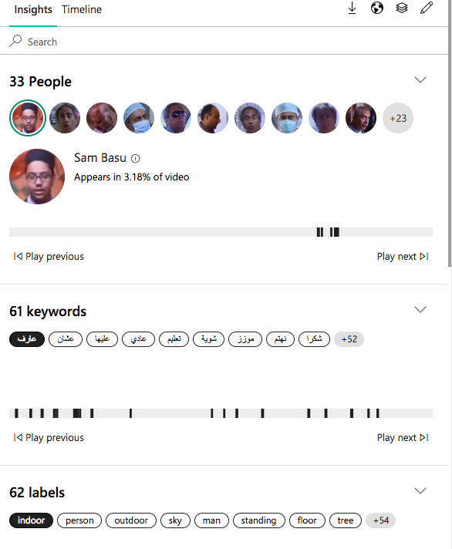
Video Indexer (COTS)

Slide 4
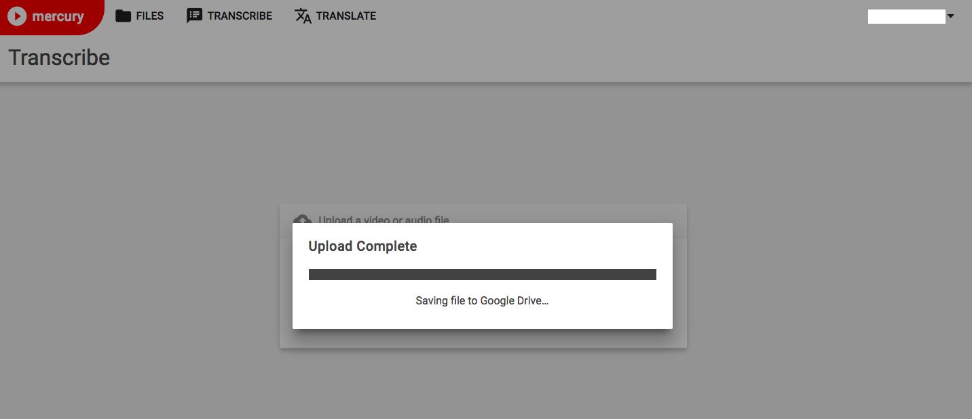
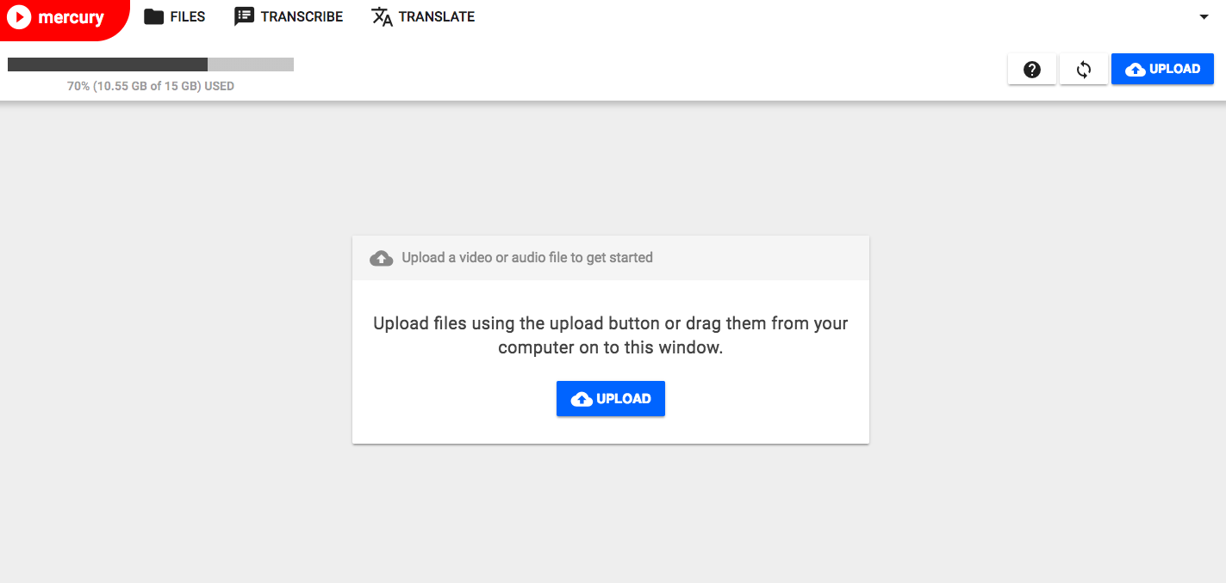
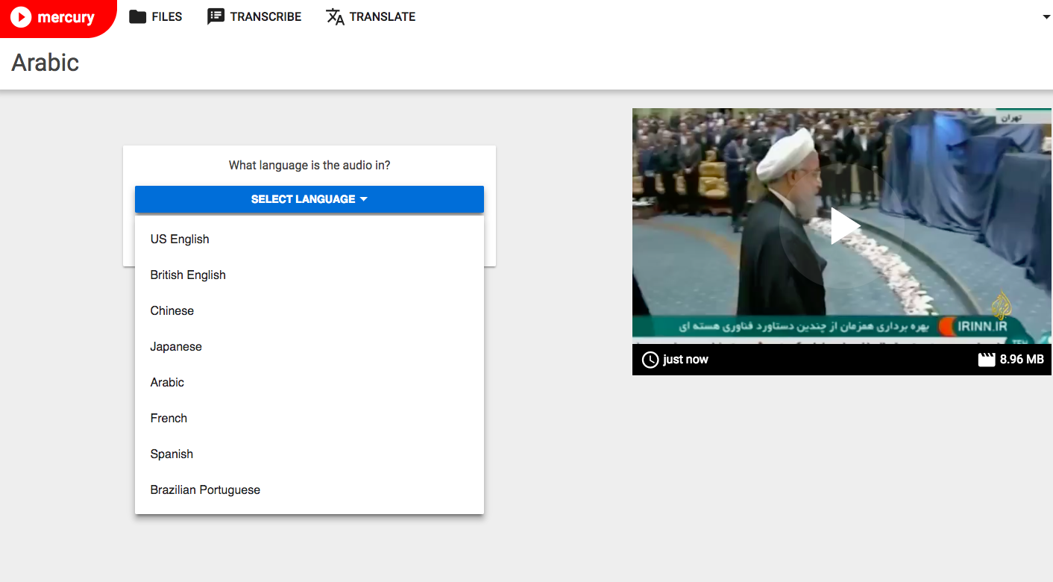
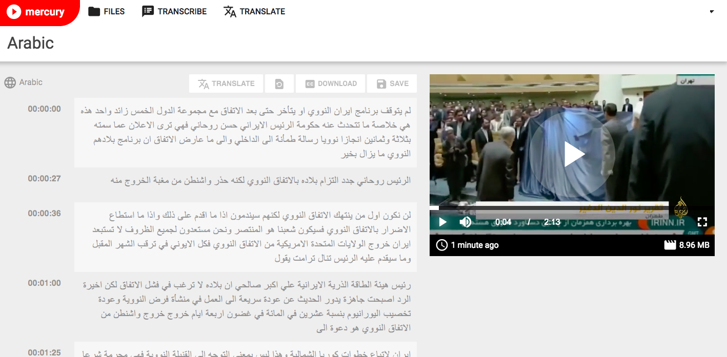
Mercury

Slide 5
Conclusions
This paper established a methodology for assessing the viability of software used to transcribe audio and video files as well as text-embedded characters in imagery
Video Indexer, Mercury as well as Google Docs provided quick, good-enough transcripts
The evaluation of audio and video transcription as well as OCR tools will continue beyond this proof of concept phase

Slide 6
lorand.bodo@ridgeway-information.com @LorandBodo
Ridgeway Information Ltd
Hogarth House
136 High Holborn
London, WC1V 6PX

