Slide 1
Creating Digital Site Maps for the Additional Protocol
J. Rutkowski¹, A. Rezniczek² and I. Niemeyer¹
¹Forschungszentrum Jülich GmbH
²UBA Unternehmensberatung GmbH

Slide 2
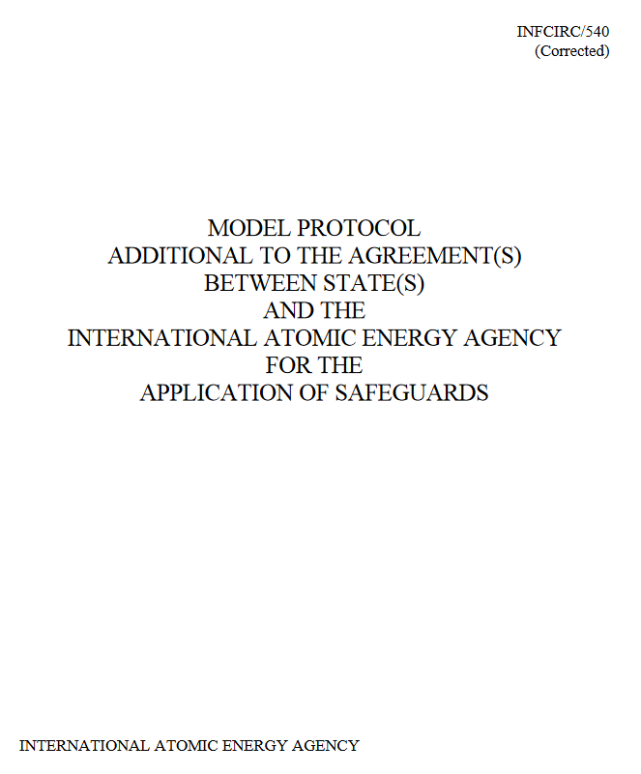
Article 2.a.(iii):
“.......... shall provide the Agency with a declaration containing:
(iii) A general description of each building on each site, including its use and, if not apparent from that description, its contents. The description shall include a map of the site.”

Slide 3
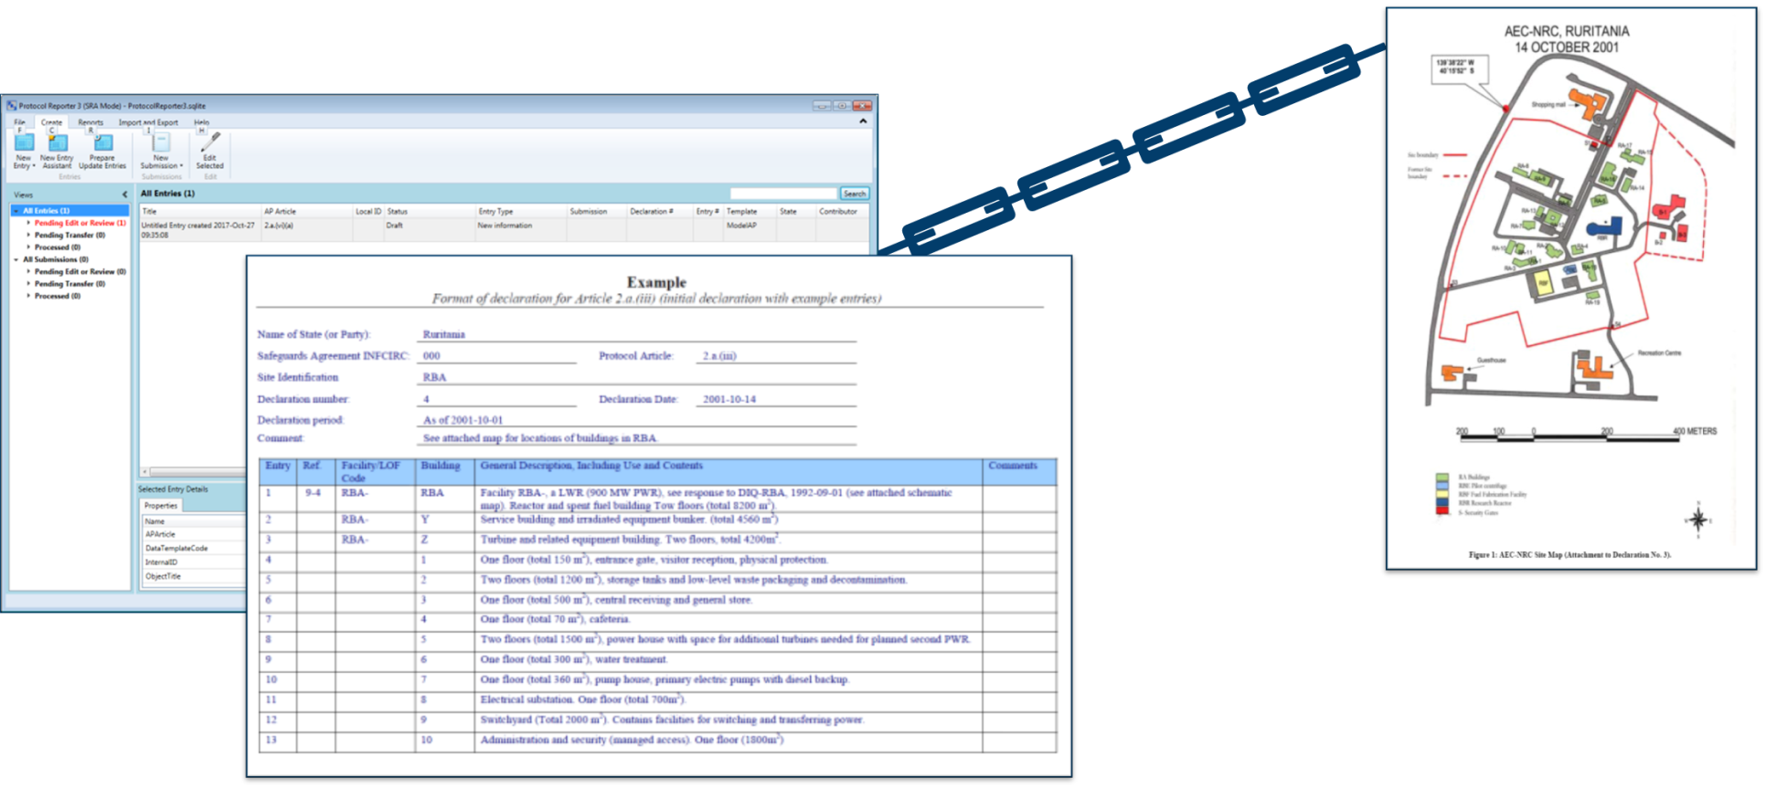
The separation of AP declarations from attached documents and maps causes problems in subsequent data storage and retrieval.
The prototype described in this paper would assist the Department of Safeguards by reducing their efforts to associate each 2.a.(iii) entry with a spatial location.

Slide 4
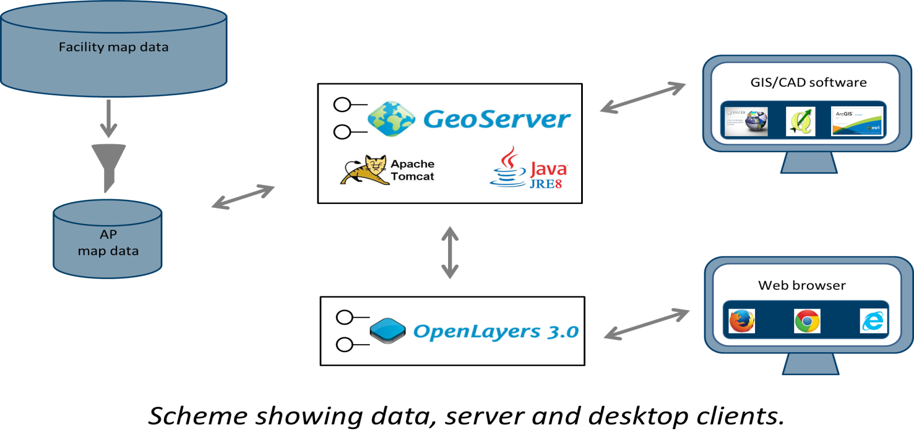
A map webportal prototype was designed to demonstrate the viability of server-based geographic information systems to support site map submissions
The web-portal prototype uses several free and open source software applications in order to create the web-portal platform.

Slide 5
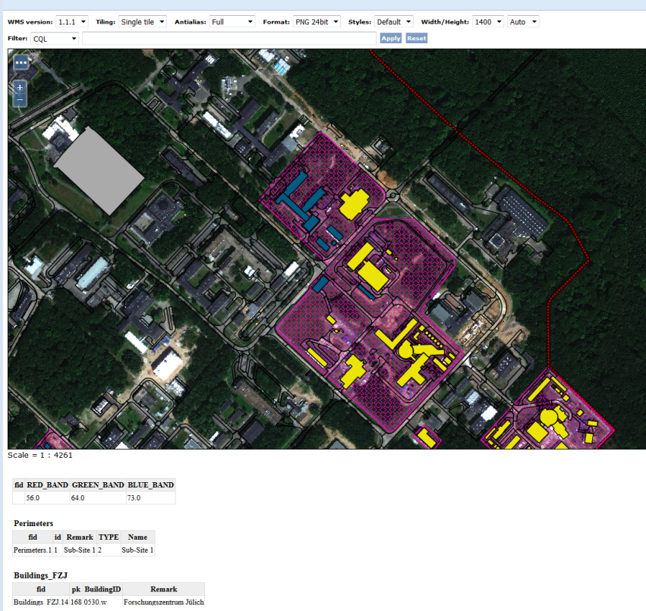
View of Jülich map data in IAEA format displayed in a web browser
Notes:
Web based GIS portals offer facility operators, SRAs and the IAEA a mechanism to connect map data related to section 2.a.(iii) of the AP.

