Slide 1
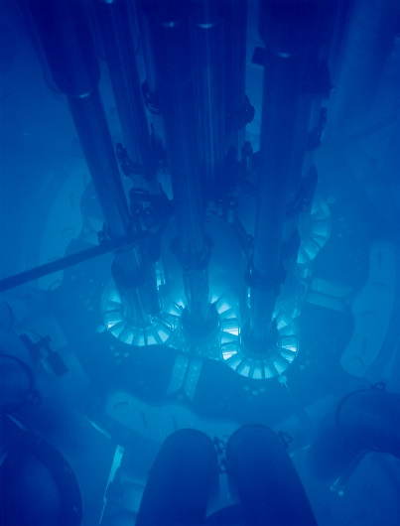
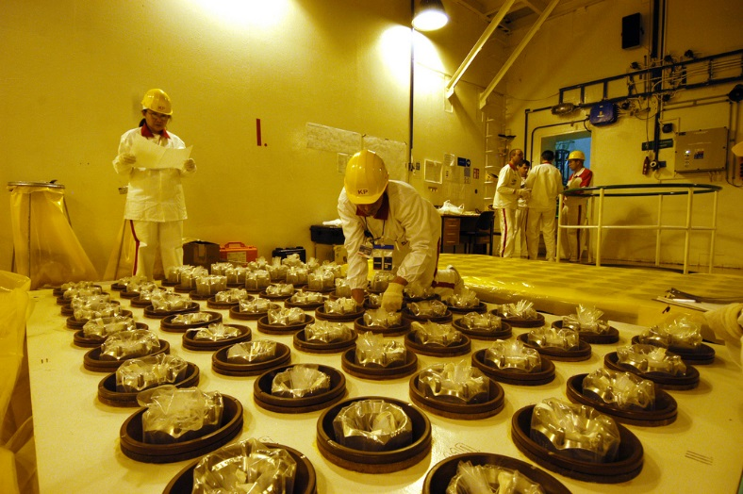
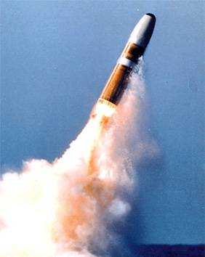
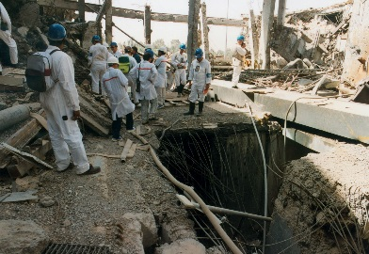
PERFORMANCE TARGETS
Dunbar Lockwood, Mark Goodman and J. Stephen Adams
NATIONAL NUCLEAR SECURITY ADMINISTRATION

Slide 2
Why Performance Targets?
Performance Targets (PT) address two questions:
How can the IAEA evaluate the technical effectiveness of its verification efforts in a way that is driven by prioritized technical objectives rather than prescriptive criteria?
How can the IAEA optimize resource allocation within a state in ways that are accepted as objective and non-discriminatory?
Notes:
Gist of my presentation: One way SLC is different from SG Criteria and IS is that it prioritizes TO. PT under SLC would help evaluate how well the Agency did in achieving TO – target attainment – and provide a basis for adjusting Frequency and Intensity of SG effort if TO not met.
The IAEA and MS are continuously trying to strengthen SG and much of these efforts flow directly from the early 1990s. In response to revelations about Iraq’s clandestine uranium enrichment program aft the 1he 1991 Gulf War, the IAEA sought to strengthen safeguards. In Programme 93+2, the IAEA looked at making better use of existing legal authorities such as ES, unannounced inspections and enhanced analysis of information. In 1995, the Board approved the Secretariat’s plans under Part 1 of Programme 93+2 for robust implementation of CSAs in accordance with this principle, and launched negotiation of new legal authorities to expand the IAEA’s access rights. In 1997, the Board approved the Model Additional Protocol (AP), which provided the IAEA with more information and access, thereby significantly increasing the IAEA’s ability to detect undeclared nuclear material and activities in States that implement the AP. These steps strengthened the IAEA’s ability to implement safeguards at the state level and its flexibility to take into account state-specific factors (SSFs) such as nuclear fuel cycle (NFC) characteristics. The most recent effort, called the State Level Concept, is a term that was introduced in the 2004 SIR.

Slide 3
Performance Targets Under Safeguards Criteria and Integrated Safeguards
Traditionally, goals for safeguards at declared facilities have been expressed in the Criteria in terms of probability of detecting diversion of a Significant Quantity of nuclear material within a specified time.
For states under integrated safeguards (IS), the performance targets for less sensitive material at declared facilities are based on model IS approaches adapted to the states and facilities, with reduced timeliness as compared to the SG Criteria.
Notes:
Integrated Safeguards are for states with CSA, AP and a broader conclusion.
APA: looking at steps along NFC that a proliferator would take to acquire material that could be used in a nuclear weapon or other nuclear explosive device.
Acquisition path analysis is used to establish technical objectives for a State with a comprehensive safeguards agreement. An acquisition path analysis does not involve judgements about a State’s intention to pursue any such path.
TO are a specific to a state, and flow from generic objectives: to detect diversion, misuse, and undeclared material & activities in State as a whole.

Slide 4
Performance Targets Under the SLC
Under the State-level concept (SLC), the IAEA should move beyond IS parameters to something more flexible under the SLC (e.g., with more emphasis on acquisition paths and the priority of technical objectives).
Notes:
APA: looking at steps along NFC that a proliferator would take to acquire material that could be used in a nuclear weapon or other nuclear explosive device.
Acquisition path analysis is used to establish technical objectives for a State with a comprehensive safeguards agreement. An acquisition path analysis does not involve judgements about a State’s intention to pursue any such path.
TO are a specific to a state, and flow from generic objectives: to detect diversion, misuse, and undeclared material & activities in State as a whole.

Slide 5
Considerations for PT Under the SLC
Keep PT Simple and Flexible: High, Medium and Low
Use PT for both planning and evaluation
Prioritize PT consistent with priority of technical objectives, influencing frequency and intensity
Diversion and Misuse: Focus on Probability of Detection
Undeclared Activities: PT in the state as a whole cannot be quantified in the same way

Slide 6
Performance Targets for Declared Path Steps
PT linked to attainment of Technical Objective for individual path steps. These targets will depend in part on how critical corresponding TOs are in providing necessary coverage of the acquisition paths.
Example: detect diversion of spent fuel assemblies from declared reactors.
PT tells inspectors what level of effectiveness they need to achieve in detecting diversion of material from declared facilities and detecting undeclared production or processing of nuclear material at declared facilities.
Notes:
TO are prioritized to address all steps along the identified plausible paths. Prioritization depends on how fast the path could be completed; the sensitivity of the material; the State’s industrial-technical capability; the Agency’s ability to cover the path or path step effectively; and the number of paths covered by the technical objective.

Slide 7
Performance Targets at the State Level
Acquisition Path Performance Targets would set requirement to detect acquisition of direct use nuclear material before State could complete plausible acquisition paths.
For paths involving only declared facilities, detection probability would be mathematical combination of probabilities of detection of each of relevant path steps, to evaluate overall strength of coverage against an acquisition path performance target.
For undeclared and mixed paths, probabilities would be combined with targets for steps at undeclared facilities to provide holistic assessment that considers interdependence between individual path steps.
Example: Diversion of spent fuel from a declared reactor followed by undeclared reprocessing/conversion of recovered Pu.

Slide 8
Potential Benefits of Performance Targets
Make logical connection between the frequency and intensity of safeguards activities and the attainment of safeguards objectives
Corollary: improve transparency and understanding of SG implementation and reduce concerns over discrimination
Prioritize in-field verification and headquarters analysis effort for individual states;
Plan safeguards activities and evaluate their effectiveness.
Strengthen path coverage and deterrence by providing a technical basis for revising SLAs if targets are not being met;
Provide indicators of performance trends that help maintain and strengthen effectiveness over time.

Slide 9
How Would Performance Targets Work for Declared Facilities?
For diversion, the target is the probability that a defective item is selected for measurement multiplied by the probability the measurement can detect the defect.
For misuse, technical analysis determines the time required for a facility to produce one significant quantity (SQ) of material. Detection probability is defined as the chance an activity is scheduled during such a misuse event multiplied by the chance the given activity can detect it.

Slide 10
How Would PT Work for Undeclared Activities in the State as a Whole?
Detecting undeclared activities in State as a whole cannot be quantified in the same way as detection of diversion from or misuse of declared facilities
Qualitative metrics could set a "due diligence" level of effort needed to maintain and improve the IAEA's understanding of the state's nuclear capabilities
How soon IAEA identifies an indicator once it becomes ‘available,’ and how soon IAEA follows up
Thus, PT for undeclared activities could convey the relative intensity of monitoring required and speed with which identified indicators are resolved.
Notes:
It’s not practical to make quantitative estimates for detecting undeclared material/activities in the State as a whole. Root problem: impossible to prove a negative, or to quantify the probability that something doesn’t exist. Regarding due diligence, we are primarily talking about making full use of existing legal authorities, and HQ information analysis to perform solid state evaluations and be ready to respond if indications of undeclared nuclear activities arise, e.g., a tip from third party information.
Due diligence level of effort could validate understanding of state’s fuel cycle and related technical capabilities, which determine plausible acquisition paths.

