Slide 1
Developing a Safeguards Self-Assessment Tool for Operators and Regulators
Sarah Frazar:
Pacific Northwest National Laboratory
Gemma Innes-Jones & Ian Hamilton:
Environmental Resources Management
Building Future Safeguards Capabilities: Symposium on International Safeguards
PNNL-SA-138657

Slide 2
Facility Capabilities are Focus of Self-Assessment Tool
Premise: Effective and efficient performance depends on the capability of the facility to implement and manage the processes and tasks associated with safeguards activities.
The self assessment tool does not assess effectiveness of safeguards measures
The tool assesses ability of the facility to perform the activities in ways that are efficient, effective, and meet quality standards
5 Discussion Topics
Safeguards Management
7 Organisational Characteristics
Governance
Safeguards Inspections
Safeguards Information Management
Safeguards Material Control and Accounting
Safeguards Issue Resolution
Task Guidance
Task Execution
Competence
Engagement
Learning and Improving
Change Management
23 performance indicators underpin the 7 organisational characteristics

Slide 3
Performance Indicators Establish Foundation for Assessment and Evaluation
SRA Functions (from SS21) | ASSIST outcomes – SRA Level | Facility Level outcome | Governance
 | 1. Establish and maintain sufficient safeguards infrastructure |  | (leadership, vision, establishing objectives, provision of resources)
Establish regulatory and control processes in the State for the purpose of assuring that the nuclear material is only used for peaceful purposes | 1.1 Establish and maintain a legal and regulatory infrastructure, including setting up a State Authority that cooperates with the IAEA in safeguards implementation | 1.1 Facility management enables staff to comply with the legal and regulatory requirements established in the safeguards agreement and codified in law by the SRA. | Facility management have defined and designated two key roles: a role responsible for the safeguards at the facility to ensure safeguards obligations are being met; and a role responsible for ensuring quality management.
 | 1.2 Establish and maintain a State system of accounting for and control of nuclear material (SSAC) | 1.2 Facility management is able to meet all international regulatory requirements and carry out functions necessary to account for and control nuclear material in accordance with established MBA structure and prepare reports for submission to the SRA. | Facility management set the overall objectives for the SSAC and facilitates Safeguards implementation (e.g. provision of resources, investment, procurement, maintenance, assigns Safeguards responsibilities).
Foundational framework for assessment
derived from IAEA guidance
Based on guidance, we defined facility-level outcomes
Indicators demonstrate how facility achieves outcomes.
Notes:
This is a sample of a larger table of performance indicators that was developed during Phase II of the project.
Key points:
IAEA guidance provides foundational framework for assessment (aligned with SRA Functions from IAEA guidance Service Series 21) and ASSIST assessment tool
We developed facility level outcomes
We develop a series of objective statements that capture key activities and responsibilities that facilities must perform to meet IAEA obligations. We developed these statements for each of the 8 domains mentioned earlier.

Slide 4
Indicators Enable Performance Assessment
Sample Topic with Associated Performance Indicators
Communication with, and facilitation for, the SRA and IAEA Task Execution
Satisfactory: The facility provides the SRA with an up to date list of site points of contact and people responsible for co-ordinating Safeguards inspections The facility's processes and systems ensure that correspondence to/from the Safeguards inspectorates is transmitted under the required protocols and is tracked and progressed in a timely manner Management are on hand to deal with Safeguards related concerns and/or issues The communication system is reviewed for and monitored for its success | Unsatisfactory: There is no process for managing or facilitating SRA or IAEA inspections Management and operational staff generally fail to take responsibility for communicating Safeguards Inspection information The facility does not specify a role(s) for communicating with the SRA/IAEA The SRA and IAEA have to actively seek out information about inspection arrangements Not all aspects of the inspection process are covered in communication with the SRA/IAEA (e.g. information is limited to a couple of areas) The communication system fails to adequately prepare the facility and/or SRA/IAEA for the inspection
Notes:
Each evidence point then has a series of corresponding performance indicators to help assessors determine whether performance is satisfactory (being performed effectively, efficiently, and with high quality).

Slide 5
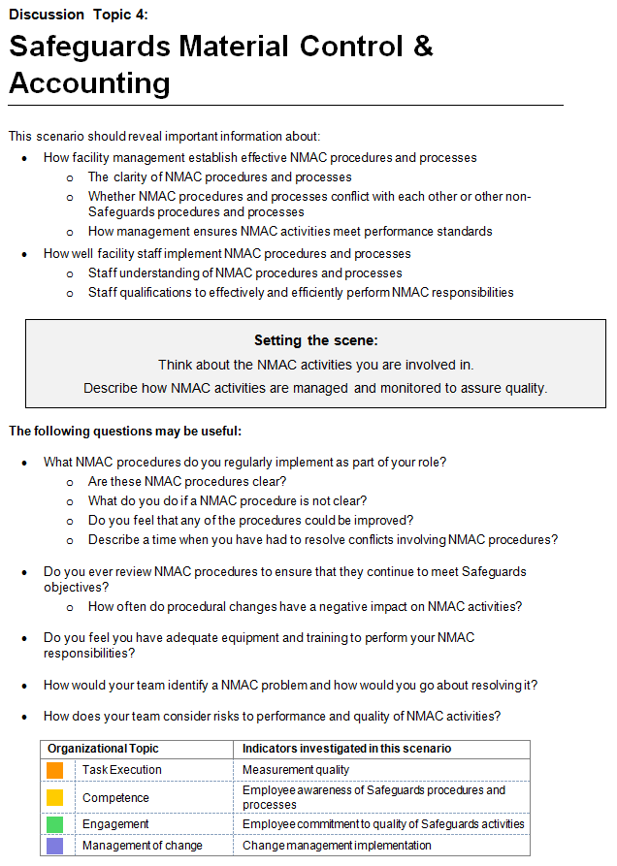
Elements of a Safeguards Assessment Tool
Discussion Topics:
Safeguards Management
Safeguards Inspections
Safeguards Information Management
Safeguards Material Control and Accounting
Safeguards Issue Resolution
Assessment Goals
Question Prompts for Assessor
Selected Performance Indicators
Notes:
The SPT consists of five discussion topics that were designed to capture keys safeguards responsibilities:
Safeguards Management
Safeguards Information Management
Safeguards Inspections
Material Control and Accounting
Safeguards Issue Resolution
This is a sample of one card to help managers facility discussion around a given topic.
It identifies assessment goals
It provides a scene setter
It provides question prompts
It identifies specific evidence points that are most relevant to evaluating whether and how safeguards staff are performing key responsibilities associated with the given topic.

Slide 6
Field Test Examined Several Aspects
Utility
Complementarity with Other Assessment Tools
Some overlap with existing audit tools useful for data verification/validation
Relevance to Facility Operations
MC&A topic needed rephrasing to meet different organizational structures/needs
Relevance
Performance criteria and evidence points relevant to facility operations
Address balance of Satisfactory and Unsatisfactory evidence points
Flexibility
Reliability
Tool could accommodate different assessor styles
Practical Application
Guidance materials and analysis process enabled objective assessment
Applicability
Implementation guidance sufficient for independent implementation; recommend quality assurance staff conduct internal assessments.
Useable by different assessors
Supports objective assessment of staff behavior
Ease of Independent Use
Ease of Execution
Notes:
Utility of the SPT: The facility indicated the SPT explored some aspects of safeguards performance not covered by other current assessment methods. The facility identified unique opportunities for improvement. The slight overlap with both internal and external audits was perceived as beneficial for two reasons: 1) to verify and validate the results, and 2) to assure facilities that the SPT is a relevant self-assessment method to help facilities prepare for regulator audits.
Applicability of the discussion topics: The facility indicated that the SPT covered the key aspects of safeguards performance. The facility indicated that the questions included in one of the discussion topics (Safeguards Material Control and Accounting) may only be applicable to a particular organizational structure and would benefit from a change in wording to accommodate a variety of organizational structures.
Relevance of the performance criteria and evidence points: The scope of the performance criteria and evidence points was considered appropriate, sufficient, and applicable to a variety of nuclear organizations. However, some recommendations were made to improve the balance of the evidence points, such that each indicator had a relatively equal number of Satisfactory and Unsatisfactory evidence points.
Flexibility of the tool: Two different assessors at the facility reported that they were able to use different parts of the toolkit to suit their personal preference. They also reported that the tool was sufficiently flexible to accommodate their changing style as they became more familiar with the material.
Reliability of the assessment: The partner facility reported that the guidance material and analysis process enabled objective comparison of data collected by different assessors. It was also noted that the analysis process helped to remove potential personal bias in a more qualitative assessment. While the assessors were able to analyse the data without difficulty, they indicated it may be valuable to provide additional instruction for the analysis.
The practical implementation of the SPT process: The facility did not report any issues with the practical implementation of the SPT and stated that the guidance provided within the toolkit was sufficient for their needs. Interviews of 60 minutes were adequate to cover the five discussion topics, with an additional 30 minutes to fully record the information collected. However, it was noted that these interviews were conducted by internal personnel and if external assessors were used, the sessions would likely require additional time. Moreover, the facility noted that if the assessment is conducted internally, staff directly responsible for safeguards oversight/performance should not also conduct the assessments. Such personnel are more valuable as interviewees rather than interviewers. The facility recommended that personnel from the quality assurance or management offices with assessment experience perform the SPT interviews.

