Slide 1
Viet Nam’s Safeguards Implementation: Cooperation with International Partners and the IAEA
Symposium on International Safeguards:
Building Future Safeguards Capabilities
5 – 8 November, 2018
IAEA Headquarters, Vienna, Austria
NGUYEN NU HOAI VI and NGUYEN TUAN KHAI
Vietnam Agency for Radiation and Nuclear Safety
Notes:
It is my pleasure today to discuss with you of the challenge that VARANS and its TSO are facing in order to prepare for the introduction of nuclear power plants into Viet Nam.

Slide 2
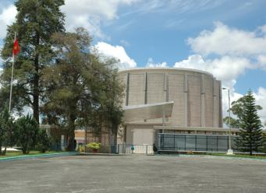
1. Introduction
Active nuclear research program at several institutes in Ha Noi, Ho Chi Minh City, and Da Lat
Operates a 500 kilowatt, pool-type research reactor for the purpose of:
– Radioisotope production
– Neutron activation analysis
– Basic and applied research in nuclear physics
– Research on reactor physics and thermo-hydraulics, and
– Training
Conversion of Da Lat reactor from highly enriched uranium to low enriched uranium in 2007

Slide 3
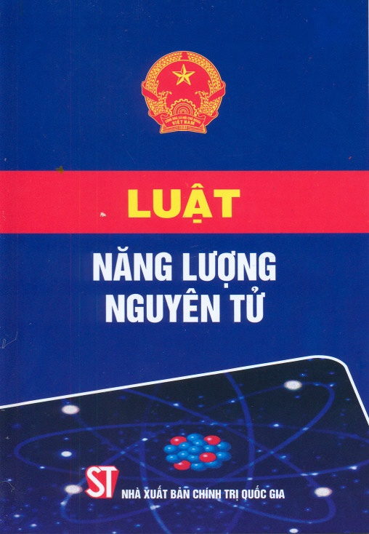
1. Introduction – Legal Framework
Atomic Energy Law, 2008
VARANS is responsible for implementing safeguards activities in Viet Nam
Prohibits the development of nuclear weapons and all forms of nuclear proliferation
PM Decision No.45/2010/QD-TTg on Nuclear Safeguards providing general requirements on safeguards
Circular No.02/2011/TT-BKHCN dated16 March 2011 on Safeguards implementation
Circular No.25/2012/TT-BKHCN dated 12 December 2012 on export and import control of AP Annex 2 items
Circular No.17/2013/TT-BKHCN dated 30 July 2013 on AP requirements
Circular No. 08/2010/TT-BKHCN dated 22 July 2010 on licensing in the field of nuclear energy

Slide 4
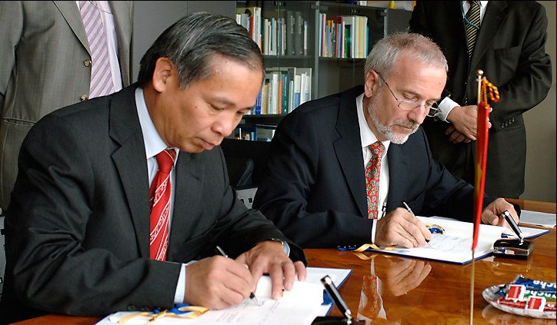
1. Introduction – Legal Framework
Vietnam acceded the following international instruments:
Nuclear Nonproliferation Treaty (1982);
Safeguards Agreement (1989);
The South East Asia Treaty on the Nuclear Weapon Free Zone (1997)
Additional Protocol signed (2007)
The AP ratified (2012)

Slide 5
1. Safeguards Regulatory Structure
IAEA
MOST
MOFA
MOPS
SG Inspection
VARANS
Vietnam’s Accounting Reports/ AP Declarations
Division of Nuclear Security and Safeguards
Facility Accounting Reports/ AP Declarations
Nuclear Facility
LOF 1
LOF 2

Slide 6
1. Introduction – SG Implementation
Revised Subsidiary Arrangement, including Safeguards Agreement and AP requirements
Main safeguards measures:
Vietnam submits reports to IAEA
IAEA carries out inspection once a year
AP Measures:
AP declarations submitted to the IAEA
Complementary access
2013: First year of AP implementation - Initial declarations: March 8, 2013; 2018: 100 declarations submitted to the IAEA
9 complementary accesses (CA) received, including 1 under Article 8 and 1 with 2-hour notice
May 2015: the IAEA reached Broader Conclusion for Viet Nam for the first time for 2014
May 2017: Implementation of State-level approach

Slide 7
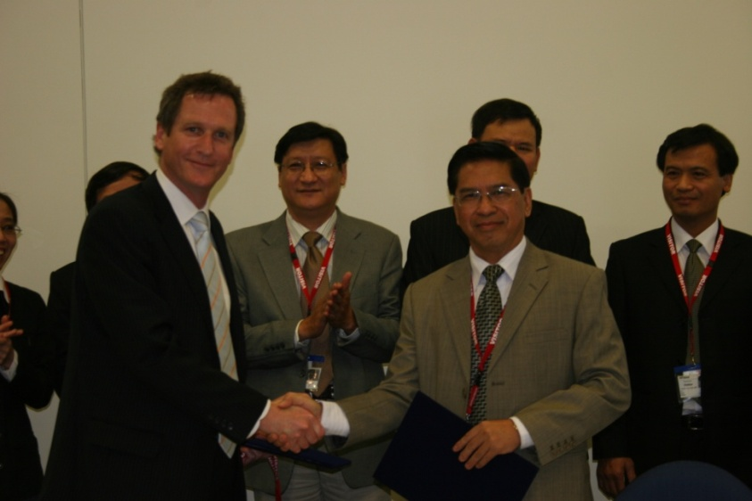
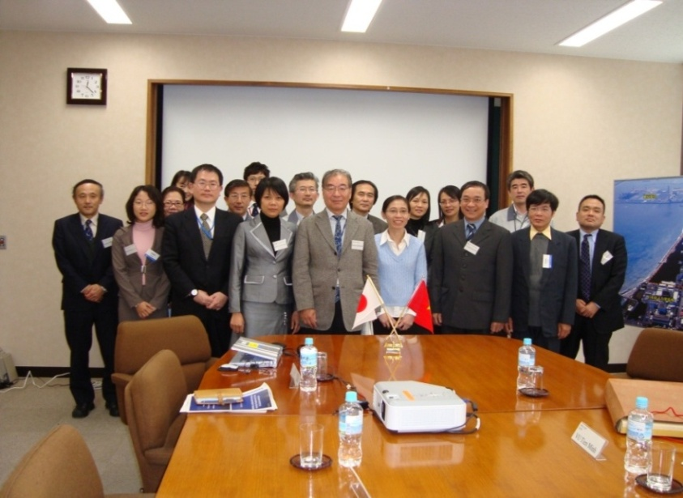
2. Cooperation with International Partners
The evolving in safeguards implementation is due to the fact that Viet Nam’s safeguards infrastructure has been strengthened, which can partly be attributed to the support from and cooperation with international partners and the IAEA in safeguards capacity building of Viet Nam in general and VARANS in particular.
Arrangement between VARANS and ASNO on cooperation in nuclear safeguards and related matters signed Nov. 2009
Memorandum of understanding between JAEA and VARANS for cooperation in the field of non-proliferation signed in 2010

Slide 8
2. Cooperation with International Partners
Arrangement between the U.S. Department of Energy and the Ministry of Science and Technology of the Socialist Republic of Vietnam for Information Exchange and Cooperation on the Peaceful Uses of Nuclear Energy signed August 2007.
The VARANS – INSEP (International Safeguards and Engagement Program) collaboration is helping meet Vietnam’s regulatory and nonproliferation objectives. The arrangement has resulted in a number of action sheets to support the following areas:
Development of legislation, regulations, and implementing rules and guidance for peaceful nuclear power
Assistance in strengthening state systems of accounting and control (SSAC)
Implementation of the Additional Protocol (AP)
Development of national outreach on the AP
Development of a safeguards laboratory
Establishment of info. management system for NM accounting and reporting

Slide 9
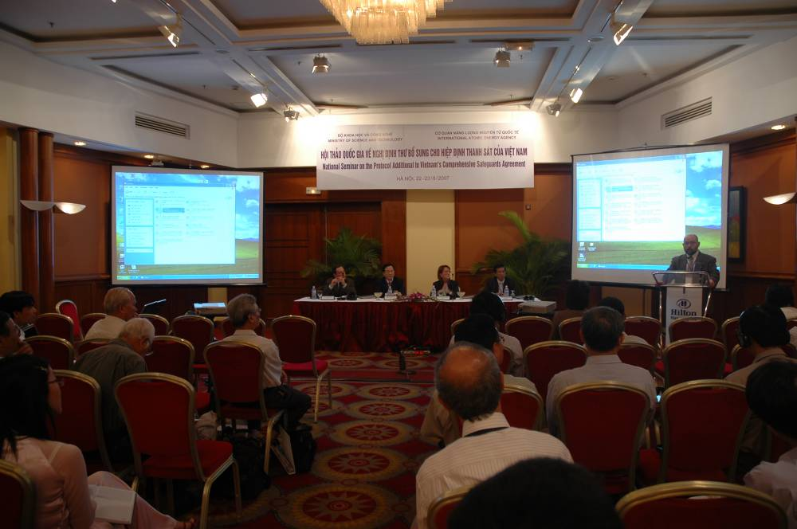
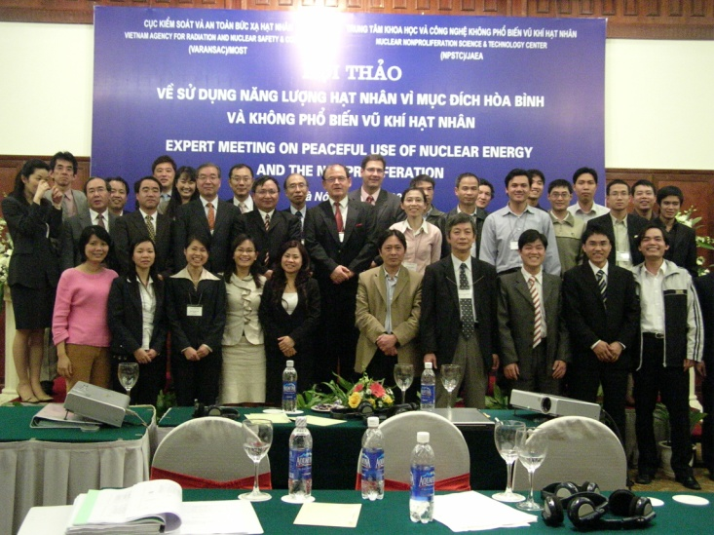
2. Cooperation with International Partners
To advocate for AP ratification and implementation, workshops were held to enhance a better understanding of Government officials on AP implementation
National Seminar on Protocol Additional to Vietnam’ Safeguards Agreement (August 2007, co-organised with IAEA, Australia and Japan)
Expert Meeting on Peaceful Use of Nuclear Energy and Non-Proliferation co-organised with JAEA in March 2008
→ AP was ratified and implemented since 2012

Slide 10
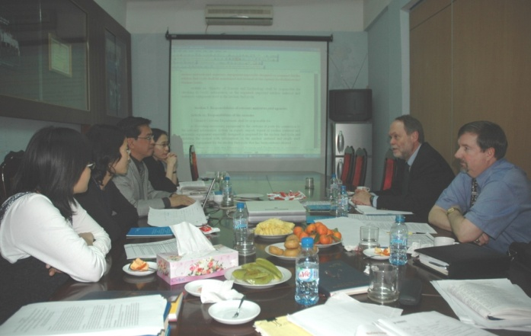
2. Cooperation with International Partners
Meetings were held between the VARANS and INSEP teams to review the legislation and regulations that had been drafted by VARANS, before they were submitted to the relevant authorities for approval and issuance.
Using the advice and consultation on nuclear legislation and regulation VARANS could be sure that it had the best available information in formulating effective control for its national nuclear infrastructure.
→ The assistance in developing regulations for safeguards and export control specifically helped Viet Nam to meet its safeguards obligations under the NPT

Slide 11
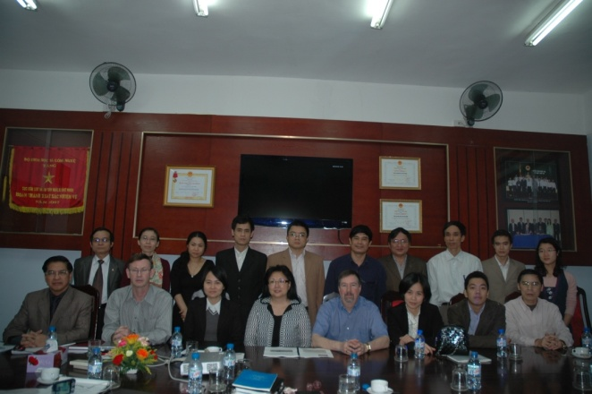
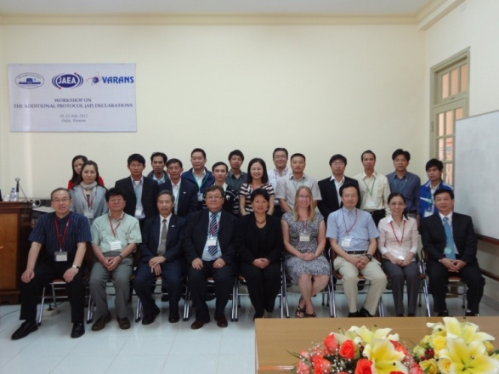
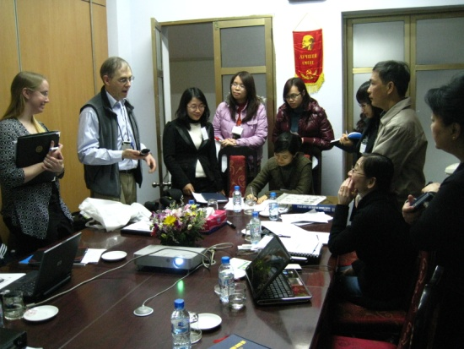
2. Cooperation with International Partners
A number of practical workshops conducted for VARANS staff and staff of operators, including:
Train-the-trainer workshops for VARANS staff to train other agencies, research and development (R&D) organisations, and universities on the AP;
Discussion on potential declarable activities on nuclear fuel cycle-related R&D;
Demonstrating and training on the use of the IAEA Protocol Reporter 2 software and the DOE/NNSA AP Declaration Helper software;
Commodity Identification Training (CIT) for items listed in AP Annexes I & II
Mock CAs were conducted to prepare VARANS and operators for successful receipt of CAs once the AP is in force
→ VARANS’ competencies in SG implementation enhanced

Slide 12
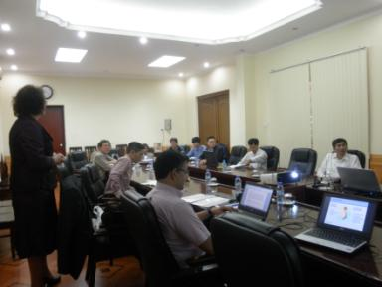
3. Cooperation with the IAEA
The IAEA experts, especially those from the Department of Safeguards OA3, provided training for VARANS’ and operators’ staff in a timely manner, in the areas such as preparation of accounting reports, AP declarable activity analysis, preparation of AP declaration using Protocol Reporter 2 and Protocol Reporter 3
Prompt assistance from the IAEA, INSEP and JAEA in preparing initial declarations after ratification of the AP (Jan and Oct 2013)
→ The initial declarations were submitted to the IAEA well in advance with such quality that no questions was raised by the IAEA after the submission

Slide 13
3. Cooperation with the IAEA
Improving the communication between VARANS and the IAEA
Setting up a secure communication channel, providing direct communication between VARANS and the IAEA to submit accounting reports, AP declarations and other information exchange
Provision of PGP key to encrypt the accounting reports
VARANS participated in the test pilot of the State Declaration Portal (SDP).
Currently, VARANS uses this system for the submission of accounting reports and AP declarations while the existing communication methods still continue to be used
Helped VARANS submit accounting reports and AP declaration in a timely manner
Helped VARANS prepare better for CA receipt
Better corresponding between IAEA and VARANS

Slide 14
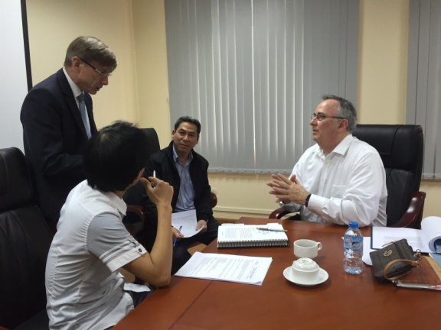
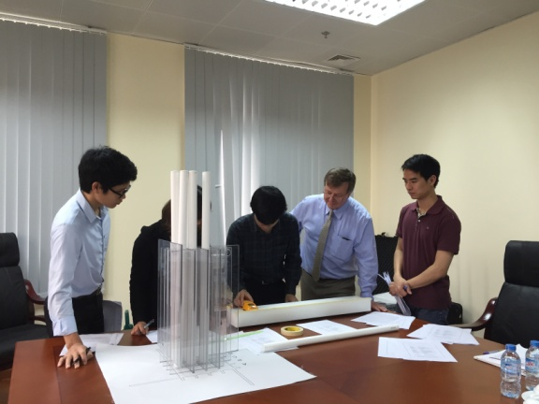
3. Cooperation with the IAEA
Enhanced cooperation in safeguards implementation
Two Technical Meetings between VARANS and the IAEA were held in Ha Noi in 2015 and 2016
Sharing of safeguards equipment
Provision of training on national safeguards inspection
→ Application of State-level approach to safeguards (5/2017)

Slide 15
Concluding Remarks
Viet Nam’s experience shows that cooperation with international partners and the IAEA can play an important role in national safeguards implementation.
It has assisted Viet Nam in strengthening its SSAC and building high level of competence in safeguards in a sustainable manner, which in turn ensuring international transparency and the credibility of nuclear activities in Viet Nam.
The cooperation of Viet Nam with international partners and the IAEA is an example of what we can do together to achieve the same shared safeguards values and goals.

