Slide 1
MAPPING TECHNOLOGY AND KNOWLEDGE TRANSFER NETWORKS
J.V. HASTINGS
University of Sydney
Email: justin.hastings@sydney.edu.au
A.N. STULBERG
Georgia Institute of Technology
P. BAXTER
Middlebury Institute of International Studies
Funded by the MacArthur Foundation
IAEA Safeguards Symposium
6 November 2018

Slide 2
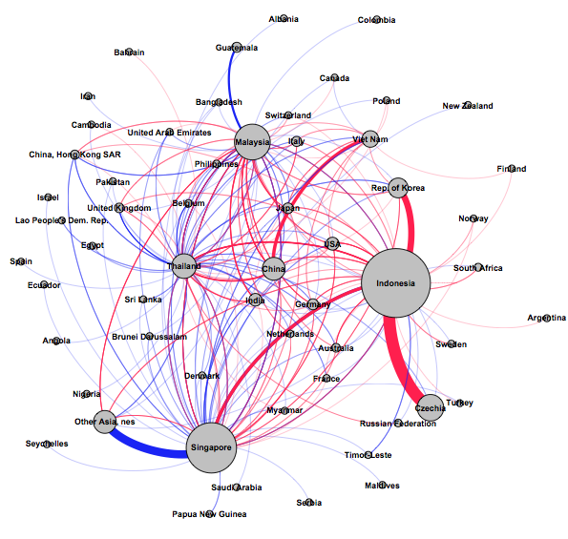
Southeast Asia nuclear components trade (2011-2015) (weighted degree)

Slide 3
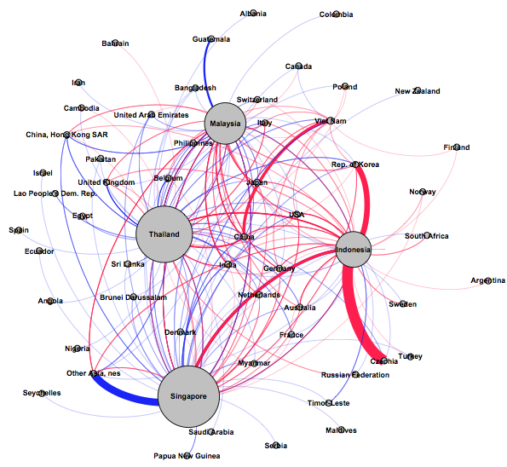
Southeast Asia nuclear components trade (2011-2015) (betweenness centrality)

Slide 4
Major nuclear component trade flows by commodity type (2013-2017)

Slide 5
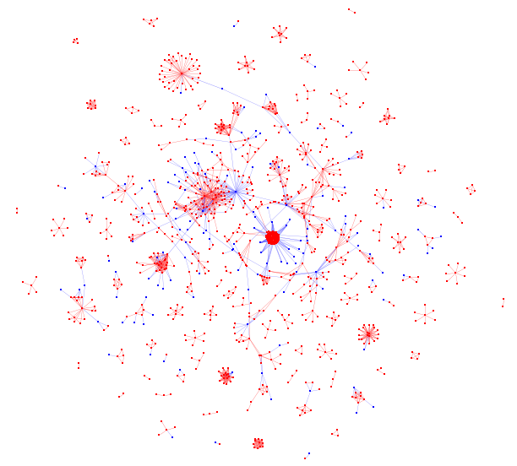
Scientific Community in Indonesia

Slide 6
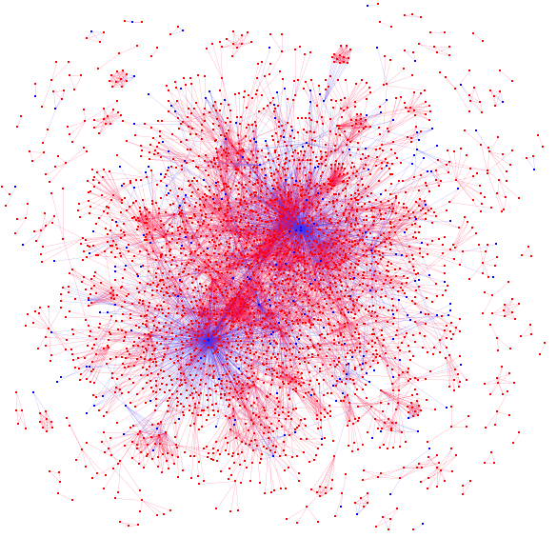
Scientific Community in Singapore

Slide 7
Research Focus Networks in Indonesia

Slide 8
Research Focus Networks in Singapore

